Slide 1
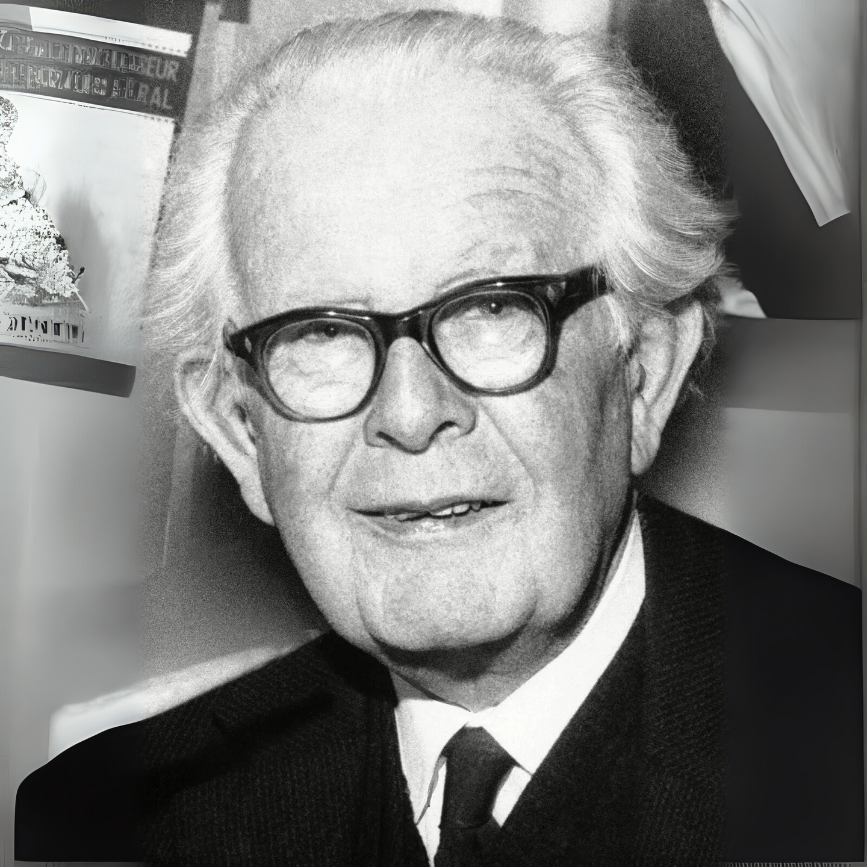
Sesiwn 2
Piaget
ECES4010/C
Damcaniaeth Dysgu ac Ymarfer
Learning Theory and Practice

Slide 2
Gorolwg Sesiwn / Session Overview
  Piaget
  Deilliant dysgu perthnasol
  Perthnasedd i’r aseiniad
  Piaget
  Relevant learning outcome
  Relevance to assignment

Slide 3
Adnoddau modiwl benodol
Module specific resources
  Sleidiau darlith
  Ymchwil
  Tutalen Moodle
  Llyfrgell ac Adnoddau Dysgu:
  Rhestrau darllen ar-lein
  Rhaglen Infoskills
  Hanfodion Myfyrywr
  Google Scholar
  Lecture slides
  Research
  Moodle page
  Library and Learning Resources:
  Online resource lists
  Infoskills programme
  Student Essentials
  Google Scholar

Slide 4

Sgiliau Cyflogadwyedd / Trosgwlyddadwy
Employability / Transferable Skills
  Cynllunio
  Trefnu
  Datrys Problemau
  Cydweithio
  Ymchwilio
  Cymryd nodiadau
  Cyfathrebu
  Hyblygrwydd
  Planning
  Organising
  Problem Solving
  Collaborating
  Researching
  Note taking
  Communication
  Adaptability
#OAstudiaethiGyflogaeth
#FromHigherEdToHired

Slide 5
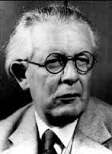
Un ddamcaniaeth seicolegol berthnasol
One relevant psychological theory
  Jean Piaget
  1896-1980
  O’r Swisdir / From Switzerland
  1921- cyhoeddi ei erthygl gyntaf am allu
  1921- publication of his first article on intelligence
  (Boeree,2006)

Slide 6
Datblygiad Gwybyddol
Cognitive Development
Focuses on underlying processes that contribute to how children begin to…
  Process information
  Develop conceptual understanding
  Reason and problem solve
Canolbwyntio ar y prosesau gwaelodol sydd yn cyfrannu at sut mae plant yn dechrau
  Prosesu gwybodaeth
  Datblygu dealltwriaeth cysyniadol
  Rhesymu a datrys problemau

Slide 7
  Piaget believed that nature and nurture interact to yield cognitive development
  Child is born with inborn plan for cognitive development which unfolds as the child matures
  The environment is necessary to provide stimulus to allow these skills to develop
  Cognitive development occurs through series of universal hierarchical stages
  Children as “active learners” engaging in “self-discovery”
  Credai bod natur a magwraeth yn rhyngweithio i greu datblygiad gwybyddol
  Caiff plentyn ei eni gyda chynllun gwybyddol sydd yn ‘datblygu’ wrth i’r plentyn aeddfedu
  Mae’r amgylchedd yn angenrheidiol er mwyn darparu’r ysgogiad i alluogi sgiliau i ddatblygu
  Datblygiad gwybyddol yn digwydd drwy gyfres o gamau hierarchaidd
  Plant fel ‘dysgwyr gweithredol’ yn ymwneud a ‘darganfod yr hunan’

Slide 8
Sgemau
Schemas
  Gelwir y dull o drefnu a phrosesu gwybodaeth yn sgema
  E.e. mae babanod yn ymchwilio eu byd drwy’r sgema o guro pethau
  Ways of organizing and processing information are the cognitive structures are called schemas
  E.g. banging is a favourite schema used by babies to explore their world

Slide 9
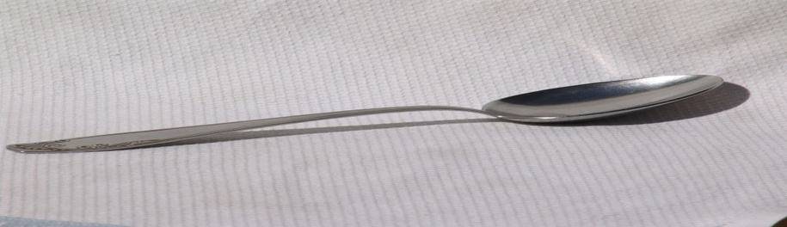
Asimileiddio a Chymhwyso
Assimilation and Accomodation
  Asimileiddio – deall profiad newydd / gwrthrych newydd yn nhermau sgema presennol
  e.e. gwrthrychau newydd
  Assimilation - understanding a new experience / object in terms of an existing schema
  e.g. when new objects are incorporated

Slide 10
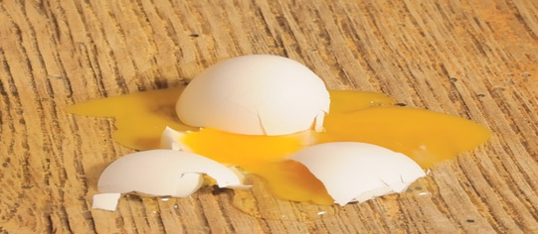
  Cymhwyso - cyfaddasu sgema sydd eisoes yn bod
  Cydbwysoli- adfer cydbwysedd trwy ddatblygu sgemau newydd neu addasu hen sgemau
  Accommodation- modifying an existing scheme
  Equilibration - restoring balance by developing new schemes or adapting old ones

Slide 11

Trafodaeth
Discussion
  Mewn parau, trafodwch eich profiad o sgemau
  Mewn plant
  Mewn oedolion
  In pairs, discuss your own experience of schemas
  In children
  In adults

Slide 12
Damcaniaeth Piaget
Piaget’s Theory
Yn cael ei alw’n adeileddol oherwydd mae plant yn adeiladu gwybodaeth eu hunain
Gwelir plant yn:
    Weithredol
    Yn dysgu gwersi pwysig eu hunain
    Wedi ei hysgogi’n gynhenid i ddysgu
Often labeled constructivist because it depicts children as constructing knowledge for themselves
Children are seen as:
    Active
    Learning many important lessons on their own
    Intrinsically motivated to learn

Slide 13
Camau datblygiad Piaget
Piaget’s developmental stages
  Piaget claimed development proceeds in distinct hierarchical stages
  Qualitative changes in cognition
  Children progress through FOUR stages of cognitive development, each building on the previous one
  Datblygiad yn symud drwy gamau hierarchaidd penodol
  Newidiadau ansoddol mewn gwybyddiaeth
  Plant yn datblygu trwy BEDWAR cam gwybyddol, pob un yn adeiladu ar yr un cynt

Slide 14
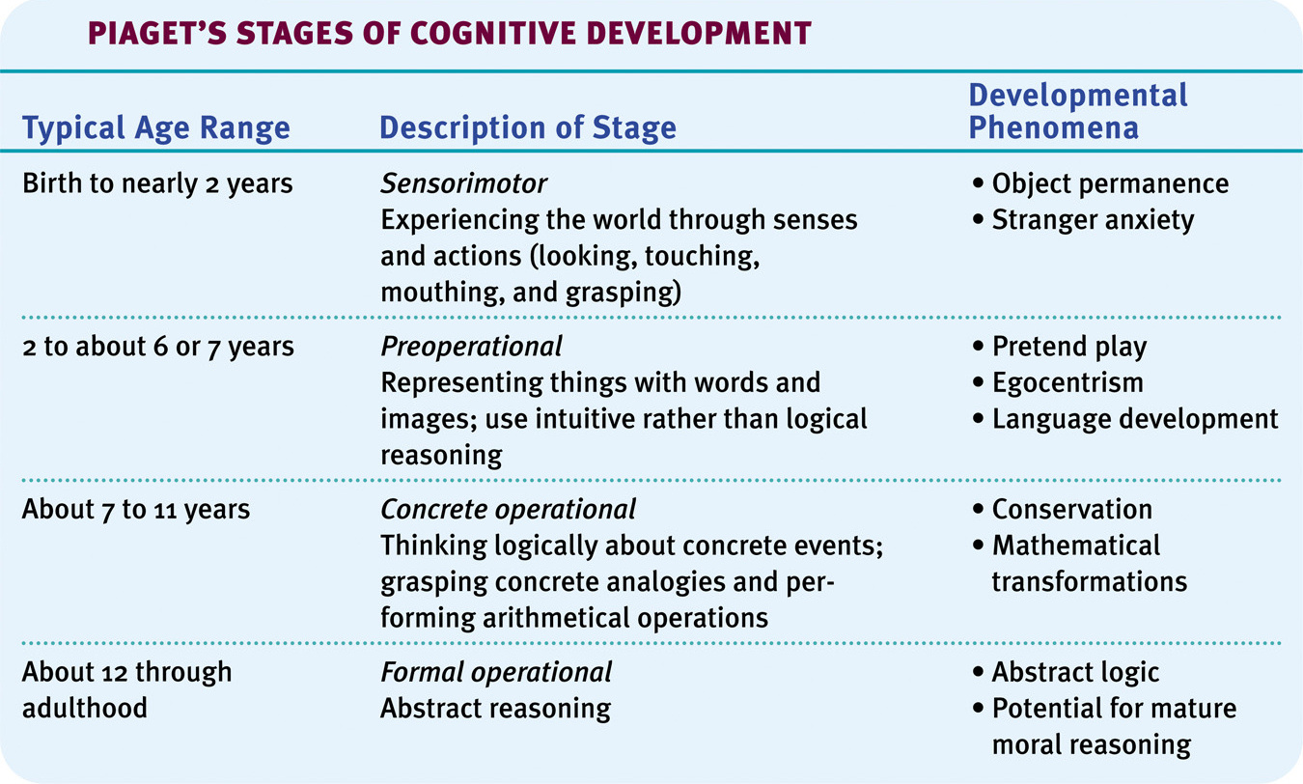
Piaget’s Theory
Damcaniaeth Piaget
Notes:
15
15

Slide 15
Pre-operational
Cyn-weithredol
  Plant heb weithrediadau – y rheolau abstract sydd yn tanategu meddwl rhesymegol oedolyn
  O ganlyniad, mae eu meddwl yn anghyson ac yn afresymol o safbwynt oedeolyn
  They lack operations – abstract rules that underpin adult logical thinking
  As a result their thinking tends to be inconsistent and irrational from an adult’s perspective

Slide 16
  Limitations on a pre-operational child’s thinking include:
    Egocentrism
    Animism
    Centration
  Children continue to develop their internal representations of the world through adaptation and accommodation of new experiences
  Cyfyngiadau ar feddwl plentyn cyn-weithredol
    Egosentraeth
    Animistiaeth
    Canoli
  Plant yn parhau i ddatblygu cynrychiolaeth fewnol o'r byd drwy addasu a chymryd i fewn profiadau newydd

Slide 17
Yn ôl Piaget
According to Piaget
  Young children do not understand that others have a different view of the world from theirs
  They assume that anyone else can see what they can see
  This egocentrism does not disappear fully until the child is 7 or 8 years old.
  Nid yw plant ifanc yn deall fod gan eraill olwg wahanol o’r byd
  Tybiant fod pawb arall yn medru gweld beth fedran nhw
  Dydy’r egosentraeth yma ddim yn diflannu yn llwyr nes bod y plentyn yn 7 neu 8 oed

Slide 18




Profi egosentraeth
Tests of egocentrism
1. Three mountains task (Piaget & Inhelder, 1956)
https://www.bing.com/videos/riverview/relatedvideo?q=three+mountains+task+youtube&mid=86661DDE4C5F2DEE4D0E86661DDE4C5F2DEE4D0E&FORM=VIRE
2. Turntable task (Borke,1975)
3. Boy and policemen task (Hughes, 1975)
Task – find out more about task 2 and 3
Notes:
19

Slide 19
Beirniadaethau o’r dasg
Criticisms of the task
  Piaget’s models lacked salient characteristics that could allow children to differentiate one view from the next
  The task of reconstructing the display, or choosing the appropriate drawings may be beyond the ability of a young child
  Modelau Piaget â diffyg nodweddion amlwg i alluogi plant i wahaniaethu un ochr i'r llall
  Gallai'r dasg o ail adeiladu’r arddangosfa, neu o ddewis y lluniau addas fod yn rhy anodd i blentyn ifanc

Slide 20

Animeiddiaeth
Animism
  Y plentyn yn credu fod popeth yn ymwybodol h.y. â theimladau
  e.e. y car ddim yn dechrau gan ei fod wedi blino neu’n sal
  The child believes that everything is conscious i.e. everything has feelings
  e.g. the car won’t start because it is sick or tired

Slide 21

Canoli
Centration
  Ffocysu ar un agwedd o gyd-destun tra’n anwybyddu’r lleill – dyma lle mae’r egwyddor gwybyddol o gadwraeth yn dod
  This involves focusing on one aspect of a context whilst ignoring others – this is where the cognitive principle of conservation arises

Slide 22
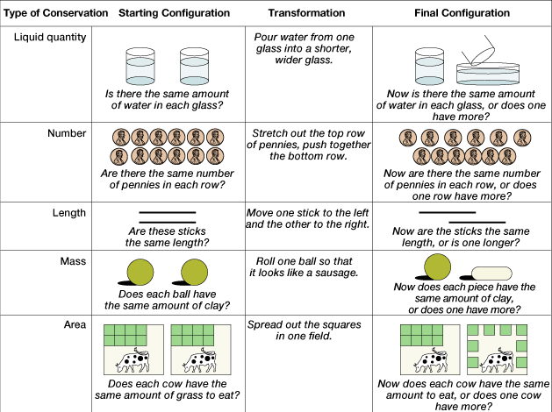
Tasg Cadwraeth
Conservation Tasks
http://www.youtube.com/watch?v=gnArvcWaH6I

Slide 23
Meddwl cyn-weithredol a’r her o gadwraeth
Pre-operational thinking and problems of conservation
  Pam mae plant cyn weithredol yn methu tasgau cadwraeth?
  Oherwydd nid yw eu meddyliau yn cael eu rheoli gan egwyddorion tu chwith, cyfadferiad a hunaniaeth
  Why do pre-operational children fail problems of conservation?
  Because their thinking is not governed by principles of reversibility, compensation and identity

Slide 24
  If children applied these principles, they would conclude liquid is conserved
  Not governed by logical operations
  Consequently, it appears egocentric (e.g., 3 mountains task) and intuitive (e.g., conservation tasks)
  Pe byddai plant yn defnyddio’r egwyddorion hyn, byddet yn dod i’r canlyniad y cedwir yr hylif
  Ni chânt eu rheoli gan weithrediadau rhesymegol
  Felly yn ‘egosentrig’ ac yn reddfol

Slide 25
Tasg / Task
  Mewn parau, ystyriwch enghreifftiau o weithgareddau yn y Cyfnod Sylfaen ac esboniwch pam fod rhain yn addas ar gyfer plentyn yn y cyfnod cyn-weithredol
  In pairs, consider examples of activities in a Foundation Phase setting and explain why these are suitable for a pre-operational child

Slide 26
Goblygiadau Addysgol 1
Educational Implications 1
  Defnyddio adnoddau a deunydd gweledol lle’n bosib
  Cadw cyfarwyddiadau’n fyr gn ddefnyddio symudiadau yn ogystal â geiriau
  Peidio disgwyl disgyblion i weld y gyd o safbwynt pobl eraill yn gyson
  Bod yn ymwybodol i'r posibilrwydd efallai fod gan ddisgyblion ystyron gwahanol am yr un gair neu eiriau gwahanol am yr un ystyr.
  Use of concrete props and visual aids whenever possible.
  Make instructions relatively short, using actions as well as words.
  Do not expect the students to consistently see the world from someone else’s point of view.
  Be sensitive to the possibility that students may have different meanings for the same word or different words for the same meaning.

Slide 27
  Give children a great deal of hands-on practice with the skills that serve as building blocks for more complex skills like reading comprehension.
  Provide a wide range of experiences in order to build a foundation for concept learning and language.
  (McLendon, 2011)
  Rhoi digon o gyfle i blant i ymarfer sgiliau penodol ymarferol fydd yn gosod y sylfaen ar gyfer tasgau mwy cymhleth fel darllen a deall.
  Darparu amrediad eang o brofiadau er mwyn adeiladu sylfaen gadarn i ddysgu iaith a chysyniadau

Slide 28
Concrit gweithredol
Concrete operational (7-11)
  Dal wedi eu gwreiddio yn y byd concrid
  Yn cael trafferth i feddwl yn haniaethol
  Flavell (1986 in Slavin 2009, p.37)
  An earthbound, concrete, practical-minded sort of problem-solving approach… a theorist the elementary school child is not
  Still very much rooted in the concrete world
  Have difficulty with abstract thought
  Flavell (1986 in Slavin 2009, p.37)
  An earthbound, concrete, practical-minded sort of problem-solving approach… a theorist the elementary school child is not

Slide 29
  Seriation develops- the ability to arrange things in logical progression
  e.g. smallest to largest
  Transitivity can then develop i.e. inferring relationships between two objects on the basis of knowledge of a third e.g. Tom is taller than Ben and Ben is taller than Sam therefore Tom is taller than Sam
  ( Slavin,2009)
  Cyfresiad yn datblygu- y gallu i drefnu pethau yn rhesymegol
  e.e. lleiaf i'r mwyaf
  Medr trosiad wedyn ddatblygu h.y. adnabod cysylltiadau rhwng dau beth yn seiliedig ar wybodaeth am y trydydd e.e. mae Tom yn dalach na Ben ac mae Ben yn dalach na Sam felly mae Tom yn dalach na Sam

Slide 30
  Children move from egocentric thought to decentred or objective thought
  Allows children to see that others can have different perceptions
  ( Slavin, 2009)
  Plant yn symud o feddwl egosentrig i feddwl gwrthrychol
  Medr plant weld fod eraill yn medru cael canfyddiadau gwahanol

Slide 31
Tasg / Task
  Mewn parau, ystyriwch sut mae’r weithgaredd ganlynol yn addas ar gyfer plentyn yn y cyfnod concrid gweithredol
  In pairs, consider how the following activity is suitable for a child in Piaget’s concrete operational stage

Slide 32
Goblygiadau Addysgol 2
Educational implications 2
    Defnyddio cyfarpar gweledol a modelau
    Darparu cyfleoedd i drafod materion cymdeithasol, gwleidyddol a diwylliannol
    Dysgu cysyniadau eang yn hytrach na ffeithiau a’u lleoli o fewn cyd-destun ystyrol a pherthnasol i’r dysgwr.
    Use visual aids and models
    Provide opportunities to discuss
    social, political, and cultural issues
    Teach broad concepts rather than facts, and to situate these in a context meaningful and relevant to the learner

Slide 33
Goblygiadau Addysgol 3
Educational implications 3
  Allow opportunities to
    classify and group information with increasing complexity
    use outlines and hierarchies to facilitate assimilating new information with previous knowledge
  Darparu cyfleoedd i
    ddosbarthu a grwpio gwybodaeth fwyfwy cymhleth
    ddefnyddio amlinelliadau a hierarchaeth i hwyluso cymhwyso gwybodaeth newydd gyda hen wybodaeth

Slide 34
Goblygiadau Addysgol 4
Educational implications 4
    Mae ‘dysgu drwy ddarganfod’ yn rhoi’r cyfleoedd i ddysgwyr ymchwilio ac arbrofi, ac felly hybu dealltwriaeth newydd
    Mae rhoi cyfleoedd sy’n galluogi myfyrwyr o wahanol lefelau gwybyddol i weithio gyda’i gilydd yn aml yn hybu myfyrwyr llai aeddfed i ddatblygu i lefel mwy aeddfed o ddealltwriaeth
    'Discovery learning’ provides opportunities for learners to explore and experiment, thereby encouraging new understandings
    Opportunities that allow students of differing cognitive levels to work together often encourage less mature students to advance to a more mature understanding

Slide 35
  Piaget’s theory was hugely important in changing the way people thought about the development of cognitive abilities in children.
  Development of cognitive abilities evolves through interaction between innate capacities and the environment
  Damcaniaeth Piaget yn bwysig iawn o ran y ffordd roedd pobl yn meddwl am ddatblygiadau gwybyddol plant
  Datblygiad galluoedd gwybyddol drwy’r rhyngweithiad rhwng natur a magwraeth a’r amgylchedd

Slide 36
Beirniadaethau o Piaget 1
Criticisms of Piaget 1
  Although Piaget’s theory remains highly influential, some weaknesses are now apparent
    The stage model depicts children’s thinking as being more consistent than it is (Seigler, 2006)
      Child often reverts to old ways of thinking/acting
    Infants and young children are more cognitively competent than Piaget recognised
  Er fod damcaniaeth Piaget yn ddylanwadol hyd heddiw, mae rhai gwendidau nawr yn amlwg
  Mae‘r model camau yn ystyried fod meddwl plant yn fwy cyson nag yw e (Seigler,2006)
    Mae plant yn aml yn mynd yn ôl i hen ffordd o feddwl/ymddwyn
  Mae babis a phlant yn fwy abl yn wybyddol na gydnabyddwyd gan Piaget

Slide 37
Beirniadaethau o Piaget 2
Criticisms of Piaget 2
  Dywed Huitt a Hummel (1998 ar gael yn Wood, Smith & Grossniklaus, 2014)
    ‘only 35% of high school graduates in industrialized countries obtain formal operations; many people do not think formally during adulthood’.
    Mae hwn yn bwysig yn nhermau datblygu cyfarwyddiadau a deunyddiau cefnogol ar gyfer myfyrwyr sydd yn oedolion, ond efallai yn gyfyngedig yn eu dealltwriaeth o gysyniadau abstract
  Huitt and Hummel (1998, in Wood, Smith & Grossniklaus, 2014)
    only 35% of high school graduates in industrialized countries obtain formal operations; many people do not think formally during adulthood’.
    This is important in terms of developing instructions and support materials for adult students, who may be restricted in their understanding of abstract concepts

Slide 38
Beirniadaethau o Piaget 3
Criticisms of Piaget 3
  McGonigle, B (1987) wedi gweithio gyda mwncïod
  Mwncïod wedi dysgu trefnu maint, siap a lliw hyd at 12 gwrthrych ar sgrin
  Yn cyfateb i lefel datblygiad plentyn 6-7 oed
  Y tro cyntaf i hyn gael ei weld mewn anifail
  ‘The monkey did it!’
  McGonigle (1987) worked with monkeys
  They learnt how to organise the size, shape and colour of up to 12 objects on screen
  This reflects a 6-7 year old child development
  The first time that this has been demonstrated in animals
  ‘The monkey did it!’

Slide 39
Ffactorau cymdeithasol
Social factors
  Damaniaeth Piaget yn anwybyddu rôl ffactorau cymdeithasol mewn datblygiad dysgu a gwybyddiaeth
  Gweld y plentyn fel ‘gwyddonydd’ datblygol- yn datblygu ar wahan i'w fyd cymdeithasol
  Damcaniaeth Vygotsky yn canolbwyntio ar ddatblygiad plant fel proses cymdeithasol
  Piaget’s theory ignores the role of social factors in learning & cognitive development
  Saw child as a developing “scientist” – developing independently from its social world
  Vygotsky’s theory in contrast focuses on child development as a social process

Slide 40
Newidiadau i ddamcaniaeth Piaget
Changes to Piaget’s theory
    Y camau oedran wedi eu adolygu yn sgil ymchwil
    Y syniad o newid yn ôl i gamau blaenorol yn debygol
  Dull Vygotsky yn ystyried rôl pwerus prosesau cymdeithasol
    The age bands have been reviewed in light of modern research
    The idea of movement back to prior stages is likely
  Vygotsky’s approach takes into account the powerful role of social processes

Slide 41
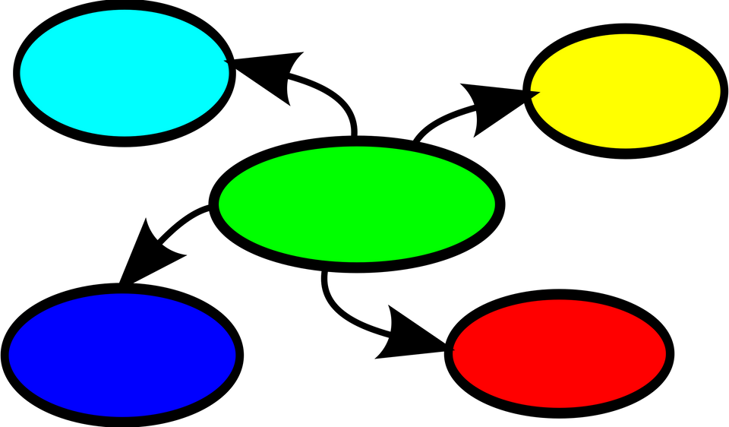
Tasg Map Meddwl
Mind Map Task
  Damcaniaeth Piaget o fewn amgylchedd dysgu ac addysgu
  Piaget theory within a teaching and learning environment

Slide 42
Llyfryddiaeth References
  Boeree, C.G. ( 2006) Jean Piaget 1896 - 1980 Biography. Available at http://webspace.ship.edu/cgboer/piaget.html [ Accessed 23.6.17]
  Borke, H. (1975) Turntable Task. Available at https://psycnet.apa.org/record/1975-20825-001 (Accessed 23.01.2023)
  Hughes, M. (1975) Policeman Doll. Available at https://quizlet.com/gb/602524140/developmenthughes-policeman-doll-study-1975-flash-cards/ (Accessed 23.01.2023)
  McGonigle, Brendan O. (1987) Non-verbal thinking by animals? Nature. Vol 325(7000) Jan 1987, 110-112.
  McLendon, K. (2011) Jean Piaget: Cognitive Development in the Classroom. Available at https://www.funderstanding.com/educators/jean-piaget-cognitive-development-in-the-classroom/ (Accessed 23.01.2023)
  Seigler, R.S ( 2006) Chapter 11 Microgenetic Analyses of Learning. Available at http://www.psy.cmu.edu/~siegler/siegler06hnbk.pdf [ Accessed 23.6.17]
  Slavin, R.E. ( 2009) Educational Psychology. Theory and Practice. New Jersey: Pearson.
  Wood, K.C., Smith, H. & Grossniklaus, D. (2014) Piaget’s Stages of Cognitive Development. Available at https://www.researchgate.net/publication/281578915_Piagetian_and_Vygotskian_Approaches_to_Cognitive_Development_in_the_Kindergarten_Classroom (Accessed 23.01.2023)
  Image of Piaget ( 2006) Available at http://webspace.ship.edu/cgboer/piaget.html [ Accessed 23.6.17]

