Slide 1

Problem solving & Decision Making
BMS4004
Lectures Name: Chijioke Uba
Student Name: Geanina Elena Tronaru
Student Number: 2118801

Slide 2

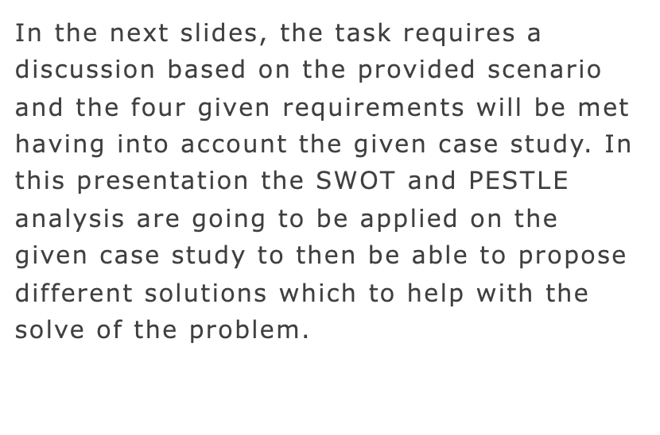
The introduction to the presentation

Slide 3

Background of the case study
The scenario provides is about the NHS hospitals and mental health community which according to what has been mentioned in the scenario there are very high shortages of staff and automatically the NHS is now in need of new strategies which to attract more and more people to join this profession.

Slide 4

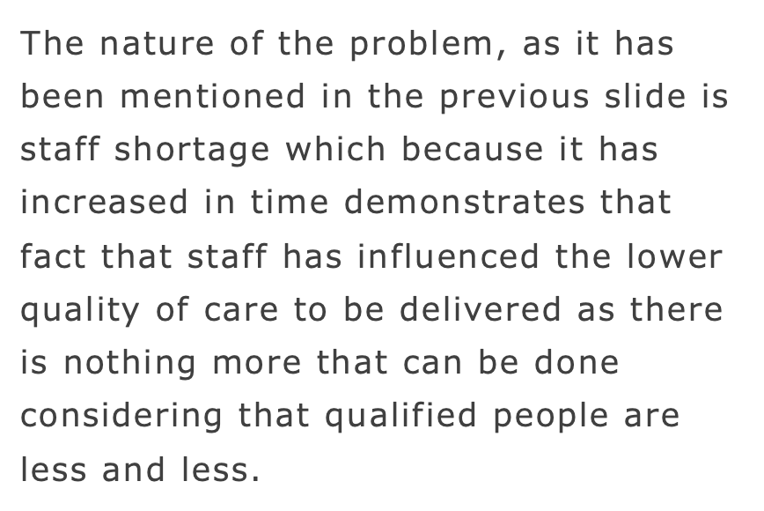
Nature of the problem

Slide 5
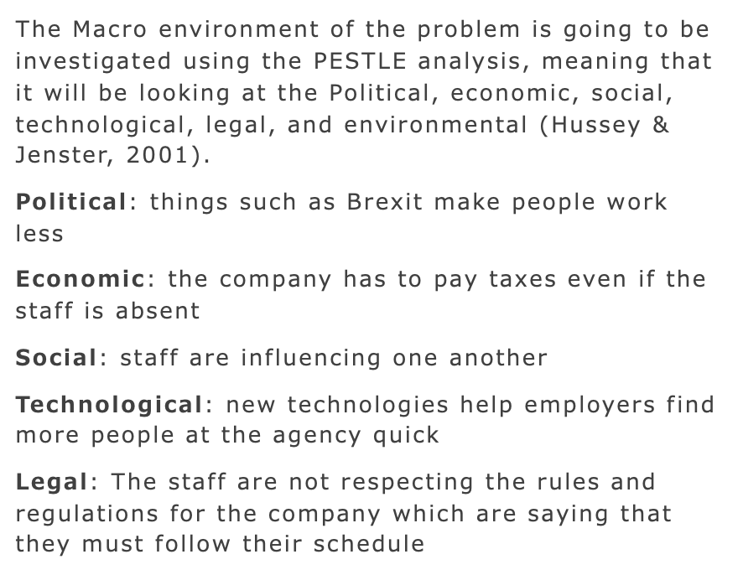

The Macro-environmental

Slide 6

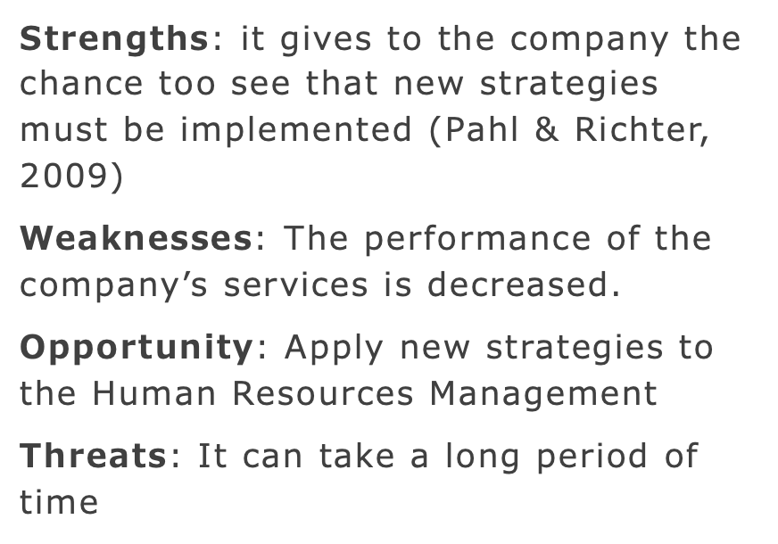
The micro-environment: SWOT analysis

Slide 7
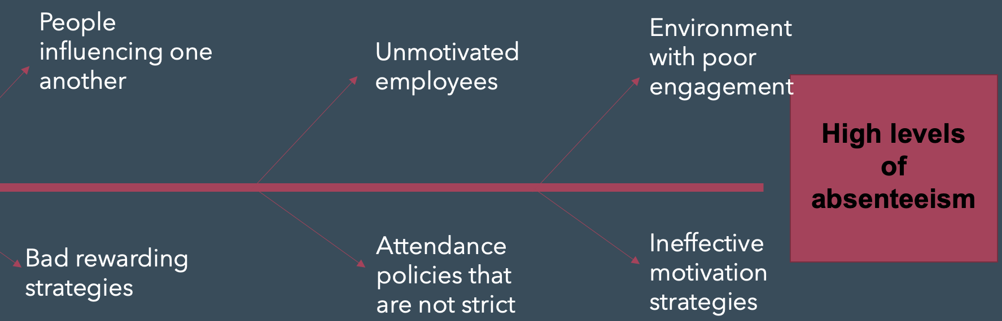
The cause-and-effect analysis

Slide 8

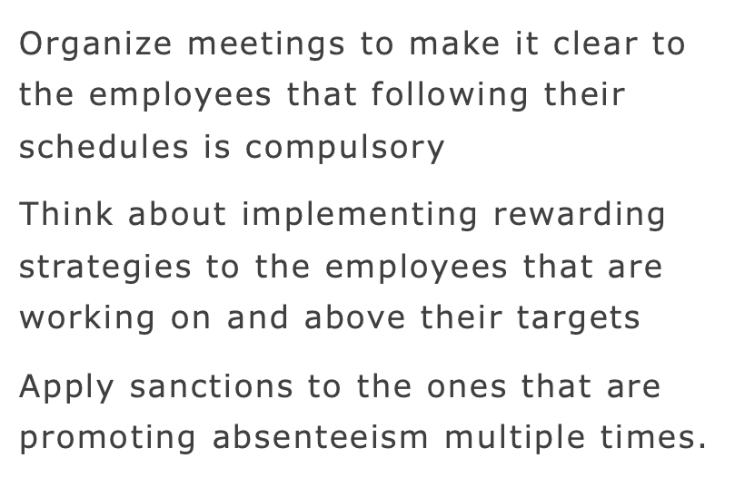
Potential solutions to apply

Slide 9

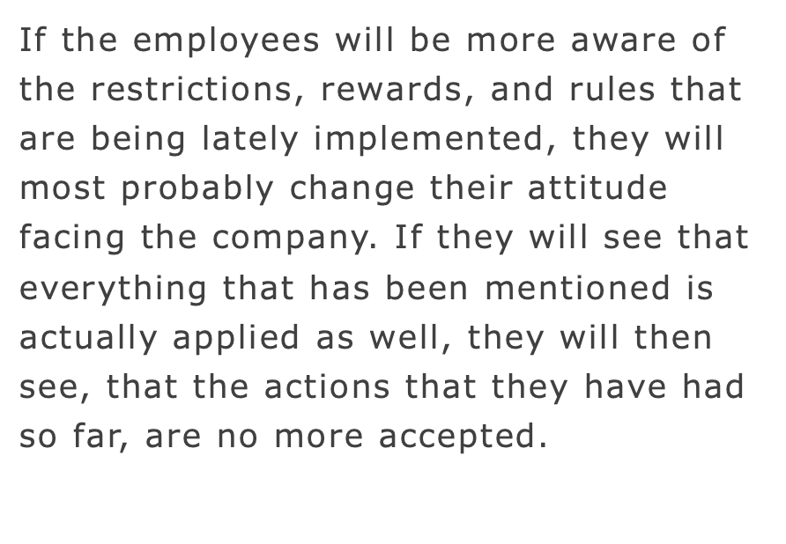
Evaluation of proposed solutions

Slide 10
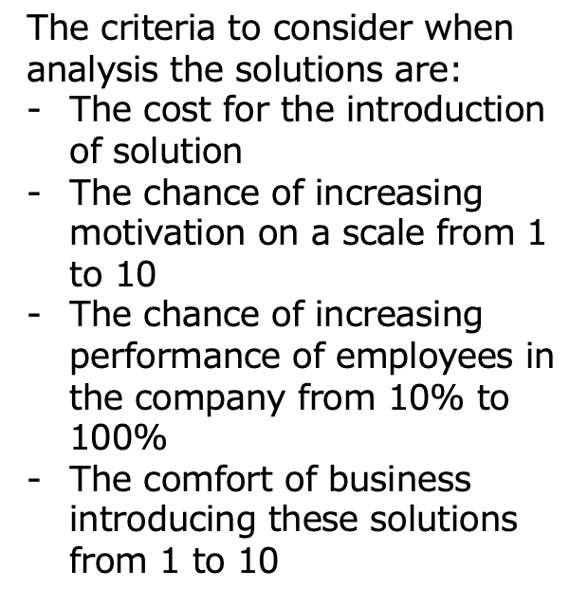
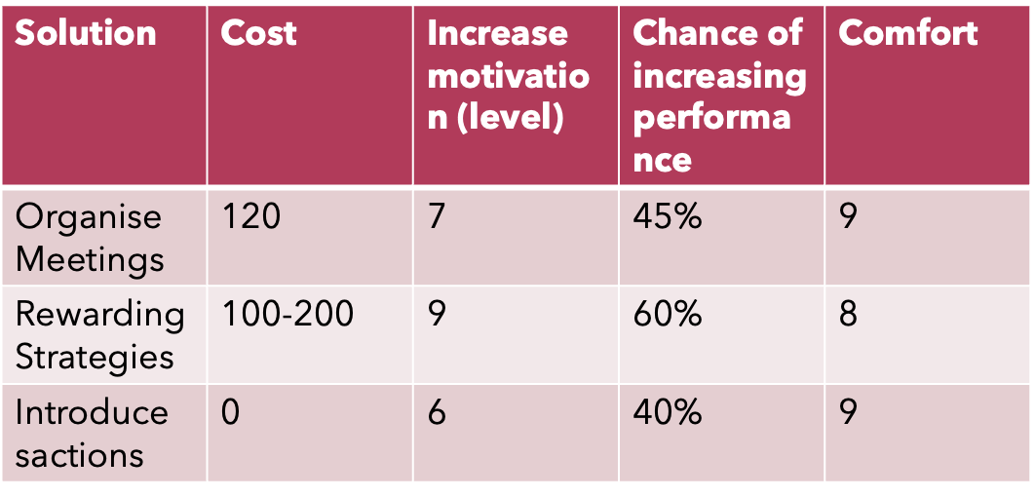
Analysis of GRID

Slide 11
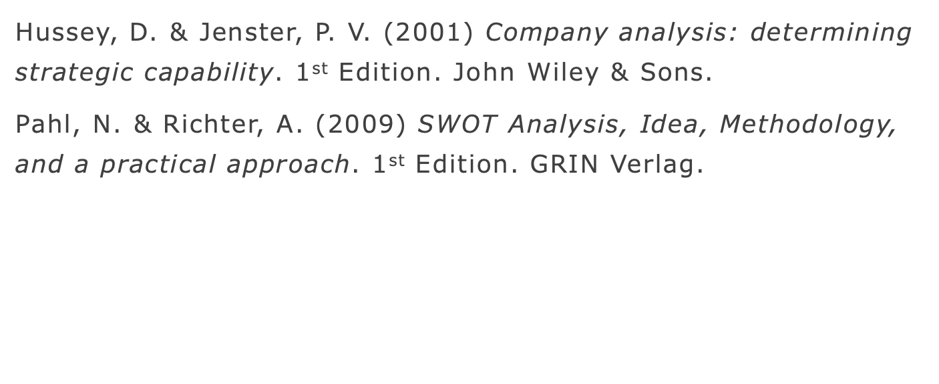
Reference List

