Slide 1
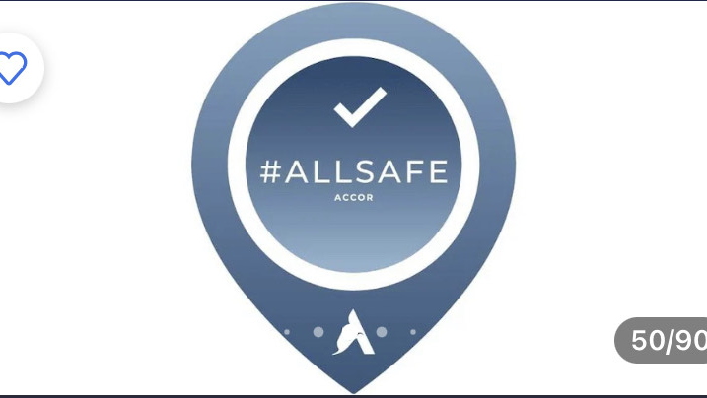
Ibis Barking Hotel
Housekeeping Health And Safety Presentation

Slide 2
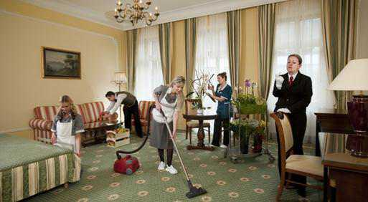
Did You Know
“A housekeeper changes body position every three seconds while cleaning a room. If the average cleaning time for each room is 25 mins, we can estimate that a housekeeper assumes 8000 different positions every shift.”

Slide 3
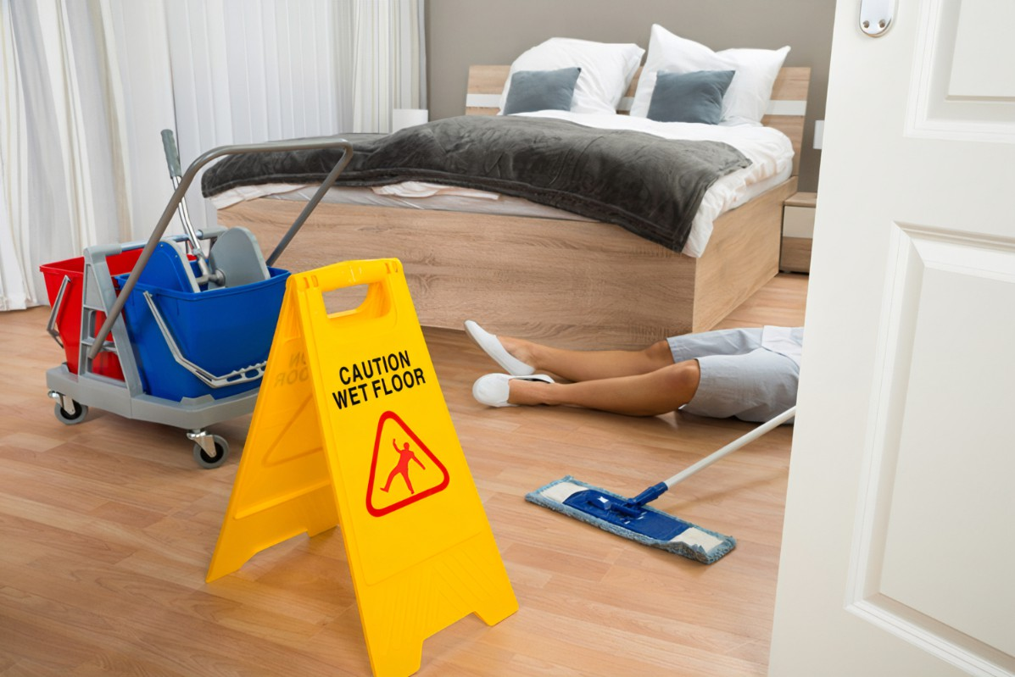
Potential Risks
Slips, trips and falls
Exposure to chemicals in cleaning products that could cause breathing and skin problems
Fractures, burns and traumas
Violence and abuse
Biological infections and diseases

Slide 4

Things To Look Out For
Blocked Fire Exits
Flamable liquids
Candles
Loose wiring

Slide 5
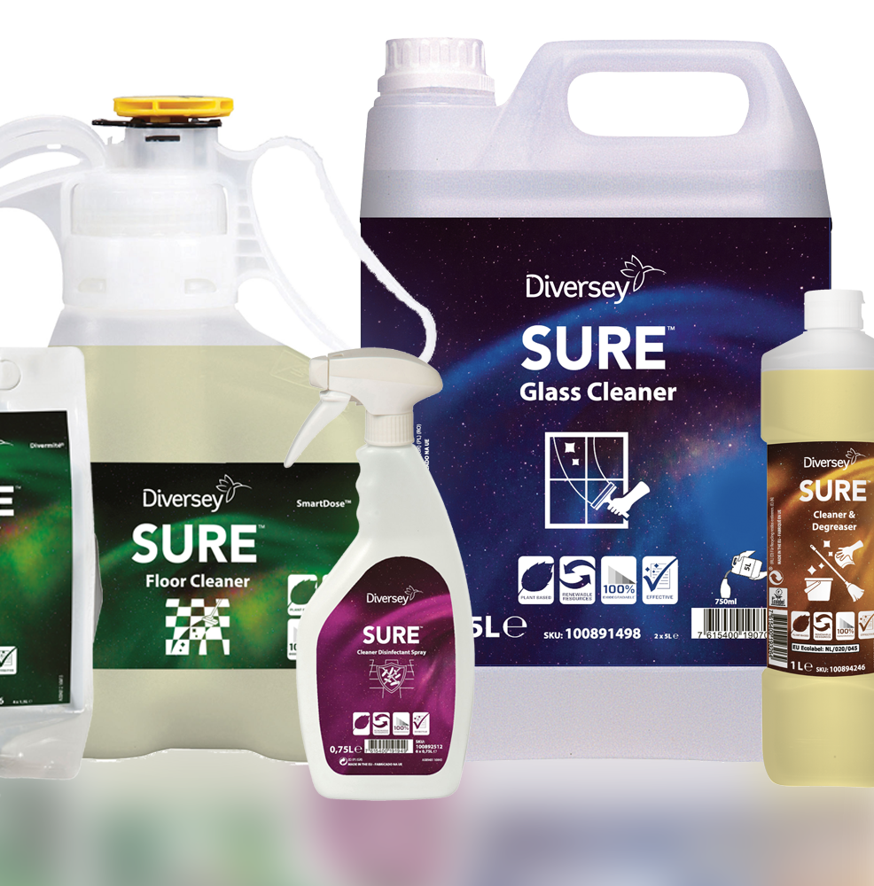
Precautions
Use the PPE provided by Ibis Barking Hotel – gloves, protective uniforms, face masks
Wear comfortable nonslip shoes
Follow the manufacturer instructions when using and storing Diversey cleaning products
Report loose sockets and wiring in the rooms and bathrooms.
Ensure that any hazards and safety concerns are reported and dealt with immediately
Wash you hands regularly

Slide 6
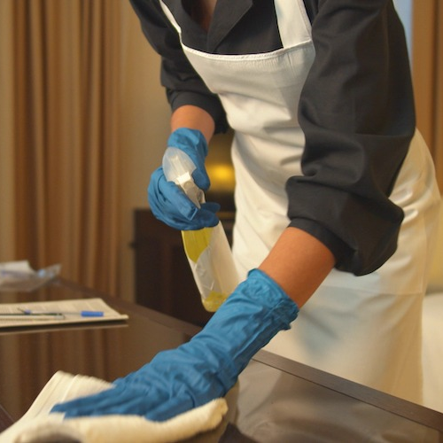
Cleaning Room Safety Tips:
Keep doors or windows open for ventilation
Check for loose wiring or fire hazards
Always wear PPE – gloves , protective uniforms
Be vigilant for broken glass or uncapped needles.
Use Diversey Cleaning chemicals correctly and follow COSHH regulations.

Slide 7
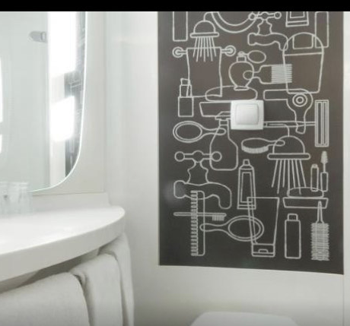
Cleaning Bathroom Safety Tips
Do not mix or inhale the chemicals
Keep sprays and chemicals away from your eyes
In case of a contact with the skin wash with plenty of cold water
Clean any spillages immediately
If you have any concerns report to your line manager

Slide 8
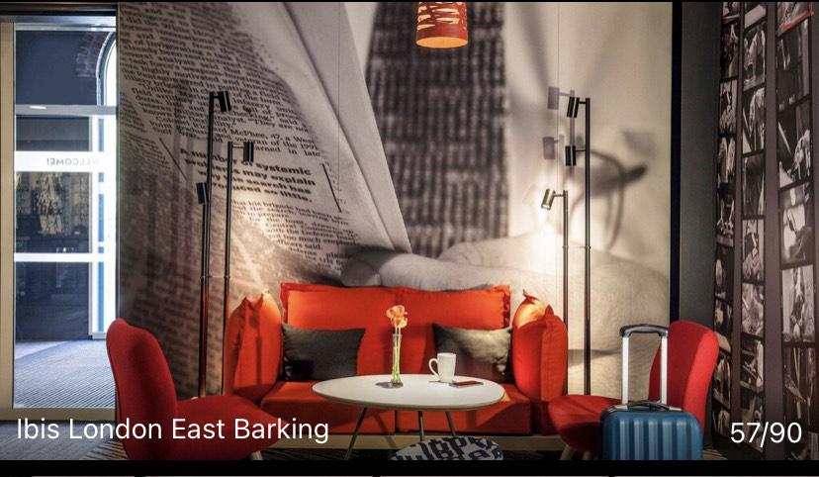
Cleaning Public Areas in Ibis Barking Hotel
Do not block corridors and fire exits
Clean immediately any leaks and spillages
Use wet floor signs

Slide 9
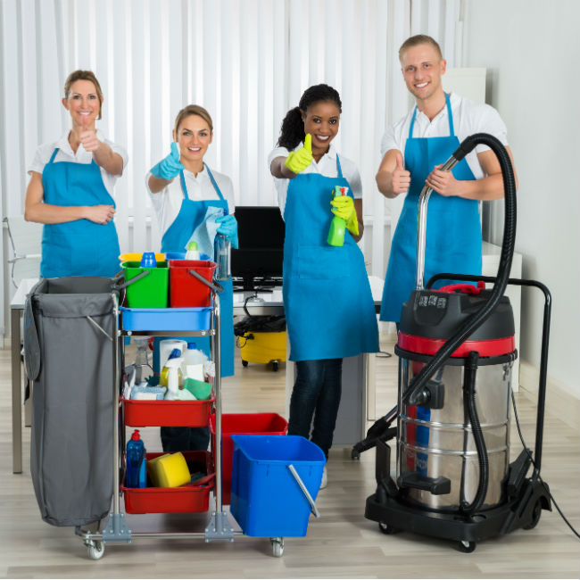
Summary
Housekeeping is Safekeeping
https://www.bing.com/images/search?view=detailV2&ccid=ZYSD3A2E&id=BCBC6F8FE23F5B1CDBA2233418A6007155FDBE62&thid=OIP.ZYSD3A2Edrlt9XjnVoKhUwHaHa&mediaurl=https%3a%2f%2fth.bing.com%2fth%2fid%2fR.658483dc0d8476b96df578e75682a153%3frik%3dYr79VXEAphg0Iw%26riu%3dhttp%253a%252f%252fbesthotelcleaning.com%252fwp-content%252fuploads%252f2018%252f02%252fHousekeeping-650.jpg%26ehk%3dnITXuvMRtl4bG3kx9w0U%252bCcI5HT6F2mV7uq05p9858E%253d%26risl%3d%26pid%3dImgRaw%26r%3d0&exph=650&expw=650&q=hotel+housekeeping+safety+pictures&simid=608045414199602729&FORM=IRPRST&ck=50616309F5BBB2ADB469434CDD9433DA&selectedIndex=49&itb=0
Work safely and be aware of hazards and safety concerns
Take care of yourself, your colleagues and hotel guests
Follow the Ibis Barking Hotel health and safety measures at all times
Do not rush and observe your surroundings

Slide 10
References
Accor: Slide 1 (Accor Brand Image) – https://all.accor.com/czech-republic-slovakia-hungary-romania/event/allsafe.en.shtml
LinkedIn: Slide 2 (Housekeeping image) – https://www.linkedin.com/pulse/benefits-effective-housekeeping-alok-sharma/
SolusGroup: Slide 2 (Housekeeping information) - https://solusgrp.com/blog/post/ergonomic-solutions-for-hotel-waste-management.html#:~:text=%22If%20we%20assume%20that%20the,of%20developing%20a%20musculoskeletal%20injury
ReactMobile: Slide 3 (Potential Risks Picture) - https://news.reactmobile.com/blog/4-key-reasons-to-implement-organization-wide-panic-buttons
YourPilla: Slide 4 (Hospitality Risks Information) - https://yourpilla.com/blog/hospitality-risks
Travelocity: Slide 4 (Ibis Hotel Picture) - https://www.travelocity.com/London-Hotels-Ibis-London-Docklands-Canary-Wharf.h564675.Hotel-Information
Udel: Slide 6 (Cleaning Picture) - https://lerner.udel.edu/seeing-opportunity/hotel-stay-stay-safe/
DayUse: Slide 7 (Ibis Hotel Picture) - https://www.dayuse.co.uk/hotels/france/ibis-paris-porte-de-clichy-centre
HotelInfo: Slide 8 (Ibis Hotel Barking Picture) - https://www.hotel.info/en/ibis-london-barking/hotel-133250/
BrightAcademy: Slide 9 (Housekeeping Summary Image) - https://brightacademy.online/training-your-team/

