Slide 1
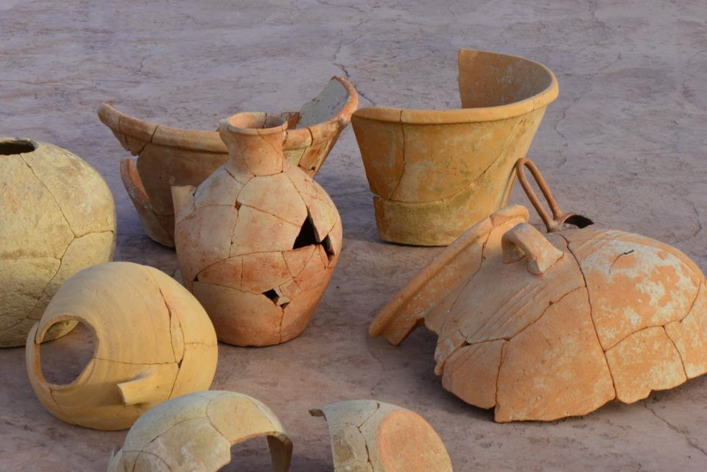
Introduction to Archaeology HPAR4002
Materialities

Slide 2
Readings
Boivin, N. 2008. Material Cultures, Material Minds: The Impact of Things on Human Thought, Society, and Evolution. Cambridge: CUP.
Hurcombe, L. 2007. Archaeological Artefacts as Material Culture. London; New York: Routledge.

Slide 3
What is Material Culture?
Discuss this in pairs/groups of three
Come up with a definition of material culture
Give a modern example…
…and an ancient/archaeological example

Slide 4
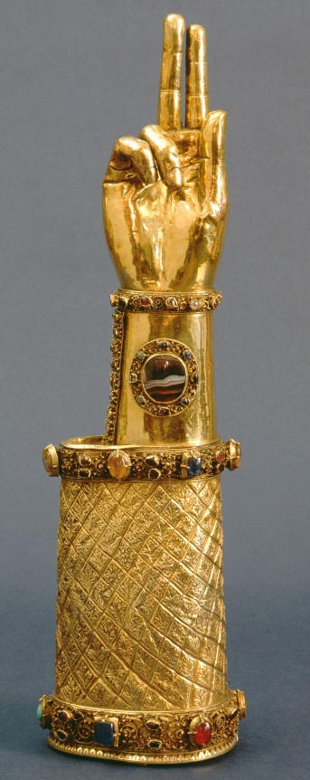

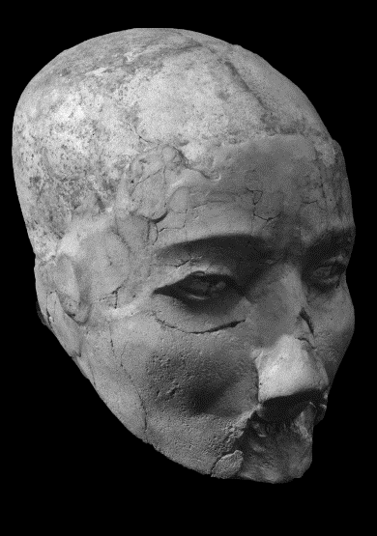
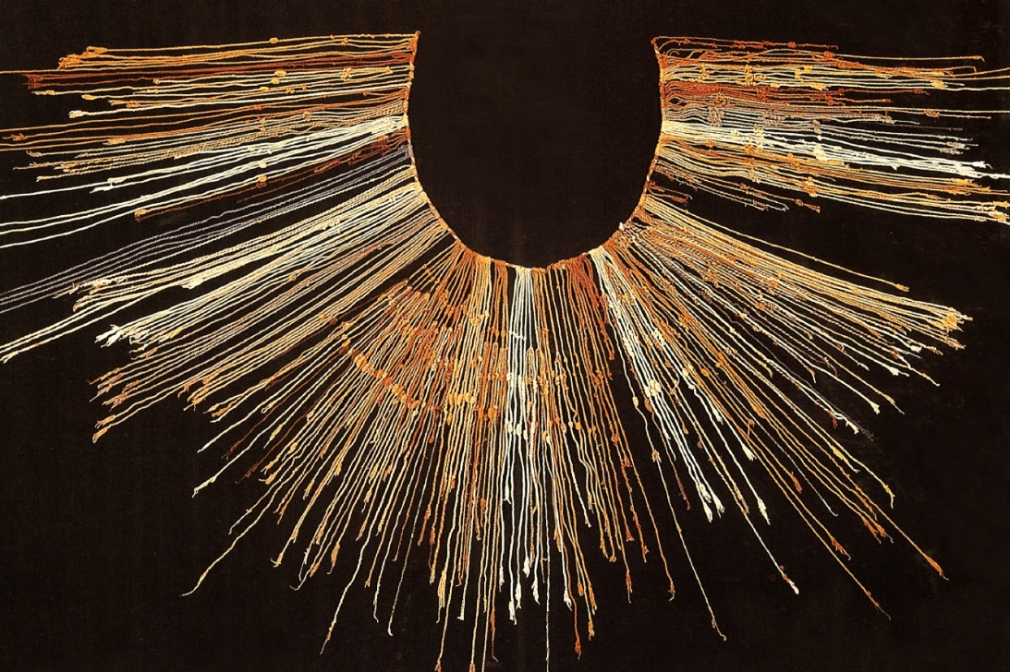
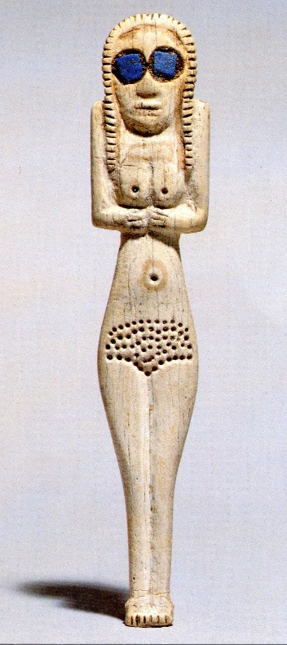


Slide 5
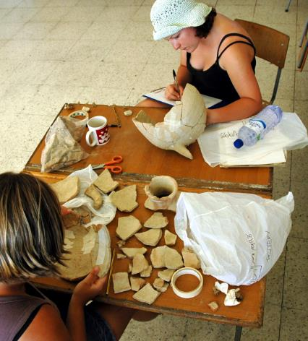
Why is Material Culture Important?
“Our world is dominated by material culture. The objects communicate things about us and the society in which we live” (Hurcombe 2007, 3)
Archaeology deals with physical remains of the past but is about people
Studying artefacts allows us to study past societies
Restoring pottery in Cyprus

Slide 6
Key Terms?
Material Culture
  Artefacts… Things… Stuff
  Objects made/modified & used by human agency….
  Material remains of past human action
Material Culture Studies
  Various anthropological approaches to the meanings of things
Materiality
  The physical properties (thingness) of things
  How people & the things they make are entwined

Slide 7
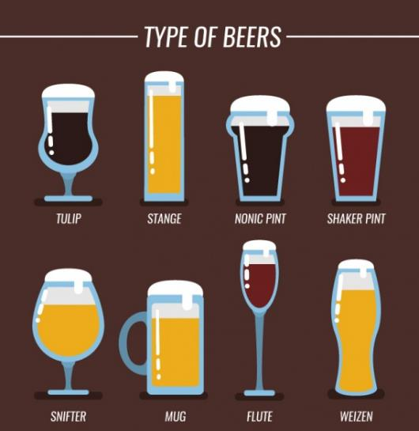
Material Culture & Archaeology
As a dating tool
  Three Age System
  Typologies / sequence dating
Culture History:
  Archaeological assemblages
Technological Advances
  Stone tools
  Pottery
  Metallurgy

Slide 8
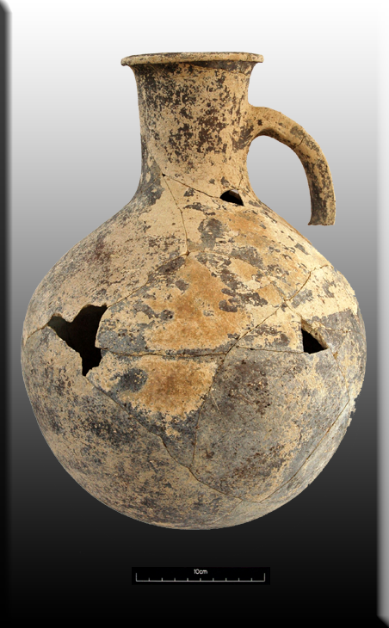
Archaeology & Material Culture?
Archaeological approaches tend to be empirical
  “ a measurements, matrices, munsells, & mohs mindset” (Govier & Steel nd.)
First step is recording:
  Quantitative data
  Qualitative information

Slide 9
Archaeology & Material Culture?
What does an archaeologist ask?
  How old is the artefact?
  What was it used for?
  What was its cultural significance?
How does the archaeologist answer these questions?
  Context of use & associations
  Inference & analogy
  Ethnoarchaeology

Slide 10
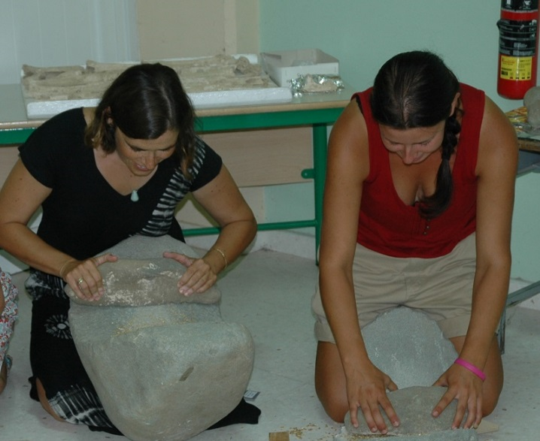
What Can Artefacts Tell Us?
Ancient technologies available to a society
Past activities at a site
Archaeologists tend to think about production & function
Focus traditionally on material sciences
But increasingly archaeologists are engaging with social aspects
LBA querns from Cyprus

Slide 11
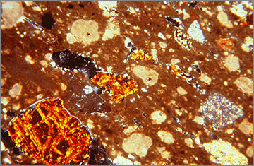
Material Sciences
Extends observations beyond the macroscopic
  Provenance analysis: sourcing trace elements
  X-rays: hand/wheelmade
  Firing temperatures
  Residue analysis
Answers questions of techniques, processes, skills etc.
…& ancient economies
Petrography: thin section analysis
www.amarnaproject.com/pages/recent_
projects/material_culture/canaanite.shtml

Slide 12
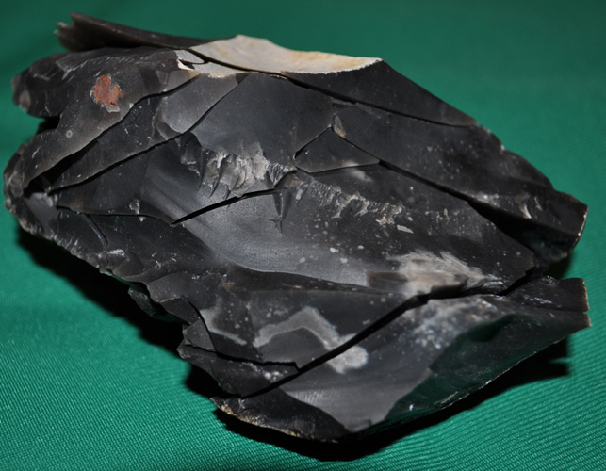
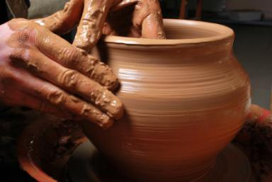
Chaîne Opératoire
Operational sequence of making things
A series of deliberate steps & choices made by the artisan(s) to transform raw materials into a finished artefact
Considers technologies as social practice
  Focuses on artisans as much as materials
http://www.ancientcraft.co.uk/
Tools/core_refits.html

Slide 13
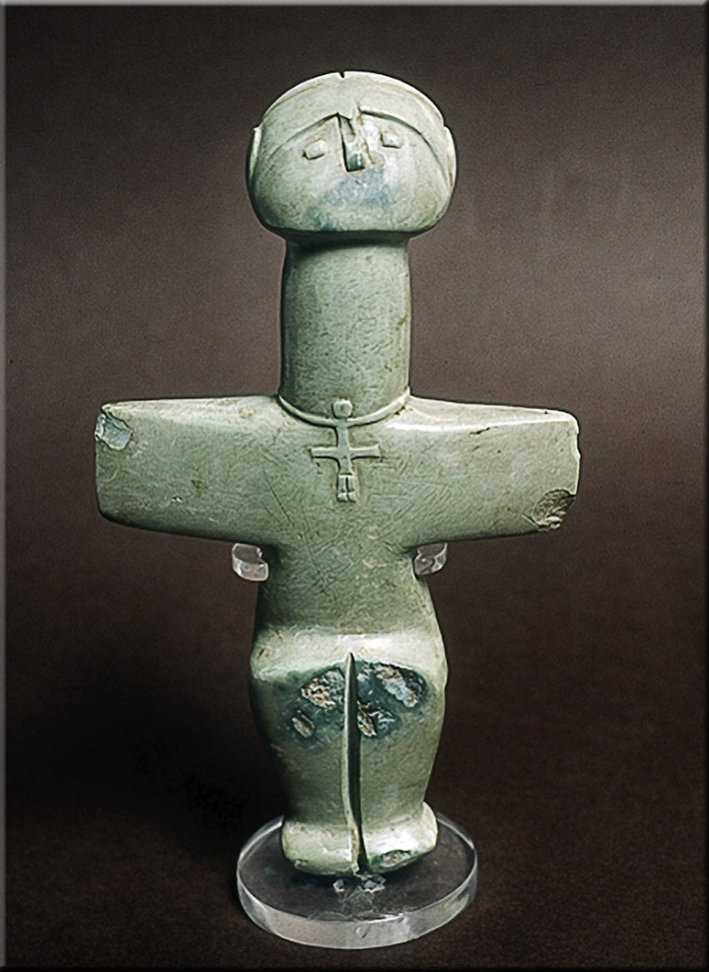
What Else Can Artefacts Tell Us?
Artefacts also convey social meanings:
  Style / fashion
  Status / wealth
  Identity
  Symbolism / esoteric knowledge
Chalcolithic figure, Cyprus

Slide 14
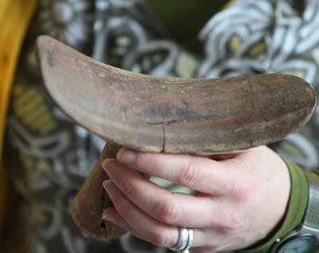
Material Culture Studies
Anthropologically informed approaches focus on the links between people & objects
  How objects are given meaning & ascribed values
  Material culture is culturally constituted & conveys symbolic meaning
Handling an Egyptian headrest

Slide 15


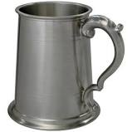

Function and Meaning of Things
All designed to hold cold liquids
…and drinking vessels
But different cultural meanings embedded in each object
How are these meanings materially embedded?

Slide 16
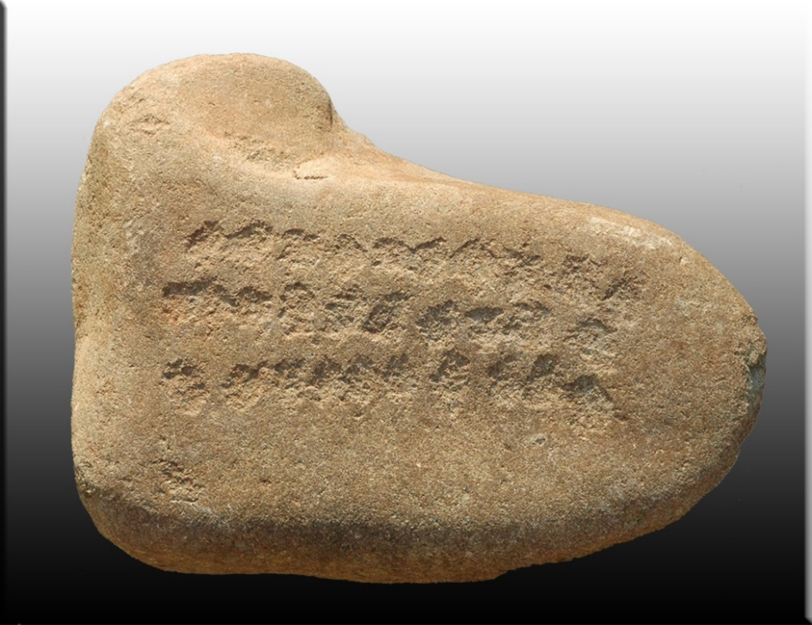
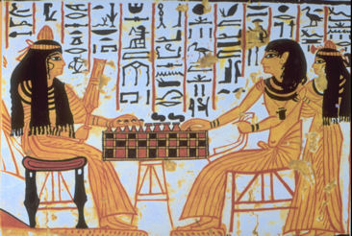
Materiality
The “two faces of materiality” (Ingold 2013, 27 )
  Physical properties or thingness of things
  The engagement of human agents & things
Recognises objects as social & relational beings entangled in complex human-thing networks
Agency of things
Cypriot senet stone

Slide 17
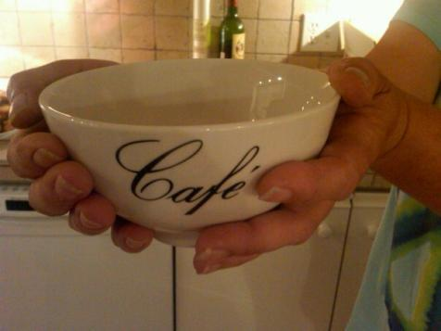


Culturally Embedded Associations of Things
How we use & handle things shapes our daily experiences:
  Habitus
  Embodiment

Slide 18
Summary
Study of the material world underpins much of archaeology
Embedded in earliest antiquarian approaches:
  Typologies & dating
Shift to interest in ancient technologies & functionalist approaches
Material Culture Studies, influenced by Anthropology, focused on the meaning of things
Materialities: human – thing relations

