Slide 1
Serious and organised crime: the threat it poses within contemporary society
Nilupa begum (2114298)
BMCP6002

Slide 2
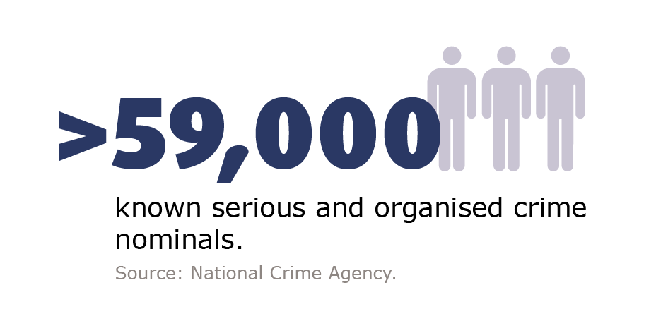
Introduction
Criminal acts of great social and economic impact, known as Serious Organised Crime (SOC), is the focus of interest as per Giommoni and Ikwu, (2021).
Human trafficking, which includes a variety of wrongful behaviours such as Force and exploitation of individuals for various reasons (e.g., forced labour, sexual exploitation, and organ removing), has emerged as a worrying aspect of SOC.
((National Crime Agency,2023a)

Slide 3
One of the most pressing SOC-related issues in modern society is human trafficking, which have huge negative impacts on human rights and international security, as a result, this problem needs to be addressed.
Complications arise for health care systems, foreign relations and law enforcement, all of which reflect violation on individual freedom (Gaitis, 2023).
Therefore, it is essential to come up with good strategies that can end these criminal networks and protect the innocent people.

Slide 4
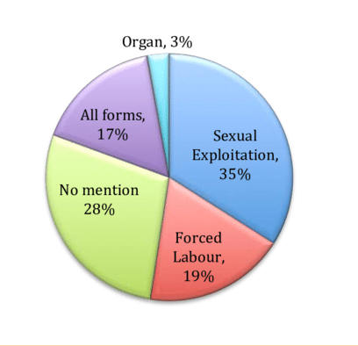
Human Trafficking
Definition And Characteristics
Human trafficking contains several stages, including recruitment, transit, transfer and harbouring: individuals are held under custody and exploited by force, compulsion, or deception (Babjak, 2023).
These complex networks, which combine numerous countries and regions, frequently target vulnerable populations such as poor people, immigrants, and refugees.
Purpose of traffickers using victims: forced labour, forced marriage, forced sexual exploitation, or organ trafficking. In doing so, traffickers subject them to severe forms of physical, emotional and psychological torture (Antonopoulos et al., 2020).
(Constantinou,2015)

Slide 5
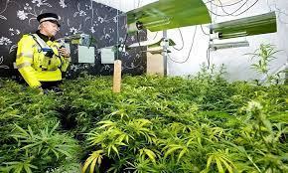
Human Trafficking
Case Study
In 2021, the case of V.C.L. and A.N. V. which took place in United Kingdom, both were under the age of 18 and had been found by police, working in the cannabis factories and charged with participation in controlled drug production (Kárníková, 2023).
Since 2021, 491 teenage boys have been found by the UK government who were child-trafficked for forced labour in cannabis factories.
(Reuters,2018)

Slide 6
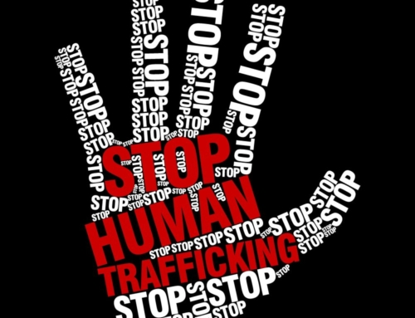
Human Trafficking
Impact on Society
Human trafficking is driven by the extreme need of the vulnerable sections of society, like children, women and deprived classes, to get a better life filled with security and opportunity.
Physical violence, abuse, and threats or blackmail are used by traffickers to control victims and to expand their operations (Landman et al., 2024).
For criminal trafficking networks not to be caught and prosecuted, they may resort to falsehoods, bribery, working with law enforcement agencies, and dishonesty.
To emphasis the privacy of their operations and avoid being discovered by law authorities, traffickers use technologies such as encryption apps and dark websites. (Nelen and Siegel, 2021).
(The Orphans Hands.2024)

Slide 7
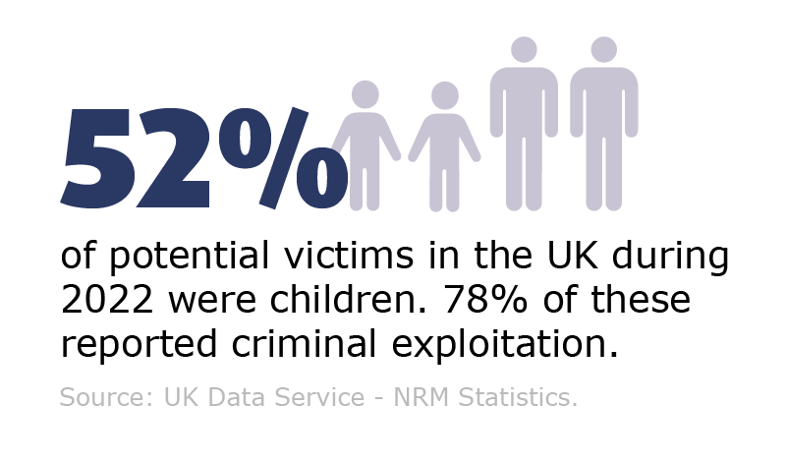
Human Trafficking
(National Cime Agency, 2023b)

Slide 8
Facts and statistics
In the year ending 2022, 7936 referrals were made for potential victims of exploitation that has occurred only in the UK, an increase of 10.3% from the year before.
Many victims work in the construction industry, in agriculture, and in the sex industry.
Numerous victims of human trafficking have come from overseas. Most commonly from Africa, Southeast Asia and Eastern Europe.
Most victims are recruited in person: however, others have been trapped through online employment advertisements or social networking websites.
In some cases, victims are threatened and potentially face extreme violence as criminals try to gain control over them, leaving them to get their identity documents confiscated and earning withheld (National Crime Agency, 2023c).

Slide 9
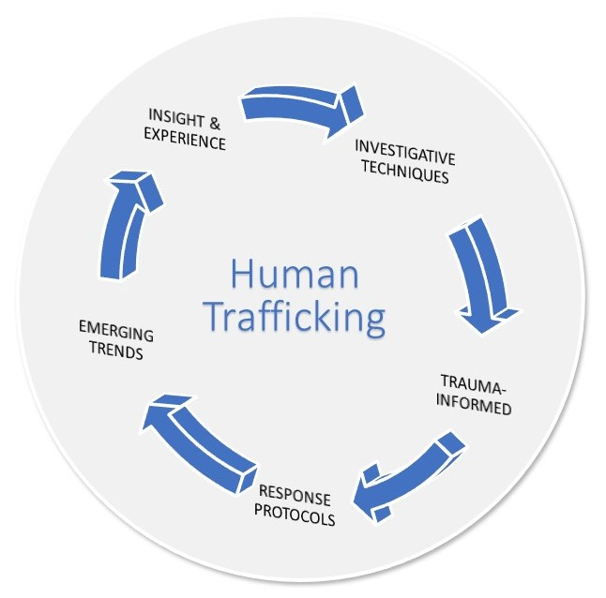
UK Government's "No Place to Hide: Serious and Organised Crime Strategy 2023-2028“
Overview of the Strategy
The UK government is in the process of designing and introducing the "No Place to Hide" strategy between 2023 and 2028 to solve the problem of serious and organised crime (SOC).
By making the UK unsuitable for the practice of criminal activities, the strategy ensures that criminal professionals leave no trace behind.
To do this, these initiatives involve the development of specific programs and the promotion of cross-sector collaboration (Turnbull and Broad, 2022).
(Government of Canada, 2023)

Slide 10
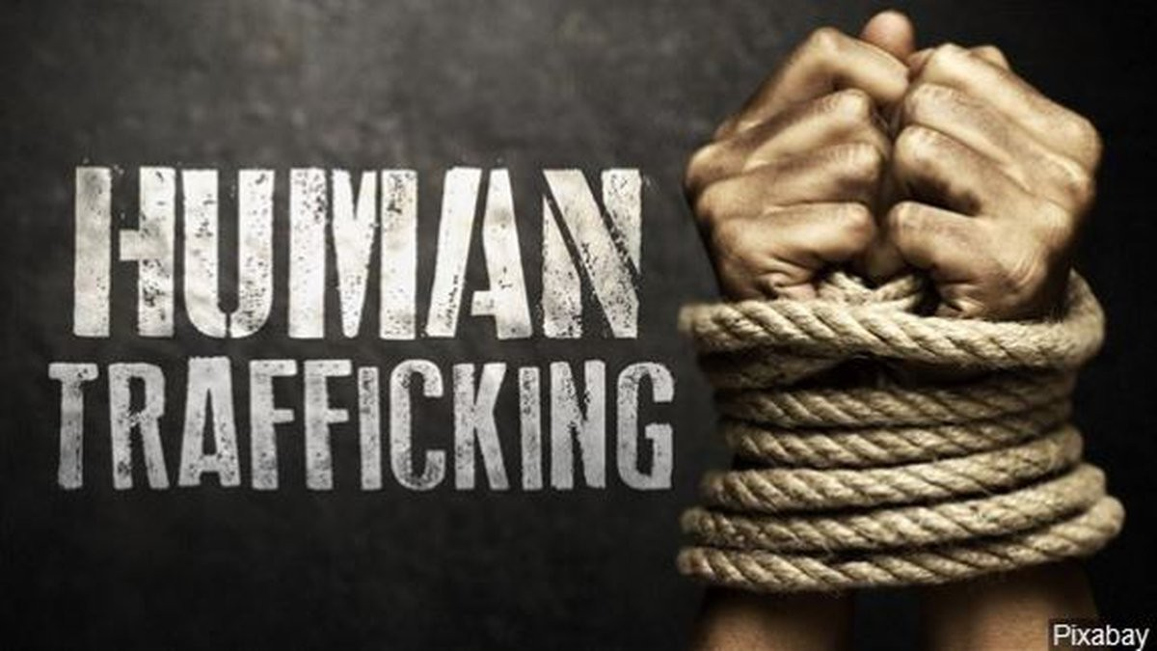
UK Government's "No Place to Hide: Serious and Organised Crime Strategy 2023-2028“
Effectiveness In Addressing Human Trafficking
A range of approaches and initiatives are adopted in "No Place to Hide" strategy to prevent the human trafficking in the United Kingdom
The two divisions within the unit are in charge of information collection, analysis of trafficking networks, and support for law enforcement operations.
This law obligated corporations to observe transparency policies to avoid using forced labuor in their supply chains, intensified penalty for human trafficking and expanded the protection of victims' rights.
One of its giving efforts is through UK Government's Modern Slavery Victim Care Contract. As well as housing, legal help, and counselling, this agreement lists a range of essential services for survivors (L’Hoiry et al., 2021).
Offering security or aiding in these aspects is a challenge, especially to those in such groups as migrant workers, irregular migrants, or those facing other inequalities, such as under-representation or discrimination.
(Mallya, 2023)

Slide 11
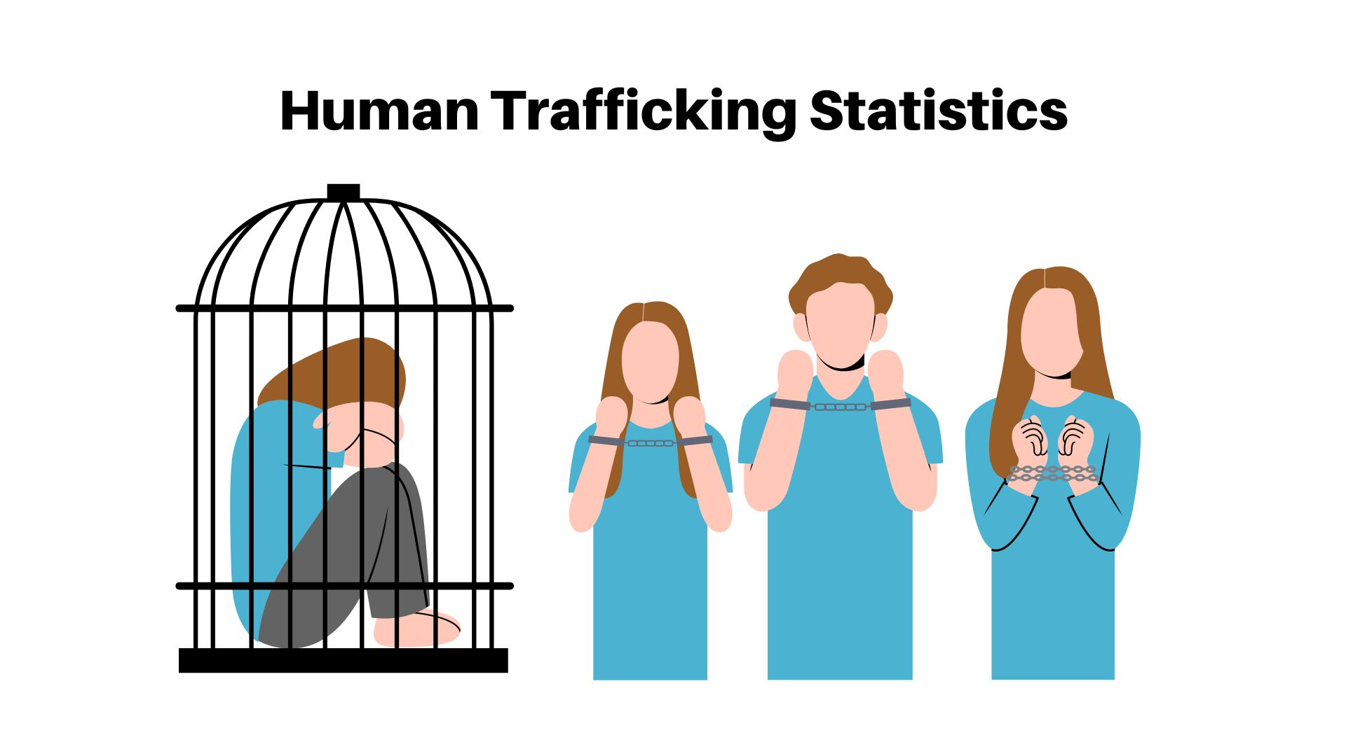
UK Government's "No Place to Hide: Serious and Organised Crime Strategy 2023-2028“
Strengths
Comprehensive coverage: Addresses all aspects of SOC including preventive, protective, investigative, and readiness practices.
Targets vulnerability: Focuses on vulnerable groups like victims of human trafficking.
Effective policy and strategic planning: Provides a more effective approach for combating organised criminal groups.
Eliminates hiding spots: Leaves no room for SOC to hide, increasing the effectiveness of enforcement efforts.
(Elad, 2024)

Slide 12
UK Government's "No Place to Hide: Serious and Organised Crime Strategy 2023-2028“
Weaknesses
Financial and practical constraints: Limited resources and practical challenges may hinder the effectiveness of the strategy.
Lack of regulation in data collection and information exchange: Without proper regulations, accurate evaluation of organised crime and its effects becomes difficult.
Complex legal systems and jurisdictional issues: the prosecution may face obstacles due to the complexity of legal frameworks and the jurisdictional difficulties present by international criminal organisations.

Slide 13
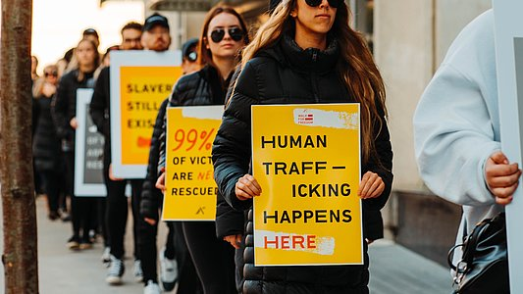
UK Government's "No Place to Hide: Serious and Organised Crime Strategy 2023-2028“
The 4 P's Principle
Prepare
The strategy particularly focuses on bringing improvements to the institutions and communities as a way of dealing with the effects of SOC.
This requires strengthening cooperation among the agencies, enhancing intelligence capacities.
Prevent
First, the strategy would focus on measures preventing individuals from being involved in the sex trade while particularly targeting vulnerable groups such as trafficking victims, who are the most vulnerable to exploitation.
Protect
The main purpose of this strategy is to ensure that the key asset and community safety is preserved from the impact caused by SOC.
Pursue
The objective of the tactics is to have the traffickers, their partners and other SOC participants be brought to justice by involving strong enforcement mechanism.
(International Security ligue, 2023)

Slide 14
Recommendations to Tackle SOC in the UK
Suggestions For Enhancing The Strategy
Collaboration with International partners
In countries that are the destination countries or the source of human trafficking, the UK might seek to improve its collaboration with law enforcement agencies and other non-profit organisations (NGOs).
Public awareness and education campaigns
For communities to recognise any unnatural behaviour and inform the police, it is important to inform the general public that human trafficking exists and alert as well as educate them.

Slide 15
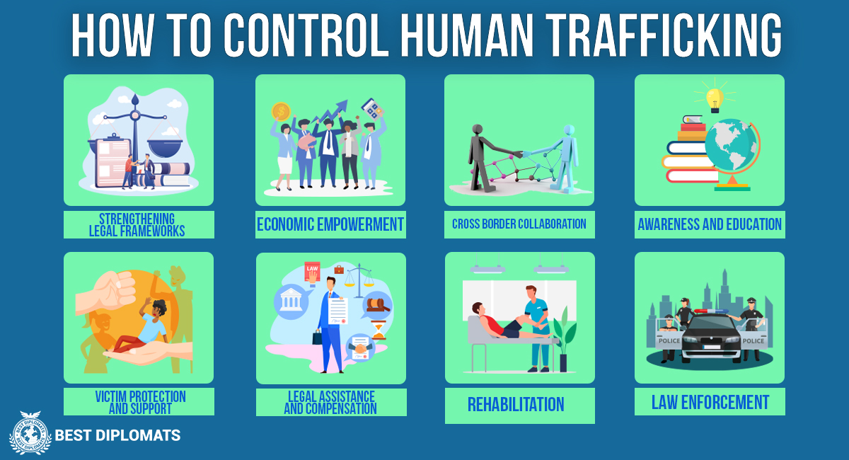
Recommendations to Tackle SOC in the UK
Legislative reforms
Two benefits of the laws that reinforce the regulations and penalties of human trafficking are being able to stop criminal activity and providing the law authority with the tools they need to start the prosecutions.
Support for victims and vulnerable communities
The most important thing with regards to providing support services that do not only attend to the initial needs but also help victims of human trafficking to recover and rehabilitate is to ensure comprehensive services.
(Mamchii. 2023)

Slide 16

Recommendations to Tackle SOC in the UK
Advances in Technology
Another recommendation which can be suggested for identifying the cases of human trafficking is through technology. Although technology is claimed to be used for enabling trafficking operations, recent technologies can also assist in reducing such cases.
For example, implementation of advanced detection Artificial Intelligence (AI) methods can improve anti-trafficking activities by location tracking of both abusers and victims with identifiers in electronic devices.
Additionally, machine learning algorithms have been developed which can also assess if online sex commercial advertisements are associated with human traffickers or not (L’Hoiry et al., 2021). Such advances should be considered by the UK government for effective tackling of the issue.
(Beatrice, 2021)

Slide 17
Conclusion
To take on significant organised crime, such as ruthless human trafficking, a holistic strategy encompassing victim support, enforcement, prevention, partnership, and assistance to the victim is needed.
The "No Place to Hide" strategy must include supplementary measures such as legislative amendments, helping victims, empowering law enforcement agencies, and conducting public awareness campaigns to successfully safeguard citizens against the menace of illegal surveillance.
One of the foundations of fighting organised crime is permanent efforts to remain alert to the elaboration of criminal networks and to be prepared for the emergence of new challenges.

Slide 18
References
Antonopoulos, G.A., Baratto, G., Di Nicola, A., Diba, P., Martini, E., Papanicolaou, G. and Terenghi, F., 2020. Technology in human smuggling and trafficking: case studies from Italy and the United Kingdom. Springer Nature.
Aronowitz, A.A. and Veldhuizen, M.E., 2021. The human trafficking–organized crime nexus. In Routledge handbook of transnational organized crime (pp. 232-252). Routledge.
Atkinson, C. and Hamilton-Smith, N., 2022. Still an ‘invisible crime’? Exploring developments in the awareness and control of human trafficking in Scotland. European Journal of Criminology, 19(5), pp.911-931.
Babjak, M., 2023. Taking a ‘leap of faith’to migrate: exploring UK approaches to anti-human trafficking.
Beatrice, A. (2021) AI leads the fight against human trafficking & harassment. Available at:https://www.analyticsinsight.net/ai-leads-the-fight-against-human-trafficking-harassment/ (Accessed: 1 May 2024).
Collins, C. and Skarparis, K., 2020. The impact of human trafficking in relation to maternity care: a literature review. Midwifery, 83, p.102645.
Constantinou, A. (2015) Review of the media framing of human trafficking.
Gaitis, K.K., 2023. Representations of traffickers in official UK discourse: Examining the least known component of the human trafficking equation. International journal of law, crime and justice, 74, p.100592.
Elad, B. (2024) Human Trafficking Statistics. Available at:https://www.enterpriseappstoday.com/stats/human-trafficking-statistics.html (Accessed: 1 May 2024).
Notes:
A

Slide 19
Giommoni, L. and Ikwu, R., 2021. Identifying human trafficking indicators in the UK online sex market. Trends in Organized Crime, pp.1-24.
GOV.UK (2024) Serious and organised crime strategy 2023-2028. Available at: https://assets.publishing.service.gov.uk/media/65798633254aaa0010050bdc/SOC_Strategy_23-28_V9_Web_Accessible.pdf (Accessed: 22 April 2024).
Government of Canada (2023) Available at:https://www.justice.gc.ca/eng/rp-pr/jr/tiprhtc-rptctctp/p13.html (accessed: 1 May 2024)
Hodkinson, S.N., Lewis, H., Waite, L. and Dwyer, P., 2021. Fighting or fuelling forced labour? The Modern Slavery Act 2015, irregular migrants and the vulnerabilising role of the UK’s hostile environment. Critical Social Policy, 41(1), pp.68-90.
L’Hoiry, X., Moretti, A. and Antonopoulos, G.A., 2021. Identifying sex trafficking in Adult Services Websites: An exploratory study with a British police force. Trends in Organized Crime, pp.1-22.
International Security ligue (2023) Available at: https://www.security-ligue.org/news?tx_news_pi1%5Baction%5D=detail&tx_news_pi1%5Bcontroller%5D=News&tx_news_pi1%5Bnews%5D=214&cHash=525172dc03180b98711675b61b199f34 (Accessed: 1 May 2024)
L’Hoiry, X., Moretti, A. and Antonopoulos, G.A., 2024. Human trafficking, sexual exploitation and digital technologies. Trends in Organized Crime, pp.1-9.
Landman, T., Brewster, B. and Thornton, S., 2024. Taking Back Control: Human Rights and Human Trafficking in the United Kingdom. Societies, 14(4), p.47.
Mallya, G (2023) Human Trafficking. Available at:https://www.linkedin.com/pulse/human-trafficking-girish-mallya-cams-came/ (Accessed: 1 May 2024).
Massey, S., Rankin, G., Massey, S. and Rankin, G., 2020. Preventing Human Trafficking. Exploiting People for Profit: Trafficking in Human Beings, pp.101-118.
Mamchii, O. (2023) 8 Different Ways to Combat Human Trafficking In 2023. Available at: https://bestdiplomats.org/how-to-control-human-trafficking/ (Accessed: 1 May 2024).

Slide 20
National Crime Agency (2023a). Available at: https://nationalcrimeagency.gov.uk/nsa-overview-of-soc (Accessed: 1 May 2024).
National Crime Agency (2023b). Available at: https://nationalcrimeagency.gov.uk/nsa-modern-slavery-and-human-trafficking (Accessed: 1 May 2024)
National Crime Agency (2023c) Modern slavery and human trafficking. Available at: https://www.nationalcrimeagency.gov.uk/what-we-do/crime-threats/modern-slavery-and-human-trafficking (Accessed: 1 May 2024).
Nelen, H. and Siegel, D. eds., 2021. Contemporary organized crime: developments, challenges and responses (Vol. 18). Springer Nature.
Orsini, B.W., 2022. Law enforcement considerations for human trafficking. In Human Trafficking (pp. 340-357). Routledge.
Pant, H.V., 2020. No place to hide.
Reuters (2018) A police officer inspects an illegal cannabis farm in the U.K. Available at: https://e.vnexpress.net/news/news/3-vietnamese-children-rescued-from-uk-cannabis-farm-4001835.html(Accessed: 1 May 2024).
Santorso, S. and Rizzuti, A., 2024. A Critical Analysis Of The Police-Prison Collaboration In Contrasting Organised Crime Groups. CrimRxiv.
Szablewska, N., 2022. Human smuggling and human trafficking. In International conflict and security law: A research handbook (pp. 1181-1206). The Hague: TMC Asser Press.
The Orphans Hands (2024) Take action: 9 ways you help fight human trafficking. Available at: https://theorphanshands.org/take-action-9-ways-you-can-help-fight-human-trafficking/ (Accessed: 1 May 2024).
Turnbull, N. and Broad, R., 2022. Bringing the problem home: The anti-slavery and anti-trafficking rhetoric of UK non-government organisations. Politics, 42(2), pp.200-215.
Yeon, T. and Lui, E., 2021. Modern Solutions to Human Trafficking: A Tangled Journey. Nottingham LJ, 29, p.1.

