Slide 1
BMSW 4006 Managing Enterprise in the 21st Century
Week 5 - Workshop

Slide 2
Agenda
Today we shall discuss:…
Facts about Entrepreneuring
UWTSD Entrepreneurial Grant
Birmingham City Library.
Entrepreneur vs Intrapreneur.
Importance of teamwork.
Assignment brief discussion.
Q & A.

Slide 3
Part 1
Facts about Entrepreneuring

Slide 4

Facts about Entrepreneuring
Do you know….
The average age of the British entrepreneur is 40.

Slide 5
Do you know….
40 is the average but almost 10,000 businesses are set up by entrepreneurs over the age of 60 in the past 12 months, as at, 2019 (Enterprise Nation, 2022).

Slide 6

Entrepreneurial Workshop
This means….
You can be an entrepreneur regardless of your present age and past failures !

Slide 7
Entrepreneurial Workshop
However,….
44% of UK respondents would not start a business due to fear of failure (Enterprise Nation, 2022).
.

Slide 8

Entrepreneurial Workshop
You have ….
to be confident in your judgement and ability – or if not, conquer those self-doubts!!

Slide 9

Entrepreneurial Workshop
To succeed as
Entrepreneur, you need a clear vision of what they want to achieve…

Slide 10
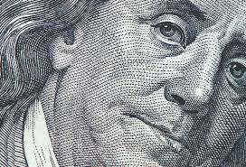

Entrepreneurial Workshop
Admittedly….
Starting or running a business can be a demanding and/or
Challenging.

Slide 11

Entrepreneurial Workshop
Undoubtedly….
Seeking help or discussing with experts can be helpful.

Slide 12
Class Activity 1
Examine the entrepreneurs,
Select one and do a mini research
on his/her age, failure and success as an entrepreneur.
Guide time to complete this activity 15 minutes.

Slide 13

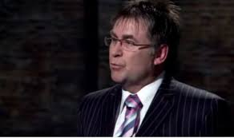
Entrepreneurs
Natalie Ellis
James Nash

Slide 14
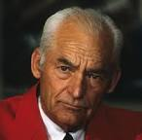

Entrepreneurs
Sam Walton
Chika Russell

Slide 15


Entrepreneurs
Rachel Lowe
Will Shu

Slide 16
Entrepreneurial Workshop
.
Part 2

Slide 17
UWTSD Entrepreneurial Grant
.
What is it about?
The University has launched a grant to offer current students and alumni necessary support to develop their business ideas.

Slide 18
UWTSD Entrepreneurial Grant
.
Prospective applicants can access a business planning support session with an Enterprise Team member:
to explore their idea in greater depth,
to receive guidance for the next steps, as well as a business start-up course , and,
to ensure they have all the necessary knowledge and skills.

Slide 19
UWTSD Entrepreneurial Grant
.
The entrepreneurial grant is called -
The Futures Fund Entrepreneurship Start-Up Grant
The fund is meant to assist applicants that can demonstrate how financial assistance will help them on their journey to starting a small business or becoming a freelancer.

Slide 20
UWTSD Entrepreneurial Grant
.
This could be to assist with the purchase of materials, create a website or cover the costs of professional services, such as legal advice.
Each successful applicant can get a grant of up to £500!

Slide 21
UWTSD Entrepreneurial Grant
.
To apply, you can access the application form:….
@:
https://future-fund.uk/future-funds/entrepreneurial-grant-application-form

Slide 22
UWTSD Entrepreneurial Grant
.
For further details, preferably before applying, you can contact:
The Enterprise Team at UWTSD Birmingham, Enterprise Hub -
Mr Vasilios Tavlaridis @: V.Tavlaridis@uwtsd.ac.uk

Slide 23

Break Time.

Slide 24
Entrepreneurial Workshop
.
Part 3

Slide 25

Part 3
Birmingham City Library.

Slide 26
Birmingham City Library.
Beside ….
housing Britain's most important Shakespeare collection,

Slide 27
Birmingham City Library.
Beside being….
one of the two most important Shakespeare collections in the world.

Slide 28
Birmingham City Library.
This library….
has a dedicated business unit located at floor 3!

Slide 29
Birmingham City Library.
The library can help with…..
- advice on intellectual property (IP).

Slide 30
Birmingham City Library.
The library can help with…..
- preparing a feasible business plan.

Slide 31
Birmingham City Library.
The library has…..
- grant finder database for entrepreneurs.

Slide 32
Birmingham City Library.
In this library you can…..
- borrow various business text books.

Slide 33
Birmingham City Library.
However…..
You have to register to use the library as a member.
Membership is free!

Slide 34
Birmingham City Library.
You can register online…
@:https://birmingham.spydus.co.uk/cgi-bin/spydus.exe/MSGTRN/WPAC/JOIN
When completed (online registration), you will be issued with a SELFREG number.

Slide 35
Birmingham City Library.
You can register online…
You will have to take the issued number to any local library in Birmingham with proof of your name and current address.
Please note, you are only entitled to one Library membership.

Slide 36
Birmingham City Library.
You can…
Visit Business and Learning on Floor 3, Library of Birmingham
Contact: 0121 242 4242
Email businessandlearning@birmingham.gov.uk

Slide 37
Birmingham City Library.
You can…
Visit Business and Learning on Floor 3, or
Book 1-2-1 session for IP advice via telephone or email
You can make enquiries about receiving help with business plan as well.

Slide 38
Entrepreneurial Workshop
.
Part 4

Slide 39
Part 4
Entrepreneur
vs
Intrapreneur.

Slide 40
Entrepreneur vs Intrapreneur.
Perhaps you do not see yourself as entrepreneur, you can be…
An intrapreneur!

Slide 41
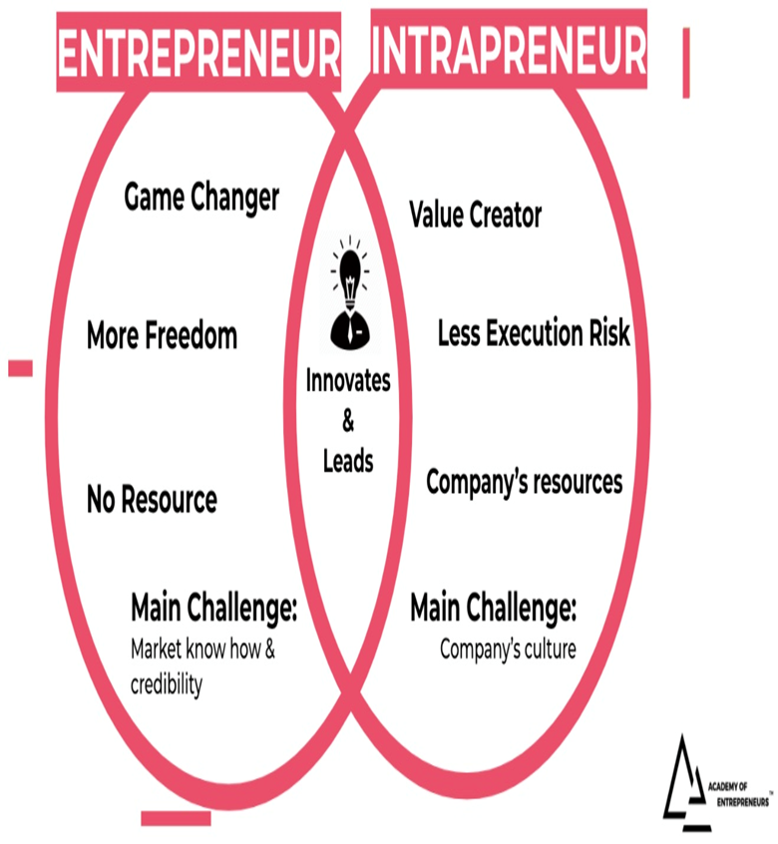
Entrepreneur vs Intrapreneur.
You are not far off an entrepreneur,

Slide 42
Entrepreneur vs Intrapreneur.
The term ‘intrapreneur’ is generally used to describe ‘an individual charged with pushing through innovations within a larger organisation that they do not own’ (Burns, 2020).
They work in an entrepreneurial way and adopt an entrepreneurial mindset – they could be called a ‘salaried entrepreneur’.

Slide 43
Entrepreneur vs Intrapreneur.
They have the skills to negotiate the politics/resolve conflicts of the organisation in order to turn the dream into reality.
The larger the organisation the harder it would appear to be ‘intrapreneurial’ (Ross, 1987).
They possess the same behaviour traits as entrepreneurs.
They are highly persuasive (Pinchot, 1985)

Slide 44
Entrepreneurial Workshop
.
Part 5

Slide 45
Part 5
Importance of Teamworking.

Slide 46
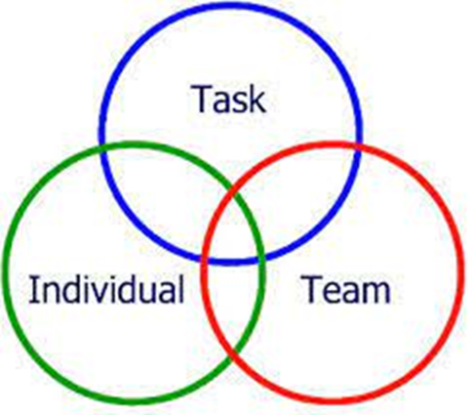
Importance of Teamwork
Teamwork is important to leverage on team member strengths in completing given task.

Slide 47
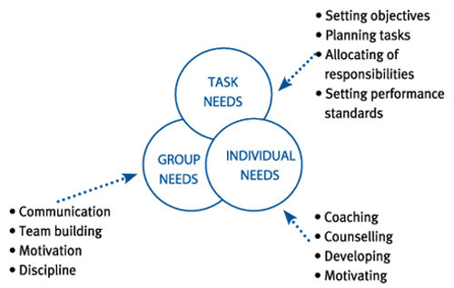
Importance of Teamwork
As an individual in teamworking it is an opportunity to develop, learn, to be motivated….
As a team, it is an opportunity to improve your communication skills, team working skills…

Slide 48
Importance of Teamwork
You need to work effectively as a team in completing task 1 & 2 in the assignment brief
That is your main objective – produce a business plan both in PPT and written business plan formats.
Refer to the assignment brief on the Moodle page for further details.

Slide 49
Class Activity 2
What will you do differently when working in group?
Guide time to complete this activity
10 minutes.

Slide 50
Class Activity 3
What have you gained during today’s workshop?
Guide time to complete this activity
15 minutes.

Slide 51
In Closing….
If you are struggling as a group in starting or working on your business plan, you have the chance to continue NOW!
Start by intentionally working together in your various groups
Should you have any question ask your lecturer!

Slide 52
References
Burns, P. (2020). Corporate entrepreneurship and innovation. 4th edition. London: RED GLOBE PRESS.
Enterprise Nation, (2022). Britain's average entrepreneur is 40 years old and most likely to be called David, available @: https://www.enterprisenation.com/learn-something/britains-average-entrepreneur-is-40-years-old-and-most-likely-to-be-called-david/ , (Accessed on 23/06/2022).
Pinchot, G. (1985). Intrapreneuring: Why You Don't Have to Leave the Corporation to Become an Entrepreneur, Harper & Row, New York.
Ross, J. (1987). Corporations and entrepreneurs: paradox and opportunity. Business Horizons., 30(4), 76–80.
UWTSD, (2022). UWTSD Entrepreneurial Grant, available @: https://www.uwtsd.ac.uk/news/press-releases/press-2022/uwtsd-entrepreneurship-start-up-grant-offers-current-students-and-alumni-chance-to-develop-business-ventures.html#:~:text=The%20Futures%20Fund%20Entrepreneurship%20Start,business%20or%20becoming%20a%20freelancer, [Accessed on 04/10/2022].

