Slide 1

Introduction to Exercise Psychology
Dr Alison Connaughton
BMSH4303
1st of October, 2026

Slide 2

Welcome!
Dr Alison Connaughton
– Module leader
A.connaughton@uwtsd.ac.uk
Moodle

Slide 3
What is Exercise Psychology?
Exercise Psychology (often linked with sport)
Related disciplines – Health / Sport

Slide 4
Exercise Psychology
Exercise psychology is primarily concerned with the application of psychology to increase exercise participation and motivational levels in the general public.
Some psychologists work in sport and exercise psychology.
Sport psychologists aim to work with, and improve the performance of, both elite athletes and amateur participants in both team and individual sports.

Slide 5
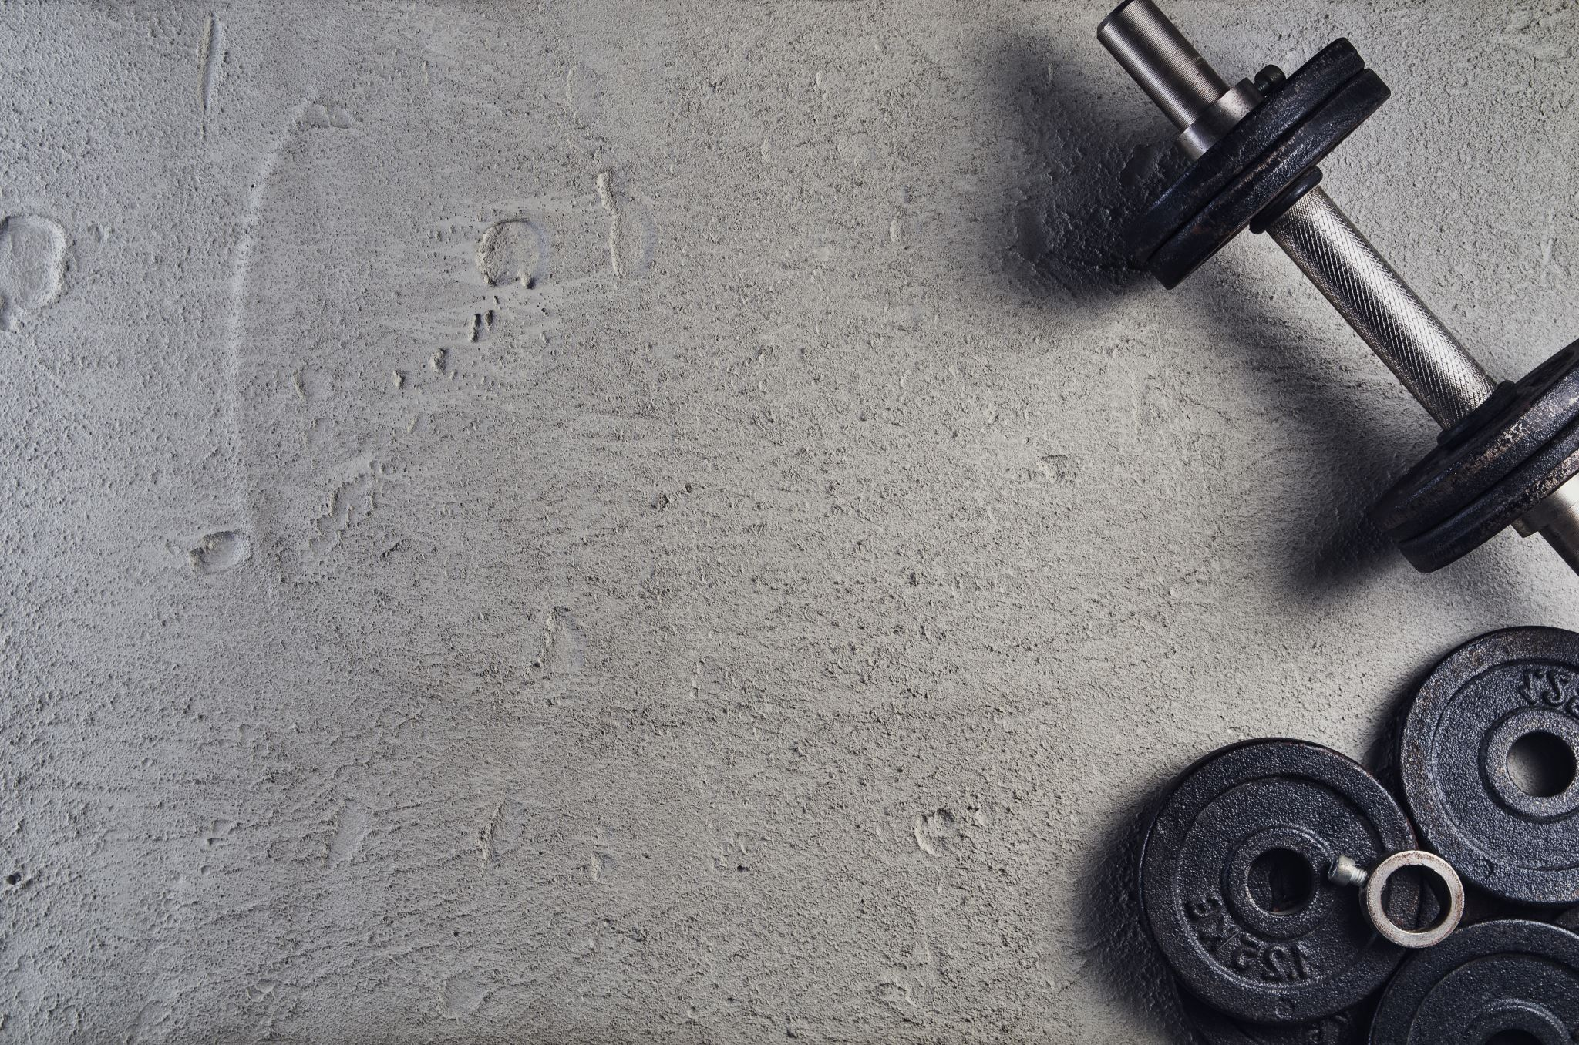
‘What is in it for me’?!
Relevance to your degree programme?
SES / NPAH / SHAPE
Relevance to your future career?
- A greater understanding of health and exercise related behaviour
Working with the general public
Working with children
Working with athletes / ex athletes
Complements other disciplines (e.g. personal training / nutrition / PE)
Relevance to YOUR life?

Slide 6
Module Assessment
1. Report (100% of the module mark – 1500 words): 11th December, 2026
Motivation
Aim: To undertake an examination of the relationship between physical activity levels and behavioural regulation to exercise for a student population.

Slide 7
assessment 1 : REPORT
COMPONENT WEIGHTING: 100% of module
WORD COUNT: 1500 WORDS
Physical activity and behavioural regulation for taking part in exercise
Aim: To examine the relationship between behavioural regulation to exercise and physical activity level for a group of students from The University of Wales, Trinity Saint David.
You will gather data as a group and then be provided with a full dataset which everyone will use for this report.
Write a report on the following topic:
Physical activity and behavioural regulation for taking part in exercise
As a group, you will be provided with a data set gathered using the Behavioural Regulation Exercise Questionnaire – 3 (Markland and Tobin, 2004) and the International Physical Activity Questionnaire (short form) for a group of students from the University of Wales, Trinity Saint David.

Slide 8
Introduction – Review of relevant literature relating to motivation and behavioural regulation of exercise (approx. 500 words).
This should include research relating to the behavioural regulation of those of differing activity levels and differences found in motives between various population groups (including students).
Method – Briefly outline the participants, procedures and design of the study (approx. 200 words).
Results – Using the data provided, present the results in an appropriate format. This should include descriptive statistics, table, figure and associated narrative (approx. 250 words).
Discussion – Discussion of your findings in relation to existing theory and previous research (approx. 550 words).
In this section you need to relate your findings to the research discussed in the introduction and either support or reject previous research findings. Briefly explain the practical implications (including the potential role for exercise psychologists) of your findings and the research literature.
The format required for the different section of the report will be discussed during lectures, with further guidance placed on Moodle.

Slide 9

Exercise Psychology
Readings:
Textbooks –
Exercise Psychology
Sport and Exercise Psychology (Exercise Psychology section)
Health psychology
Databases: Psycharticles / Sportsdiscus
Several resources will also be provided via moodle
Journals: Sport and Exercise Psychology

Slide 10
Introduction
UK: stemmed from findings from ADNFS (1992) Sports Council / HEA London
The Allied Dunbar National Fitness Survey (ADNFS) was conducted in a representative sample of English adults aged 16 to 96 years, between February and November 1990. A total of 4,316 participants (76% response rate) were interviewed about a range of socio-demographic characteristics and lifestyle factors, such as diet, physical activity (type, frequency and duration), smoking, alcohol, sleep, stress and social support.
A subsample of 2,767 participants also took part in a physical appraisal which included objective assessment of body dimension, composition, flexibility, and cardio-respiratory and muscular fitness.
ADNFS was commissioned by the Health Education Authority and The Sports Council, with funding from the Department of Health
More recent survey… July, 2020.
National Survey for Wales summary – 2022/23 (12th September, 2023)
https://www.gov.wales/adult-lifestyle-national-survey-wales-april-2022-march-2023

Slide 11
What did they do?
A subsample of 2,767 participants also took part in a physical appraisal which included objective assessment of body dimension, composition, flexibility, and cardio-respiratory and muscular fitness.
ADNFS was commissioned by the Health Education Authority and The Sports Council, with funding from the Department of Health
More recent survey… July, 2020.
National Survey for Wales summary – 2022/23 (12th September, 2023)
https://www.gov.wales/adult-lifestyle-national-survey-wales-april-2022-march-2023

Slide 12
Tracking the nations health…

Slide 13
National Survey for Wales summary – 2019/20 (29th July, 2020)
2015 results:
58% of adults were classified as overweight or obese, including 22% obese.
36% of children were reported as undertaking physical activity for at least an hour on every day of the previous week.
Up from 35% in 2015
2019-2020 results:
53% (=18/19) of adults (aged 16+) reported doing at least 150 minutes of moderate PA in blocks of at least 10 minutes.
33% (=16-20) reported doing less than 30 minutes of moderate PA in the last week.
61% (59% - 18/19) of adults were classified as overweight or obese, including 25% (23% - 18/19) obese.
Men more likely to be overweight or obese
Sedentary population, CHD, diabetes, obesity

Slide 14
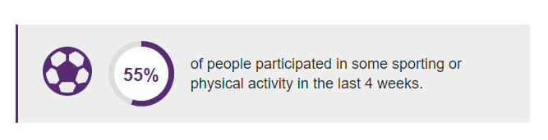
National Survey for Wales early data: April to June 2021
The first results from the 2021-22 National Survey cover the period from April to June 2021 and involved over 3,000 people – published 14th October, 2021
Sport and physical activity
The pandemic has had a marked effect on sport and physical activity results when compared with previous years.
However, the results for two activities that were not restricted were comparable with previous years: walking over two miles (49%) and jogging or running (14%) were still common activities.
People were also asked whether there were any sports or activities they would like to do, or to do more of.
33% say they want to do more sport or physical activity in general.
In particular, 22% want to do more fitness activities (such as fitness classes, running/jogging, cycling or swimming) and 12% want to do more sports or games (such as football, rugby, table tennis or golf).
5% would like to do more outdoor pursuits like rambling, kayaking or sailing.

Slide 15
Adult lifestyle
(National Survey for Wales)
April 2022-March 2023
Results should not be compared with years prior to 2020-21 (when telephone interviews replaced face-to-face interviews).
Main points
13% of adults reported that they currently smoked
17% of adults reported that they drank more than the weekly guidelines (that is, average weekly alcohol consumption above 14 units)
29% of adults reported that they ate at least 5 portions of fruit or vegetables the previous day
55% of adults reported that they had been active for at least 150 minutes in the previous week
37% of adults reported a healthy weight
92% of adults reported following 2 or more of the 5 healthy behaviours.
Adults in the most deprived areas were less likely to report healthy lifestyle behaviours than those in the least deprived areas, this was the case for all behaviours except drinking above guidelines.
There was no significant change in most lifestyle behaviours between 2021-22 and 2022-23, however there was an increase in use of e-cigarettes.

Slide 16
Most recent survey….

Slide 17
National Survey for Wales April 24 – March 25
94% of people reported 2 or more healthy behaviours, a similar level to 2022-23.
Welsh Government public health policy focuses on five healthy behaviours:
not smoking
not drinking above guidelines
being a healthy weight
eating 5 portions of fruit or vegetables
being active
34% of people reported 4 or 5 of these healthy behaviours, a similar figure to 2022-23.
10% of people said they were smokers, compared with 13% in 2022-23. This continues a gradual downward trend over recent years.
17% of people said they did not drink alcohol, while 15% drank more than the guideline maximum of 14 units per week.
36% of people were a healthy weight and 62% were overweight or obese, based on self-reported weight and height.
33% of people said they ate 5 or more fruit and vegetable portions the previous day.
59% of people said they were active for at least 150 minutes the previous week, which meets weekly activity guidelines.

Slide 18
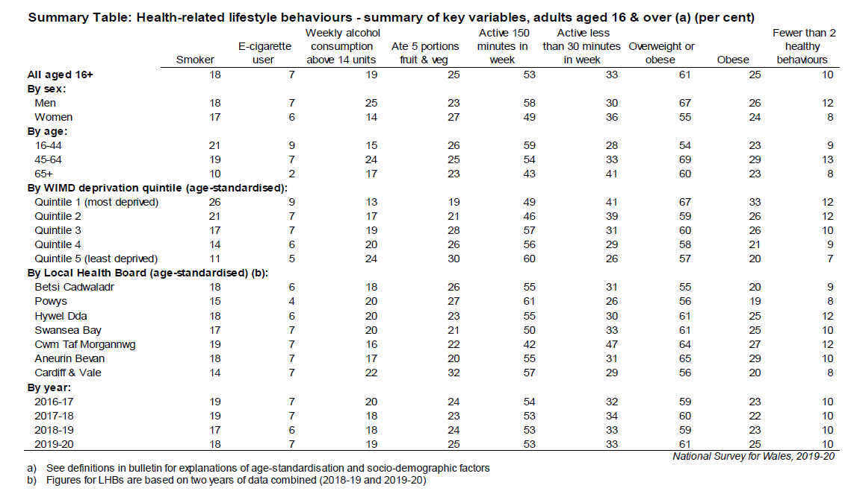
Task 1: What is going on?
NSW 19/20
Identify any differences by:
  Sex
  Age
  Areas of deprivation
  Local health board
  Over time – by year.
  Link on Moodle

Slide 19
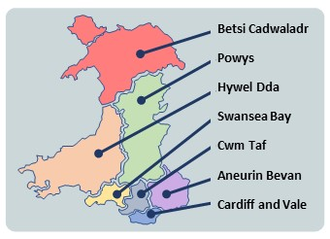
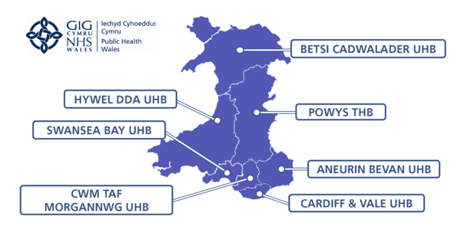

Slide 20
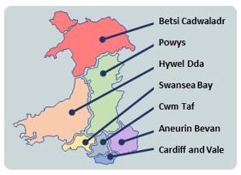
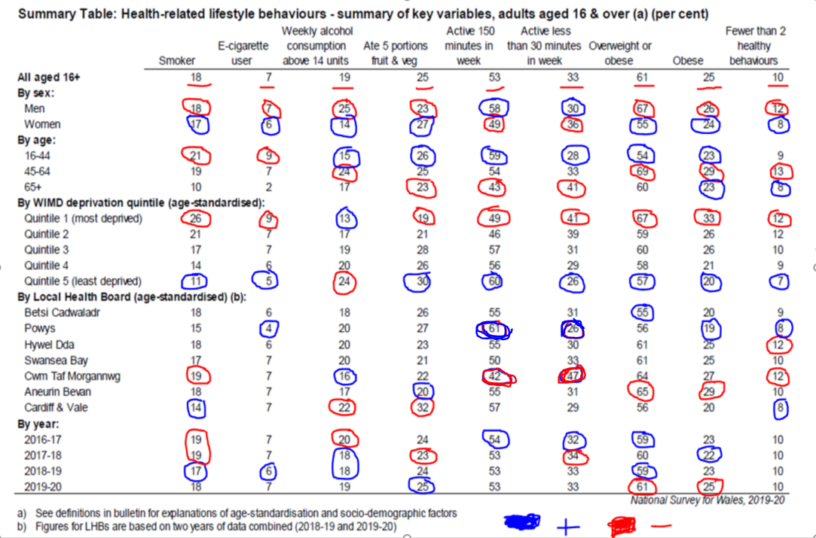
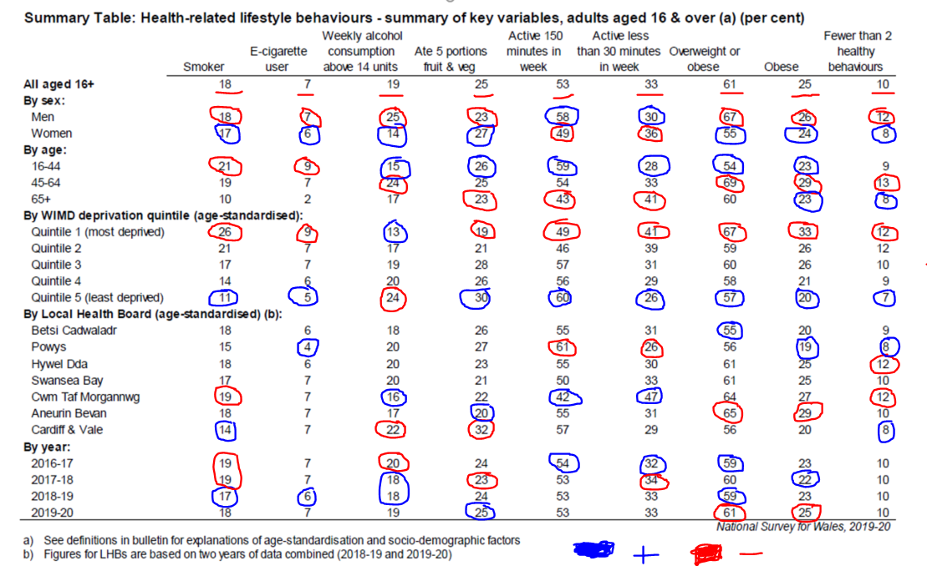
Task: What is going on?
Categories:
Smoker
E-Cigarettes
Alcohol consumption
5 portions of fruit and veg
Active 150 minutes
Active less than 150 minutes
Overweight or obese
Obese
Fewer than 2 healthy behaviours

Slide 21
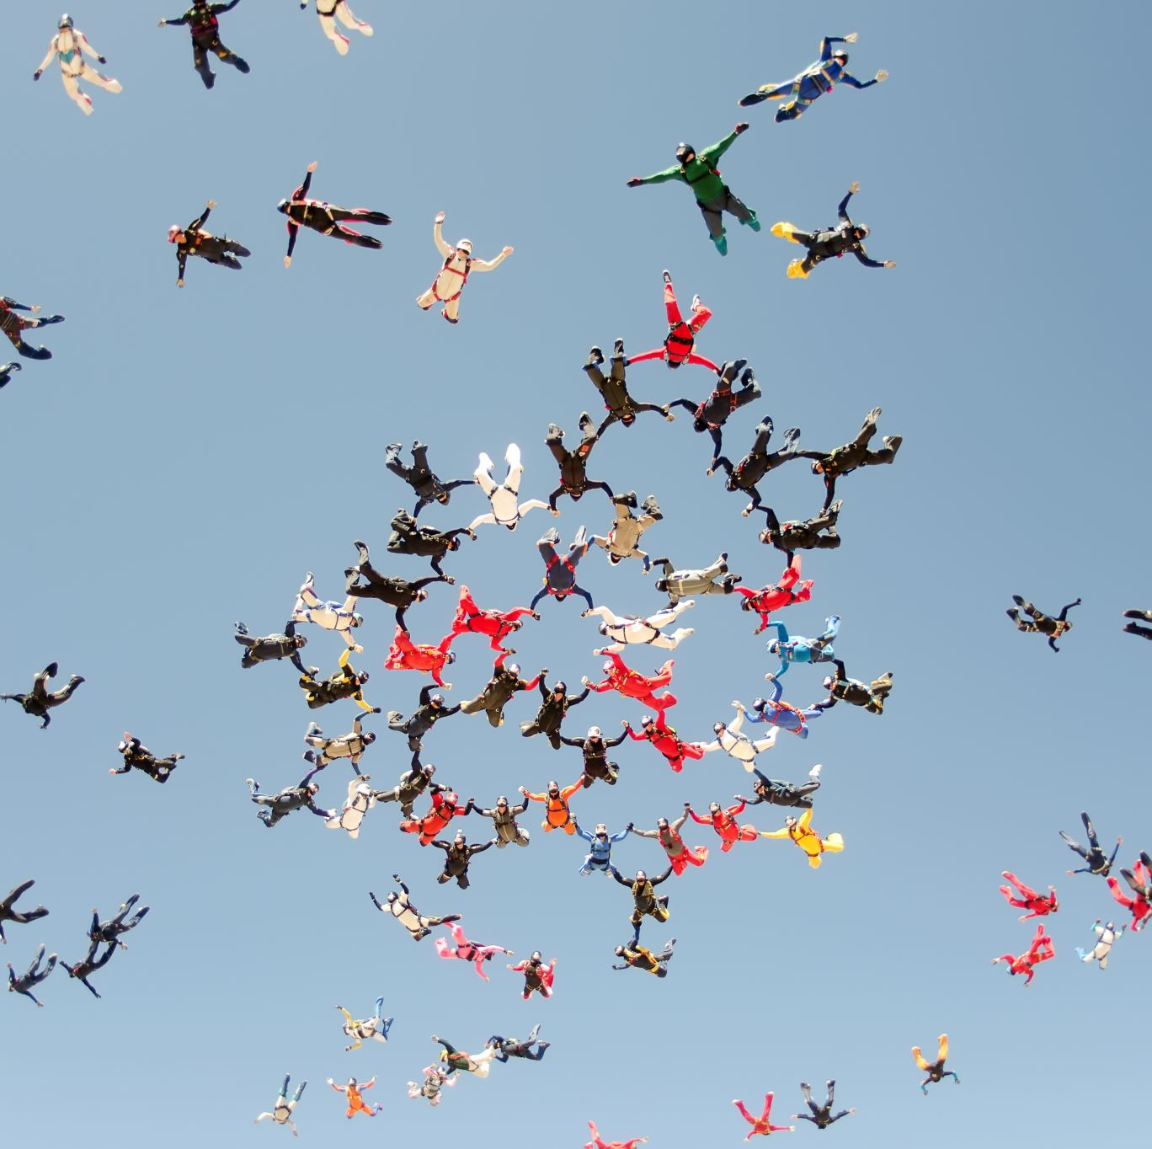
Adult lifestyles – additional variables, 2020-21 onwards
https://statswales.gov.wales/Catalogue/National-Survey-for-Wales/Population-Health/Adult-Lifestyles/adultlifestyles-additional-from-202021

Slide 22
Adult lifestyles by local authority and health board, 2020-21 onwards
https://statswales.gov.wales/Catalogue/National-Survey-for-Wales/Population-Health/Adult-Lifestyles/adultlifestyles-by-healthboard-from-202021

Slide 23
Health status, illnesses and other conditions
51% of adults reported currently being treated for an illness such as:
  20% of adults currently being treated for high blood pressure
  14% for a respiratory illness
  12% for arthritis
  13% for a mental illness
  8% for a heart condition
  7% for diabetes
  Linked conditions…

Slide 24

Why is being physically active important?
Physical benefits?
Psychological benefits? – of particular relevance in the past during Covid-19
  Stress / anxiety / depression / isolation
  http://health.gov/paguidelines/guidelines/Chapter2.aspx
  American site – Look at chapter 2.

Slide 25

Exercise adherence and determinants
What motivates individuals to make transition from sedentary to regular exercise? Largely unknown
Early research - Sallis et al. (1986). 1400 adults with battery of determinants. Comparison made.
Characteristics:
  Exercise self efficacy. Succeed at vigorous exercise programme
  Knowledge of what constitutes a healthy lifestyle
  Knowledge (importance & value)
  Perception (self control)
  Attitudes (value and importance)
  Initial condition
  These are still supported by recent research today…

Slide 26
Q. What motivates individuals to:
  Start exercising?
    Why did you start exercising?
  Adhere to exercise?
    What makes you keep going back…
  Try again after failure?

Slide 27

Task: Barriers to exercising
(Talk to those around you):
Individually, identify what (if anything) prevents you (or other people you know) from exercising on a regular basis? Include sport and physical activity…
There may be one…or many barriers that you can identify.
These may be real or perceived.
They may seem small / trivial…
If they prevent you from exercising they are important!
List these…
  Discuss this information with others on your programme.
Add the information gathered to the link below – also on the module Teams page / Moodle.
https://padlet.com/aconnaughton/task-bmsh4303-26-27-barriers-to-exercise-and-physical-activi-cx3b6vecuzot09km

Slide 28
Now look at the following populations…are there any others which may be population specific which you can add to your list!
Populations…
  Sedentary office job
  Shift workers
  Ex athlete
  Previously active – now with an injury affecting favoured activity
  Students (18+)
  Elderly
  Teenagers (13-17years)
  Those with a chronic condition (i.e. arthritis / type 2 diabetes / CHD / osteoporosis / hypertension)

Slide 29
Predicting older adults' maintenance in exercise participation – Stiggelbout et al. (2006)
Study (n = 1,725; age 50 years or older) involving 10 different types of exercise programmes, with measurements at baseline and after 6 months.
Predictors of intention to continue participating and the actual maintenance of exercise participation in the exercise programme were assessed .
Predictors of the intention to continue with the exercise programme were found for:
female sex,
younger age,
being married,
being a non-smoker,
being in paid employment,
having a positive attitude towards exercise,
having a high self-efficacy at baseline.

Slide 30
Predictors of actual maintenance of exercise participation
Short lapses,
Absence of lapses,
High intention at baseline,
High perceived quality of the programme,
Positive attitude at baseline and few risk situations at baseline.
In order to promote maintenance of exercise participation for older adults:
Effort should be taken to prevent lapses,
To help people cope with risk situations for lapses,
To improve the attitude towards exercise participation
to improve the quality of the programme.

Slide 31
Which exercise / sport / PA situations are you most confident in?
Chat with others around you!
Why are you comfortable in those situations?
Are there any situations where you are less confident?
  E.g. Dance? Swimming? Team games? Group exercise classes?
  Similarities / differences to those that you know?

Slide 32
Self efficacy – situation specific confidence
Mc Auley & Blissmer, (2000) – Highly efficacious individuals: lower perception of effort & increased positive affect.
Parental influence – Kimiecik & Horn (1998) Parental involvement / parental beliefs.
Parents play a role in shaping children’s health behaviors (Davison & Birch, 2001)
Do the parents have to be active themselves? Is there more to it than this?

Slide 33
Summary of exercise determinants
General Determinants of Exercise Adherence
  Available time
  Behavioural coping skills
  Equipment and facility accessibility
  Exercise self efficacy
  Group cohesion
  High risk of heart disease
  Intrinsic motivation
  Personal perception of good health
  Social support

Slide 34
Determinants of Exercise Non-adherence
Working in manual occupations
Being overweight or obese
Physical discomfort during exercise
Being a smoker
Social physique anxiety
What are the practical implications of working with the above for a fitness instructor / exercise class leader / personal trainer?
Interventions….Research findings…We will look at these issues!

Slide 35

Any questions?

Slide 36

Some additional readings:
1. Global trends in insufficient physical activity among adolescents – November 2019
https://www.thelancet.com/action/showPdf?pii=S2352-4642%2819%2930323-2
2. Physical Activity Has Many Health Benefits: Chapter 2
http://health.gov/paguidelines/guidelines/Chapter2.aspx
3. National Survey for Wales summary – 2019/20 (29th July, 2020)
https://gov.wales/sites/default/files/statistics-and-research/2020-07/adult-lifestyle-national-survey-wales-april-2019-march-2020-390.pdf
4. An emphasis on physical activity rather than sport
https://www.sport.wales/files/f16771b9041ecbd847704e346c9e15bc.pdf

Slide 37

Relevant reading /Resources:
Pubmed.gov - http://www.ncbi.nlm.nih.gov/pubmed
Psycharticles (e-resources) LRC
Biddle, S.J.H. (2003) Physical Activity and Psychological Well-being [ebook], London: Routledge.
Biddle, S.J.H. (2008) Psychology of Physical Activity: Determinants, Well-being and Interventions. London: Routledge.
Weinberg, R. & Gould, D. (2015) Foundations of Sport & Exercise Psychology, Champaign, IL: Human Kinetics.

