Slide 1

BMSW 4004
Lecturer: Hafiz Rahman
Student Name: Mariana Roman
Student ID: 2118893
Mr. Abdi Rahman
Healthcare Staff Shortage

Slide 2

Introduction
This report aims to provide elaboration of relevant points which are to be assessed in terms of the problem of staff shortage which has been provided in the form of a scenario of NHS hospitals.
Notes:
Introduction
This report aims to provide elaboration of relevant points which are to be assessed in terms of the problem of staff shortage which has been provided in the form of a scenario of NHS hospitals. These points include explaining the nature and effects of staff shortage for staff, patients and healthcare organizations including NHS. A PESTLE analysis and cause and effect diagram to explain the major reasons behind this major problem. Lastly important solutions have to be provided for this specific problem from which one prominent solution has to be selected in accordance with certain success indicators and its implementation has to be explained in accordance with the issue

Slide 3

Nature and Impact of Staff Shortage problem
Nature
The issue of medical staff shortage has been quite prevalent in the healthcare industry and in healthcare organizations such as NHS especially in recent years
Notes:
Nature and Impact of Staff Shortage problem
Nature
The issue of medical staff shortage has been quite prevalent in the healthcare industry and in healthcare organizations such as NHS especially in recent years. The issue itself has caused the complete deterioration of proper healthcare provision and has transformed patient centered care into a difficult task for the healthcare industry (Shamsi and Peyravi, 2020). This issue added along with the aging population and newly discovered diseases and viruses will cause great problems for largescale healthcare organizations such as NHS as low staffing in vital healthcare positions will result in the decreased health and safety of patients. The situation is severe to the extent that many important healthcare positions remain empty for almost 7 to 8 months which creates several issues especially in the busy seasons of the year. The patient load being experienced by organizations such as NHS demands a balanced supply of healthcare staff including nurses, physicians and allied health professional. However, in reality NHS and similar healthcare organizations are unable to comply with this demand in the current scenario which can cause severe impacts for the healthcare industry and patients.

Slide 4

Nature and Impact of Staff Shortage problem
Impacts
Increase in Medication Errors
Increase in Overall Cost of Providing Healthcare
Decreased quality of care and Patient Safety
Constant Need of Training Staff
Notes:
Impacts
Increase in Medication Errors
Due to staff shortage the available medical staff will have to deal with a large number of patients and will have to face working more hours than their regular shifts, this can cause increased fatigue and stress. In such a situation it not uncommon for nurses to make errors and mistakes in terms of medication (Kuitunen et al., 2021). These can include providing the medicine of one patient to another, getting confused as to when more than one doses of medicine were to be administered to a patient, miscalculations regarding medicine administration and wrong insulation rate as well. These can bring about harmful results for patient’s health and may even lead to their death.
Increase in Overall Cost of Providing Healthcare
If healthcare organizations such as NHS have too many medical positions which aren’t filled then they might be forced to increase expenses related to the healthcare provision services. This is mainly due to that fact that the overall operational costs of clinical functions will also increase for NHS. Patients will have to bear increased expenses while the healthcare organizations will also face problems in submitting payroll on and office bills on time.
Decreased quality of care and Patient Safety
It is obvious that shortage of medical staff will result in dire consequences for the patients as a smaller number of available healthcare providers will mean numerous patient’s being tended to by limited medical personnel. This limitation can cause time delays in providing on time care to patients and can result in the overall decrease of the medical staff’s control over the care and safety of patients. This can come as a great blow to healthcare organizations such as NHS as patients will lose trust in them due to the decrease in overall quality of their healthcare provision.
Constant Need of Training Staff
Low number of available staff will mean that the healthcare organizations such as NHS will have to constantly train their available and new staff so that they’ll be able to handle the increased number of patients and relative responsibilities. As the experienced staff leave the new staff will have to be trained in order to provide the same level of healthcare. This will cost both an increased amount of time and money to be spent by NHS on staff training.

Slide 5
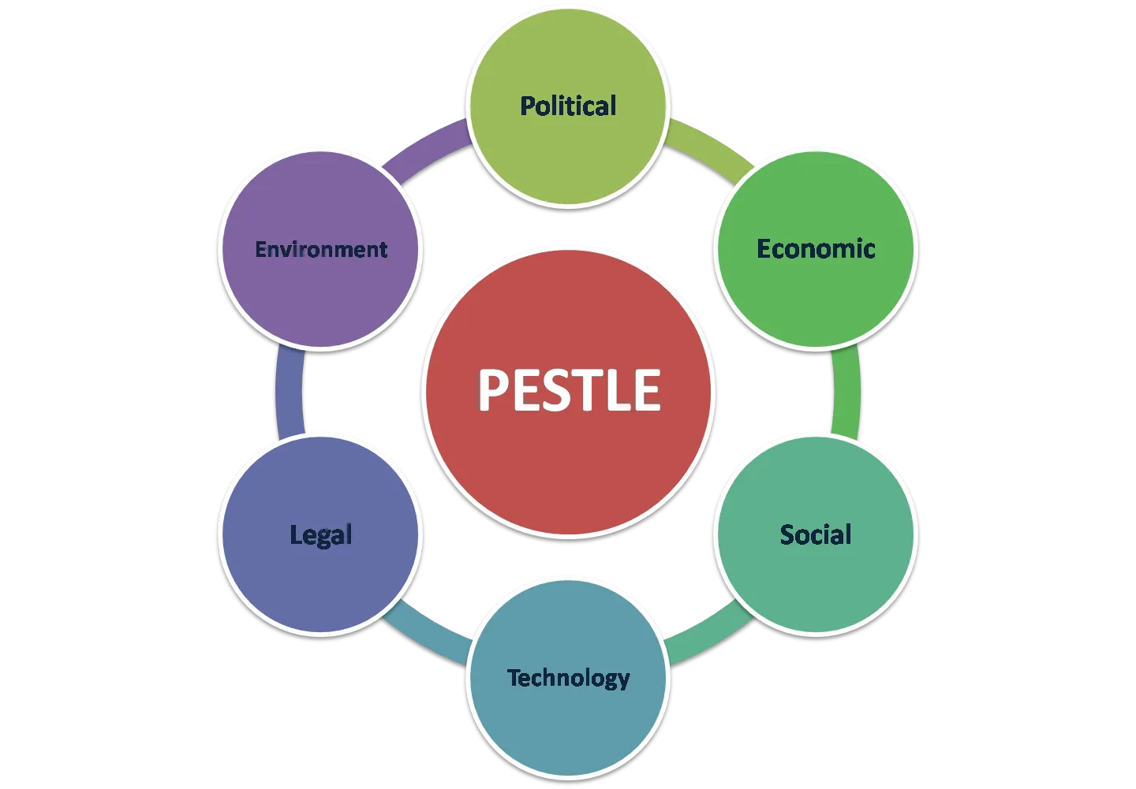
PESTLE Analysis
Political Factors
Economic Factors
Social Factors
Technological Factors
Legal Factors
Environmental Factors
Notes:
PESTLE Analysis
Political
Healthcare staff these days have to face a work environment which is heavily influenced and involved by internal politics. This kind of overtly political behavior within the workplace results in the annoyance of healthcare staff in their day to day work (Clarke, 2019). These political quagmires also lead to a decrease in productivity of healthcare staff such as nurses and thus staff becomes less motivated towards their work and profession. External politics also has an impact on the staff as political decisions and policies are given without the insight of relevant medical staff which makes those policies and decisions insufficient and ineffective within the work place thus making the work of medical staff even more difficult. Due to the level of dissatisfaction caused by these political issues the staff is forced to resign.
Economic
The healthcare organisations such as NHS have been plagued with economic issues regarding increasing interest rates and inflation which in turn results in the deterioration of their financial performance. Financial problems result in the organizations having to perform budget cuts which in turn cause a decrease in salary for available healthcare staff. This reduction of income is an issue which can’t go by so easily and so staff tend to leave these organisations so as to find better jobs with better salaries for them.
Social
The social environment of modern medical organisations is home to various issues which relate to acts such as bullying and work place harassment. Healthcare staff including nurses are faced with such issues in their daily work transgressions which end up causing serious physical and mental harm to them. These actions can also take the form of humiliation, and oppression of staff which impacts staff not just in the workplace but in their personal lives as well. This kind of bullying and harassment can come from management and even the staff as well. This kind of negative environment is detested by healthcare staff and thus they end up leaving their jobs (Taylor et al., 2022).
Technological
The addition of technology within the healthcare facilities has had a dual ended impact on the healthcare industries and their staff. These technological advancements have brought ease for some staff but the staff still face difficulty in using these new technologies and thus find themselves struggling in terms of providing modernized healthcare for their patients. Many staff jobs have also been replaced with new technologies such as AI thus they are forced to resign.
Legal
The healthcare organisations including NHS have many legal concerns which are all applicable towards the healthcare staff. The main legal concerns which staff should be wary about include intentional torts such as causing emotional distress to patients, any form of negligence towards patients and care along with assault and battery. If a member of staff is found having done any of these acts, they may be subject to criminal charges, financial penalties, jail time, revocation of nursing license, being forced to take unpaid leave, demotion and being fired (Griffith and Tengnah, 2020). These financial repercussions are often feared by medical staff and the current environment revolving these laws within healthcare organisations has become quite dangerous which is why healthcare personnel opt to leave these jobs to avoid being entangled in these legal issues.
Environmental
The work environment of the healthcare industry and organisations is home to numerous challenges along the lines of workplace hazards. Healthcare professionals, especially nurses have to face taking care of patients which have harmful and contagious diseases, flus and viruses. The germs and bacteria from these medical conditions can cause the same harmful diseases and infections for the staff. There is no way to completely avoid these kinds of diseases as there can also be moments where nurses handle patients which are yet to be diagnose with such diseases and symptoms aren’t visible, the interactions of healthcare staff with another can cause these diseases to spread on a greater scale. The safety and health of staff is thus in jeopardy and thus they tend to leave these kinds of occupations.

Slide 6
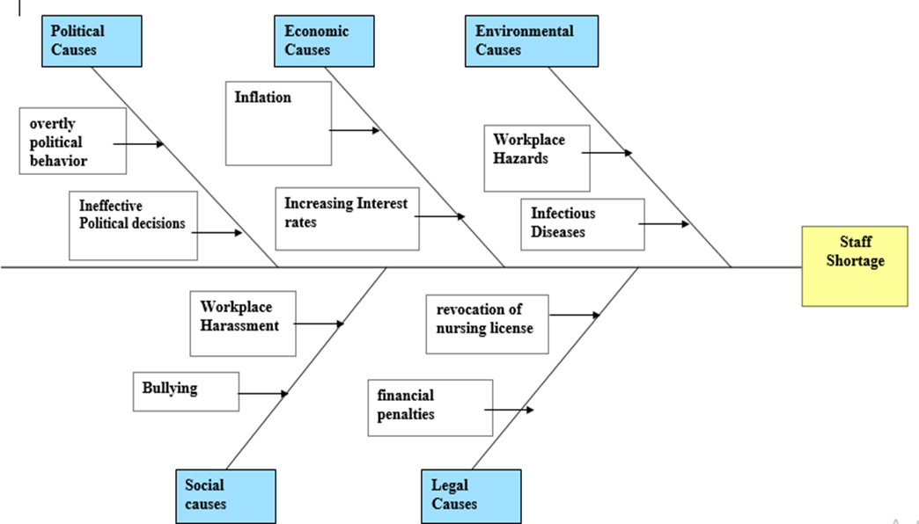
Fishbone/Cause and Effect Diagram

Slide 7

Solutions for Staff Shortage Problem
Using Technology
Empowerment of Staff
Providing Higher Wages
Notes:
Solutions for Staff Shortage Problem
Using Technology
Technological advances can be used to make the work of healthcare staff much easier and safer. Technologies such as electronic medical record and patient monitoring through A.I can make prolonged and time staking tasks feasible for healthcare professionals. The staff can also be trained in the use of these technologies so that they can make the best and most efficient use of them. These technologies will also remove the issue of the hazardous and disease-ridden environment nurses face as patients with infectious diseases will be dealt with by means of technologies which will prevent the nurses from closely interacting with them (Chau et al., 2019).
Empowerment of Staff
Healthcare organisations including NHS have to meet the specific requirement and needs of healthcare staff, this can result in the staff becoming motivated towards providing better and safe care for the patients. NHS and similar organisations should strive towards making the work environment positive so as to empower their staff in turn rejuvenating and sustaining the workforce as a whole resulting in retention of staff. The issues of staff such as work-related stress and burnout can be assessed by organisations for which they can provide solutions or can even provide special bonuses and benefits for staff which experience any form of over working.
Providing Higher Wages
A major factor in job satisfaction and retention of staff is that of the wages being provided to healthcare staff for their constant efforts in the realm of healthcare provision. Higher salaries can be effective in both retaining current staff members and even attracting new recruits for open staff positions (Flynn et al., 2018). These increased salaries can be provided by largescale organizations such as NHS to attract better and more experienced personnel which can end up making the workforce even more effective than before.

Slide 8

Selection and Implementation of Solution
The solution which can be deemed appropriate for solving this issue of NHS is to empower the staff of the healthcare organisation
Notes:
Selection and Implementation of Solution
The solution which can be deemed appropriate for solving this issue of NHS is to empower the staff of the healthcare organisation. The selection is based on the PMI success indicator in which empowering the staff provides relevant positive effects in this case scenario. The implementation can primarily include the healthcare organisations such as NHS nurturing the staff so that a sense of empowerment is created by which they can ask the staff of important decisions and innovative ideas which can bring benefit to them and their specific healthcare departments. Managers can work alongside staff to know what they are passionate about and what inspires them, this information can be integrated in their work so as to ensure they are empowered and inspired through their daily work which will result in increased satisfaction with their jobs. These kind of positive engagements and interactions will bring better insight to know what can be done for progression and professional growth of staff. A staff committee can also be created in which staff could have meetings regarding healthcare practices and issues which can help shape the work environment and workforce in accordance with the comfort and feasibility of the staff (Bogaert et al., 2018).

Slide 9
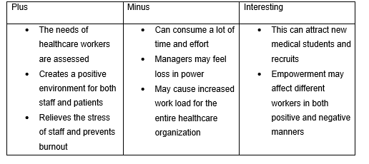
Success Indicator
PMI for Empowerment of Staff

Slide 10

Conclusion
The report was successful in providing an intricate level of understanding for the staff shortage situation. The scenario was explained along with the adverse effects of medication errors, poor quality of care and the cost of healthcare and training
Notes:
Conclusion
The report was successful in providing an intricate level of understanding for the staff shortage situation. The scenario was explained along with the adverse effects of medication errors, poor quality of care and the cost of healthcare and training. The Pestle analysis paired alongside the cause and effect diagram provided the major factors which contribute to the problem of staff shortage. In order to solve this problem three relevant solutions were provided out of which the empowerment of medical staff was selected due to the PMI success indicator. The report can be utilized by NHS and similar healthcare organizations in order to achieve better staffing and to increase the retention rate of their valued staff (Marć et al., 2019).

Slide 11

References
Bogaert, P.V., Slootmans, S., Roosen, I., Aken, P.V., Hans, G.H. and Franck, E., 2018. Staff empowerment and engagement in a magnet® recognized and joint commission international accredited academic centre in Belgium: a cross-sectional survey. BMC health services research, 18(1), pp.1-12.
Taylor, V., Scott, H. and Walter, M., 2022. Organization and Management of Health and Healthcare. In Health Studies (pp. 323-364). Palgrave Macmillan, Singapore.
Notes:
References
Bogaert, P.V., Slootmans, S., Roosen, I., Aken, P.V., Hans, G.H. and Franck, E., 2018. Staff empowerment and engagement in a magnet® recognized and joint commission international accredited academic centre in Belgium: a cross-sectional survey. BMC health services research, 18(1), pp.1-12.
Chau, K.Y., Lam, M.H.S., Cheung, M.L., Tso, E.K.H., Flint, S.W., Broom, D.R., Tse, G. and Lee, K.Y., 2019. Smart technology for healthcare: Exploring the antecedents of adoption intention of healthcare wearable technology. Health psychology research, 7(1).
Clarke, C., 2019. Strategic planning in healthcare. In Textbook of medical administration and leadership (pp. 31-46). Springer, Singapore.
Flynn, R., Newton, A.S., Rotter, T., Hartfield, D., Walton, S., Fiander, M. and Scott, S.D., 2018. The sustainability of Lean in pediatric healthcare: a realist review. Systematic reviews, 7(1), pp.1-17.
Griffith, R. and Tengnah, C., 2020. Law and professional issues in nursing. Sage.
Kuitunen, S., Niittynen, I., Airaksinen, M. and Holmström, A.R., 2021. Systemic causes of in-hospital intravenous medication errors: a systematic review. Journal of patient safety, 17(8), p.e1660.
Marć, M., Bartosiewicz, A., Burzyńska, J., Chmiel, Z. and Januszewicz, P., 2019. A nursing shortage–a prospect of global and local policies. International nursing review, 66(1), pp.9-16.
Shamsi, A. and Peyravi, H., 2020. Nursing shortage, a different challenge in Iran: A systematic review. Medical journal of the Islamic Republic of Iran, 34, p.8.
Taylor, V., Scott, H. and Walter, M., 2022. Organization and Management of Health and Healthcare. In Health Studies (pp. 323-364). Palgrave Macmillan, Singapore.

