Slide 1

Changemakers: creativity & Value
Assignment Overview

Slide 2

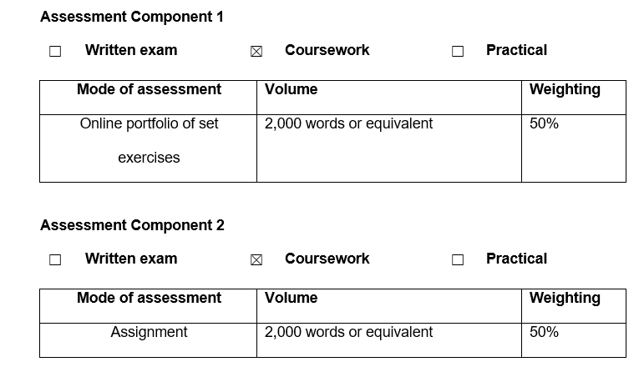
Assessment Components

Slide 3

What Are Your Research Questions?
Assignment 1

Slide 4

Assessment Component 1
E-Portfolio

Slide 5
Assessment Component 1
Task 1 – Formulate a Research Question
Task 2 – Primary & Secondary Research Techniques
Task 3 – Present Your Ideas
Task 4 – Data Analysis
E-Portfolio

Slide 6

Task 1 - Formulate a Research Question
Produce a written statement of a 1,000 words that considers the following:
  A Research Question that has been formulated as a result of identifying an issue / problem that you would like to investigate that is appropriate to your programme of study. Within your summary you should express the Value that your research could create for the field being researched.
  Your chosen Research Approach (deductive / inductive / abductive) (qualitative / quantitative / mixed methods).
  Your Data Collection Method(s) (primary / secondary methods).
  Your Sampling Method & Sample Size.
  (supported by 4 sources of literature)
The resources covered in Unit One & Unit Two of this module will help you to complete this task.

Slide 7

Task 2 – Primary and Secondary Research Techniques
In no more than 300 words, select an appropriate research technique and conduct Primary and Secondary Research based on your chosen research approach from Task 1.
(supported by 3 sources of literature)
The resources covered in Unit Two of this module will help you to complete this task.

Slide 8

Task 3 – Present Your Ideas
Produce a 3 minute video elevator pitch that presents your area of research to identified stakeholders and obtain feedback that should be reflected upon in no more than 200 words.
(supported by 1 sources of literature)
The resources covered in Unit Three of this module will help you to complete this task.

Slide 9
Task 4 – Data Analysis
In no more than 500 words create a conference poster that demonstrates the initial analysis of your findings and highlights key conclusions drawn from your research.
(supported by 2 sources of literature)
The resources covered in Unit Four of this module will help you to complete this task.

Slide 10
Submission & Contribution
Submission
Contribution
You should submit all parts of the portfolio in one document, which includes a title page and contents page along with a list of references for all elements.
If it is not possible to incorporate the work into a document then links to the materials should be inserted.
This mark will be awarded based on your tutor’s assessment of your active participation in, and contributions to, the learning activities throughout the module.
(10 Marks)

Slide 11

Assessment Component 2
Reflection on Research

Slide 12
Reflection on Research
With the use of Reflective Model (EG Gibbs, 1988), produce a 2,000 word essay that reflects on the Research Process:
  Identifying the problem
  Setting the research question
  Outlining the research approach
  Data collection
  Presenting the idea
  Analysing the data
  Formulating conclusions
  (You should aim to consult at least 20 sources to inform your essay)

Slide 13
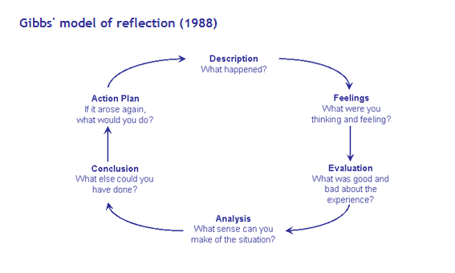

Slide 14
Reflection on Research
Your essay should demonstrate:
  your knowledge and understanding of key concepts and ideas covered during the module.
  your ability to apply module ideas to a practical situation represented by your proposed idea.
  your ability to learn from feedback gained from presenting your idea to your tutor and fellow students.
  your ability to reflect on and learn from your experience in creating a plausible solution to a problem.
  good academic practice in citing sources of information appropriately.

Slide 15
Reflection on Research
Your reflection should cover the following:
  Reflecting on the creation of your idea: this section should address issues related to your idea, including what influenced it, the way it developed over time and what you see as its strengths and weaknesses.
  Reflecting on the process of developing your idea: this section should consider issues such as the main challenges you faced over the course of your research.
  Reflecting on your individual learning: this section should focus on your own personal development, including the skills, knowledge and understanding you have gained from the experience and how you might apply this learning to your future career.

Slide 16

Submission Deadlines
Assignment 1
Assignment 2
Friday 9th December 2022
Friday 13th January 2023

Slide 17


