Slide 1
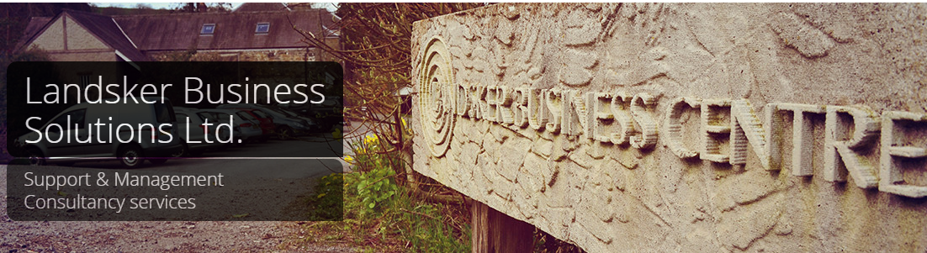
www.landsker.co.uk
01994 123 456
Ashley Calvert (Business Consultant) – Haverfordwest Castle Feasibility Study

Slide 2
Agenda
Agenda
Who are Landsker Business Solutions?
Who is Ashley Calvert? – What's his experience?
Setting the context – What is the question?
Project Objectives
Methodology & Approach
Timing plan
Cost
Any questions

Slide 3
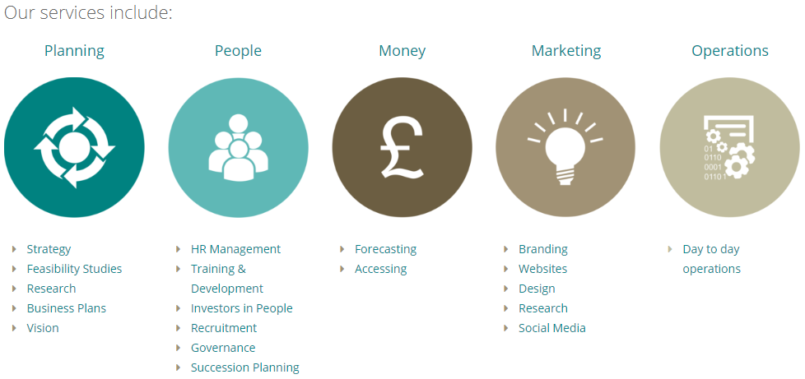
Who are Landsker Business Solutions?
Our overall aim is to help our clients make the right business decision
and find the right business solution.

Slide 4
Who is Ashley Calvert? – What's his experience?
Has been working at Landsker for 2.5 year
Has extensive
    Retail, Social enterprise, Private sector expertise.
Approved consultant on
    Farming Connect, WCO-OP – Social Business Wales,
    Arts Council of Wales Resilience programme
Works primarily for Landsker on
    Heritage projects,
    Farm diversification,
    Business and Financial plans, Feasibility studies
    Research, Community consultation & Audience development.
    Event Management

Slide 5
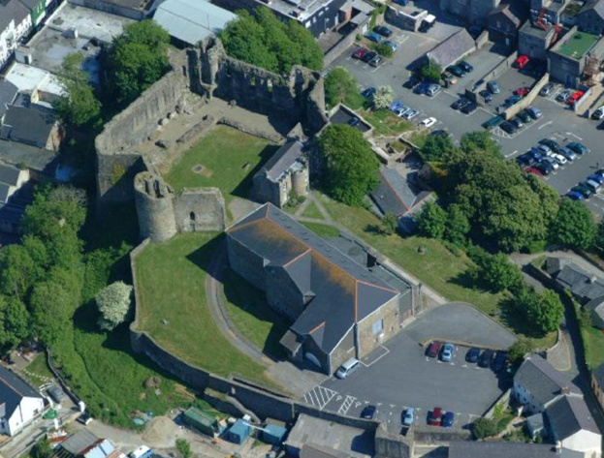
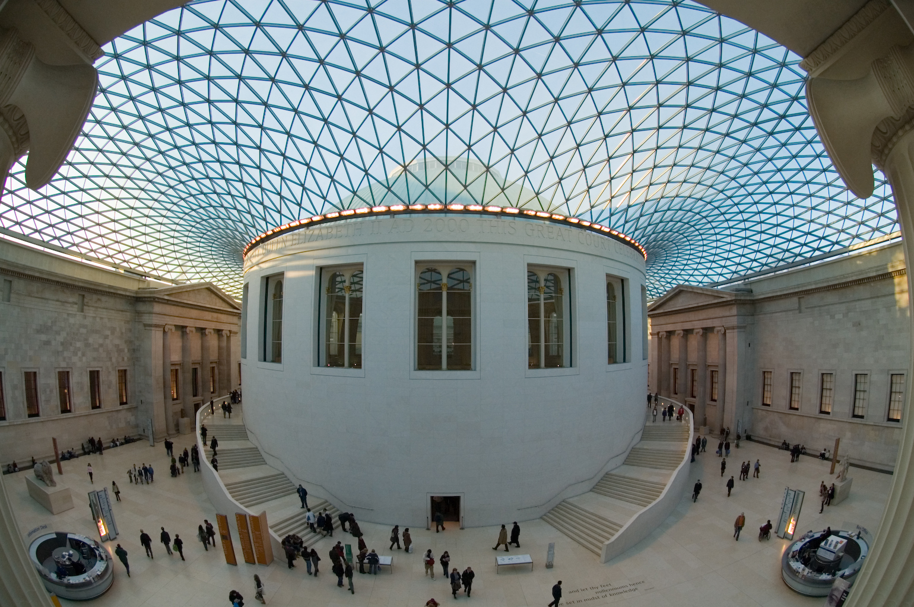
Setting the context – What is the question?
The purpose of this feasibility study is to provide interested parties with an objective, independent and analytical view of the potential to establish an all weather space in the Castle of Haverfordwest, the county town of Pembrokeshire.
http://map.coflein.gov.uk
https://place.fliggy.com

Slide 6
Project Objectives
Project Objectives:
Research of best practice elsewhere, locally, regionally into the existence and uses of similar castle structures in comparable settings.
Conduct local market analysis to determine potential uses for the covered court yard and adjacent areas and identify viable target audiences
Consult with PCC Licensing officers re likely licensed capacity and its impact on the economics of possible attractions at the Castle.
Documenting all of the above in a comprehensive but succinct report accompanied by supporting appendices and to make recommendations.

Slide 7
Methodology & Approach
Our methodology:
Inception meeting, meet the design team, confirming the project plan
Tourism and Marketing research – CADW, ONS, Stat Wales, ACW, RSA–Heritage Identity & Place
External research, best practice & benchmark analysis, event analysis
Consultation with stakeholders and the “community”
Work with appointed architects – feasible options, roof options
SWOT, STEEPLE, Event cost assumptions, Pro and Cons analysis
Construction of Feasibility study

Slide 8
Timing plan

Slide 9
Cost
Subject to the availability of client and stakeholder personnel, I estimate that the project would take between five and eight weeks to complete.
I would be prepared to undertake the work on a fixed price basis of
£4,975 (+ VAT)

Slide 10
www.landsker.co.uk
01994 123 456
Thank you for your time
Any Questions?

Slide 11
www.landsker.co.uk
01994 123 456
Slide References
Slide 5 - Coflein Mapping, (2004), Haverfordwest Castle [ONLINE]. Available at: http://map.coflein.gov.uk/index.php?action=do_images&cache_name=&numlink=94235 [Accessed 26 April 2018].
Slide 5 - Fliggy.com, (2008), British Museum [ONLINE]. Available at: https://place.fliggy.com/newguide/2016113016340604256?spm=181.7743038.21.1.642edd4aPryBd1 [Accessed 26 April 2018].

