Slide 1
Bowlby’s Attachment Theory and Early Childhood Development: Supporting Isaac’s Emotional and Social Wellbeing
Ismail Ali
STUDENT NAME:
STUDENT ID:2506872
MODULE CODE:
LCHS4009_BIRM

Slide 2
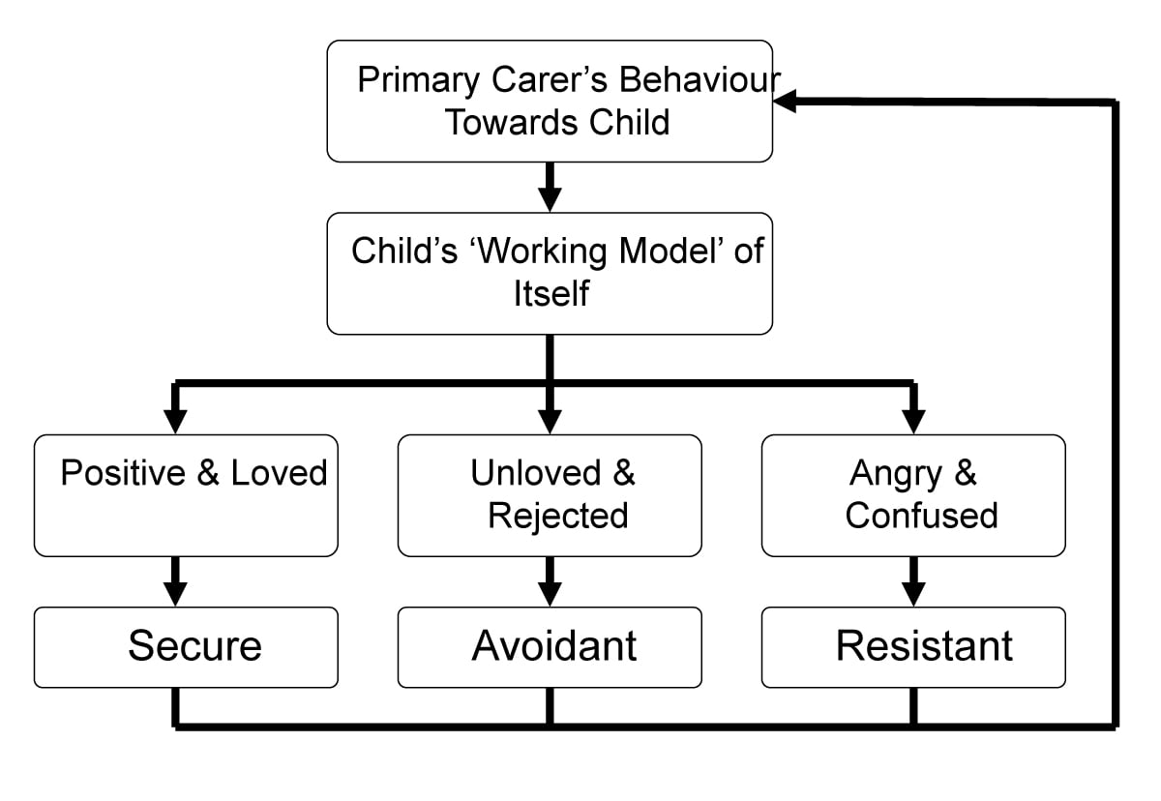
Introduction to Bowlby’s Attachment Theory
John Bowlby developed Attachment Theory, explaining how early emotional bonds between children and caregivers influence social, emotional, and cognitive development throughout life (Bowlby, 1969).
Bowlby believed that children need a secure attachment with a consistent caregiver to feel safe, confident, and emotionally supported during early childhood development.
This theory is relevant to Isaac because his disrupted childcare experiences, separation anxiety, emotional distress, and limited social interaction may indicate insecure attachment patterns affecting his wellbeing and development (Ainsworth et al., 1978).
Notes:
This presentation focuses on Bowlby’s Attachment Theory and how it can help us understand Isaac’s development. Bowlby argued that strong emotional attachments formed during early childhood are essential for healthy emotional and social development. Children who experience stable and responsive caregiving usually develop secure attachment, while inconsistent or disrupted caregiving may contribute to insecurity and emotional difficulties. Isaac’s behaviour, including clinginess, separation distress, withdrawal during play, and delayed social interaction, suggests attachment related challenges. By applying Bowlby’s theory, early years practitioners can better understand how Isaac’s experiences may influence his development and create effective support strategies to improve his emotional wellbeing and learning outcomes.

Slide 3

Key Concepts of Attachment Theory
Bowlby introduced the concept of secure attachment, where children feel safe exploring their environment because they trust their caregiver will provide comfort and support when needed (Bowlby, 1969).
Attachment theory also explains insecure attachment patterns, including anxious and avoidant attachment, which may develop when caregiving is inconsistent, emotionally unavailable, or disrupted (Ainsworth et al., 1978).
During early childhood, attachment relationships influence emotional regulation, confidence, language development, social interaction, and future relationships. Therefore, secure attachment is essential for healthy development in the early years (Howe, 2011).
Notes:
Bowlby believed that attachment relationships are biologically important because children rely on caregivers for safety, comfort, and emotional security. Secure attachment develops when caregivers consistently respond to a child’s emotional and physical needs. Children with secure attachment usually feel confident exploring their environment and interacting with others. However, inconsistent caregiving or emotional unavailability can result in insecure attachment styles. These children may become anxious, withdrawn, overly dependent, or emotionally distressed. Attachment relationships also influence language development, emotional regulation, and social confidence. In Isaac’s case, his separation anxiety and withdrawal from group activities may indicate insecure attachment patterns caused by disrupted caregiving experiences and family stress.

Slide 4
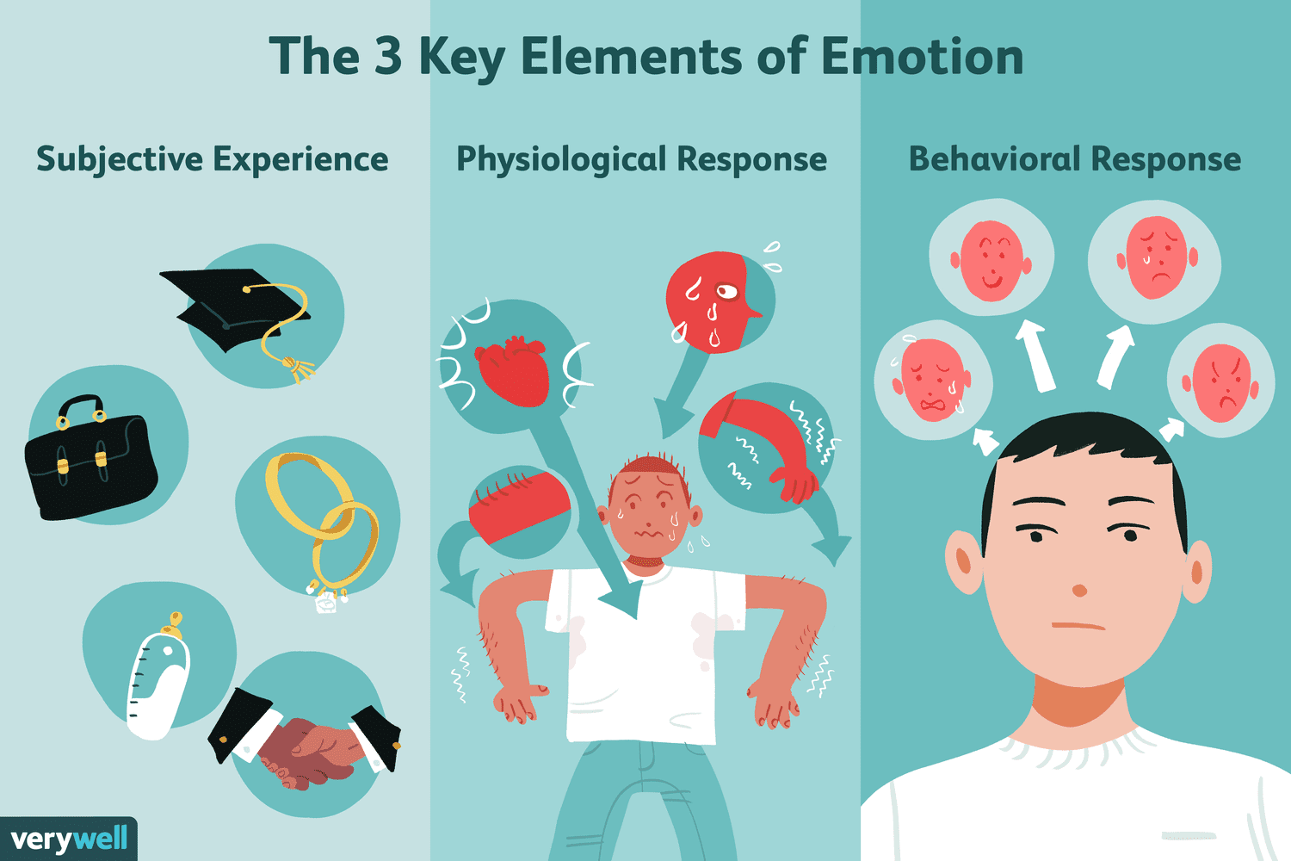
Applying the Theory to Isaac’s Situation
Isaac’s disrupted childcare arrangements and frequent transitions may have reduced his sense of stability and emotional security, contributing to anxiety and withdrawn behaviour (Bowlby, 1969).
His mother’s post natal depression and low confidence may affect emotional responsiveness and attachment quality, potentially influencing Isaac’s emotional regulation and independence (Murray & Cooper, 1997).
Isaac’s language delay, clinginess, and difficulties joining group activities may reflect limited opportunities for consistent social interaction and emotional support during important developmental stages (Howe, 2011).
Notes:
Bowlby’s theory helps explain how Isaac’s early experiences may have affected his development. Moving homes and experiencing disrupted childcare can create feelings of insecurity and instability for young children. In addition, parental mental health difficulties such as post natal depression may affect emotional communication and responsiveness between parent and child. Isaac’s clingy behaviour and distress during separation suggest he may struggle with emotional security and independence. His quiet behaviour during free play and difficulty joining groups may also reflect low confidence and anxiety in social situations. Furthermore, inconsistent social experiences may have contributed to delayed language development and reduced opportunities for communication and peer interaction.

Slide 5
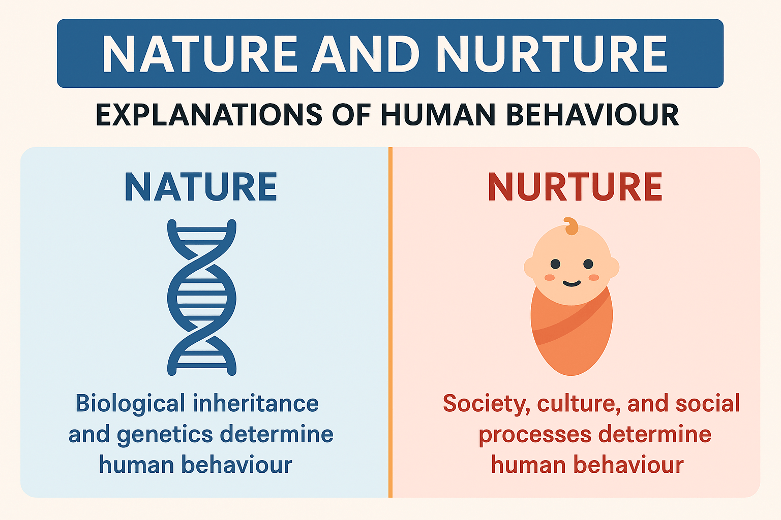
Nature and Nurture Influences
Nature influences include temperament, emotional sensitivity, and early brain development, which may affect how children respond to stress, transitions, and attachment experiences (Bee & Boyd, 2020).
Nurture influences include caregiving quality, family relationships, emotional support, and opportunities for social interaction, all of which strongly affect early childhood development (Bowlby, 1969).
Isaac’s development is influenced by both biological and environmental factors, including family stress, disrupted routines, maternal mental health, and limited social experiences within new environments (Howe, 2011).
Notes:
The nature versus nurture debate is important when understanding child development. Nature refers to biological influences such as genetics, temperament, and brain development. Some children may naturally be more emotionally sensitive or anxious than others. However, nurture refers to environmental influences including parenting, social relationships, routines, and emotional support. Bowlby believed that caregiving experiences significantly shape emotional development during childhood. In Isaac’s case, both biological and environmental factors may contribute to his difficulties. For example, he may naturally have a sensitive temperament, but environmental stressors such as disrupted childcare, limited support networks, and maternal mental health challenges are also likely affecting his emotional wellbeing and development.

Slide 6
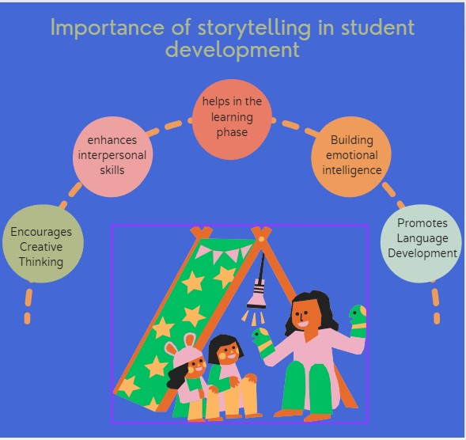
Theory Informed Support Plan
Early years staff should provide consistent routines, key worker support, and emotionally responsive interactions to help Isaac develop secure attachment relationships within the setting (Howe, 2011).
Play based learning, storytelling, and language rich activities should be used to improve communication skills, confidence, and peer interaction in a supportive environment (Vygotsky, 1978).
Multi agency collaboration involving speech therapists, mental health professionals, family support workers, and Isaac’s mother can provide holistic support for emotional wellbeing and developmental progress (Department for Education, 2021).
Notes:
A theory informed support plan should focus on helping Isaac feel emotionally secure and supported. Consistent routines and positive relationships with a trusted key worker can help reduce anxiety and increase confidence. Attachment based approaches encourage staff to respond sensitively to Isaac’s emotions and provide reassurance during separation times. Play based learning activities can also improve communication, emotional expression, and social interaction. Language rich environments involving storytelling, songs, and group activities may support his speech and communication development. Additionally, multi agency collaboration is important because Isaac and his mother may benefit from wider professional support including speech therapy, emotional wellbeing services, and parenting support programmes.

Slide 7
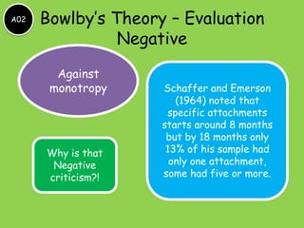
Critical Evaluation of Bowlby’s Theory
Bowlby’s theory is highly influential because it highlights the importance of early relationships and emotional security in child development and early years practice (Bowlby, 1969).
However, critics argue that the theory may place too much responsibility on mothers and does not fully consider cultural differences or wider social influences on development (Rutter, 1995).
In diverse communities such as London, practitioners must recognise that attachment relationships can develop in different family structures and cultural caregiving systems while still supporting children’s emotional needs effectively.
Notes:
Bowlby’s Attachment Theory remains one of the most important theories in child development because it emphasises the importance of emotional security and stable caregiving relationships. The theory is highly useful in early years settings because it helps practitioners understand children’s emotional behaviours and support attachment needs effectively. However, some researchers criticise Bowlby for focusing too heavily on the mother-child relationship and underestimating the role of fathers, extended family members, and cultural differences. In multicultural cities such as London, children may develop secure attachments with several caregivers across different family structures. Therefore, practitioners should apply the theory flexibly while recognising diverse parenting and caregiving practices.

Slide 8

Conclusion
Bowlby’s Attachment Theory helps explain how Isaac’s early experiences, disrupted childcare, and family stress may influence his emotional, social, and language development.
Secure and supportive relationships are essential for promoting confidence, emotional regulation, communication skills, and healthy social interaction during early childhood (Howe, 2011).
Early years practitioners can support Isaac effectively through attachment based strategies, language support, play based learning, and multi agency collaboration to improve his wellbeing and developmental outcomes.
Notes:
In conclusion, Bowlby’s Attachment Theory provides a useful framework for understanding Isaac’s emotional and developmental needs. His experiences of disrupted childcare, maternal mental health difficulties, and limited social interaction may contribute to insecure attachment behaviours such as clinginess, anxiety, and withdrawal. The theory highlights the importance of secure emotional relationships during early childhood and explains how these relationships influence emotional wellbeing, language development, and social confidence. Early years professionals can support Isaac by creating stable routines, positive relationships, and supportive learning environments. Attachment based interventions combined with multi agency support can improve his confidence, communication skills, and overall developmental progress in the early years setting.

Slide 9
Reference List
Ainsworth, M., Blehar, M., Waters, E. and Wall, S. (1978) Patterns of Attachment. Hillsdale: Erlbaum.
Bee, H. and Boyd, D. (2020) The Developing Child. 14th ed. Boston: Pearson.
Bowlby, J. (1969) Attachment and Loss: Volume 1 – Attachment. London: Penguin.
Department for Education (2021) Early Years Foundation Stage Framework. London: DfE.
Howe, D. (2011) Attachment Across the Lifecourse. London: Palgrave Macmillan.
Murray, L. and Cooper, P. (1997) Postpartum Depression and Child Development. New York: Guilford Press.
Rutter, M. (1995) Clinical Implications of Attachment Concepts. Journal of Child Psychology and Psychiatry, 36(4), pp.549–571.
Vygotsky, L. (1978) Mind in Society. Cambridge, MA: Harvard University Press.

