Slide 1
Chapter 3: Preparticipation Screening

Slide 2
Introduction
Previous preparticipation screening guidelines focused on risk classification based on the following:
  CVD risk factors
  Signs and/or symptoms of CVD, metabolic disease, and pulmonary disease
  Known CVD, metabolic disease, and pulmonary disease
Recent evidence suggests this type of screening may erroneously over-refer individuals to seek medical clearance prior to exercise.
A new paradigm has been created to encourage physical activity, while minimizing barriers, and still ensure client safety.

Slide 3
Preparticipation Health Screening
Goals for preparticipation screening
  To identify those who should receive medical clearance prior to initiating or progressing an exercise program
  To identify those with clinically significant disease
  To identify those with medical conditions who should be restricted from exercise participation
  This will be accomplished by collecting:
    Individual’s current physical activity level
    Individuals with signs and symptoms of CVD, metabolic disease, and renal disease
    Individuals with diagnosed CVD, metabolic disease, and renal disease
    Individual’s desired exercise program intensity

Slide 4
Preparticipation Health Screening: ACSM Preparticipation Screening Algorithm (Fig. 3.1)
The algorithm follows these steps to determine if an individual should seek medical clearance prior to exercise:
  1) Identify if the individual currently participates in regular exercise.
    Exercising at least 30 minutes on 3 or more days per week at a moderate intensity for at least 3 months.
  2) Identify if the individual has been diagnosed with CVD, metabolic disease, or renal disease.
  3) Identify if the individual has any signs or symptoms suggestive of the same diseases (Table 3.1).
  4) Identify the individual’s desired exercise program intensity.

Slide 5
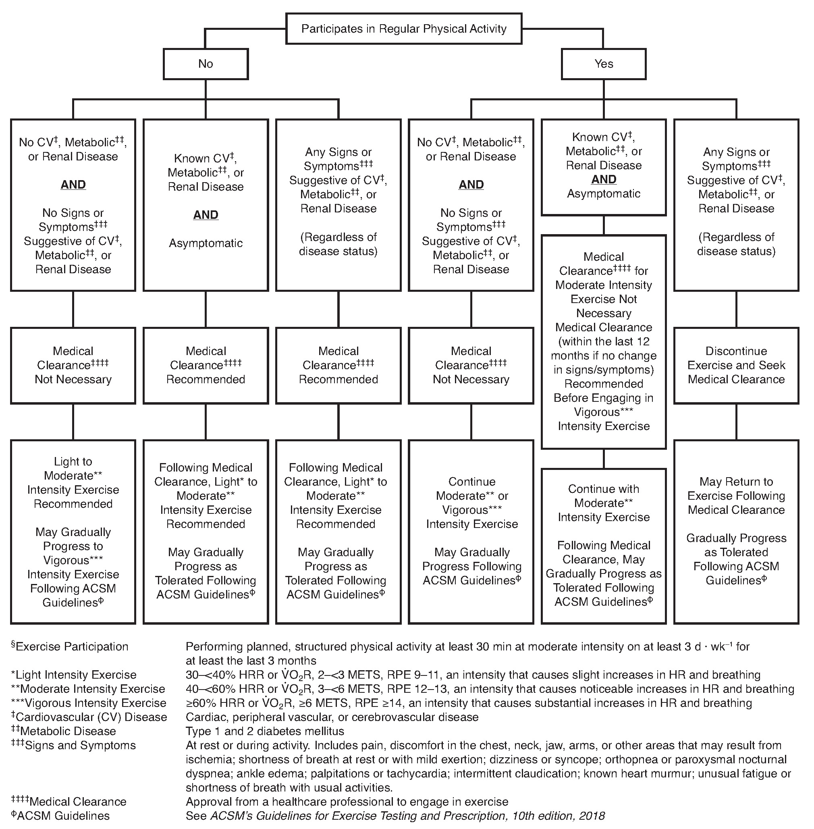
ACSM Preparticipation Screening Algorithm

Slide 6
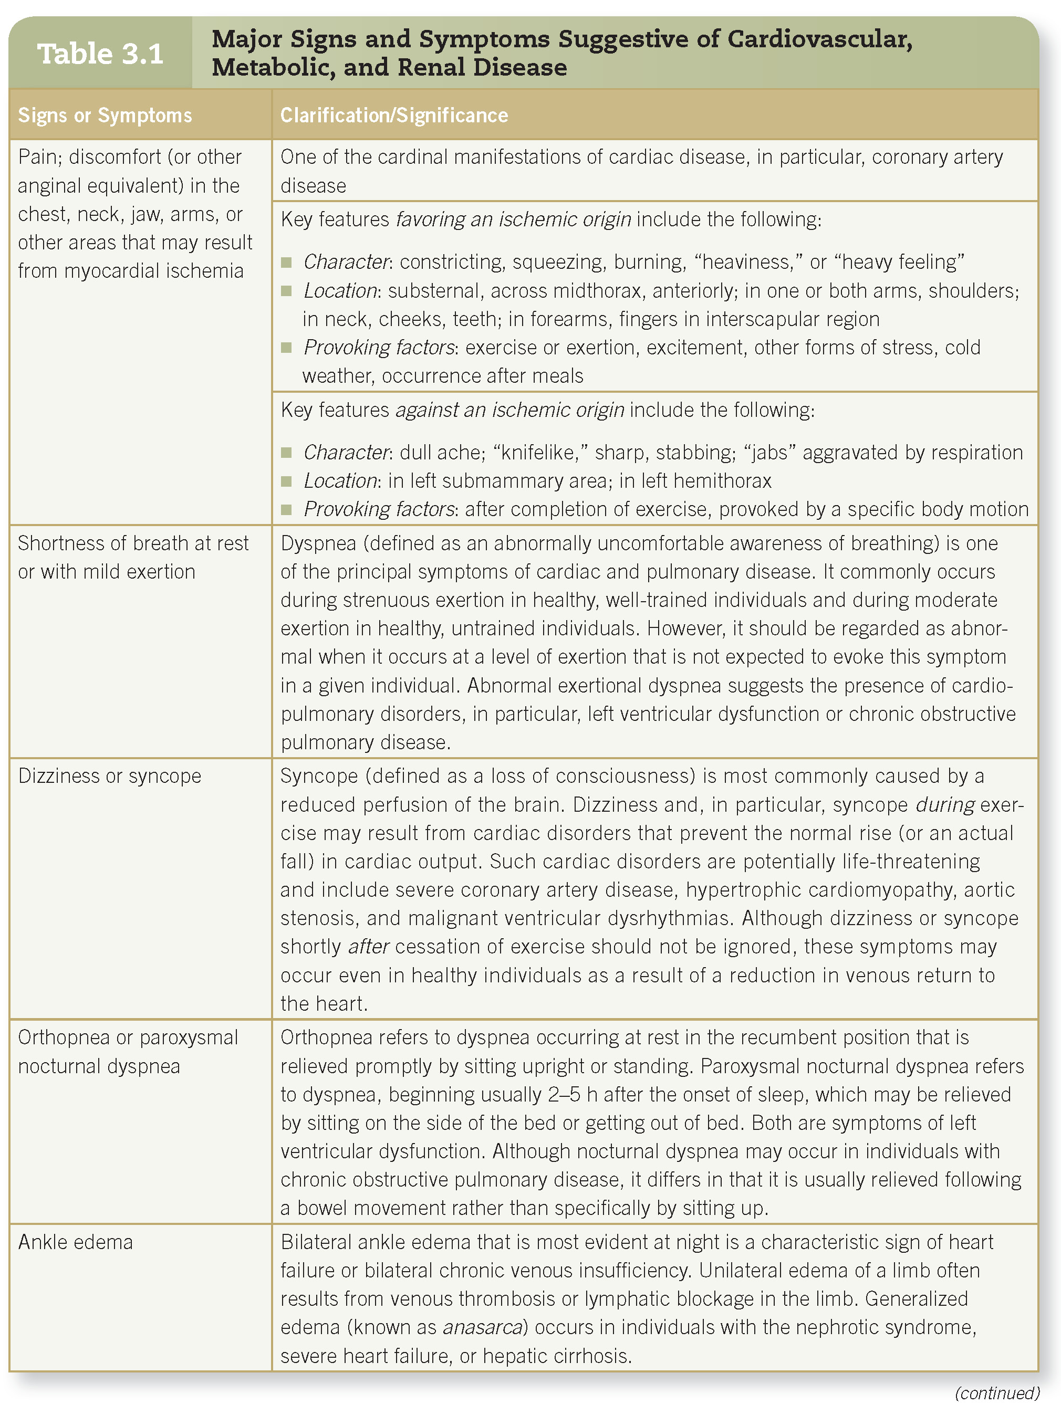
Preparticipation Health Screening—(cont.)

Slide 7
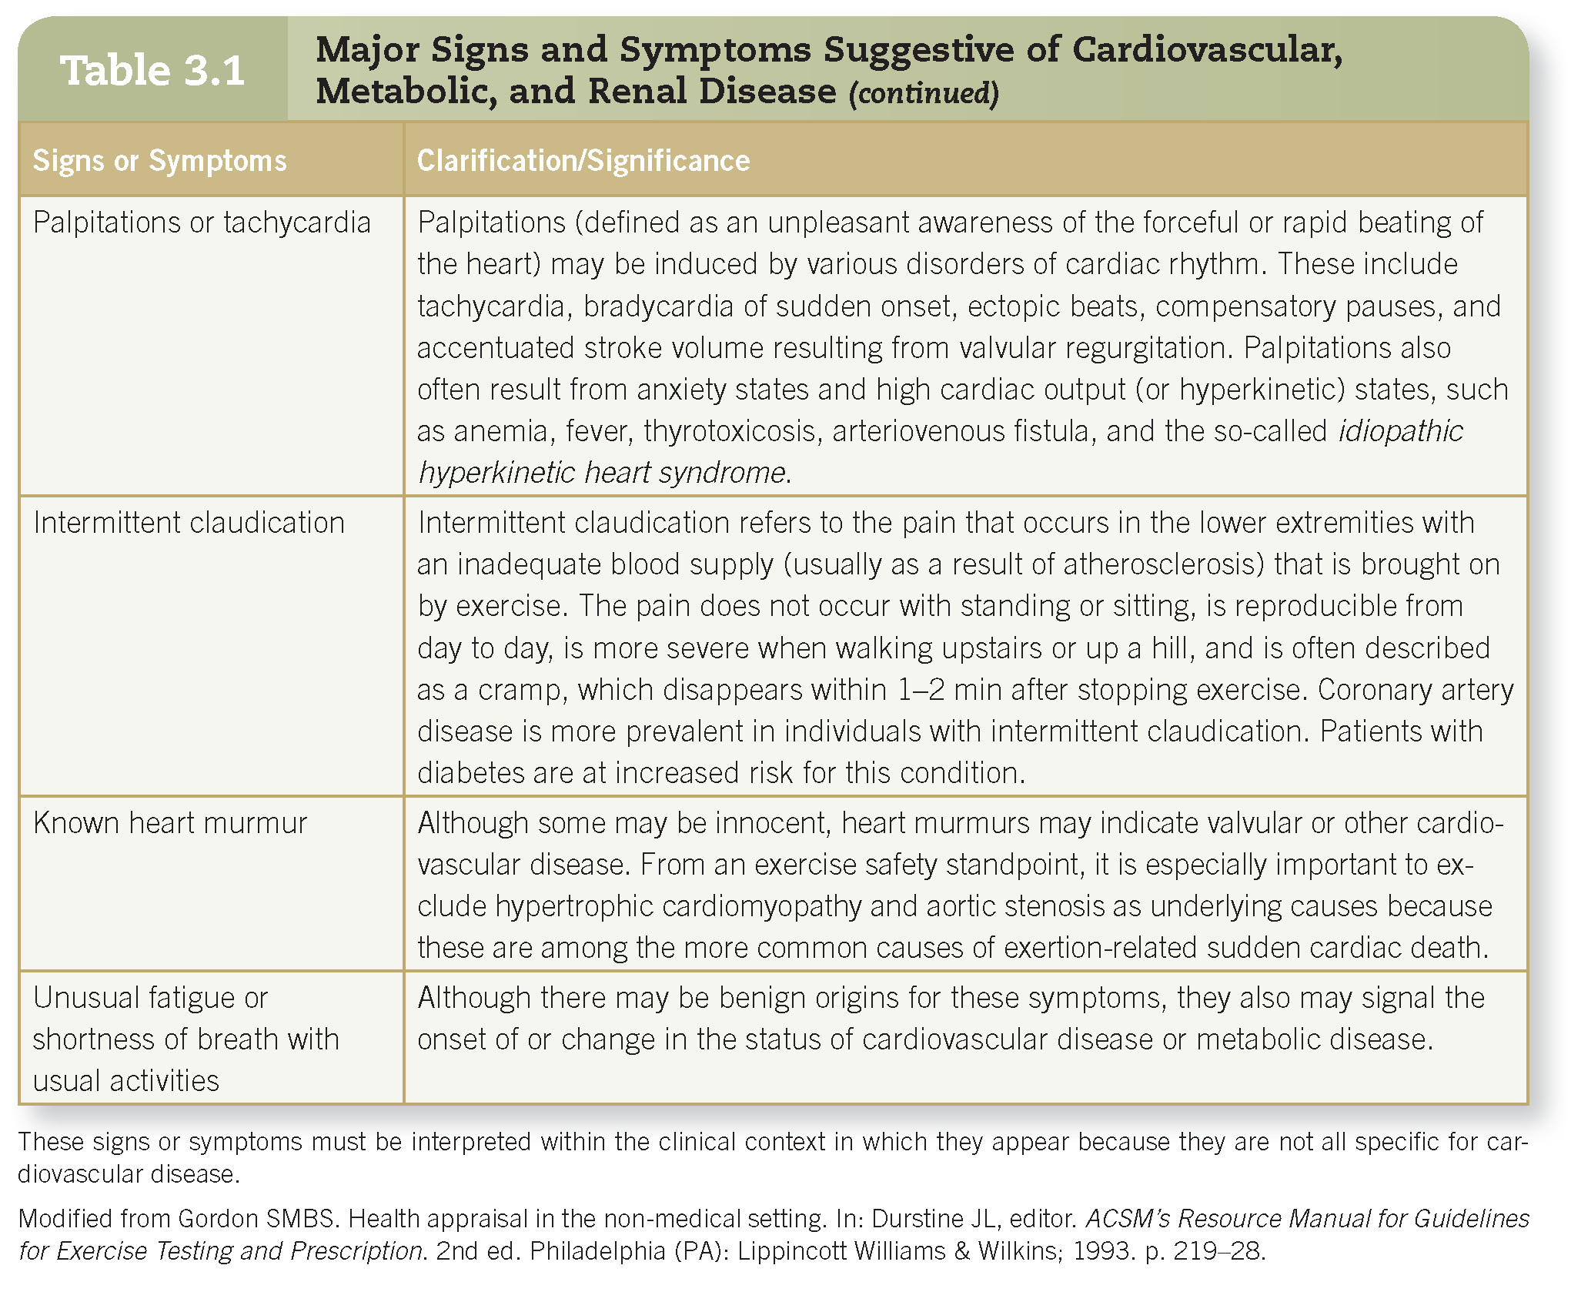
Preparticipation Health Screening—(cont.)

Slide 8
Preparticipation Health Screening: Self-Guided Methods
The most common self-guided screening form is the Physical Activity Readiness Questionnaire for Everyone (PAR-Q+).
  A recent update to the traditional PAR-Q, which now includes several follow-up questions.
  The updated form was created to reduce barriers to exercise and the number of false positive screenings.
  It will also allow the exercise professional to better tailor an exercise prescription (ExR_{x}) based on the individual’s medical history.

Slide 9
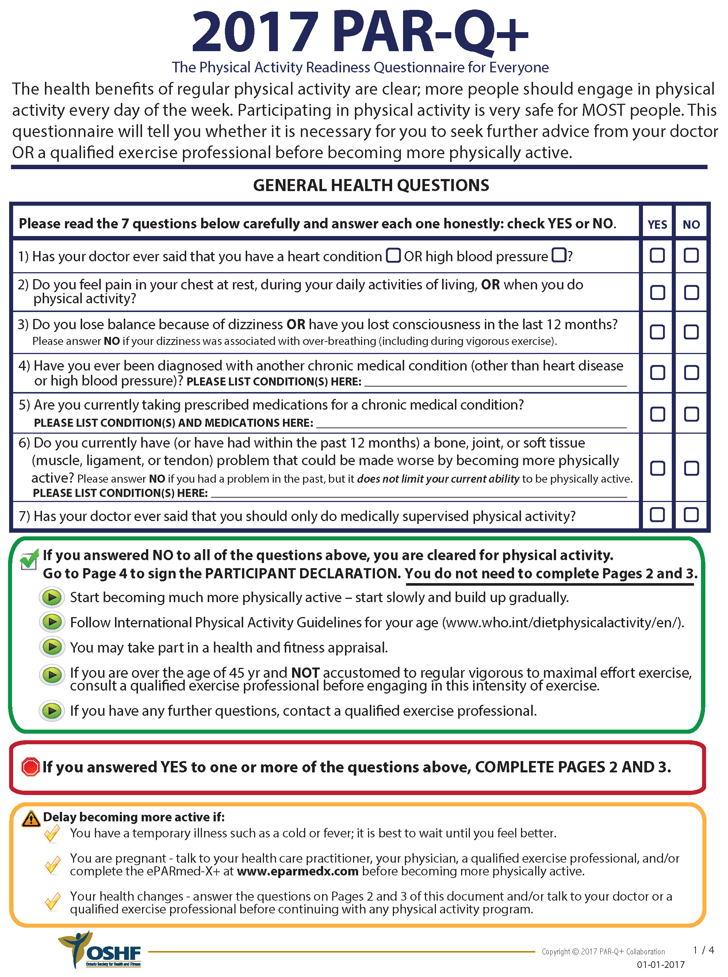
Physical Activity Readiness Questionnaire for Everyone

Slide 10
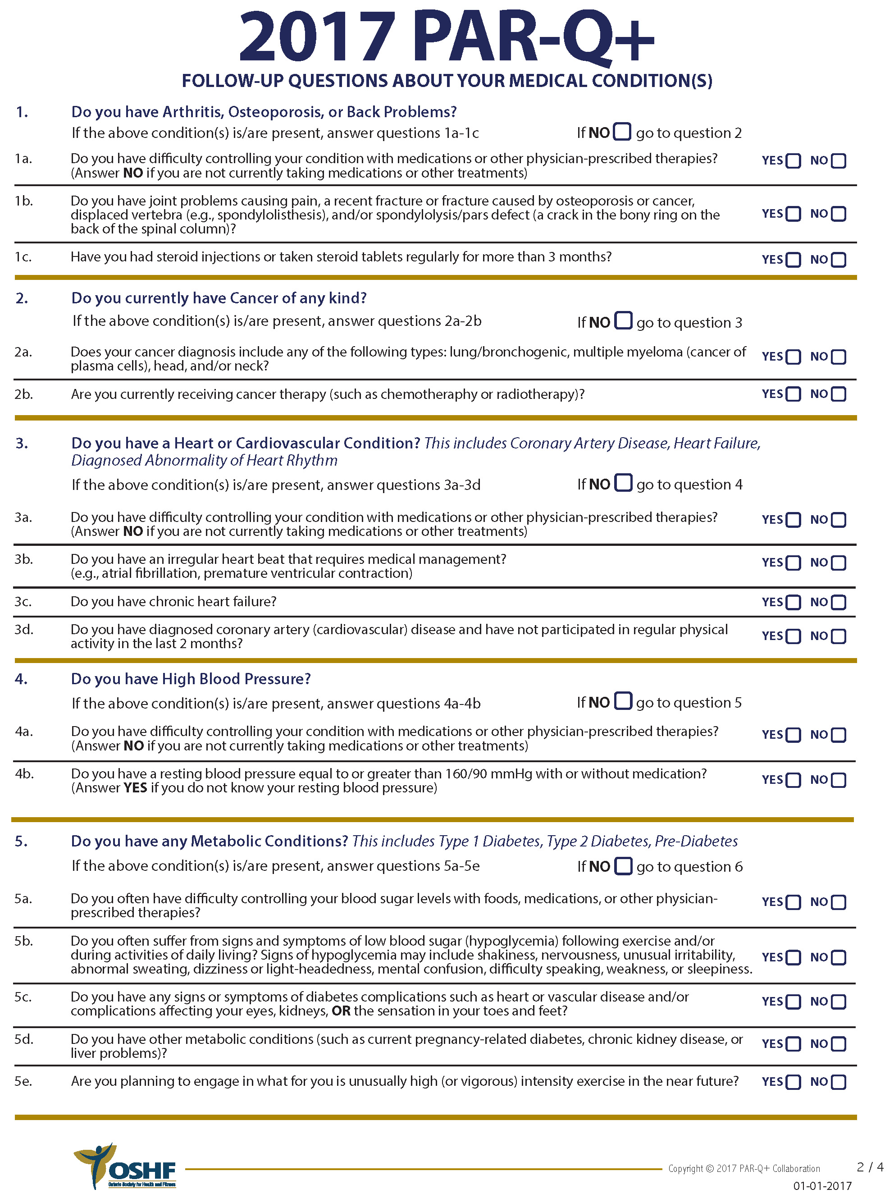
Physical Activity Readiness Questionnaire for Everyone—(cont.)

Slide 11
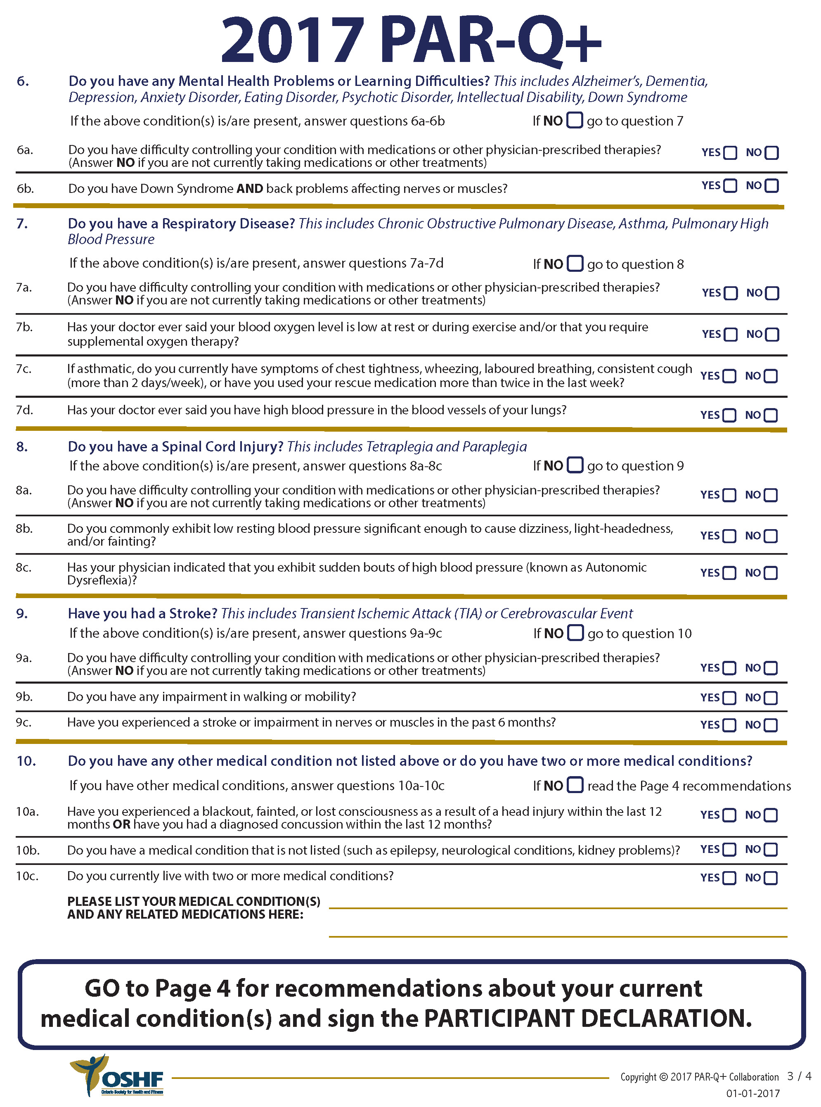
Physical Activity Readiness Questionnaire for Everyone—(cont.)

Slide 12
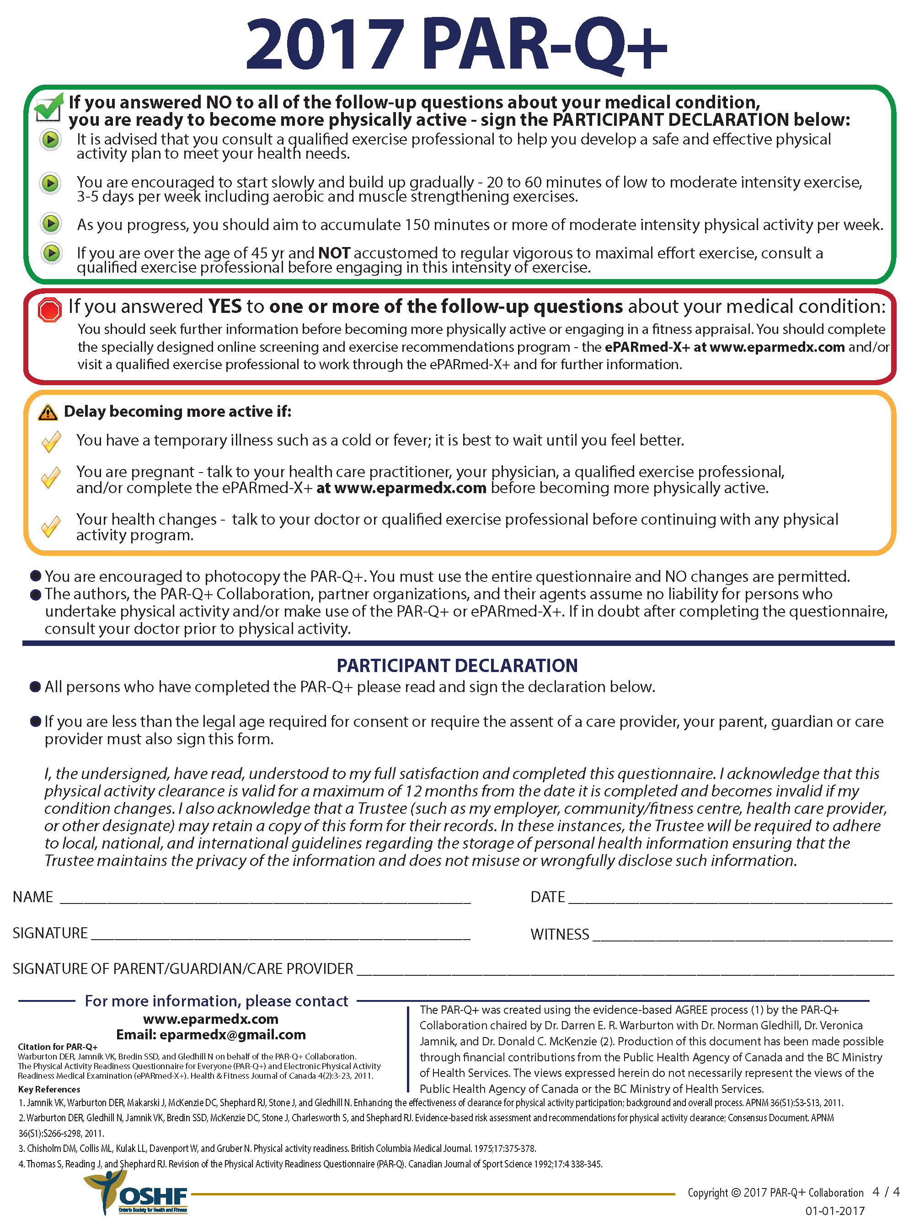
Physical Activity Readiness Questionnaire for Everyone—(cont.)

Slide 13
Risk Stratification for Those in Cardiac Rehabilitation and/or Medical Fitness Facilities
A more in-depth screening process is needed for individuals in cardiac rehabilitation or medical fitness facilities.
  Risk stratification criteria outlined in Box 3.1 from the American Association of Cardiovascular and Pulmonary Rehabilitation (AACVPR).
    Provides telemetry monitoring and exercise supervision recommendations
    Recommendations do not take into account the comorbidities.

Slide 14
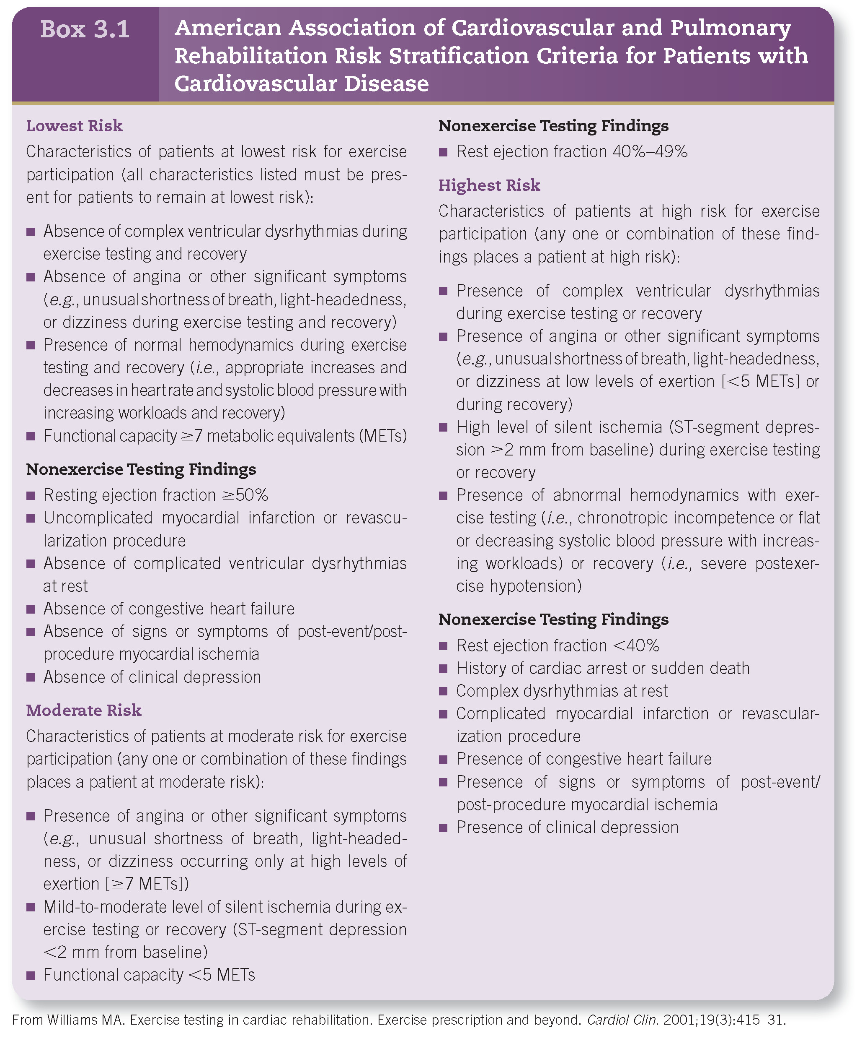
Risk Stratification for Those in Cardiac Rehabilitation and/or Medical Fitness Facilities—(cont.)

Slide 15
Pre-exercise Evaluation: Informed Consent
The informed consent should include the following:
  Comprehensive explanation of the risks and benefits associated with exercise testing
  Indication that the participant is free to withdraw without consequence
  Statement that “emergency procedures and equipment are available”
The form should be explained verbally.
The individual should be given time to ask questions.
If the participant is a minor, the parent or legal guardian provides consent, whereas the minor provides assent.

Slide 16
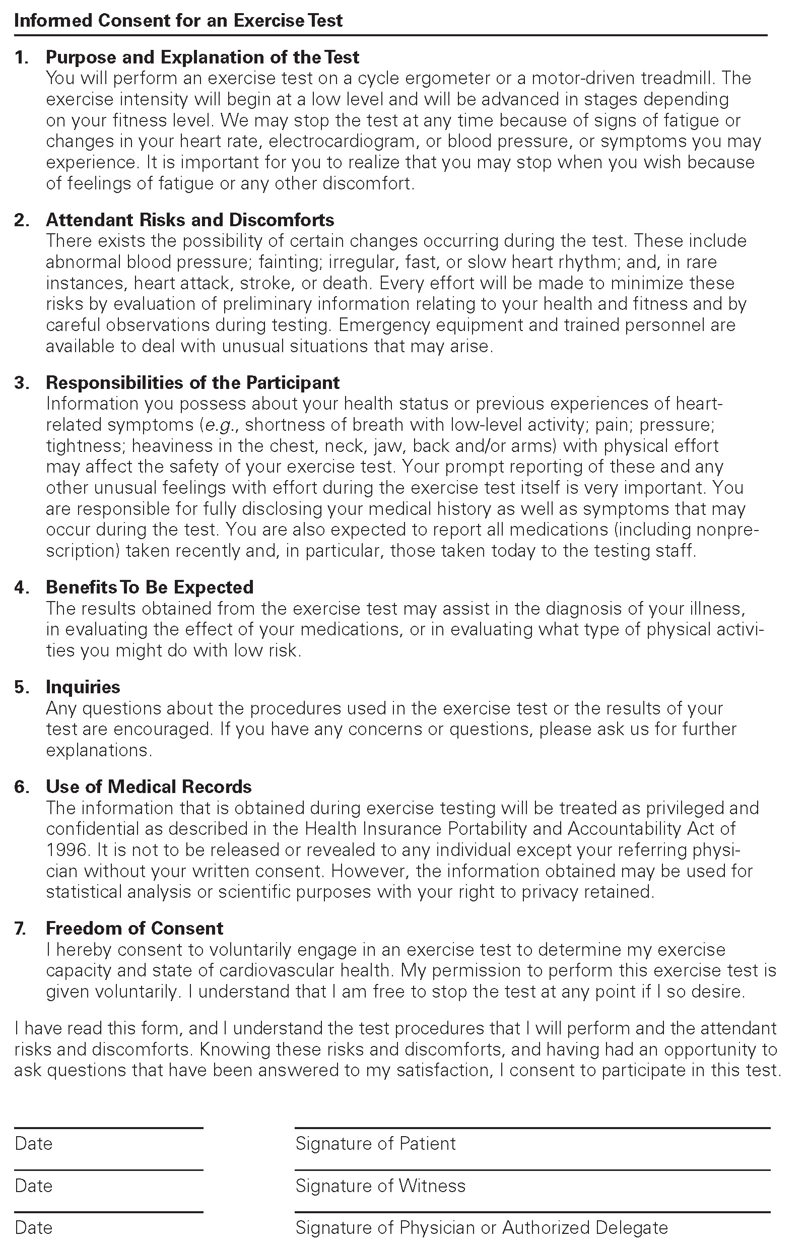
Informed Consent Sample

Slide 17
Pre-exercise Evaluation: Medical History and CVD Risk Factor Assessment
CVD risk factors should be identified and controlled to/for:
  Aid in development of individual’s ExR_{x}
  Lifestyle modification
  Disease prevention and management
The following steps should be followed:
  1) Determine if patient meets any positive risk factors from Table 3.2.
    If patient does not know if he or she meets the criteria for a risk factor, it should be counted.
  2) Sum the positive risk factors.
  3) If client meets negative risk factor from Table 3.2, subtract one from the total of positive risk factors.

Slide 18
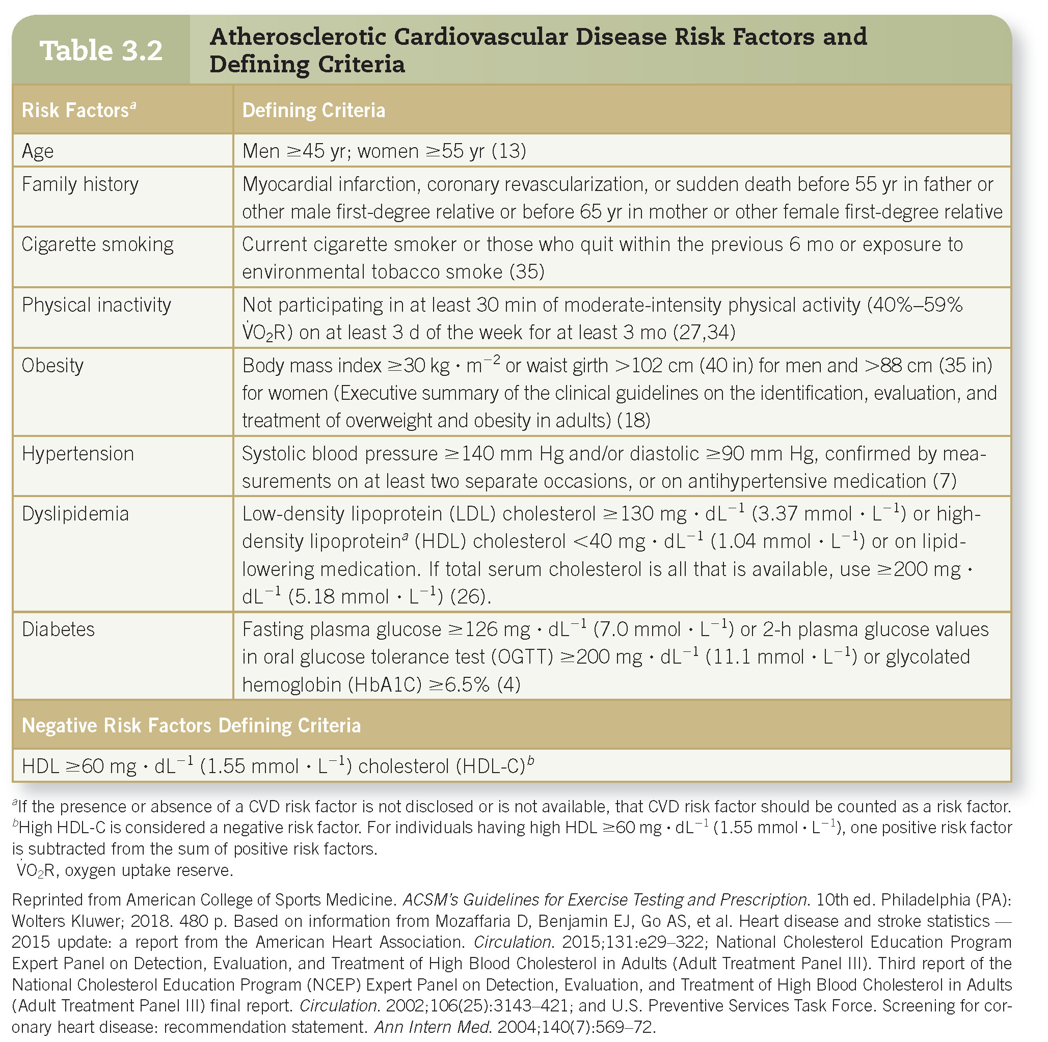
Pre-exercise Evaluation: Medical History and CVD Risk Factor Assessment—(cont.)

Slide 19
Pre-exercise Evaluation: Blood Pressure
A resting blood pressure (BP) measurement is a vital component of any prescreening evaluation.
BP is typically classified as follows:
  Normal BP = <120 systolic blood pressure (SBP) and <80 diastolic blood pressure (DBP)
  Prehypertension = 120–139 SBP or 80–89 DBP
  Stage 1 hypertension = 140–159 SBP or 90–99 DBP

Slide 20
Pre-exercise Evaluation: Blood Pressure—(cont.)
Blood pressure is typically measured using auscultation.
  Exercise professional listens for the sounds of Korotkoff.
    BP cuff is inflated to a suprasystolic pressure, which occludes the brachial artery.
    As cuff is deflated, pulsatile flow is reestablished and is accompanied by sounds, which can be heard with a stethoscope.
    Typically, five Korotkoff sounds can be heard (Box 3.2).
  In order to avoid BP assessment errors, all of the following should be considered:
    Appropriate testing procedures (Box 3.3)
    Type of instrument used
      Ausculatory or oscillometric
    Posture of subject
      Supine, seated or standing
    Common sources of assessment error (Box 3.4)

Slide 21
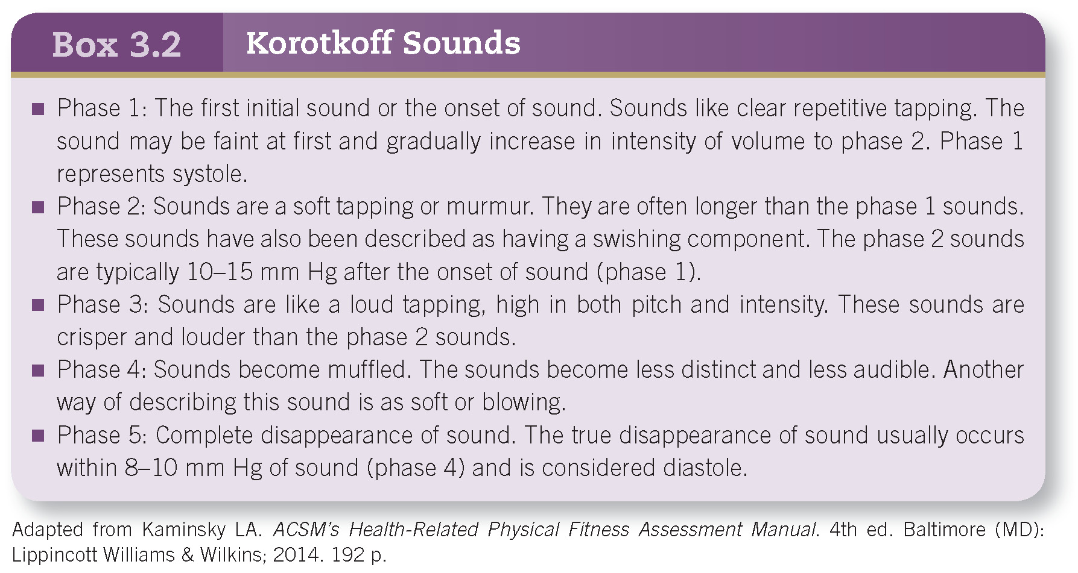
Pre-exercise Evaluation: Blood Pressure—(cont.)

Slide 22
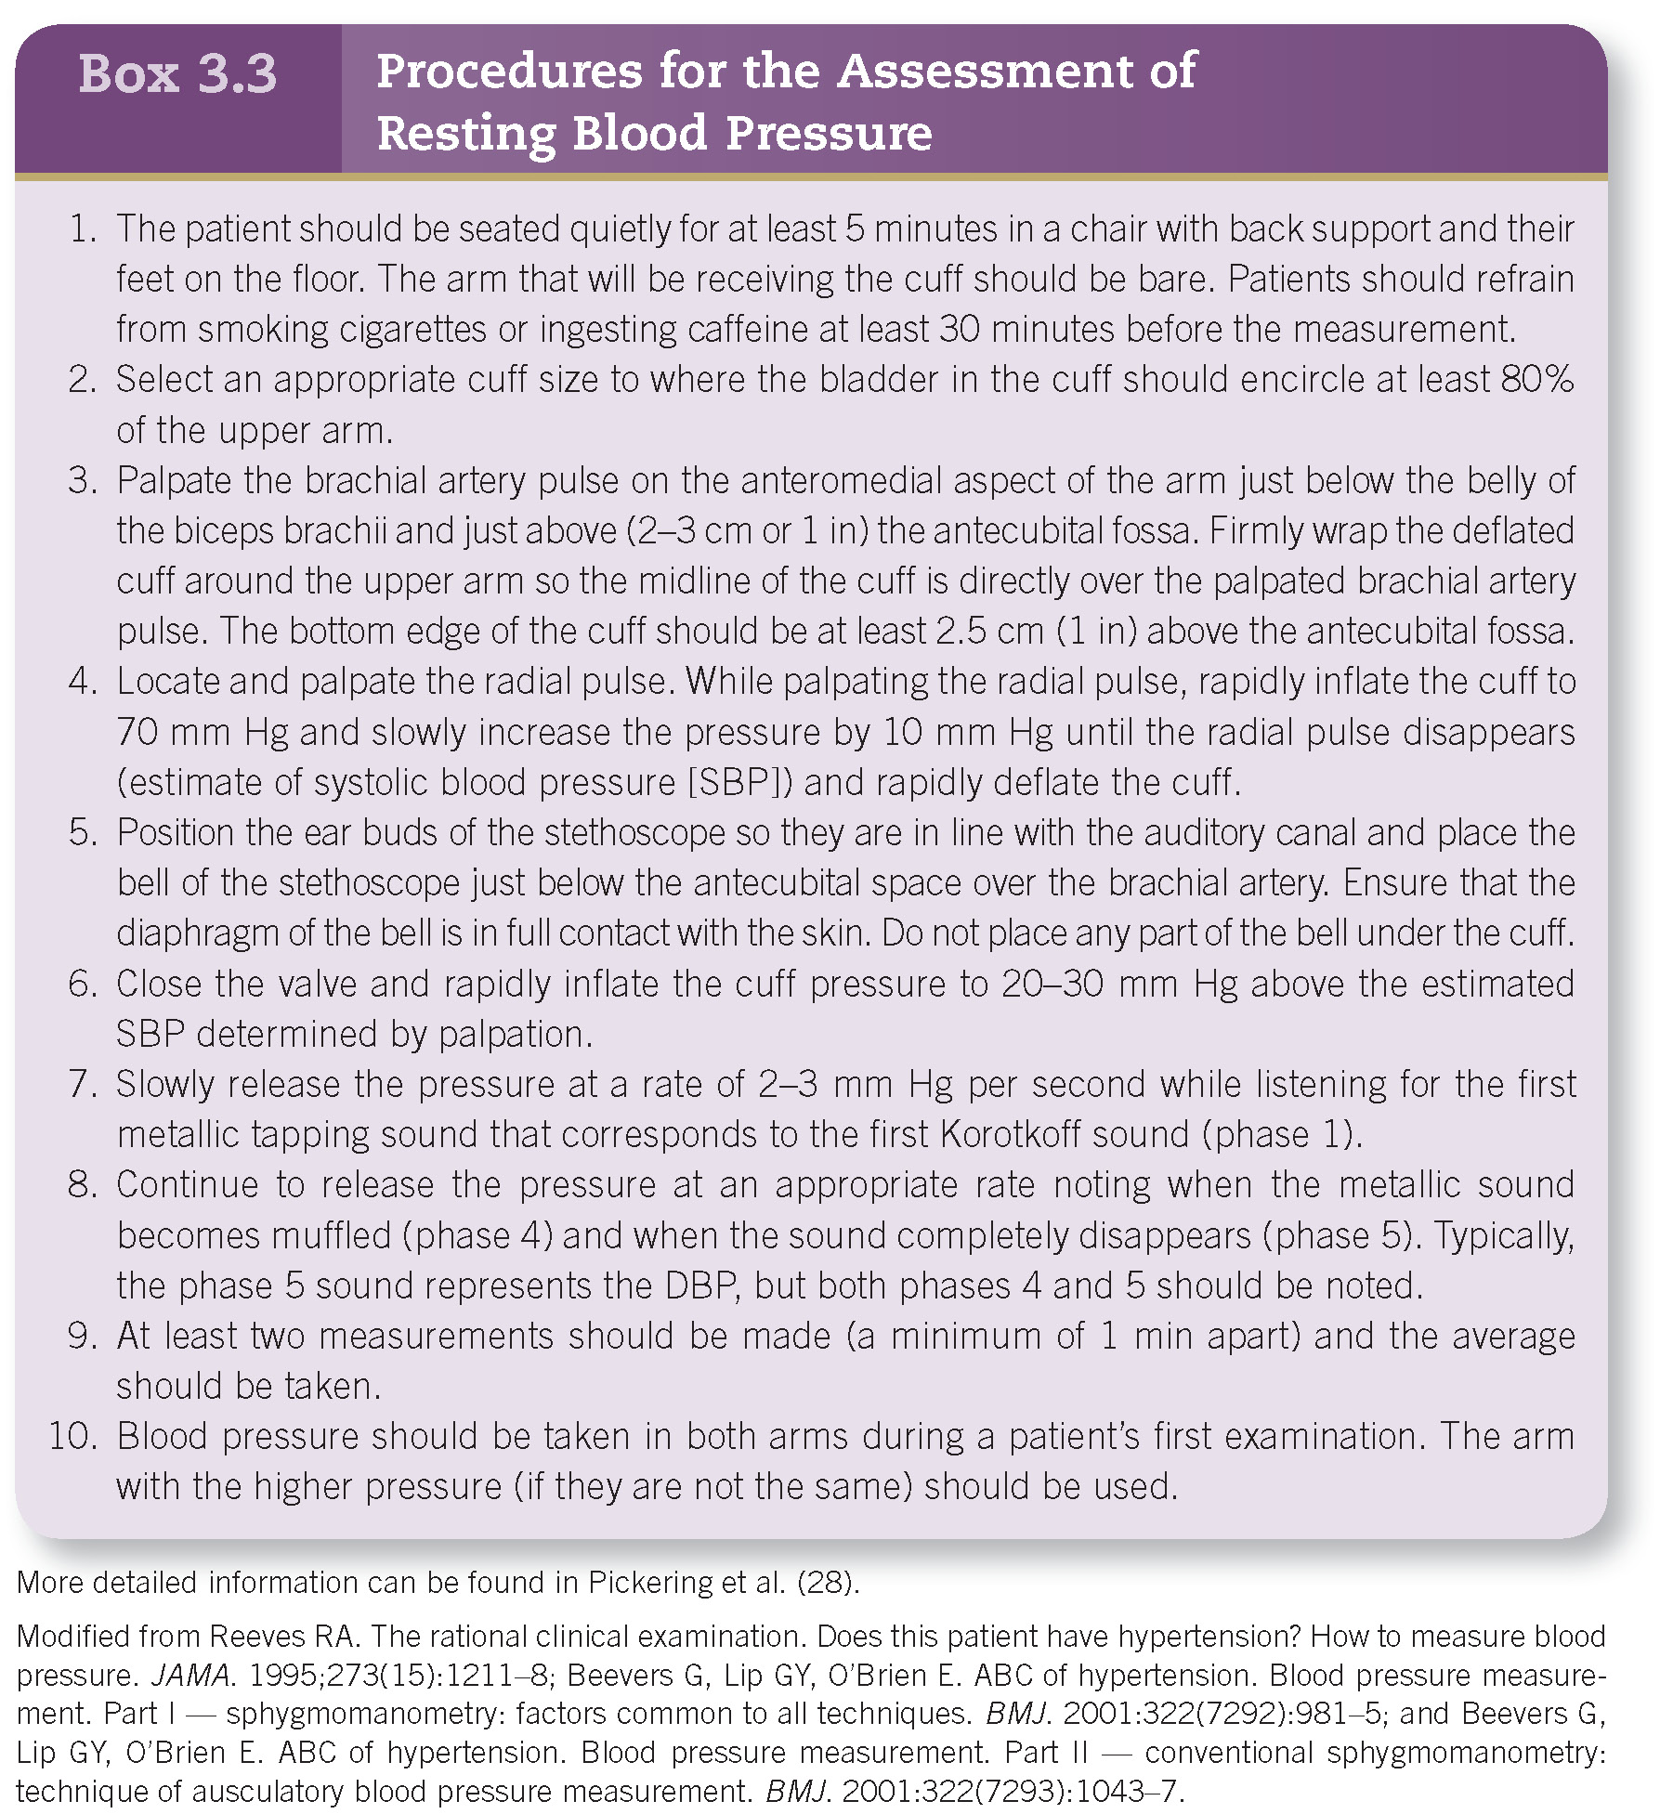
Pre-exercise Evaluation: Blood Pressure—(cont.)

Slide 23
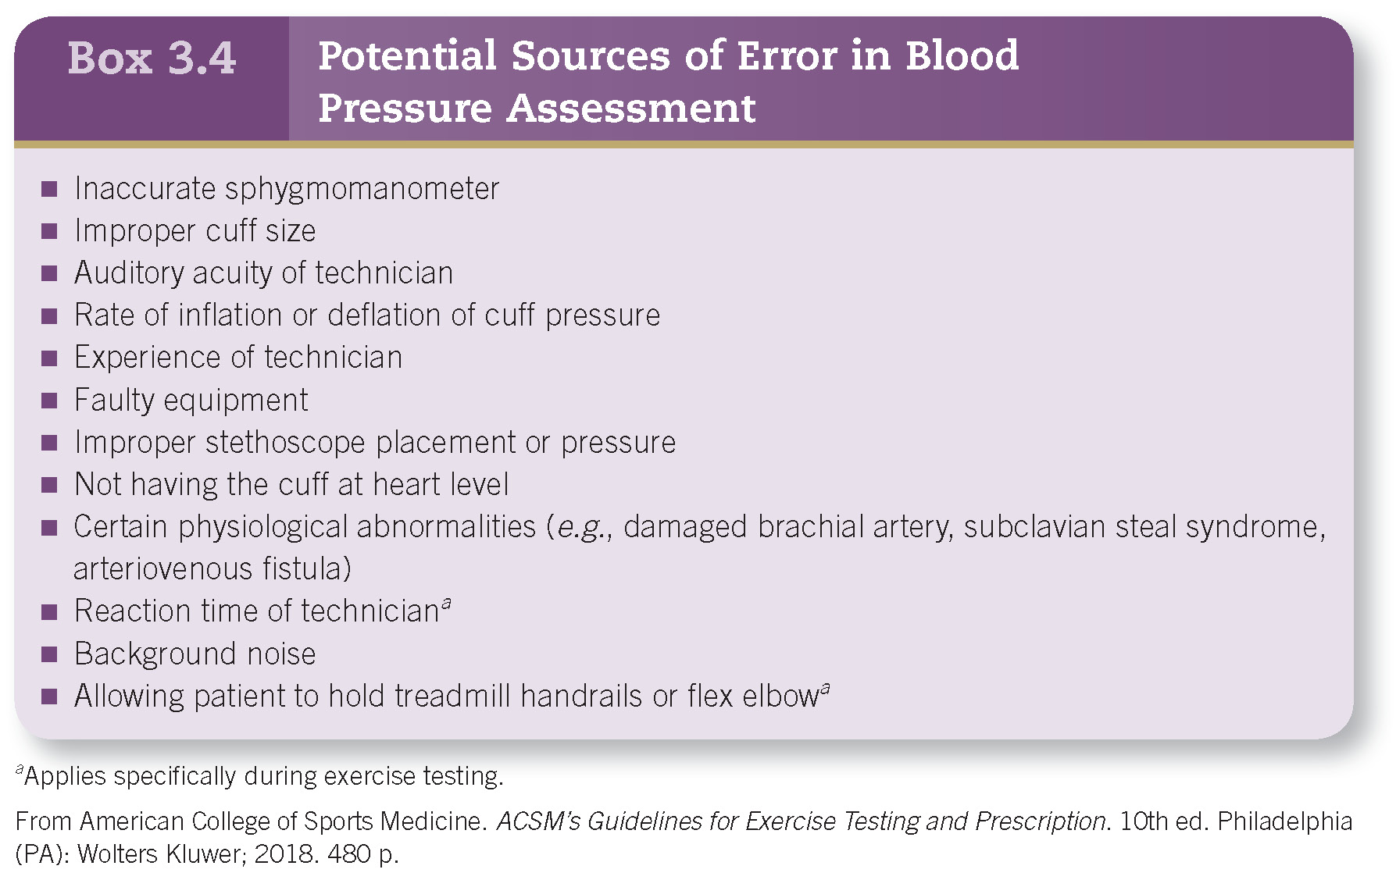
Pre-exercise Evaluation: Blood Pressure—(cont.)

Slide 24
Pre-exercise Evaluation: Patient Participation
Detailed instructions should be provided to participants prior to exercise testing.
  Instructions should include the following:
    Avoid eating and smoking 3 hours prior to testing.
    Wear comfortable footwear and loose-fitting clothing.
    Directions for medication usage prior to testing
    Avoid unusual physical efforts for 12 hours prior to testing.
Preparticipation screening and physical exam should be completed.
Contraindications to exercise testing should be determined (see Chapter 4, Box 4.1).
Informed consent should be reviewed and signed.

Slide 25
Summary
Preparticipation screening is used to identify individuals who are at risk to experience an adverse exercise-related event.
The new screening algorithm is based on:
  Low risk of CV events with the adoption of new exercise programs
  Risk associated with vigorous exercise can be mitigated if the individual begins at a lower intensity and progresses over time.
In addition to preparticipation screening, the exercise professional should administer a medical history and CVD risk factor assessment.
Once through the screening process, an appropriate exercise mode and protocol should be chosen to assess any or all of the health-related components of fitness.

Slide 26


