Slide 1
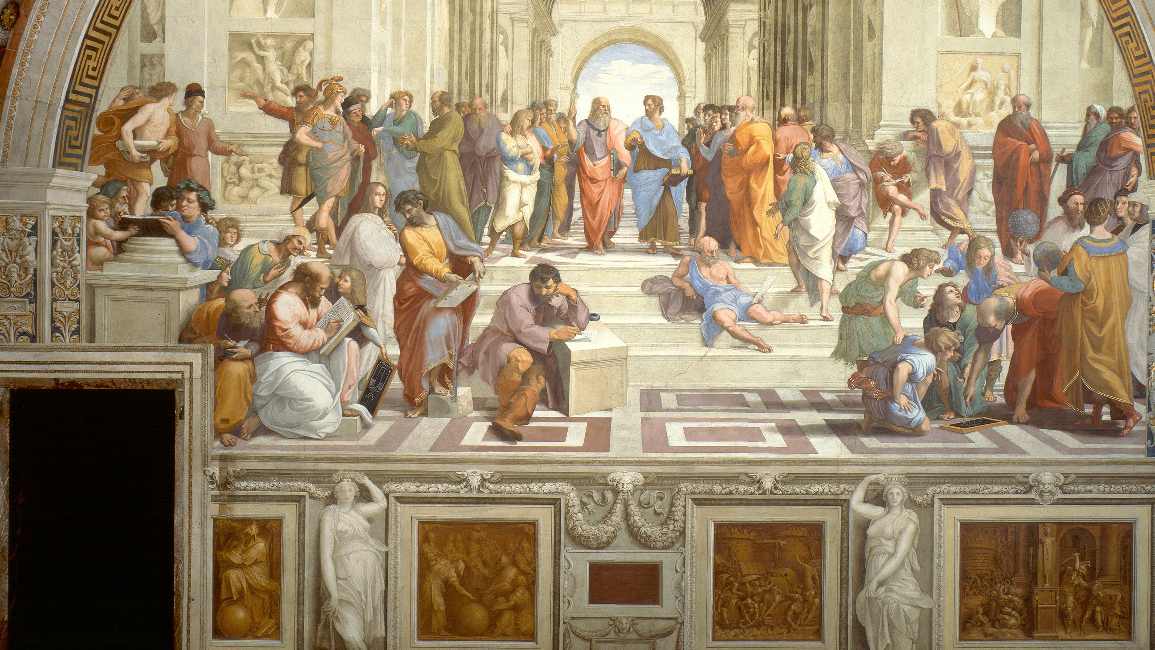
DBA7007 21ST CENTURY BUSINESS AND SOCIETAL ETHICS
DR CAROLINE JAWAD

Slide 2
Foundations of Moral Reasoning
  Steps to ethical behavior:
    Awareness.
    Judgment.
    Decision.
    Action.
  Recognizing a situation as ethical:
    Requires framing it as one that requires ethical reasoning.
    Involves serious harm that is concentrated, likely, proximate, imminent, and potentially violates our moral standards.
  Obstacles to recognizing a situation is ethical include:
    Euphemistic labeling, rationalizing our actions, diminishing comparisons, displacement of responsibility, diffusion of responsibility, disregarding or distorting the harm, dehumanizing the victim, and redirecting blame.
Notes:
1.4.2: The Structure of Moral Reasoning
Point 1 – What are the steps to ethical behavior?
Point 2 – Awareness of an ethical issue or situation (i.e., an issue or situation to which we can respond ethically or unethically).
Point 3 – Judgment about what the ethical course of action is.
Point 4 – Decision to do or not do what we judge is right.
Point 5 – Act on the intention or decision we have made.
Point 6 – Questions to consider in Step 1?
Will one or more persons be harmed?
How much harm has or will be inflicted?
How likely is it that harm will occur
How close is the harm?
Has the harm occurred, or will it occur?
Does the harm violate moral standards acceptable to most people?
Point 7 – What are some forms of moral disengagement that falsely reduce the moral problem?
Euphemistic Labeling
Rationalizing Our Actions: “Downsizing” rather than “firing.”
Diminishing Comparisons: Comparing current situation to a much larger problem.
Displacement of Responsibility: “I was just following orders.”
Diffusion of Responsibility: “I was one of many.”
Disregarding or Distorting the Harm: Denial of evidence.
Dehumanizing the Victim: Nonhuman labels.
Redirecting Blame: Adversary or circumstances are responsible.
Point 8 – How do we judge what the ethical course of action is?
Avoid three forms of biased theories about:
the world.
others.
self.
Point 9 – How do we decide whether to do what’s right?
The ethical climate of the organization: expectations for behavior.
The ethical culture of the organization: encouraged and discouraged behavior.
Point 10 – How do we act on our decision?
Ego strength: strength of will.
Loss of control: believing that what happens is under one’s control.
Response to authority: one’s strength of respect for authority.

Slide 3
Foundations of Moral Reasoning
  Judging the ethical course of action.
    Avoid three forms of biased theories
    Organization.
  Judging the ethical course of action often depends on:
    The ethical climate of the organization.
    The ethical culture of the organization.
  Acting on a decision depends on:
    Ego strength.
    Loss of control.
    Response to authority.

Slide 4
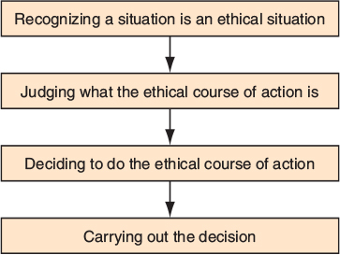
Figure 1 The Four Steps Leading to Ethical Behavior

Slide 5
Moral Responsibility and Blame
Assess the factors that define and refine the concept of moral responsibility
  Clarity about what’s involved in moral reasoning:
    Responsibility.
    Accuracy.
    Appropriate emotions.
    Accountability.
When is a Person Morally Responsible?
  Criteria for moral responsibility for injuries or wrongs:
    Causality.
    Knowledge.
    Freedom.
Notes:
1.5: Assess the factors that define and refine the concept of moral responsibility
Point 1 – Why is it important to be clear about what is involved in moral reasoning?
Responsibility for amends.
Accuracy in identifying responsible party or parties.
Responsibility accounts for appropriate feelings.
Accountability for one’s actions.
1.5.1 When is a Person Morally Responsible?
Point 1 – What are the criteria for moral responsibility for injuries or wrongs?
One caused, helped cause, or could have prevented a harm
The individual knew what he or she was doing.
The individual willingly committed the act

Slide 6
Moral Responsibility and Blame
Mitigating Factors
  Moral responsibility is mitigated by:
    Minimal contribution.
    Uncertainty.
    Difficulty.
  Moral responsibility is not mitigated by:
    The cooperation of others.
    Following orders.
Moral Responsibility: Essential Points
  Essential points of responsibility
    Causation.
    Knowledge.
    Freedom.
Notes:
1.5.2: Mitigating Factors
Point 1 – What are mitigating factors that reduce one’s moral responsibility for an action?
Circumstances that reduce involvement.
Circumstances that affect knowledge of what one is doing.
Circumstances that interfere with one’s free will to act or refrain from acting, such as coercion or threat.
The extent of the wrong.
1.5.3: Moral Responsibility: Essential Points
Point 1 – What are the essential points of moral responsibility and elimination of moral responsibility?
Causation.
Knowledge.
Freedom.
Point 2 – How is moral responsibility mitigated?
Minimal contribution to the act.
Uncertainty.
Coercion or threat.
Seriousness of the wrong.

Slide 7
Moral Responsibility and Blame
  Mitigation of moral responsibility
    Minimal contribution to the act.
    Uncertainty.
    Coercion or threat.
    Seriousness of the wrong.
Responsibility for Corporate Actions
  Corporate moral responsibility
    Individual
    Corporation
Notes:
1.5.4: Responsibility for Corporate Actions
Point 1 – How is moral responsibility for corporate action determined?
Some say it is the individuals who performed the action.
Some say it is the corporation itself.

Slide 8
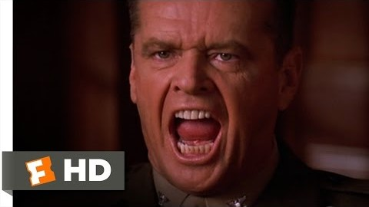
A Few Good Men

Slide 9
Plot
1992 American military drama movie about the corruption of the US Navy in Cuba and Washington, D.C.
Santiago bad relationships with marines.
Jessop ‘Code Red.’
What was Colonel Jessup’s perspective on why he should be allowed to break the law?
What is the immediate ethical dilemma in this scene? What is the ethical dilemma in the movie?

Slide 10
Case Study Slavery in the Chocolate Industry
  Child slavery in Ivory Coast to farm cocoa beans.
  U.S. chocolate companies purchase the cocoa beans from Ivory Coast, knowing that slavery is involved.
Pressure Leads to Action
  Pressure from U.S. legislators led to chocolate companies committing to reforms.
Far from Achieving Goals
  As of 2010, no progress on a certification system reached conclusion.
Mixed Responses
  Some cocoa is now certified “slave-free,” but most cocoa from Ivory Coast is not.
Notes:
Case Study 1.1: Slavery in the Chocolate Industry
Point 1 – What are the salient facts of the story presented in the CNN story?
“Forty-five percent of the chocolate we consume in the United States and in the rest of the world is made from cocoa beans grown and harvested on farms in Ivory Coast.”
“Most of the chocolate we eat was grown and harvested by children who work as slaves.” The chocolate industry is $14 billion alone in the United States.”
U.S. companies that use Ivory Coast chocolate: Hershey Foods Corp., Mars, Inc., Nestlé USA, and Kraft Foods.
The children are between ages 9 and 16.
The minimum employment age in Ivory Coast is 14.
Point 2 – What is the ethical problem presented in the CNN story?
The children are treated inhumanely; they are abused.
The children are not allowed to leave.
The living conditions are inhumane.
U.S. chocolate makers knew about the slavery in Ivory Coast.
It was not until their complicity came to light that members of the Chocolate Manufacturers Association and the World Cocoa Foundation took action to help eliminate child slavery in the production of chocolate.
Pressure Leads to Action
Point 1 – How did lawmakers exert pressure on U.S. chocolate makers to stop complicity in child slavery?
“Slave-free” labeling bill.
Threat of a new bill that would prohibit the import of cocoa produced by slave labor.
Point 2– What was the result of the proposed legislation?
“Members of the Chocolate Manufacturers Association and the World Cocoa Foundation, caught in the spotlight of media attention, announced on October 1, 2001, that they intended to put in place a system that would eliminate ‘the worst forms of child labor,’ including slavery.”
CMA, WCF, and major U.S. chocolate companies “signed an agreement to establish a system of certification that would verify and certify that the cocoa beans they used were not produced by the use of child slaves.”
Far from Achieving Goals
Point 1 – What is the situation?
No certification system as of 2008.
Some progress made by 2010, but companies failed to meet their newest deadline.
Mixed Responses
Point 1 – What are some chocolate companies doing, independently of formal actions, to eliminate reduction of child slavery in the production of cocoa beans?
Hershey announced that by 2020, its entire cocoa supply would come from certified farms, and in 2014, reported that 18% of its cocoa supply was certified by the Rainforest Alliance or other NGOs. Nestlé announced that by 2014, the cocoa used in its Kit Kat candy would be UTZ Certified (an NGO headquartered in Amsterdam that provides traceability services for palm oil, tea, and cocoa). Kraft/Cadbury announced that, like Hershey, it was working to have the Rainforest Alliance certify its cocoa.”
Point 2 – What additional actions were taken?
Former child slaves sued chocolate companies for knowingly supporting farmers who used child slaves.

Slide 11
Case Study: Aaron Beam and the HealthSouth Fraud
  Aaron Beam and Richard Scrushy founded HealthSound in 1984.
  The company’s profitability was misrepresented.
  In 1986, the company went public.
  Beam and Scrushy became very wealthy.
Hiding a Shortfall to Appear Profitable
  From 1986-1996, HealthSound grew to be a $3 billion Fortune 500 company.
  Over the next near, the company’s quarterly earnings repeatedly fell short of Wall Street analysts’ expectations.
  The company continued to falsify earnings reports.
  Beam retired in 1997.
Notes:
Case Study 1.2: Aaron Beam and the HealthSouth Fraud
Point 1 – What ethical problems does the Aaron Beam and Richard Scrushy case present?
Fraud, misrepresentation, and deception.
Hiding a Shortfall to Appear Profitable
Point 1 – How did HealthSound engage in unethical practices?
Falsification of financial reports.
Deceptive accounting that violated accepted accounting standards.
Misrepresentation to shareholders.
Investigation and Outcome
Point 1 – How do Scrushy and Beam’s responses to the case’s outcome differ?
Beam, who now owns a lawn mowing business, says he finally can live with a clear conscience.
Scrushy presents himself as a successful businessman and inspirational speaker.

Slide 12
Case Study: Aaron Beam and the HealthSouth Fraud
Investigation and Outcome
  The FBI began investigating HealthSound in 2003.
  Scrushy was not convicted of wrongdoing in the HealthSound case, but was later convicted of bribery in an unrelated case and was sentenced to seven years in prison.
  Scrushy lost a $2.8 billion civil lawsuit brought by HealthSound shareholders.
  Beam blamed Scrushy for much of what happened at HealthSound.

Slide 13

Task

Slide 14
Approaches to Moral Decision Making
Examine the foundations of moral decision-making in business
  Moral decision-making clarifies ethical issues.
  Strengths and weaknesses of each approach to moral decision-making.
Unocal and Burma
  Ethical issues in Unocal decision-making process.
    Cost-benefit analysis for company and host country (Burma).
    Existing human rights issues in Burma.
Notes:
2.1: Examine the foundations of moral decision-making in business
Point 1 – How will approaches to moral decision-making be discussed and analyzed?
Identify the strengths and weaknesses of each approach and explain how using moral decision-making can clarify the ethical issues that confront us in business.
Begin by looking at how one company, Unocal, dealt with a series of moral decisions it had to make.
2.1.1: Unocal and Burma
Point 1 – What were the decision-making issues involving Unocal’s Yadana gas field project in Burma?
Assessment of the benefits to the region and the company.
The existence of a military dictatorship in Burma.
The decision to go forward with the project, despite the risks.
Human rights issues in Burma.
Critics’ claims that Unocal supported an unjust military regime, which brutally violated Burmese citizens’ rights.
Central ethical standards involved in thinking about rights and justice:
Rights.
Justice.
Utilitarianism.
Caring.
Individuals’ virtues and vices.

Slide 15
Utilitarianism: Weighing Social Costs and Benefits (1 of 4)
2.2: Detail the concept of utilitarianism and how it is applied to business decisions
  Ethical framework enlisted by Unocal in its decision-making process.
    Utilitarianism.
2.2.1: Utilitarianism and Ford Motor Company’s Pinto
  The central Ford Pinto ethical error:
    They chose to ignore a dangerous design feature.
2.2.2: Traditional Utilitarianism
  Bentham and Mill
    Founders of traditional utilitarianism.
  A significant feature of utilitarianism:
    It attempts to provide ethical principle that serves as a publicly acceptable basis for determining the best social policies, as well as the ethically best courses of action.
Notes:
2.2: Detail the concept of utilitarianism and how it is applied to business decisions
Point 1 – What is utilitarianism?
The approach to which Unocal managers appealed.
The view that actions and policies are evaluated by the benefits and costs produced for society.
2.2.1: Utilitarianism and Ford Motor Company’s Pinto
Point 1 – Why was the Pinto a rush project?
Ford was losing market share to Japanese car companies, which were producing compact, fuel-efficient cars.
The gas shortage put more pressure on Ford to come up with a competitive vehicle.
Point 2 – What ethical errors did Ford make?
Although the gas tank produced met legal and government standards at the time, its location made it susceptible to explosion if there was a collision.
Ford decided to take the risk that this sort of collision would not happen or would be infrequent.
Point 3 – How did Ford use a utilitarian decision-making model?
Point 4 – The design met all the legal and government standards then in effect. At the time, government regulations required that a gas tank only remain intact in a rear-end collision of less than 20 miles per hour.
Point 5 – Ford managers knew the car was comparable in safety to several of the small cars other companies were making and quickly putting on the market.
“The design met all the legal and government standards then in effect. At the time, government regulations required that a gas tank only remain intact in a rear-end collision of less than 20 miles per hour.”
“According to an internal cost-benefit study Ford conducted, modifying the Pinto would be more costly to customers (and ultimately to society) than leaving its design unchanged. The study stated that approximately 12.5 million of the autos would eventually be built. Modifying the gas tank of each car by surrounding it with a rubber bladder to contain any gasoline leaks, it said, would cost about $11 a unit.”
2.2.2: Traditional Utilitarianism
Point 1 – Who are Jeremy Bentham and J.S. Mill?
Bentham and Mill are generally considered the founders of traditional utilitarianism.
Point 2 – What are some significant features of utilitarianism?
It attempts to provide an objective basis for making ethical judgments.
It attempts to provide ethical principle that serves as a publicly acceptable basis for determining the best social policies, as well as the ethically best courses of action.
That principle is based on objectively ascertainable beneficial and harmful consequences of actions.
Point 3 – What is the utilitarian ethical principle?
The ethical action is the one that had the most beneficial consequences for society or that at least minimized the harmful consequences.
Mill: “Actions are right in proportion as they tend to promote happiness, wrong as they tend to produce the reverse of happiness.”
Point 4 – To what does the term “utility” refer?
“The result of combining the beneficial and costly consequences of an action.”
Point 5 – How does Velasquez summarize utilitarian decision-making procedure?
“An action is right from an ethical point of view, if and only if, the net sum of utilities produced by that action is greater than the net sum of utilities produced by any other action the agent could have performed in its place.”
Point 6 – What are some mistakes in thinking about utilitarianism?
The right action is the one whose benefits outweigh the costs.
The utility produced is for the agent performing the action.
Consideration only of direct and immediate consequences.
Point 7 – What is a real-world application of utilitarian decision-making?
Lawrence Summers, President Barack Obama’s director of the National Economic Council and the chief economist of the World Bank, wrote a 1991 memo arguing that the waste from rich countries should be sent to poor countries. He provided four arguments, the claims of each being utilitarian.

Slide 16
Utilitarianism: Weighing Social Costs and Benefits
  The utilitarian ethical principle:
    The ethical action is the one that had the most beneficial consequences for society or that at least minimized the harmful consequences.
    Mill: “Actions are right in proportion as they tend to promote happiness, wrong as they tend to produce the reverse of happiness.”
The Advantages of Utilitarianism
  Advantages of utilitarianism
    It advocates policies that provide the greatest benefits.
    It impartially considers everyone’s interests.
    It explains why some activities are right or wrong.
Notes:
2.2.3: The Advantages of Utilitarianism
Point 1 – What are some advantages of utilitarianism?
It advocates policies that provide the greatest benefits.
It impartially considers everyone’s interests.
It explains why some activities are right or wrong.
Point 2 – What is the connection between utilitarianism and economics?
Economics applies cost-benefit analyses, which is a utilitarian application.

Slide 17
Utilitarianism: Weighing Social Costs and Benefits
Utilitarianism’s Measurement Problems
Some of utilitarianism’s measurement problems
Utility is subjective and comparisons are difficult.
Some benefits and costs seem impossible to measure.
Benefits and costs are unclear.
It assumes that all goods are commensurable.
Utilitarian Replies to Measurement Objections
Utilitarian justifies its decision-making process by claiming it:
Focuses on moral estimates, not absolutes.
Appeals to intrinsic and instrumental goods.
Distinguishes between wants and needs.
Quantifies value in monetary terms.
Notes:
2.2.4: Utilitarianism’s Measurement Problems
Point 1 – What are some of utilitarianism’s measurement problems?
Utility is subjective and comparisons are difficult.
Some benefits and costs seem impossible to measure.
Benefits and costs are unclear.
It assumes that all goods are commensurable.
2.2.5: Utilitarian Replies to Measurement Objections
Point 1 – What are some utilitarian replies to measurement objections?
Utilitarianism uses estimates, not absolutes.
Utilitarianism appeals to intrinsic and instrumental goods.
Utilitarianism distinguishes between wants and needs.
Utilitarianism is amenable to quantification by monetary value.

Slide 18
Utilitarianism: Weighing Social Costs and Benefits
Utilitarian Problems with Rights and Justice
  Some problems with utilitarianism:
    It does not take into account how evenly utility is distributed among members of a society.
    It does not take into account the negative impact on the rights of those negatively impacted by its calculus.
Utilitarian Replies to Objections on Rights and Justice
  Rule-utilitarianism
    Limits the utilitarian analysis to moral rules.
    Determines the correctness of a rule by the total utility produced being greater than it would be otherwise.
    Assumes everyone follows that rule.
Notes:
2.2.6: Utilitarian Problems with Rights and Justice
Point 1 – What are some utilitarian problems associated with rights and justice?
It does not take into account how evenly utility is distributed among members of a society.
It does not take into account the negative impact on the rights of those negatively impacted by its calculus.
2.2.7: Utilitarian Replies to Objections on Rights and Justice
Point 1 – How does the utilitarian respond to criticisms about a failure to protect rights and promote justice?
The alternative to traditional utilitarianism is rule-utilitarianism, which limits the utilitarian analysis to moral rules.
Point 2 – What are the two parts of rule utilitarianism?
“An action is right from an ethical point of view if, and only if, the action would be required by a correct moral rule.”
“A moral rule is correct if and only if the total utility produced if everyone were to follow that rule is greater than the total utility produced if everyone were to follow some alternative rule.”
Point 3 – What is a criticism of rule-utilitarianism?
It is simply traditional utilitarianism in disguise: “If a rule allows people to make an exception whenever an exception will maximize utility, then it will produce more utility than a rule that allowed no exceptions.”

Slide 19
Rights and Duties
Examine a rights-based approach to business ethics
  Unocal offered a utilitarian defense of its decision.
    The utilitarian defense did not address criticisms of rights violations.
Human Rights and Walt Disney Company’s Supplier
  Disney stockholders responded to a moral problem.
    It urged the company to adopt 11 widely accepted principles of human and labor rights.
The Concept of a Right
  A right is an entitlement
    To act in a certain way.
    To have others act in a certain way toward the right-holder.
Notes:
2.3: Examine a rights-based approach to business ethics
Point 1 – How does the Unocal-Burma case study provide an opportunity to studying a rights-based approach to business ethics?
Unocal offered a utilitarian defense of their decision.
A right-based approach allows us to see the problems with the utilitarian approach.
Unocal, critics argued, supported Burma’s military regime’s violation of citizens’ rights, e.g., “to participate in the political life of their nation, their right to speak freely and to come and go as they wanted, and their right to unionize and associate with one another.”
2.3.1: Human Rights and Walt Disney Company’s Supplier
Point 1 – What action did Walt Disney Company stockholders take in response to findings that the company was violating human rights through its factory suppliers in China?
It urged the company to adopt 11 widely accepted principles of human and labor rights.
2.3.2: The Concept of a Right
Point 1 – What is the concept of a right?
It is largely defined in terms of duties entailed by it.
A right involves liberty, often from governmental interference.
A right can involve a claim that someone do something for the right-holder.
Velasquez defines a right as follows: “A person has a right when that person is entitled to act in a certain way or is entitled to have others act in a certain way toward him or her.”
Rights are moral or legal, inherent or conventional.
Point 2 – What are essential features of a right?
Absence of prohibitions.
Person is authorized.
Existence of prohibitions.
A violated right does not always entail a harm.
Moral rights are correlated with duties and provide a basis for justifying actions.
Point 3 – What are the essential differences between a conception of moral rights and utilitarianism?
Rights are focused on the individual.
Rights limit the validity of utilitarian appeals to social benefits.

Slide 20
Rights and Duties
A Basis for Moral Rights: Immanuel Kant
  Kant’s categorical imperative and rights.
    The CI requires that people be treated equally. This requirement allows people to claim equal treatment as their right.
    The CI commands respect for each person’s freedom and rationality.
    The CI commands consent from free and rational beings.
    The CI commands that we contribute to each person’s ability to pursue their freely and rationally chosen ends.
Notes:
2.3.4: A Basis for Moral Rights: Immanuel Kant
Point 1 – What is the relation between Kant’s categorical imperative and rights?
The CI requires that people be treated equally. This requirement allows people to claim equal treatment as their right.
Point 2 – What is a maxim?
A personal rule for acting.
Point 3 – How does the maxim work in the first formulation of the CI?
For a maxim to be a moral duty, one must be able to universalize it without contradiction in thought (conceptual/logical) or will.
Everyone must be able to act on this maxim, at least in principle.
The maxim-holder must be willing for his or her maxim to be applied to him or herself, as well.
Point 4 – What is the connection between rights and the second formulation of the CI?
It commands respect for each person’s freedom and rationality.
It commands consent from free and rational beings.
It commands that we contribute to each person’s ability to pursue their freely and rationally chosen ends.
Point 5 – What are some rights based on Kant’s CI?
The right to have basic needs met.
The right to be free from interference.
Contractual rights.
Point 6 – What are some problems with Kant’s theoretical framework?
It is not entirely clear.
It does not clarify the limits of rights.
It is sometimes proven wrong by counterexamples.
2.3.6: Robert Nozick and The Libertarian Objection
Point 1 – What are Nozick’s libertarian claims?
The only moral right is the negative right to freedom. Consequently, restrictions on freedom are unjustified except to prevent greater restrictions on freedom.
The right to freedom requires private property, freedom of contract, free markets, and the elimination of taxes to pay for social welfare programs.
Freedoms are reciprocally restrictive. So, Nozick’s claim that restrictions on freedom are unjustified implies that freedom itself is unjustified.

Slide 21
2.4: Justice and Fairness (1 of 2)
2.4: Explain justice and fairness as key ethical principles
  Unocal and the Burmese government
2.4.1: Wages in the Fast Food Industry
  Justice and fast food wages
    What is a living wage?
2.4.2: Standards of Justice and Fairness
  Justice and fairness in business disputes
    Discrimination, favoritism, and unfair workloads.
  Forms of justice typically deployed to redress or prevent injustice.
    Distributive justice.
    Retributive justice.
    Compensatory justice.
Notes:
2.4: Explain justice and fairness as key ethical principles
Point 1 – How did Unocal promote injustice?
Critics argued that Unocal’s decision allowed the Burmese government to enrich itself at the expense of its citizens.
2.4.1: Wages in the Fast Food Industry
Point 1 – How is injustice understood in terms of wages in the fast food industry?
If an employee cannot make a living wage, critics argue, then the company that pays those wages commits an injustice.
2.4.2: Standards of Justice and Fairness
Point 1 – How do disputes in business often revolve around justice and fairness?
Examples of unjust or unfair treatment include discrimination, favoritism, and unfair workloads.
Point 2 – What forms of justice are typically deployed in response to injustice?
Distributive justice.
Retributive justice.
Compensatory justice.

Slide 22
2.4: Justice and Fairness (2 of 3)
2.4.3: Distributive Justice
  Distributive justice
    Justice that aims to fairly distribute benefits and burdens.
Notes:
2.4.3: Distributive Justice
Point 1 – What is the fundamental principles of distributive justice?
“Individuals who are similar in all respects relevant to the kind of treatment in question should be given similar benefits and burdens, even if they are dissimilar in other irrelevant respects; and individuals who are dissimilar in a relevant respect ought to be treated dissimilarly, in proportion to their dissimilarity.”
Point 2 – What is the major conceptual element of distributive justice?
Equality or egalitarianism.
Point 3 – What is justice based on contribution?
Capitalist justice.
Point 4 – What is justice based on needs and abilities?
Socialism.
Point 5 – What is justice as freedom?
Libertarianism.
Point 6 – What are some critiques of Libertarianism?
It enshrines one value at the expense of others.
It promotes unjust treatment of the disadvantaged.
Point 7 – What are the two principles of Rawls’ “justice as fairness”?
“Each person has an equal right to the most extensive basic liberties compatible with similar liberties for all.”
“Social and economic inequalities are arranged so that they are both:
“To the greatest benefit of the least-advantaged persons.”
“Attached to offices and positions open to all under conditions of fair equality of opportunity.”
Point 8 – What are Rawls’ methods for evaluating moral principles?
The hypothetical original position.
The veil of ignorance.
Point 9 – What are some criticisms of Rawls’ version of egalitarian justice?
The original position is not an adequate method for evaluating moral principles.
The original position is not adequate because it does not tell us if the principles chosen through it are moral.

Slide 23
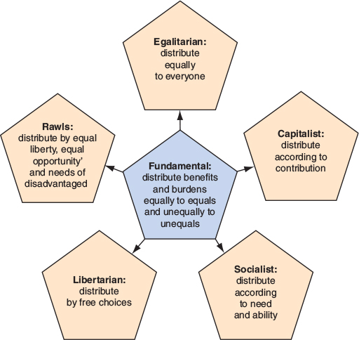
Figure 2.1
Summary of Principles of Distributive Justice

Slide 24
2.4: Justice and Fairness (3 of 3)
2.4.4: Retributive Justice
  Retributive justice
    Justice of blaming or punishing wrongdoers.
2.4.5: Compensatory Justice
  Compensatory justice
    The justice by which a wronged person is restored to his or her initial condition.
Notes:
2.4.4: Retributive Justice
Point 1 – What is retributive justice?
It is the justice of blaming or punishing wrongdoers.
2.4.5: Compensatory Justice
Point 1 – What is compensatory justice?
It is the justice by which a wronged person is restored to his or her initial condition.
Point 2 – When should someone be compensated?
The action that inflicted the injury was wrong or negligent.
The person’s action was the actual cause of the injury.
The person who inflicted the injury did so voluntarily.

Slide 25
An Ethic of Care
Analyze an ethic of care as applied to business decisions and practices
  Care ethics requires we pay attention to concrete, valuable relationships
Malden Mills Company
  Malden Mills textile factory burned down.
    One of the remaining textile mills in operation in New England.
    Owner could have collected $100 million in insurance.
Partiality and Care
  Malden Mills story reflects an ethic of care.
    Owner did not shut down factory after it burned down.
    Owner did not move operations to another country.
    Owner paid employees while factory was being rebuilt.
Notes:
2.5: Analyze an ethic of care as applied to business decisions and practices
Point 1 – How does an ethic of care apply to business decisions and practices?
“The moral task is not to follow universal and impartial moral principles, but instead to attend and respond to the good of particular individuals with whom we are in a valuable and close relationship.”
The Malden Mills Company is an example of a care ethic at work.
2.5.1: Malden Mills Company
Point 1 – What happened in December 1995 at the Malden Mills textile factory, and what is the Malden Mills backstory?
A fire broke out.
Malden Mills, founded in 1906, was one of the last remaining textile factories still operating in New England.
After the fire, people predicted that Malden Mills’ owner, Aaron Feuerstein, would collect the more than $100 million in insurance, close the factory, and relocate to another country where manufacturing was cheaper.
Point 2 – What did Malden Mills do after the fire?
Promised every employee forced out of work by the fire would continue to be paid full wages, receive full medical benefits, and be guaranteed a job when operations restarted in a few months.
Rebuilding in Lawrence would cost over $300 million, and keeping 1,400 laid-off workers on full salaries for a period of up to three months cost an additional $20 million.
Point 3 – How does the Malden Mills story reflect an ethic of care?
Rather than opting for the most lucrative or cost-effective option, Malden Mills prioritized employees over profits.
2.5.2: Partiality and Care
Point 1 – How does the Malden Mills story emphasize the partiality component of care ethics?
Malden Mills’ owner, Aaron Feuerstein, believed his company had a special obligation to his employees.
Point 2 – What are some other moral demands of care ethics?
Relationships should be preserved.
Understanding the forms of caring that operate in relationships:
Caring for someone.
Caring about something.
Caring after someone.
Understanding that the quality of relationships affect the ethics of care, e.g., concretely valuable relationships.
Understanding that the type of relationships affect the ethics of care e.g., dependence.
Attempting to reconcile the demands of caring and justice.

Slide 26
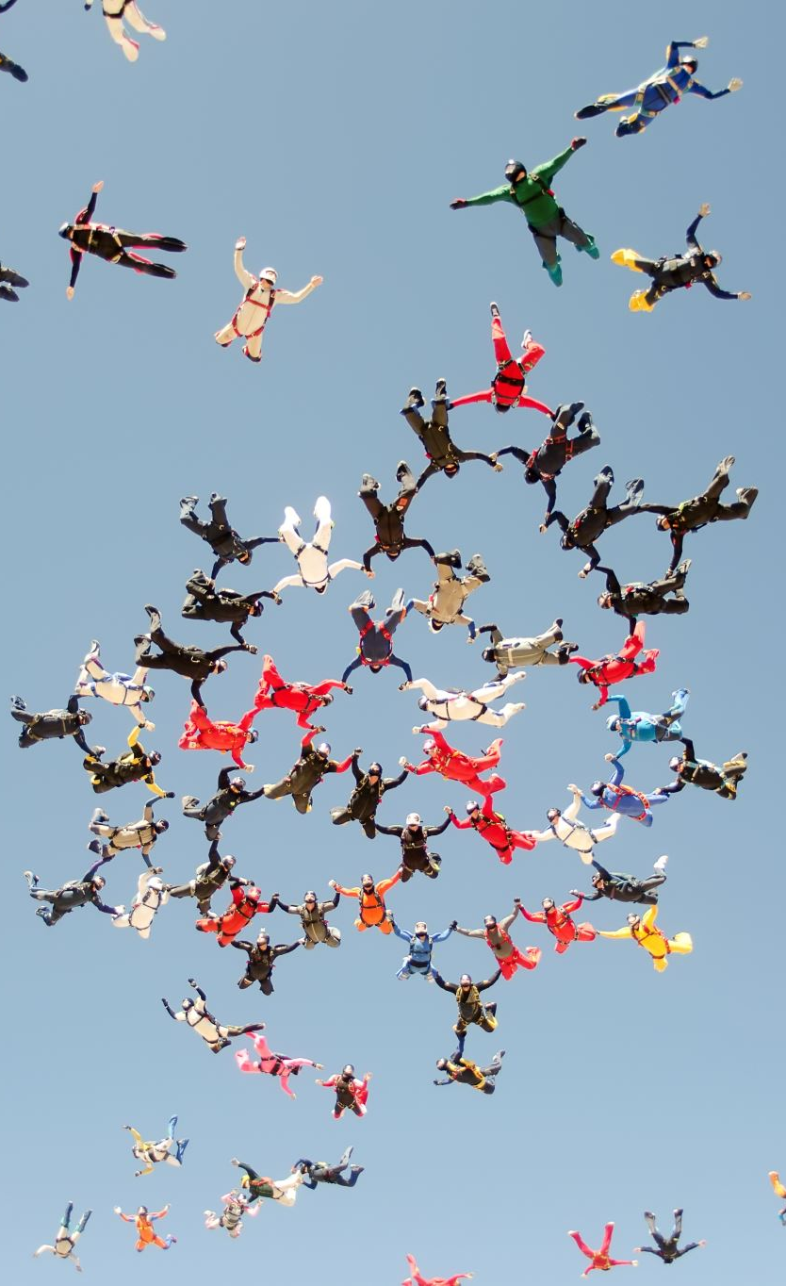
An Ethic of Care
Criticisms of an Ethic of Care
  Care ethics
    Reflects unjust favoritism.
    Is so demanding that it leads to burnout.
Notes:
2.5.3: Criticisms of an Ethic of Care
Point 1 – What are some criticisms of care ethics?
It reflects unjust favoritism.
Its demands can lead to burnout.

Slide 27

Integrating Utility, Rights, Justice, and Caring
Evaluate an approach to business ethics that combines four main moral standards
  Distinctive standards of utility, rights, justice, and care
    Analyses of costs and benefits of using resources.
    Prescriptions for how individuals should be treated.
    Prescriptions for how burdens and benefits should be distributed.
    Prescriptions for what we owe to those with whom we have special relationships.
The Four Moral Considerations and Behavior
  Elements of the four moral models as blueprints for behavior.
    Maximizing benefits and minimizing harms.
    Respect for moral rights.
    Promotion of just distribution of benefits and burdens.
    Exhibiting appropriate care.
Notes:
2.6: Evaluate an approach to business ethics that combines four main moral standards
Point 1 – What are the distinctive standards of utility, rights, justice, and care?
Analyses of costs and benefits of using resources.
Prescriptions for how individuals should be treated.
Prescriptions for how burdens and benefits should be distributed.
Prescriptions for what we owe to those with whom we have special relationships.
2.6.1: The Four Moral Considerations and Behavior
Point 1 – How can a combination of the four moral models provide blueprints for our behavior?
Our actions should maximize benefits and minimize harms.
Our actions should be consistent with the moral rights of affected persons.
Our actions should lead to a just distribution of benefits and burdens.
Our actions should exhibit the appropriate care for those around us.

Slide 28
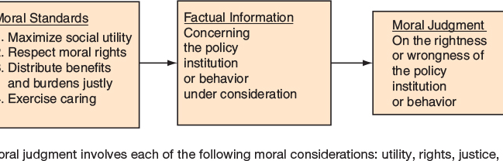
Figure 2
The Process of Making a Moral Judgment

Slide 29
2.6: Integrating Utility, Rights, Justice, and Caring (2 of 2)
2.6.2: Relating Moral Standards to Each Other
  Moral standards relate to each other when moral judgments are based on:
    Maximizing the action’s net utility.
    Respecting moral rights.
    Ensuring just distribution of benefits and burdens.
    Caring for those in concrete relations to us.
Notes:
2.6.2: Relating Moral Standards to Each Other
Point 1 – How do the moral standards relate to each other?
Moral judgments should be based on:
Maximizing the action’s net utility.
Respecting moral rights.
Ensuring just distribution of benefits and burdens.
Caring for those in concrete relations to us.

Slide 30
Case Study: Traidos Bank and Roche’s Drug Trials in China
  Triodos’ six principles of moral decision-making
    Promote sustainable development.
    Respect and obey the law.
    Respect human rights.
    Respect the environment.
    Be accountable.
    Continuously improve.
Responses to the Bank's Decision
  Roche’s dilemma
    The moral problem offset by the practicalities of selling the resulting drug in China.
Notes:
Case Study 2.1: Traidos Bank and Roche’s Drug Trials in China
Point 1 – What decision did Triodos Bank make in 2010?
To remove Roche from its investment portfolio because the results of Roche’s clinical trials with transplanted organs in China were falling short of the bank’s investment criteria for selection.
Point 2 – What six principles does Triodos Bank claim as guides to their decision-making?
Promote sustainable development.
Respect and obey the law.
Respect human rights.
Respect the environment.
Be accountable.
Continuously improve.
Responses to the Bank's Decision
Point 1 – What was Roche’s response?
It was apparently already concerned about the use of organs from non- or involuntary participants (Chinese prisoners).
It also claimed, however, that it could not market a drug in China if the company did not test it there.
Roche used a utilitarian decision-making model.

Slide 31
Case Study: Testing Drugs in the Developing World
  Concerns about testing drugs in the developing world.
    Vulnerability to exploitation.
The Problem of Finding Ways to Test Drugs
  Limitations on drug companies.
    Opportunities for testing.
Notes:
Case Study 2.2: Testing Drugs in the Developing World
Point 1 – What are some concerns with testing drugs in the developing world?
Participants may be more easily manipulated than participants in wealthier countries.
Participants may be exploited.
Participants may not receive existing treatments, since researchers may claim those treatments aren’t available to those patients anyway.
The Problem of Finding Ways to Test Drugs
Point 1 – Why do some companies pursue testing drugs in developing countries?
Sometimes, they do not have the opportunities to test them elsewhere, as when, for example, there is a meningitis outbreak.

