Slide 1
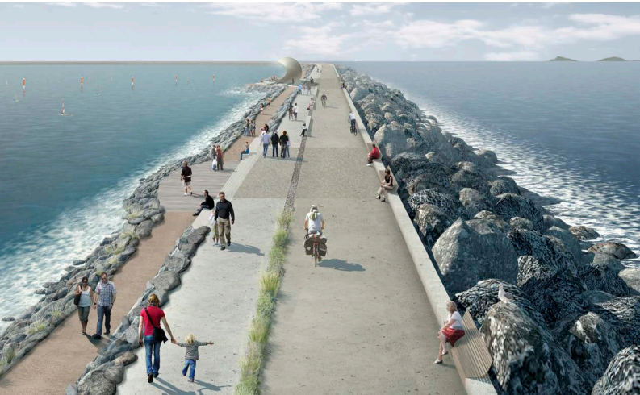
Swansea Bay Tidal Lagoon EIA analysis
Mateusz Pucilowski
2206720

Slide 2
Introduction
Large scale development projects in the UK often require EIAs to be conducted
Environmental Impact Assessments (EIAs) aim to help avoid and mitigate anthropogenic impacts on the environment due to land use changes
Renewable energy projects benefit from quantitative data and prediction models to assess benefits versus potential impacts on the environment
Green infrastructure is another area incorporated into development projects in Wales

Slide 3
EIA Overview
EIAs were first introduced in the EU in 1985 with directive (85/337/EEC) and been updated since (DHPLG, 2018)
In the UK, EIAs are governed by the Town and Country Planning (EIA) Regulations 2017, which stems down from the EU directive (Glasson et al., 2019)
Projects fall under Annex 1 (EIAs mandatory) or Annex 2 (EIAs decided on a case by case basis) (Dobreva, 2018)
The process is split into 5 stages: screening, scoping, preparing an environmental statement, planning application and consultation, and decision making (gov, 2020)
Public consultation is a big part of the decision making process (Hendry, 2016)
Projects on coastal areas can suffer from delays due to separate legislations concerning land and marine construction (Hamlyn, 2015)
Notes:
Dhplg
Glasson 2019
Dobreva
Gov 2020
Hendry 2016
hamlyn

Slide 4
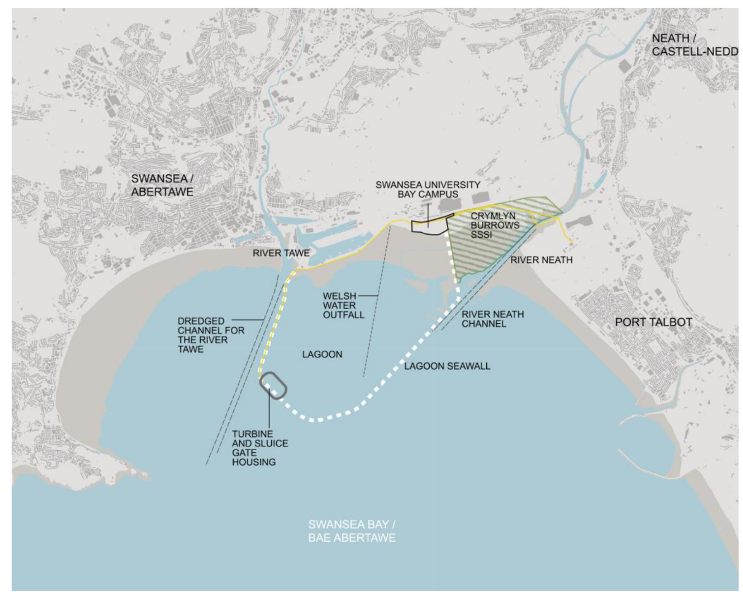
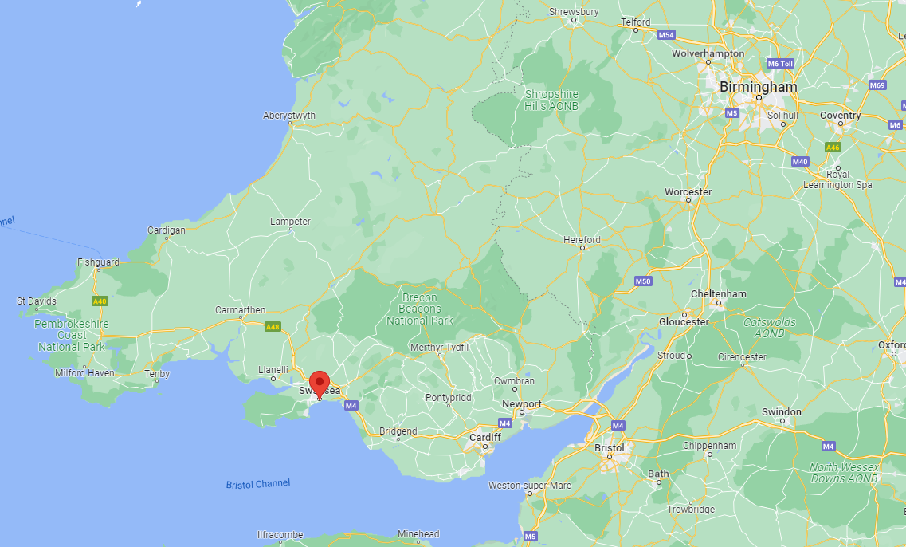
Case study: Swansea Bay Tidal Lagoon
The proposed development area
(TLSB, 2014)
Location of Swansea in South Wales
(Google maps, 2023)
Notes:
Tlsb technical summary

Slide 5
Case study: Swansea Bay Tidal Lagoon
Project falls within Schedule 1 Regulation 15 of EIA regulations in the UK (Dobreva, 2018)
The Tidal Lagoon would be the first of its kind in the world (Langley and Evans, 2017)
Extensive surveys were conducted within Swansea Bay, taking multiple impacts and mitigation measures into consideration
Initially surveys were re-commissioned due to major omissions
The project design followed legislation in context of the Well-being of Future Generations Act 2015, with bio-positive design and special consideration given to local Sites of Special Scientific Interest (SSSIs)
The potential 120 year life-span of the project, the project had potential to reduce greenhouse gas emissions more than when compared to shorter life-span projects such as solar farms (Guo, 2022)
Impacts on climate change due to construction and material production are omitted in renewable energy projects (Simon, 2015)
Notes:
Langley
Well being
Guo
simon

Slide 6
Conclusion
EIAs have been under review since their introduction in 1985, constantly adapting to new knowledge and technology
Main goal is to provide a comprehensive review of impacts versus benefits of projects, especially in the context of renewable energy
Issues still exist within the EIA process, such as when developing on both land and water
Omissions within the official process exist, and are significant in renewable energy projects when concerning greenhouse gas emissions due to material production
Wales has additional legislation which supports the existing UK and EU directives

Slide 7
References
CIEEM (2019) About CIEEM. Available at: https://cieem.net/about-cieem/ (Accessed: 09/01/2023)
DHPLG (2018) ‘Guidelines for Planning Authorities and An Bord Pleanála on carrying out Environmental Impact Assessment’, (August), p. 122.
Dobreva, S. (2018) Introduction to the EIA and SEA Directives.
Glasson, T. and C. (2019) An Introduction to Environmental Impact Assessment 4th Edn, The Natural and Build Environment Series. Book
Government (2020) Environment Impact Assessment. Available at: https://www.gov.uk/guidance/environmental-impact-assessment (Accessed: 08/01/2023)
Guo, B. (2022) Hydro-environmental Modelling and Interaction of Tidal Lagoons around the UK Coast.
Hamlyn, V. J. (2015) the Legal Regimes Governing Marine Renewable Energy in England and Wales, University of Plymouth Research Thesis.
Hendry, C. (2016) The Role of Tidal Circularisation.
Langley, E. and Evans, P. (2017) ‘Impacts of a Tidal Lagoon on Urban Drainage and Pollutant Dispersion Impacts in a Coastal Embayment’, in, pp. 1144-1-1144–10.
Simon, P. (2015) Assessment of embodied energy and carbon emissions of the Swansea Bay Tidal Lagoon From a life cycle perspective. Book
TLSB (2014) ‘The Proposed Tidal Lagoon Swansea Bay ( Generating Station ) Order’, 8(February), pp. 1–41.
UNECE (2014) ‘Good Practice Recommendations on Public Participation in Strategic Environmental Assessment’, Economic and Social Council.
Welsh Government (2015) ‘Well-being of Future Generations (Wales) Act 2015: The Essentials’, p. 1-12.

Slide 8
Questions

