Slide 1
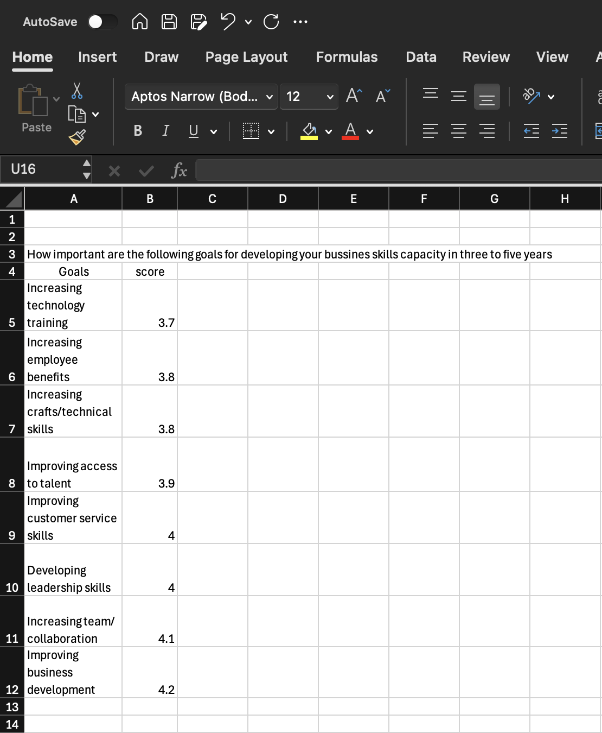
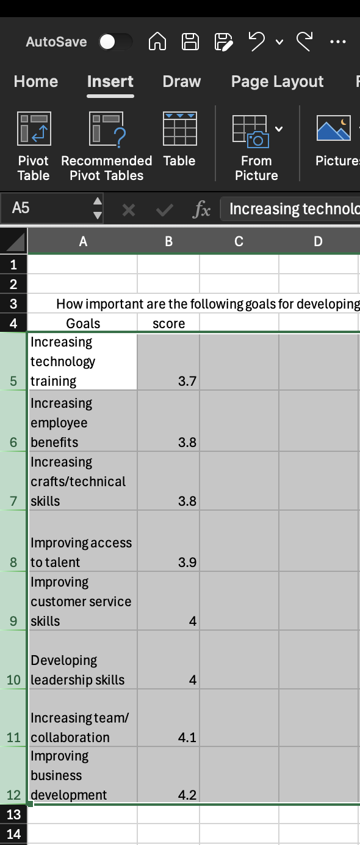
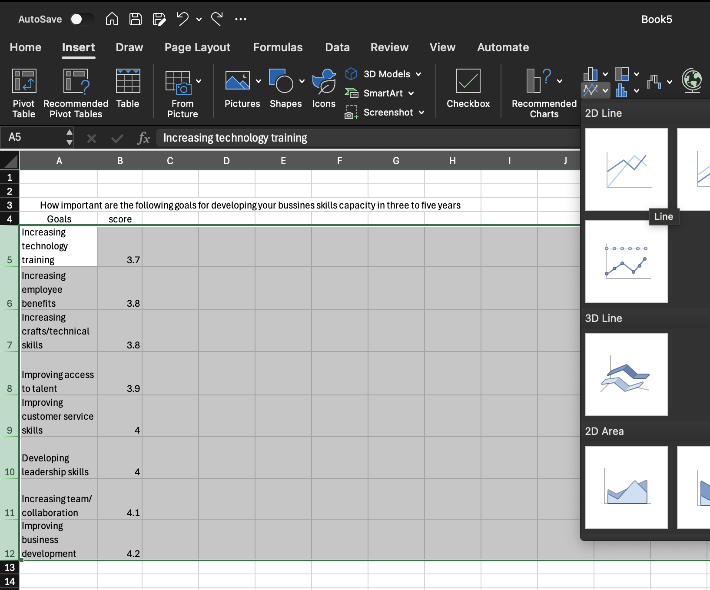
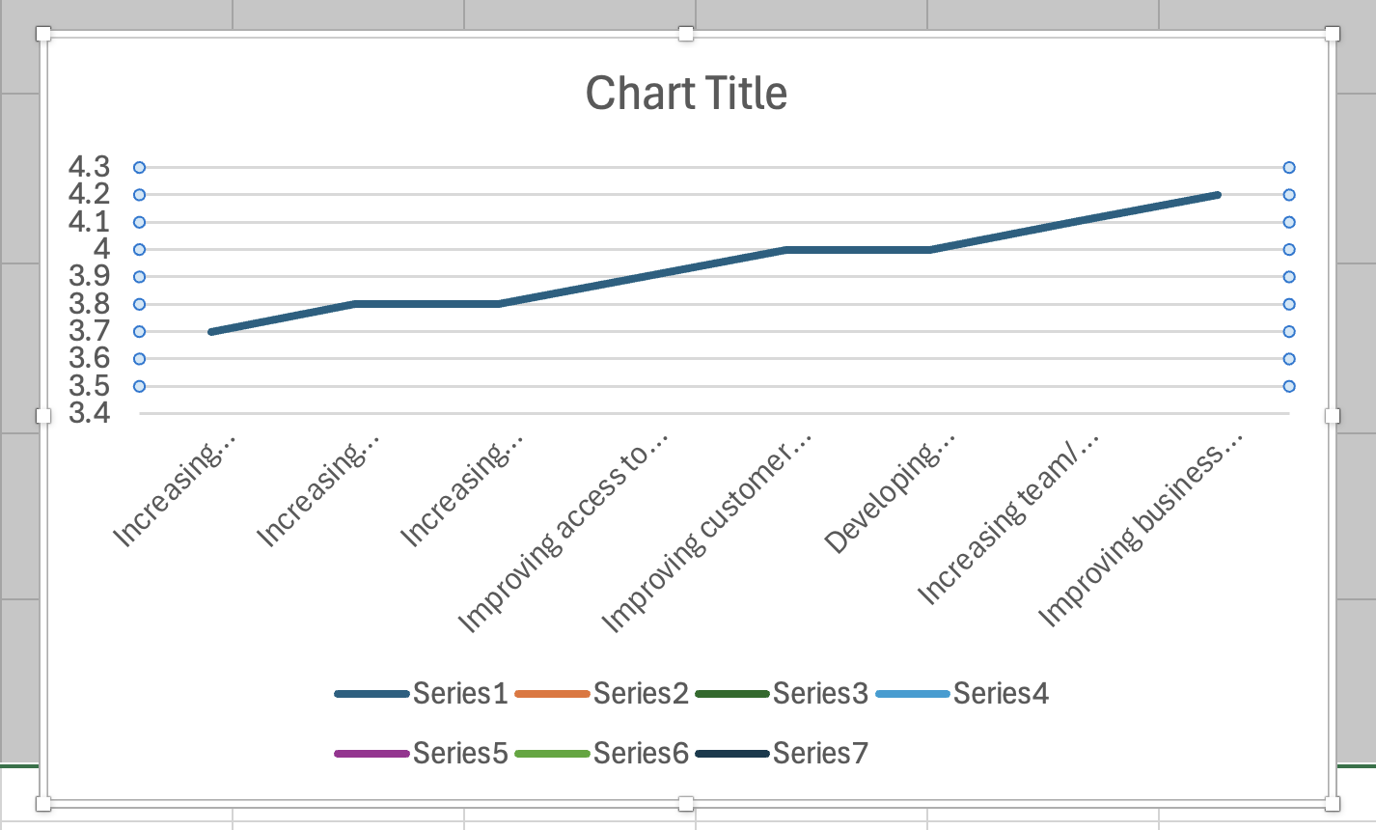
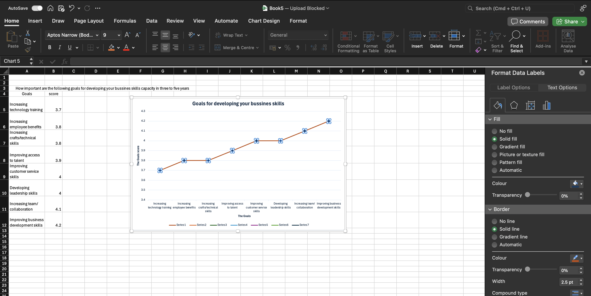
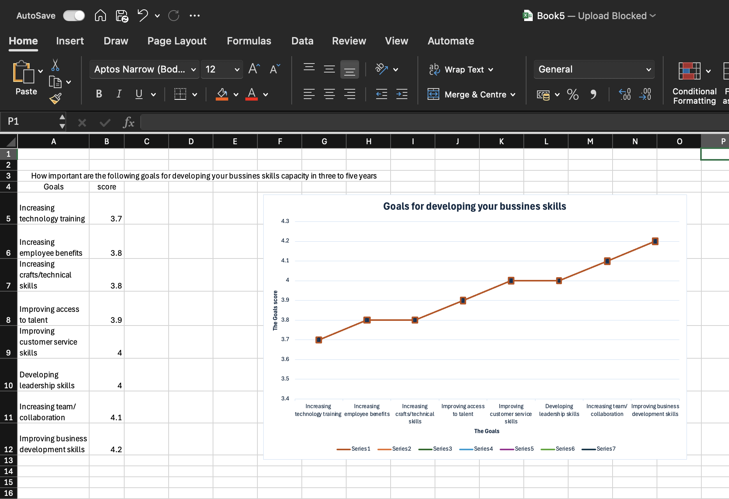

How to create a chart in Excel
Enter your data in rows, with one row for each sample.
Remember the heading should also help you to keep track of what everything is
Generate a chart.
Highlight the relevant cells. Select(highlight) the cells containing the sample statistic of interest.
Watch Pic. 2
Next Insert a Line Chart
You can do this by navigating to the Insert tab, in the Charts selection of the ribbon click on the Insert Line Chart dropdown list and select the first option under 2-D Line
Select this option to insert the chart into your spreadsheet, as shown.
Watch Pic. 3
Adjust the size of the chart as required.
Click on the chart, and then drag (left click, and move the mouse while holding the left mouse button) any of the 8 handles (small squares on the border of the chart) to resize the chart.
Pic.4
Pic.1 Sample Statistics
Pic.2 Selecting Chart Data
Pic.3 Inserting Chart
Format the Run Line (Data Points)
Now if you want you can change the line color. To do so you have to select the Marker sub-option in the task pane and under that Marker options.
Also choose the Built-in option if you want to visualize the data a bit more. You can choose different shape and size of the marker if you prefer
Wath Pic.5
Pic.4 Inserting Chart
To add axes titles:
Click on 'Add Chart Elements', select the 'Axes Titles' option, and enter the name in the new space that appears in the chart.
Wath Pic.6
Pic.5 Formatting Run Line
Pic.6 To Add Axes Titles
Inna Romanovych
2516135@student.uwtsd.ac.uk

