Slide 1

Digital Inequalities and Welsh Policies

Slide 2

Aims and Objectives
Aim: To consider the causes and impacts of digital inequalities and the impact of Welsh policies.
Define inequality.
Discuss different digital and health inequalities.
Hypothesise the impact of different inequalities.
Discuss Welsh policies aimed at reducing digital inequalities

Slide 3

Inequality
What does this term mean?

Slide 4
Inequality
We often refer to social inequality or health inequality here.
Social – uneven distribution of resources.
Health - unfair, avoidable differences in health

Slide 5
Inequality
Inequality of outcome
Inequality of access
Inequality of use
Inequalities in service provision

Slide 6
Health Inequality
"…the unjust and avoidable differences in people’s health across the population and between specific population groups.
Health equity a more appropriate term?
Determined by circumstances largely beyond an individual’s control. These circumstances disadvantage people and limit their chance to live longer, healthier lives…
The existence of health inequalities in the UK means that the right of everyone to the highest attainable standard of physical and mental health is not being enjoyed equally.

Slide 7
Health Inequalities
“ Drive to tackle healthcare gulf”
“ North – South health divide widening
“ Is Glasgow bad for your health?”
“ Poorer Scottish men die younger
“ Poor less likely to survive cancer”
“ Health divide starts from birth”
“Universal credit claimants dying younger as rich live longer”
“Covid-19 is still worsening health inequality. Why hasn't anything been done?”
“What do we know about Covid-19 inequalities among people from minority ethnic groups?”

Slide 8
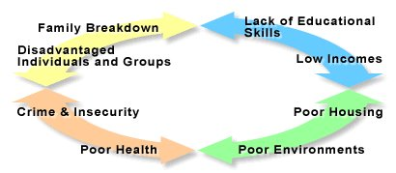
Cycle of Deprivation

Slide 9
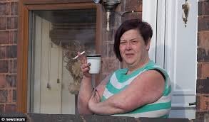
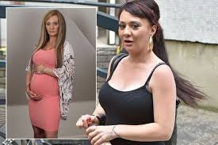
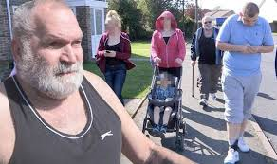
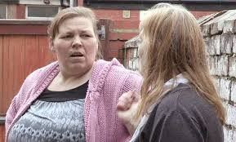

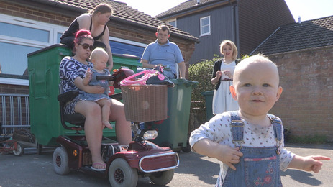
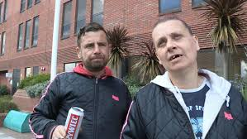
Today’s Underclass

Slide 10

Health Inequalities reports since 1980’s
These reports revealed:
The nature of health inequalities
The scale of the health inequalities
The causes of these health inequalities in the UK
The Black Report 1980
The Health Divide 1987
The Acheson Report 1998
The Marmort Review
2010

Slide 11



The Black Report 1980
Income
Unemployment
Environment
Poor housing
Poor education
Health of the nation overall had improved but..
Gap between health of rich and poor was getting bigger
Inequalities started at birth and continued all through life
Professional class people could expect to live five years longer than unskilled manual class
Differences were result of different social and economic conditions.

Slide 12
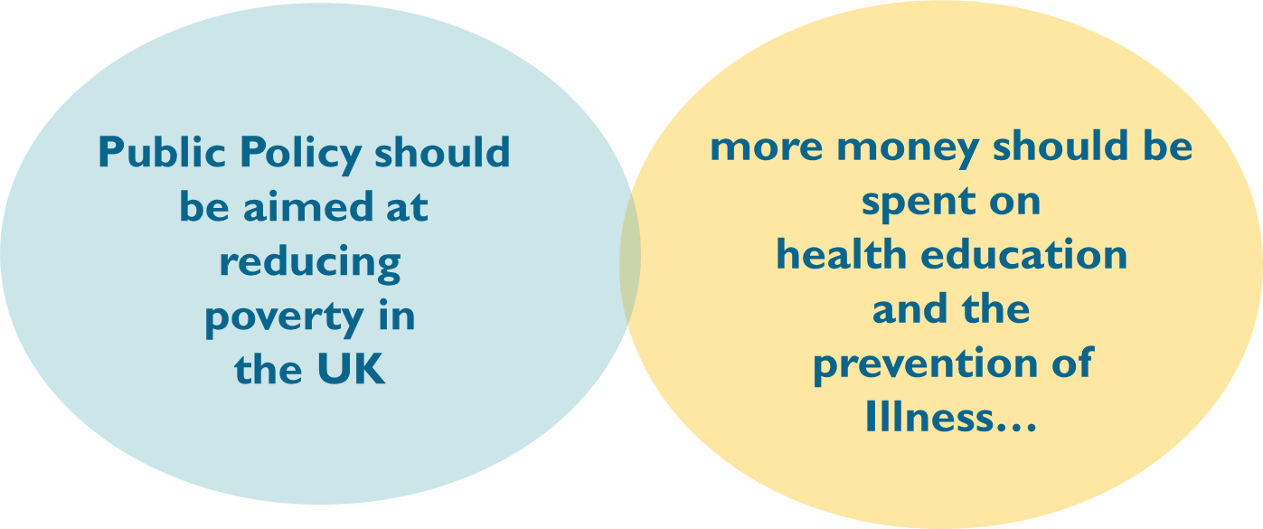
The Black Report 1980
37 recommendations: focused on two main areas:

Slide 13
The Black Report 1980
37 recommendations: focused on two main areas:
Scrapped by the Government

Slide 14
The Health Divide 1987
Aim of report to update the evidence on inequalities in health and to assess the progress made since the Black Report six year earlier
The report also found social class to be one of the main causes of inequalities in health
Root cause of ill-healthy = Poverty
Notes:
The World Health Organisatzation played a leading role in the Health Promotion Movement in the 1980s
The first International Conference on Health Promotion was held in Ottowa on November 21st 1986 (to be revisited in future lectures)
Introduced a revised definition of health…
in dynamic terms of resiliency, in other words, as "a resource for living".
Acknowledged the importance of health education
proposed a wider agenda which involved modifying circumstances, environment and policy to become more "Health Promoting"
So that people would have opportunities to choose a healthier lifestyle
Recognition that peoples capacity to take action was limited by environmental/social circumstances.
1984 WHO ^{10]} Thus, health referred to the ability to maintain homeostasis and recover from insults. Mental, intellectual, emotional and social health referred to a person's ability to handle stress, to acquire skills, to maintain relationships, all of which form resources for resiliency and independent living.^{[9]} This opens up many possibilities for health to be taught, strengthened and learned.
World Health Organization. Regional Office for Europe (1984). Health promotion : a discussion document on the concept and principles : summary report of the Working Group on Concept and Principles of Health Promotion, Copenhagen, 9–13 July 1984 (ICP/HSR 602(m01)5 p). Copenhagen: WHO Regional Office for Europe.

Slide 15
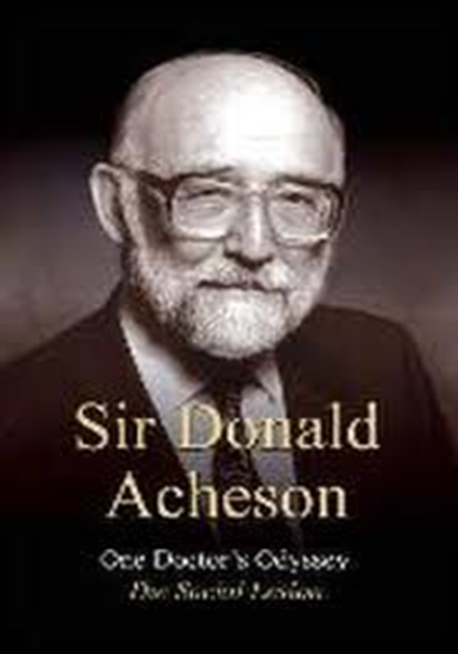
The Acheson Report (1998)
An independent study into health inequality…
Commissioned by the new Labour government in 1997
Under the chairmanship of a former Chief Medical Officer for England and Wales, Sir Donald Acheson…
Remit: to investigate health inequalities in the UK…

Slide 16

The Acheson Report (1998) key findings
Children from poor families weighed on average less than those from wealthy families
Infant mortality rates:
  7/1000 – lower social classes
  5/1000 – upper social classes
Long term illness
  17% of professional men aged 45-64
  48% of lower class men aged 45-64
Income levels
  2.2 million children live on income levels 50% below the national average
Health campaigns
  Higher uptake of screening amongst upper social classes – widened health gap
Notes:
The World Health Organisatzation played a leading role in the Health Promotion Movement in the 1980s
The first International Conference on Health Promotion was held in Ottowa on November 21st 1986 (to be revisited in future lectures)
Introduced a revised definition of health…
in dynamic terms of resiliency, in other words, as "a resource for living".
Acknowledged the importance of health education
proposed a wider agenda which involved modifying circumstances, environment and policy to become more "Health Promoting"
So that people would have opportunities to choose a healthier lifestyle
Recognition that peoples capacity to take action was limited by environmental/social circumstances.
1984 WHO ^{10]} Thus, health referred to the ability to maintain homeostasis and recover from insults. Mental, intellectual, emotional and social health referred to a person's ability to handle stress, to acquire skills, to maintain relationships, all of which form resources for resiliency and independent living.^{[9]} This opens up many possibilities for health to be taught, strengthened and learned.
World Health Organization. Regional Office for Europe (1984). Health promotion : a discussion document on the concept and principles : summary report of the Working Group on Concept and Principles of Health Promotion, Copenhagen, 9–13 July 1984 (ICP/HSR 602(m01)5 p). Copenhagen: WHO Regional Office for Europe.

Slide 17
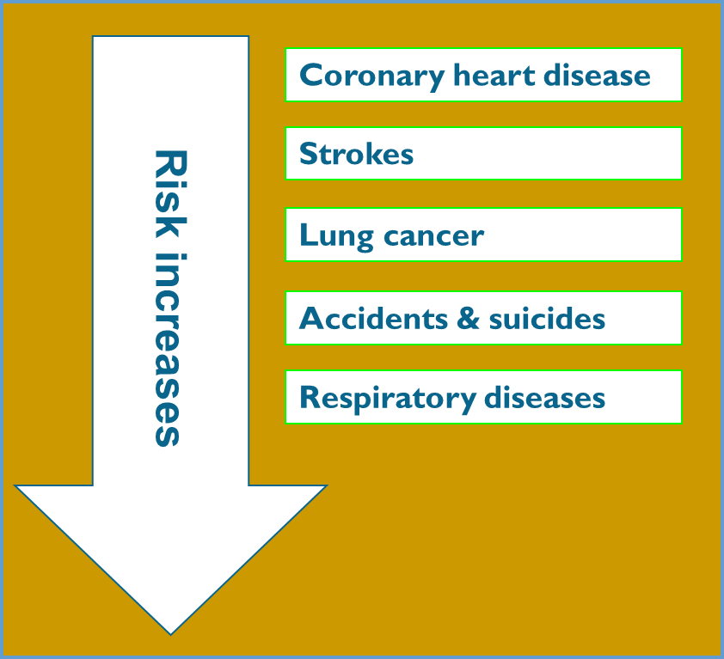
The Acheson Report (1998) key findings
Poor men are 68% more likely to die in middle age than richer men.
Poor women are 55% more likely to die young.
Health inequalities start before birth
A key factor in low weight babies is the mother’s birth weight and her pre-pregnant weight.

Slide 18

The Acheson Report recommendations
The root cause of inequality in health was poverty
In order to improve the health of millions, the gap between the richest and the poorest in UK society had to be reduced

Slide 19
Health inequalities are not inevitable or immutable
Health inequalities result from social inequalities ‘causes of the causes’ – the social determinants
Focusing solely on most disadvantaged will not be sufficient – need proportionate universalism’
Reducing health inequalities vital to economy – cost of inaction

Slide 20
Key messages from these studies…
Socio-economic, environmental factors such as education, ethnicity, gender, housing etc have a measurable effect on health.
Social class is frequently implicated in health inequalities and the wealth gap has been steadily widening…
Population health policies should have the dual purpose of promoting health gain in the population as a whole and reducing health inequities…
Actions should be concerned with tackling the wider determinants of health inequalities...

Slide 21

What has happened since 2010 and Marmot?
There have been various attempts to both measure and tackle health inequalities…
Each has taken a different approach based on different understandings of Health
…and different understandings of the causes of health inequalities…

Slide 22
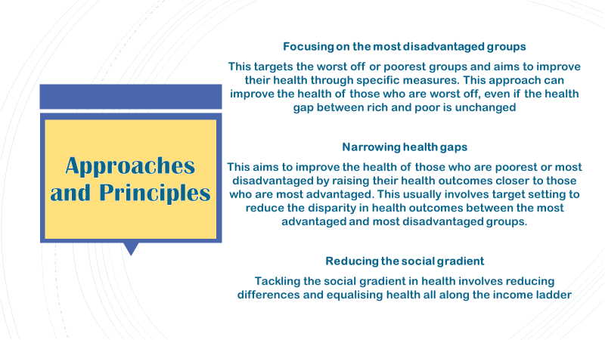
Approaches and Principles
Focusing on the most disadvantaged groups
This targets the worst off or poorest groups and aims to improve their health through specific measures. This approach can improve the health of those who are worst off, even if the health gap between rich and poor is unchanged
Narrowing health gaps
This aims to improve the health of those who are poorest or most disadvantaged by raising their health outcomes closer to those who are most advantaged. This usually involves target setting to reduce the disparity in health outcomes between the most advantaged and most disadvantaged groups.
Reducing the social gradient
Tackling the social gradient in health involves reducing differences and equalising health all along the income ladder
Approaches and Principles

Slide 23
Digital Inequalities
What are digital inequalities?

Slide 24

Digital Inequalities
The gap between those who have digital skills/resources and those who do not.

Slide 25
Digital Inequalities in Children
Up to 20% of children in the UK lack access to necessary tools.
This also includes a lack of digital literacy skills and broadband access.
UNICEF has set out a 10-point plan to close this divide.

Slide 26

Causes of Inequality
What causes inequalities?

Slide 27
Causes of Inequality
Lower socioeconomic backgrounds
Social norms
Technological progression
Automation
Unemployment
Lack of education

Slide 28
Impacts of Inequality
What could all of this lead to?

Slide 29
Impacts of Inequality
Social impacts
Economic impacts
Health impacts
Climate impacts

Slide 30
Impacts of Inequality - Social
Social instability
Unrest
Riots
Protests

Slide 31
Impacts of Inequality - Social
Social stratification
Residential segregation
Undermined institutional trust
Political polarisation
Nationalism

Slide 32

Impacts of Inequality - Economic
Lower economic growth
Discouraged skill accumulation
Choking of social mobility

Slide 33
Impacts of Inequality - Health
Lowered life expectancy
Lack of access to services
Lack of health literacy

Slide 34
Impacts of Inequality - Climate
Vulnerability to climate change
Low-income groups and countries are more vulnerable to the impacts of climate change

Slide 35
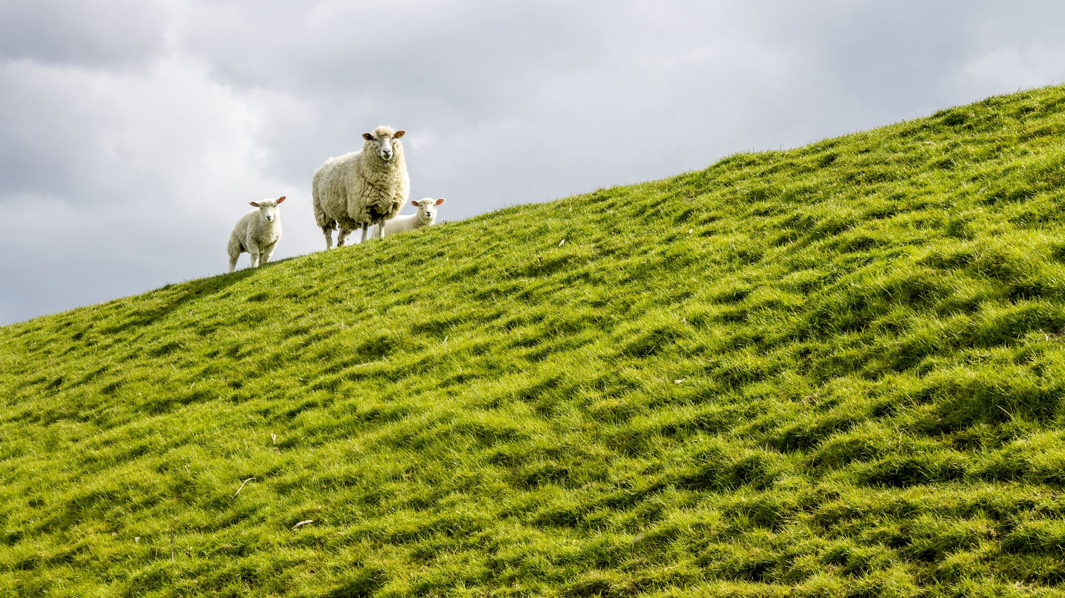
Welsh Policies
Can you think of any policies/Acts of the Senedd that are aimed at tackling inequality?

Slide 36

Welsh Policies
Wales has one of the highest poverty rates in the UK.
29% of children and 21% of working aged people.
One policy in Wales aimed at reducing this is the Socio-economic Duty.

Slide 37
The Socio-economic Duty
Public bodies must ensure that their strategic decisions improve inequality of outcomes for those suffering socioeconomic disadvantages.
https://www.youtube.com/watch?v=UR9_Y-zRDIw

Slide 38
Welsh Policies
An anti-racist Wales
LGBTQ+ Action Plan for Wales
Grassroots Pride Funds
VAWDASV Strategy
Flying Start
Play Sufficiency
And many more!

Slide 39
Next Week
Next week we will be considering the impact of digital experiences on children and young people and looking at digital resilience.
Consider how we can empower children and young people to be digitally resilient.

