Slide 1


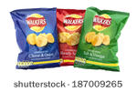
Investigating attitudes towards a Walkers crisps advertisement.
Stephen Busby 1600078.

Slide 2

Introduction.
It has been reported that Walkers crisps ranked first in the UK with crisp sales in the year 2017 valued at 660 million pounds, outperforming all others in the top ten combined. Mccoys ranked in second place at 130 million pounds ("UK: crisp brands by sales value 2017 | Statista", 2018).
This Photo by Unknown Author is licensed under CC BY-SA

Slide 3
Continued…
Research has looked at attitude formation in relation to advertising and has shown that attitudes can be either; attitude towards the brand - where customers are influenced towards a specific product. Also attitude towards the advertisement - where a positive advertisement is constructed to leave the viewer with a lasting positive image of the brand (Shimp, 1981).
The theory of planned behaviour looks at people’s intention to perform a behaviour based on their own attitude towards it – whether it is favourable or not, their perceived control over performing the behaviour – the ease of which it can be carried out, and the influence of social norms – social pressure to perform or not, due to other people’s attitudes towards an object or behaviour (Ajzen, 1991).

Slide 4

Continued.
Following previous research in America that showed negative attitudes towards advertising Shavitt, (1998) set out to examine public attitudes towards advertising in general by conducting a large scale survey where participants were selected by age and media use, although to the best of this authors knowledge the researchers fail to show exactly how many participants took part in their survey. The survey consisted of 17 questions scored with a 5-point Likert scale. The researchers also looked at income, education and race. The results indicated that for gender there was minor differences in attitude with men having a more positive view of advertising. Age differences showed that younger participants aged 18 to 34 viewed advertising more favourably than those aged 34 to 64.
This Photo by Unknown Author is licensed under CC BY-NC

Slide 5

Influences on attitudes towards advertising and brand choice.
Food choice.
Research by Wardle et al., (2004) has shown that eating habits around food choice can differ between men and women. They used self-reporting questionnaires to gain understanding as to the types of foods eaten and the reasons for the choice. They found from approximately 19,000 participants that women were less likely than men to eat fatty foods, were more likely to be dieting and have a positive view of healthy eating. Although this was based on students aged 17 to 30 and so is not representative of society as a whole.
Humour.
The use of humour in advertising has been shown by Eisend, (2009) in a literature review to be positively correlated to attitudes towards an ad, the researcher concluded that humor in advertising enhances peoples attitude towards a brand and their intention to purchase it.
This Photo by Unknown Author is licensed under CC BY-NC-ND

Slide 6
Methodology.
Design.
This study used a between subjects design with the potential to be analysed using a 2x2 analysis of variance (ANOVA)
Hypotheses.
1 – younger participants = favourable attitude.
2 – males = favourable attitude. (Potential Interaction - younger males)
Participants.
20 male and female participants with an age range of 18 to 60.

Slide 7
Procedure.
An online questionnaire was constructed using a modified attitude scale.
Participants were asked to view the Walkers crisps 70th anniversary advertisement and then answer the 10 questions that followed, participants were scored using a 5-point Likert scale, with 1 = strongly disagree, 5 = strongly agree.
https://www.youtube.com/watch?v=7FEzAmAIRMc
Example questions.
Walkers TV ads are entertaining, pleasing and enjoyable.
When I view a good Walkers TV ad I pay full attention to it.
I feel more inclined to buy a product after watching a Walkers TV ad.
Means scores were calculated :-
for age – either young (18 to 35, n = 11)
or old (36 to 60, n = 9)
and gender – either male (n = 10)
or female (n = 10).

Slide 8
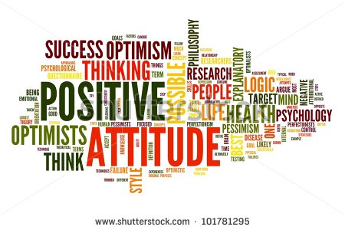
Results.
The table below shows mean scores for age and gender.
Variables | Mean scores
Young – (18 to 35) Old – (36 to 60) | 40.1 36.1
Male Female | 38.3 38.4

Slide 9
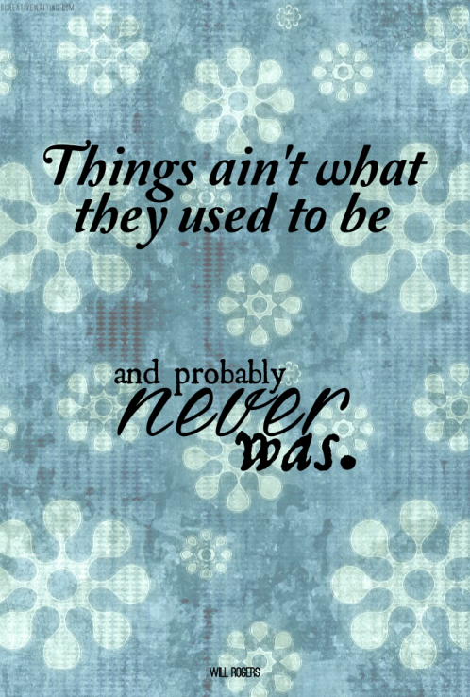
Discussion.
Research by Muehling, Sprott, & Sprott, (2004) with 159 undergraduates aged 18 to 35 who were shown ads to evoke nostalgia and then assessed for their attitude towards the brand and the advertisement. The study showed that participants who viewed the ad deemed nostalgic had significantly more favorable attitudes than the control group. This researchers manipulated the viewing of nostalgic ads by incorporating them within a run of adverts, this is a positive as it reduces the chance of the participant influencing the results. The researchers could have measured differences in age ranges.
This Photo by Unknown Author is licensed under CC BY-NC-ND

Slide 10
Continued.
Mere exposure.
Research by Zajonc, (1968) has looked at the relationship between repeated exposure to a stimulus and attitudes that are formed and found support for the idea that either positive or negative attitudes can be formed after repeated exposure. Although he does acknowledge that the frequency and duration of exposure as well as the intervals between exposure could affect the formation of an attitude.
Limitations. Future research.
Small sample size. Address these issues.
Unverified scale. Assess attitudes of more specific age groups.
Weak rationale. Include the responses of gender neutral individuals.

Slide 11
References.
Ajzen, I. (1991). The theory of planned behavior. Organizational behavior and human decision processes, 50(2), 179-211.
Eisend, M. (2009). A meta-analysis of humor in advertising. Journal of the Academy of Marketing Science, 37(2), 191-203.
Google Images. (2018). Retrieved 2018, from https://images.google.com/
Muehling, D. D., Sprott, D. E., & Sprott, D. E. (2004). The power of reflection: An empirical examination of nostalgia advertising effects. Journal of Advertising, 33(3), 25-35.
Shavitt, S., Lowrey, P., & Haefner, J. (1998). Public attitudes toward advertising: More favorable than you might think. Journal of advertising research, 38(4), 7-22.
Shimp, T. (1981). Attitude toward the AD as a Mediator of Consumer Brand Choice. Journal of Advertising., 10(2), 9-48.
Stock Photos, Royalty-Free Images and Vectors | Shutterstock. Retrieved 2018, from https://www.shutterstock.com/
UK: crisp brands by sales value 2017 | Statista. (2018). Statista. Retrieved 27 April 2018, from https://www.statista.com/statistics/788112/leading-crisp-brands-ranked-by-sales-value-in-the-united-kingdom/
Wardle, J., Haase, A. M., Steptoe, A., Nillapun, M., Jonwutiwes, K., & Bellisie, F. (2004). Gender differences in food choice: the contribution of health beliefs and dieting. Annals of Behavioral Medicine, 27(2), 107-116.
Zajonc, R. (1968). Attitudinal effects of mere exposure. Journal of Personality and Social Psychology., 9(2p2), 1-27.

