Slide 1
ECWB7004
Global Citizenship and
Sustainability
Session 3

Slide 2
Topic 2: Sustainability and Sustainable Development
Session 3: Understanding Sustainability and Sustainable Development
Session 4: Sustainable Development Goals

Slide 3
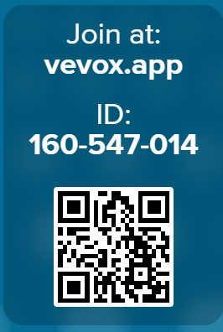
Warm up: is it sustainable or not?
Please use the QR code on the right-hand side or through the link below to take part in the activity:
https://uwtsd.display.vevox.com#/present/857863/8Z4CUX8Q7YOWDPWN89JZ
You will see 6 images.
Please make a judgement on each image on whether it is ‘sustainable’, ‘unsustainable’ or ‘it depends’.

Slide 4
Warm up: is it sustainable or not?
Now that you have chosen your answers, please consider the following questions:
What criteria are you using to decide?
Where did disagreement emerge—and why?
Are you thinking environmentally, socially, economically—or all three?

Slide 5
Sustainability and Sustainable Development
When did the term ‘sustainable development’ originate?
What are the definitions of sustainable development?
Why did the discussion of sustainability and sustainable development become important?
Sustainable development goals (UN).

Slide 6
Workshop
Investigate the questions in groups, present key ideas in PowerPoint slides and report back to class:
How did the concept of sustainable development emerge.
What is the relationship between growth and sustainable development?
Sustainable Development: Definitions, Goals, and Achievements
*You need to identify key ideas, key historical events and draw links between them to answer the above questions.

Slide 7
Useful Resources for the Workshop
Pisani, J. A. D. (2006) Sustainable Development – Historical Roots of the Concept, Environmental Sciences, 3(2):83-96
National Assembly for Wales (2015) Quick Guide to Sustainable Development: History and Concepts
UN Sustainable Development Goals
The Sustainable Development Goals Report 2022
The Sustainable Development Goals Report 2023

