Slide 1

Student Name: Nazish Shahid
Student Number: 2330299
Lecturer’s name: Neale Haddon
Module Code: BMHP6029
Module Title: Psychological Classifications and Provisions
Title of Poster: A Critical Review and Analysis of Generalised Anxiety Disorder

Slide 2
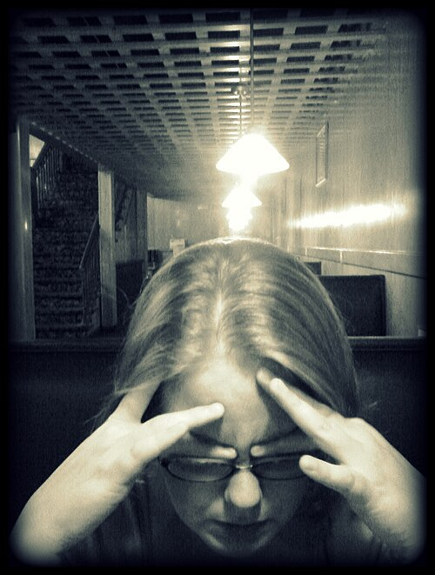
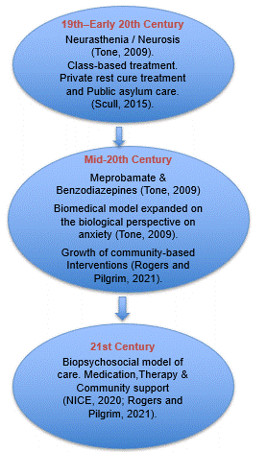
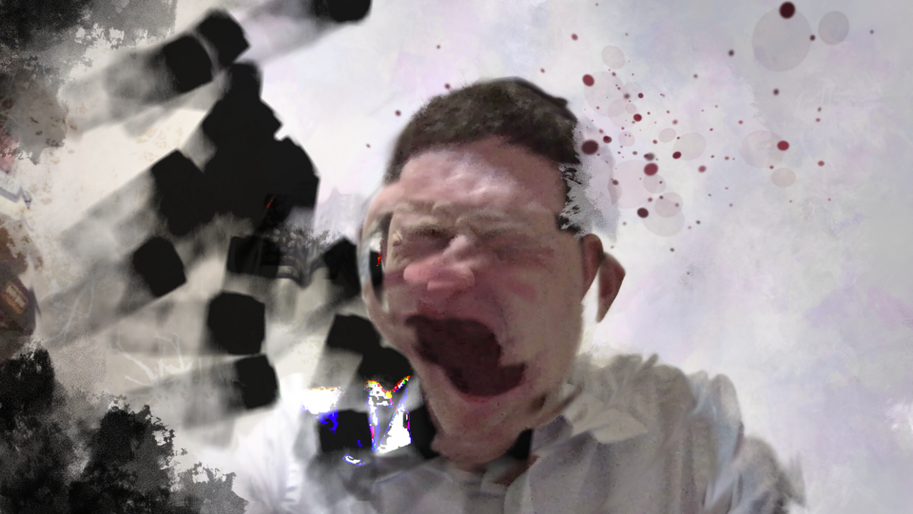

A Critical Review and Analysis of Generalised Anxiety Disorder
Biopsychosocial causes and factors of maintenance of GAD
Historical Stages of Care
ICD-11 Disease Classification
Generalised Anxiety Disorder (GAD): classified under ICD-11 code 6B00 (WHO, 2024).
Chronic and uncontrollable worry in a variety of domains (WHO, 2024).
Symptoms: Muscle tension, restlessness, insomnia, gastrointestinal disorders, sweating and palpitations (WHO, 2024).
Mental disorder diagnosis: Distress, Dysfunction and Duration help to distinguish from normal stress
(Davis, 2009).
Biological Factors
Genetic vulnerability and the dysregulation of the stress-response systems may make an individual more vulnerable to anxiety disorders (Bandelow and Michaelis, 2015).
Psychological Factors
Maladaptive worry, negative thinking and intolerance of uncertainty also perpetuate the symptoms of GAD (Wilson et al., 2023).
Social Factors
Unemployment and housing insecurity linked to an increased risk for anxiety disorders
(Rogers and Pilgrim, 2021).
(Wikimedia Commons, 2009)
Stepped Care Model In The UK
NHS Talking Therapies for Anxiety and Depression (NICE, 2020).
Stepped-care Model with the least intensive treatment first (NICE, 2020).
STEP 1
Identifying the Signs
Targeted Screening
STEP 2
Guided self-help
Psychoeducation
Digital interventions
STEP 3
One-to-one Cognitive Behavioural Therapies (CBT).
Applied relaxation
Specialist psychological interventions
Wikimedia Commons (2021)
(Zimmermann,, 2023)

Slide 3

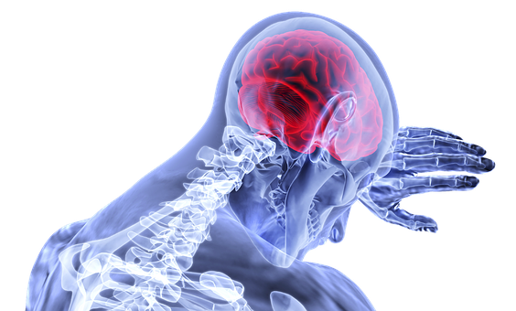
A Critical Review and Analysis of Generalised Anxiety Disorder
Clinical Approaches Of Treatment
Social Impact on GAD
Inequality in care Provision
Cognitive Behavioural Therapy (CBT): Targets maladaptive thought patterns and avoidance behaviours
(Beck, 2011; Cuijpers et al., 2014).
Metacognitive Therapy: Focuses on beliefs about worrying and thinking control
(Wells, 1995).
Intolerance of Uncertainty Model: Designed to help people become more tolerant of uncertainty and ambiguity
(Wilson et al., 2023).
Pharmacological treatment:
Primary choice SSRIs. Long-term
benzodiazepine use is not recommended
because of the risk of dependency
(Bandelow et al, 2017).
GAD is about twice as common in women as in men (Bandelow and Michaelis, 2015).
Men may not report symptoms due to stigma and difficulties accessing support
(Thornicroft et al., 2016).
Social inequalities have direct impact on treatment and long-term recovery
(Rogers and Pilgrim, 2021).
Private Healthcare - Improved occupational retention, earlier stabilisation and faster access to therapy
(Rogers and Pilgrim, 2021).
Public Waiting Lists- Delayed intervention and increased risk of symptom deterioration prior to treatment
(Rogers and Pilgrim, 2021).
Unequal access to psychological treatments can exacerbate and maintain socioeconomic inequalities (Rogers and Pilgrim, 2021).
Future Policy Recommendations
Trauma-Informed Care (Rogers and Pilgrim, 2021).
Digital CBT Expansion (NICE, 2020).
Preventive Action (WHO, 2022).
Address Social Determinants (WHO, 2022).
(Physiopedia,2018)

Slide 4

Reference List
Bandelow, B. and Michaelis, S. (2015) ‘Epidemiology of anxiety disorders in the 21st century’, Dialogues in Clinical Neuroscience, 17(3), pp. 327–335. Available at: https://doi.org/10.31887/DCNS.2015.17.3/bbandelow.
Bandelow, B., Michaelis, S. and Wedekind, D. (2017) ‘Treatment of anxiety disorders’, Dialogues in Clinical Neuroscience, 19(2), pp. 93–107. Available at: https://doi.org/10.31887/DCNS.2017.19.2/bbandelow.
Beck, J.S. (2011) Cognitive Behavior Therapy: Basics and Beyond. 2nd edn. New York: Guilford Press.
Books image (no date) Microsoft PowerPoint Stock Image Library. Available at: Microsoft PowerPoint (Accessed: 16 June 2026).
Cuijpers, P., Sijbrandij, M., Koole, S., Huibers, M., Berking, M. and Andersson, G. (2014) ‘Psychological treatment of generalized anxiety disorder: A meta-analysis’, Clinical Psychology Review, 34(2), pp. 130–140. Available at: https://doi.org/10.1016/j.cpr.2014.01.002.
Davis, T. (2009) 'Conceptualizing Psychiatric Disorders Using "Four D's" of Diagnoses', The Internet Journal of Psychiatry, 1(1), pp. 1–5. Available at: https://ispub.com/IJPSY/1/1/5049? (Accessed: 9 June 2026).
Good Healthy Mind (2020) ‘How to Cope with the Fear of Going Crazy’ (image), Good Healthy Mind. Available at: https://medium.com/good-healthy-mind/how-to-cope-with-the-fear-of-going-crazy-good-healthy-mind-a38a58a7a485 (Accessed: 15 June 2026).
National Institute for Health and Care Excellence (NICE) (2020) Generalised anxiety disorder and panic disorder in adults: management (CG113). Available at: https://www.nice.org.uk/guidance/cg113 (Accessed: 10 June 2026).
Physiopedia (2018) Pain stress brain (image). Available at: https://www.physio-pedia.com/Generalised_Anxiety_Disorder#/media/File:Pain_stress_brain.png (Accessed:15 June 2026).
Rogers, A. and Pilgrim, D. (2021) A Sociology of Mental Health and Illness. 6th edn. Maidenhead: Open University Press.
Scull, A. (2015) Madness in Civilization: A Cultural History of Insanity. London: Thames & Hudson.

Slide 5
Reference List
Thornicroft, G., Mehta, N., Clement, S., Evans-Lacko, S., Doherty, M., Rose, D., Koschorke, M., Shidhaye, R., O'Reilly, C. and Henderson, C. (2016) 'Evidence for effective interventions to reduce mental-health-related stigma and discrimination', The Lancet, 387(10023), pp. 1123–1132. Available at: https://www.thelancet.com/journals/lancet/article/PIIS0140-6736(15)00298-6/abstract (Accessed: 10 June 2026)..
Tone, A. (2009) The Age of Anxiety: A History of America's Turbulent Affair with Tranquilizers. New York: Basic Books.
Test tube image (no date) Microsoft PowerPoint Stock Image Library. Available at: Microsoft PowerPoint (Accessed: 14 June 2026).
Wells, A. (1995) ‘Meta-cognition and worry: A cognitive model of generalized anxiety disorder’, Behavioural and Cognitive Psychotherapy, 23(3), pp. 301–320. https://doi.org/10.1017/S1352465800015897
Wikimedia Commons (2009) File: Human stress.jpg. Available at: https://commons.wikimedia.org/wiki/File:Human_stress.jpg (Accessed: 14 June 2026).
Wikimedia Commons (2021) A subjective impression of a panic attack image. Available at: https://commons.wikimedia.org/wiki/File:A_subjective_impression_of_a_panic_attack.png (Accessed: 14 June 2026)
Wilson, E.J., Abbott, M.J. and Norton, A.R. (2023) 'The impact of psychological treatment on intolerance of uncertainty in generalized anxiety disorder: A systematic review and meta-analysis', Journal of Anxiety Disorders, 97, 102729. Available at: https://doi.org/10.1016/j.janxdis.2023.102729 .
World Health Organization (2024) ICD-11 for Mortality and Morbidity Statistics: Generalised anxiety disorder (6B00). Geneva: World Health Organization. Available at: https://icd.who.int/browse/2024-01/mms/en#1712535455 (Accessed: 9 June 2026).
World Health Organization (2022) World Mental Health Report: Transforming Mental Health for All. Geneva: World Health Organization. Available at: https://www.who.int/publications/i/item/9789240049338 (Accessed: 9 June 2026).
Zimmermann, K.A. (2023) Generalized Anxiety Disorder: Causes, Symptoms & Treatment (image). Live Science. Available at: https://www.livescience.com/45781-generalized-anxiety-disorder.html (Accessed: 19 June 2026).

