Slide 1
ECPS4022 Skills for Success in Psychology
Week 3: Being a good communicator of knowledge
"Knowing something is not enough; psychologists must be able to communicate it clearly, ethically and persuasively."

Slide 2
Session 1 (2 Hours): Writing as a psychology student
Session Aim
To develop students’ understanding of the requirements of writing for assessment.

Slide 3
Aim of Assessment
Essays
Report writing
Exams
  The principle is the same
For you (students): To convey your mastery of the subject area being assessed
For us (academics): To judge you based upon transparent criteria

Slide 4
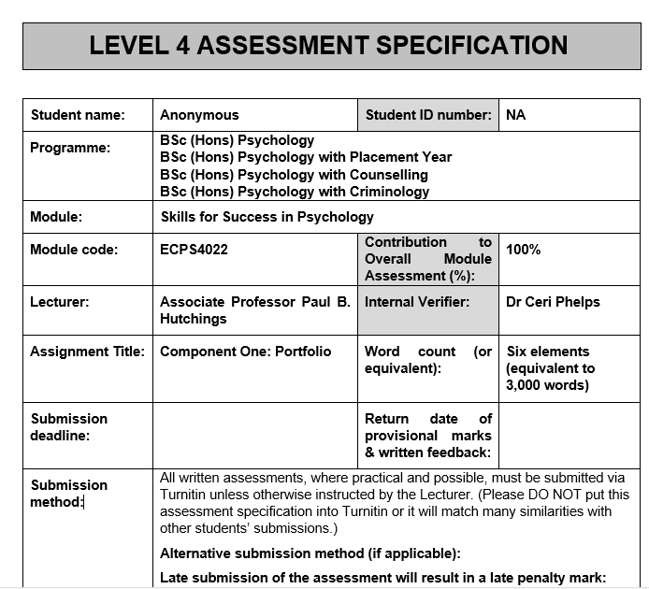
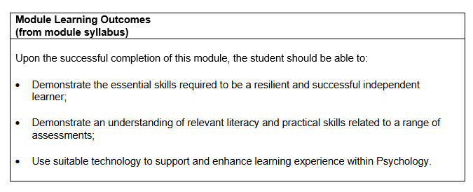
Assessment Proforma

Slide 5
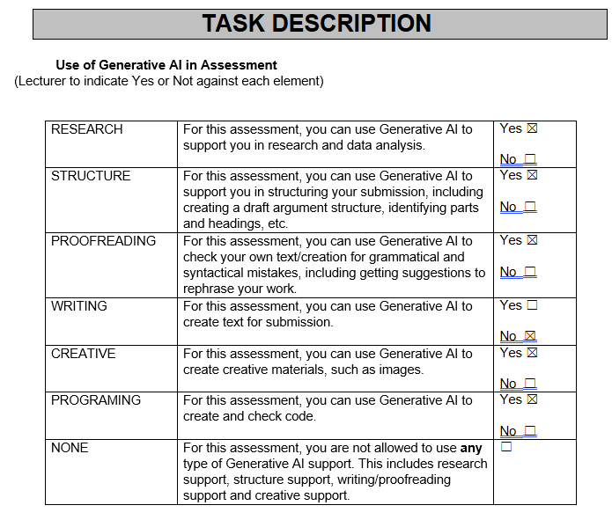
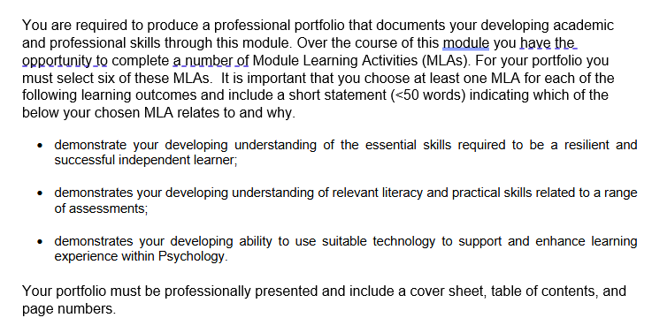

Slide 6
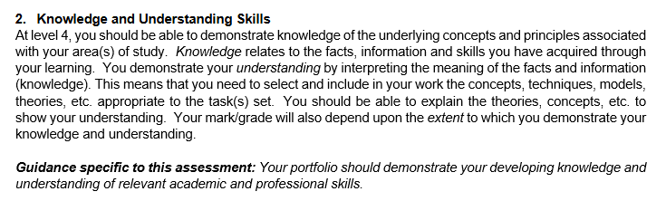
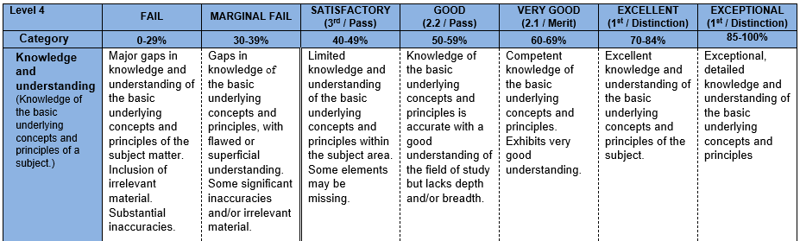

Slide 7
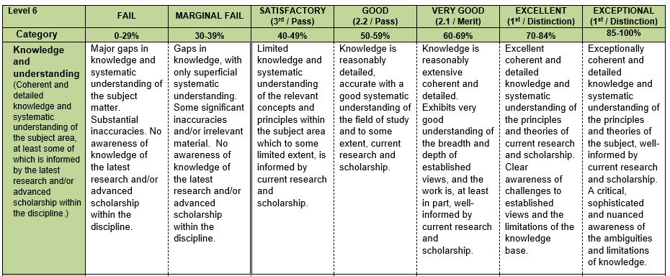

Slide 8
Activity 1: Reading the Proforma (30 minutes)
Can be carried out and discussed in groups
  Read the proforma in its entirety
  What strikes you as key requirements for this assessment based upon the Generic Level Four criteria?

Slide 9
Activity 2: Marking an Essay (1 hour)
You will be given three essays on the same topic
  Assess each essay against the Level Four criteria you have looked at in Activity 1 and give each essay a mark
  What feedback would you give to the writer?
  You will have the same amount of time that we have to assess… 20 minutes per assessment

Slide 10
Session 2 (2 Hours): Finding Your Academic Voice
Session Aim
To develop students' ability to move beyond copying information and instead engage critically with sources.

Slide 11
Why Students May Struggle With Writing
Think good writing appears instantly.
Think academic writing should sound complicated.
Think using long words means writing critically.
Paralysis!
The first step is to take one!

Slide 12
What is Paraphrasing?
Translating ideas into your own language.
Preserving meaning.
Demonstrating understanding.
Avoiding patch-writing.
An intellectual skill, not simply changing words.

Slide 13
What is Synthesis?
Many students summarise sources individually.
Psychologists synthesise.
Example:
  Instead of:
Smith (2010) says A. Jones (2012) says B.
While Smith (2010) suggests A, Jones (2012) argues B, highlighting ongoing debate within the literature. For example, they differ in X, but additional research by Davies (2012) suggests Smith is correct.

Slide 14
Developing Academic Voice
Confidence in writing.
Evidence-based claims.
Academic caution.
Avoiding unsupported assertions.

Slide 15
Activity 3 (MLA9): The Synthesis Puzzle (40 minutes)
Two papers on the same topic:
Does social media affect wellbeing?
In groups, review the information in the papers and identify elements that can be brought from both papers into a summary that addresses the question.

Slide 16
Activity 4: AI as a Research and Writing Tool (15 mins)
Put the two papers from the previous activity into an AI tool and ask it to write a summary.
Is meaning preserved?
Is critical thinking visible?
Is academic integrity maintained?
What is the difference between demonstrating knowledge and demonstrating understanding?

Slide 17
Session 3 (2 Hours): Presenting With Confidence
Session Aim
To develop students' confidence in verbal communication, presentation skills and professional self-expression whilst introducing principles of effective public speaking.

Slide 18
Why Communication Matters in Psychology
Writing is an important part of being a psychology graduate
  The ability to convey knowledge and information in a sustained way
No different for other forms of communication
  Presenting research findings
  Working with clients
  Conducting interviews
  Team meetings
  Professional discussions
  Conference presentations

Slide 19
Presentation Anxiety
Fear of judgement
Imposter syndrome
Perfectionism
Self-consciousness
Cognitive distortions
Confidence develops through exposure and practice rather than waiting to feel ready.

Slide 20
What Makes a Memorable Presentation?
Structure
Storytelling
Audience engagement
Visual design
Vocal delivery
Body language
Credibility

Slide 21
Professional Communication
Clear explanations
Audience awareness
Professional language
Active listening
Responding to questions

Slide 22
Activity 5: What Does A Bad Presentation Look Like? (15 mins)
In groups, design the worst presentation slide that you can
  Identify what is wrong with it, why, and what a better alternative could be

Slide 23
An Intro to Preseenting well
PEOPLE THINK THAT PRESENTATIONS ARE EASY WHEN THEY CAN ACTUALLY BE REALLY DIFFICULT
LOTS OF EVIDENCE SHOWS THAT ANXIETY HAS A HUGE INFLUENCE ON HOW PEOPLE PRESENT AND THIS CAN THEN THEN IMPACT ON THEIR MARKS WHICH CAN MAKE THEM WORSE AND THEN IT BECOMES A SELF-PHULFILLING PROFECY WHICH DOESN’T ALLOW STUDENTS TO SHOW THEIR FULL LEVELS OF KNOWLEDGE AND UNDERSTANDING SO THEY THEN BECOME MORE ANXIOUS AND THIS CAN HAVE A HUGELY DETRIMENTAL EFFECT ON THEIR MENTAL HEALTH AND IMPACT ON OTHER AREAS OF THEIR STUDIES.
THE OTHER THING THAT PEOPLE OFTEN DO IS TO TO ALMOST WRITE THEIR ORAL PART OF THE PRESENTATION AND THEN READ FROM THE SLIDE OR A SCRIPT THAT CONTAINS THE WORD ON A SLIDE AND THIS REALLY BORES THE AUDIENCE.
ESPECIALLY IF THEY DO IT IN A REALLY BORING AND MONOTONOUS TONE OF VOICE THAT MAKES IT SOUND LIKE THEY DON’T KNOW WHAT THEY ARE TALKING ABOUT AND PUTS THE AUDIENCE TO SLEEP.

Slide 24
Tips for Presenting Well
The hook – what is your presentation about?
The main points – clear, concise, and simple
The conclusion – what do you want your audience to take away from your presentation?
Slides should support, not replace, your oral presentation
  A few words per point, not a paragraph
  Use visuals that support your presentation
  Rule of thumb = 1-2 minutes per slide (10 minute presentation = 5-10 slides)
  Practice! Good for delivery, timing, confidence

Slide 25
Activity 6 (MLA10) Confidence Ladder Challenge (40 mins)
Level 1:
  Speak to another student in the class who you do not know well.
Level 2:
  Speak to a small group.
Level 3:
  Speak to the class.
Reflection: How does each of the levels make you feel and how can you feel more confident at each level?

Slide 26
Week 3 Potential Portfolio Evidence (MLAs)
Possible portfolio artefacts:
MLA9 The synthesis puzzle (Activity 3)
MLA10 Confidence ladder challenge (Activity 6)

Slide 27
The overarching Week 3 question that will continue throughout the entire module is:
"How can I develop my wider skills to clearly communicate my knowledge and understanding through multiple assessment formats?"

Slide 28
"Knowing something is not enough; psychologists must be able to communicate it clearly, ethically and persuasively."

