Slide 1

Counselling Skills and Approaches ECPS5008
Week 3
Pre-recorded Session

Slide 2
RECAP
REVIEW Pre-recording session and videos that have been provided.
Psychodynamic and Psychoanalytical Traditions
Attachment Theory and Attachment Styles
British Psychoanalytical Association https://www.psychoanalysis-bpa.org/
United Kingdom Council of Psychotherapy https://www.psychotherapy.org.uk/

Slide 3
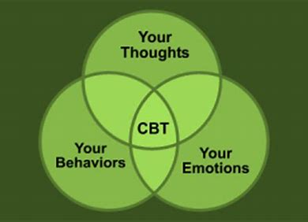
Introduction to CBT
Reviews the information provided by the (Rory Lee Oakes Videos) on Aaron Beck and Albert Ellis

Slide 4
Aims
Provide a Timeline of Contemporary CBT
To begin to understand the worldview of Cognitive Therapy
To become familiar with the key concepts and major contributors to Cognitive therapy.
To become familiar with REBT
Introduce you to New Cognitive Approaches (3rd Wave)
Resources for CBT
On Campus Session
Reflective Quote

Slide 5
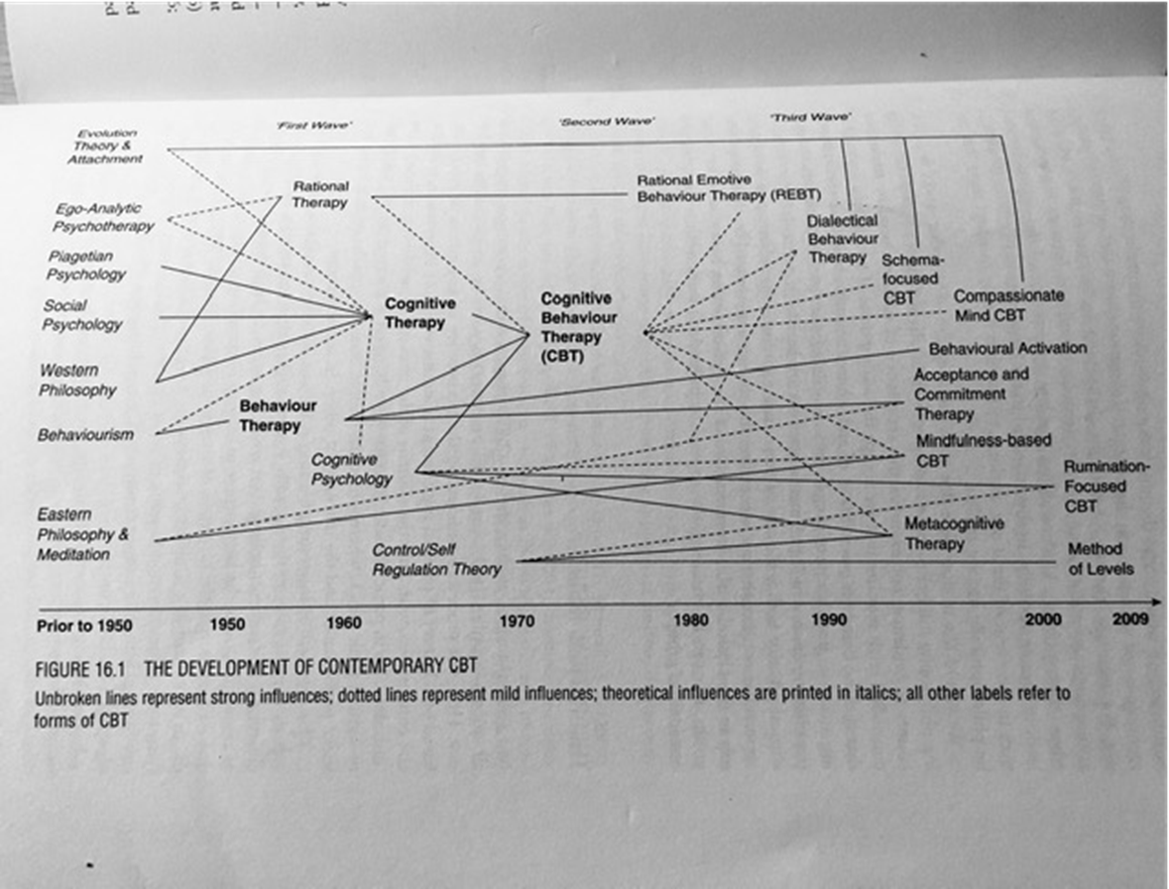
Development of Contemporary CBT
First Wave
Second Wave
Third Wave
Grant, A. Ed. (2010) Cognitive Behavioural Therapy in Mental Health, London: Sage (p.251

Slide 6

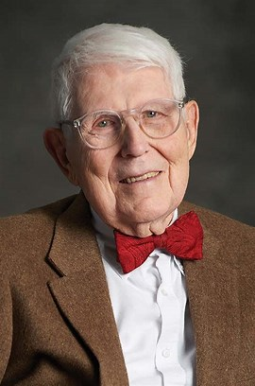
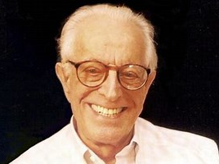
Behaviour therapy and cognitive therapy.
Much of the research in the development of behaviourism was based on experiments and observations of animal behaviour.
Cognitive behaviour however aimed to look at thinking processes that might influence behaviour.
  Aaron T. Beck
  Albert Ellis
  Donald Meichenbaum CBM

Slide 7
Aaron T. Beck
Beck argued that the processes of thinking are influenced by emotional difficulties.
He argued that if we change our thinking patterns it will also reduce the emotional difficulties.
Cognitive therapy can be seen as working with emotion.
Emotions and behaviour are mediated by cognitive processes, this makes it different to psychoanalysis which gives prime importance to the unconscious.

Slide 8
Two Key Publications
Cognitive Therapy and the Emotional Disorders (Beck, 1976)
Cognitive Therapy of Depression (Beck et al., 1979)
Notes:
Therapists support the client to consider how they think about a situation. If the therapist can enable the client to see how they can influence the way they experience a situation, this can help them to bring about emotional change.

Slide 9
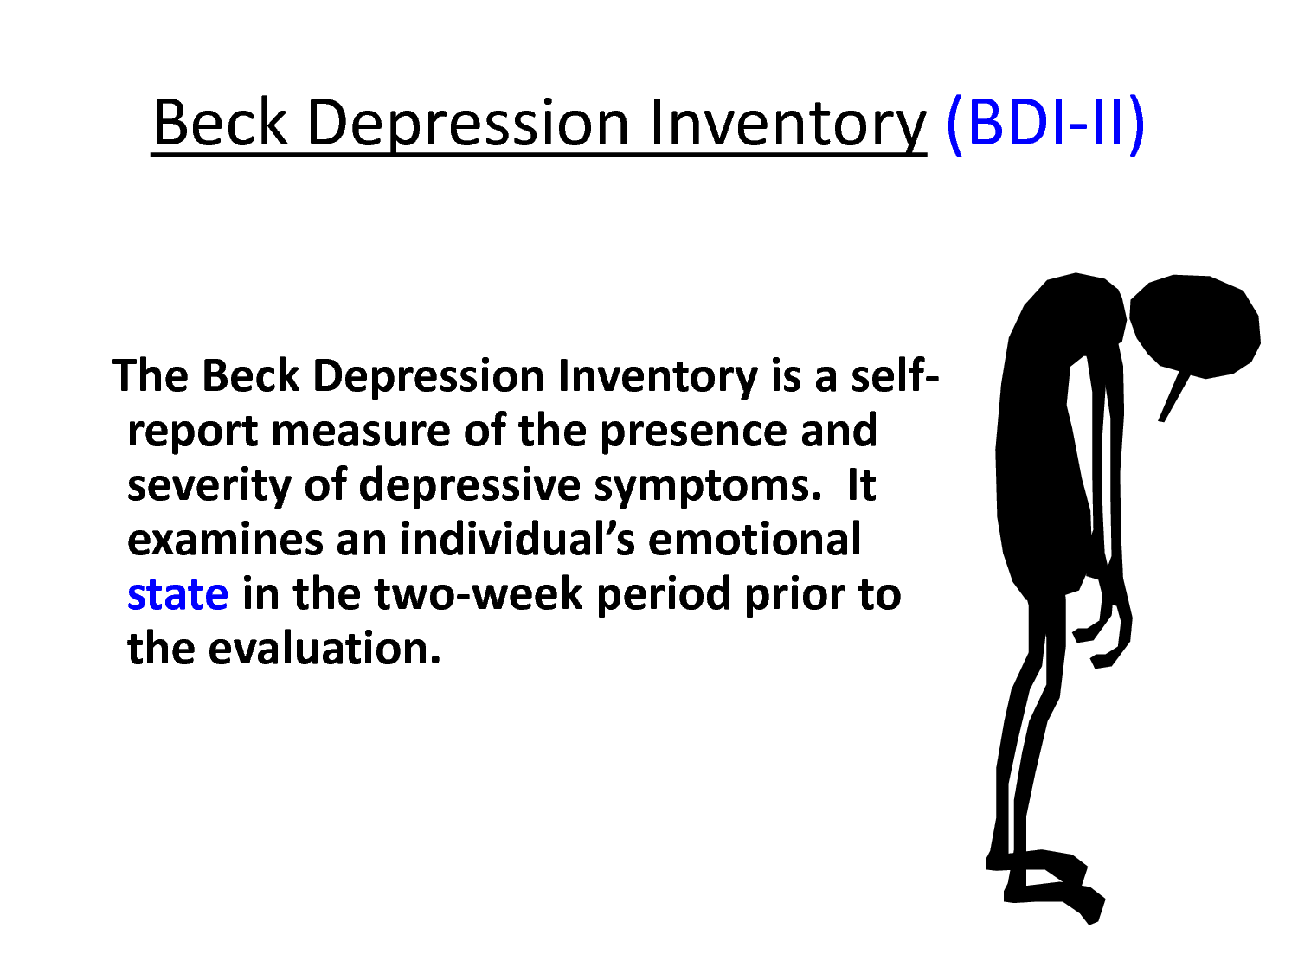

Slide 10
Pioneering Work on Depression
In Depression there is a negative view of the Self, the world and the future.
In Anxiety there is an overestimation of the physical or social threat alongside the underestimation of the individual’s ability to cope with the situation.
In Panic and Health anxiety the focus of the client’s attention is usually on bodily symptoms
In Generalised Anxiety Disorder it is worry which is the cause of distress.
Any negative events can set off worry, worry is then chosen as the coping strategy, but then negative beliefs about worry set in and a vicious cycle is set up.

Slide 11
Cognitive Model
Thoughts
Behaviours
Emotions
We interact with our environment through:
Thinking
Interpreting
Evaluating
These in turn our linked to our:
Feelings
Behaviour

Slide 12
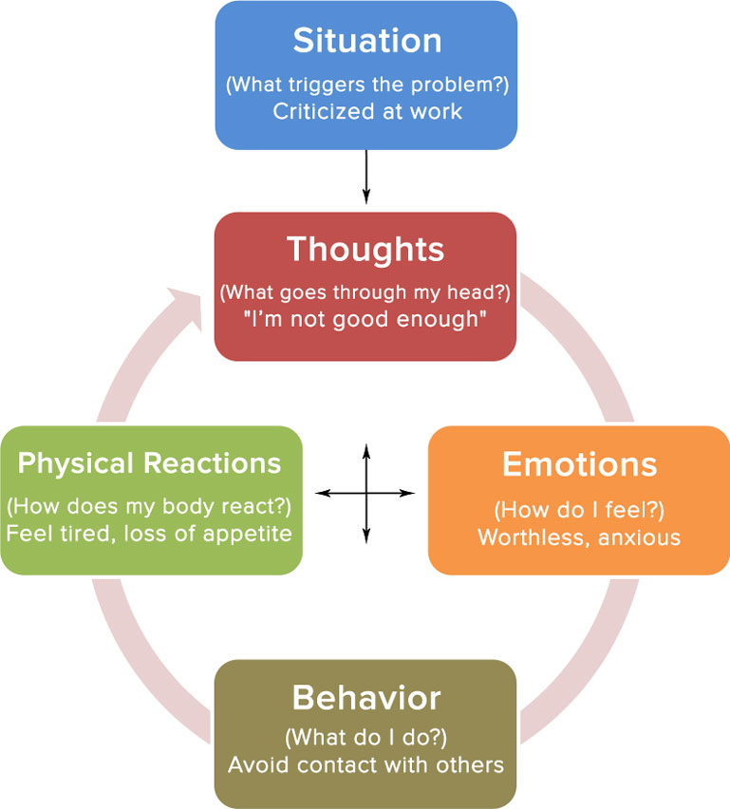

Slide 13
Three Types of Cognition
Information Processing
Individuals constantly receive information from inside themselves (body experiences) and their environment.
Automatic Thoughts
The internal dialogue that occurs in an unplanned way
Schema
Core beliefs and views of the world. Our schema allow us to filter out unwanted information and attend to important aspects of our environment.

Slide 14
Negative Automatic Thoughts
People with psychological disorders often have frequent, disruptive thoughts known as ‘negative automatic thoughts’
Spontaneous thoughts that pop into the head, they seem plausible at the time, but when they are thought through are unrealistic.

Slide 15
Maintaining Behaviours
The depressed client will maintain his thought processes. The person who believes he will fail won’t try anything and so the result is a confirmation of the negative belief.

Slide 16

Beck’s Illogical ways of thinking
Arbitrary Inference
  Reaching conclusions without any evidence
Catastrophising
  Predicting a negative result, without thinking of other possible outcomes
Overgeneralisation
  Sweeping negative beliefs about a situation
Magnification
  Emphasising problems, situations or issues
Minimising
  Reducing own values or successes
Dichotomous Thinking
  Using extreme terms in thinking e.g. Never
Filtering
  Selecting or highlighting negative aspects at the expense of a fuller picture.

Slide 17
Emotional Disturbance and Information Processing
In emotional disturbance information-processing is biased, usually in a negative and distorted way.
Beck reasoned that we need to use Reality-Testing skills to solve personal problems as they happen.
A depressed individual who was not successful at job interview would have illogical ways of thinking about the process.
An adaptive way of thinking would be to consider the reasons why the job interview did not go well and take responsibility and look for ways to prevent it in the future.

Slide 18
Cognitive Schemata
Cognitive schemata are useful for effective functioning in the world.
Healthy schemata are reasonably flexible. Unhealthy schemata will be more rigid, absolute and overgeneralized.
e.g. “I must get high grades for all of my work”.
A healthy response would be
“It would be great to get the high grades, but sometimes it isn’t possible”.
An individual with rigid schemata will criticise themselves heavily if they fall short of their excessively high standard.

Slide 19
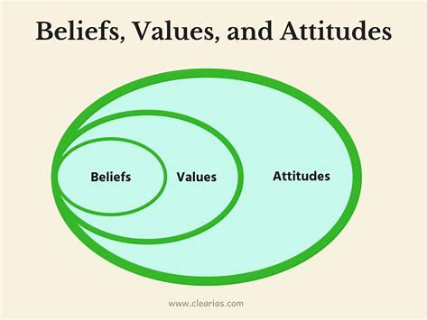
Where do beliefs and attitudes come from?
Early experiences
Traumas
Chronic stresses

Slide 20
Albert Ellis: Rational Emotive Behaviour Therapy (REBT)
Established in 1955
Having trained as psychoanalyst Ellis was disappointed with the results he was seeing with his patients. He became increasingly disenchanted.
He began to highlight the importance that thoughts and philosophies have in creating and maintaining psychological disturbance.
He continued to develop the idea that cognitive factors have a role to play in human disturbance
You are responsible for your own emotions and behaviours.

Slide 21
Pioneering Text:
Reason and Emotion in Psychotherapy (Ellis, 1962)
  Cognitions, Emotions and Behaviours are linked and interact and often overlap.
  By changing our thinking, we can change our emotion.

Slide 22
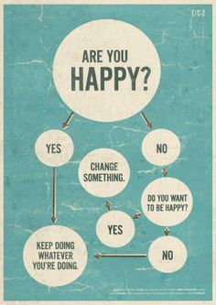
Cognitive Behavioural Therapy- Albert Ellis
Take responsibility for your distress
Only you can upset yourself about events--the events themselves, no matter how undesirable, can never upset you
Identify your "musts." Once you admit that you distort your own emotions and actions, then determine precisely how. The culprit usually lies in one of the three core "musts:"

Slide 23

Image of the Person
The main human goal is to stay alive and to pursue happiness
Human fallibility: Humans naturally make errors as they seek to achieve their basic goals and purposes.
Biological Emphasis:
  Virtually all humans show evidence of major human irrationalities
  Many human irrationalities actually go counter to the teachings of parents, peers and the mass media
  Humans often adopt other irrationalities after giving up on former ones
  Humans often go back to irrational activity even though they have worked hard to over come it. (Ellis, 1976)

Slide 24

Image of a Person
Humans can achieve their goals if they are active in the pursuit of them. If they are half hearted the goals will not be achieved.
The most effective way in which a client can experience lasting change is to alter their philosophies.

Slide 25
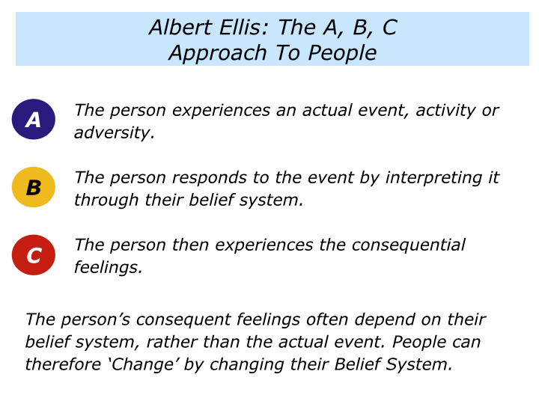

Slide 26
REBT
"Must" #1 (a demand on yourself): "I MUST do well and get approval, or else I'm worthless." This demand causes anxiety, depression, and lack of assertiveness
"Must" #2 (a demand on others): "You MUST treat me reasonably, considerately, and lovingly, or else you're no good." This "must" leads to resentment, hostility, and violence
"Must" #3 (a demand on situations): "Life MUST be fair, easy, and hassle-free, or else it's awful." This thinking is associated with hopelessness, procrastination, and addictions

Slide 27

REBT
Dispute your “musts”. The only way you can ever remain disturbed about adversity is by vigorously and persistently agreeing with one of these three “musts”.
Thus, once you’ve bared them, then relentlessly confront them and question your demands.
Begin by asking yourself: “What’s the evidence for my ‘must’?” “How is it true?” “Where’s it etched in stone?” and then by seeing: “There’s no evidence my ‘must’ is entirely false.”

Slide 28
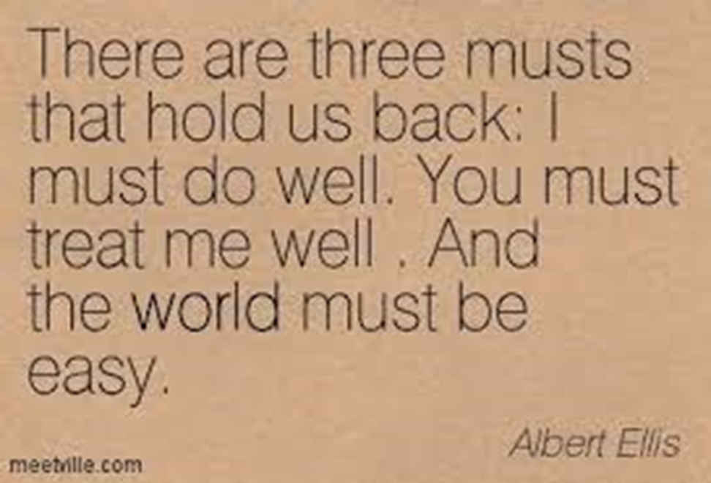
REBT
Reinforce your preferences and conclude, therefore:
Preference #1: "I strongly PREFER to do well and get approval,
but even if I fail, I will accept myself fully,“
Preference #2: "I strongly PREFER that you treat me reasonably, kindly, and lovingly,
but since I do not run the universe, and it's a part of your human nature to, I, then, cannot control you,“
Preference #3: "I strongly PREFER that life be fair, easy, and hassle-free,
and it's very frustrating that it isn't, but I can bear frustration and still considerably enjoy life."

Slide 29
Concepts
Irrational Beliefs
Rigid, extreme and illogical. They are inconsistent with reality
Rational Beliefs
Flexible, logical and consistent

Slide 30
Key Factors Influencing the Effective Delivery of CBT
Therapeutic relationship – a trusting, safe, therapeutic alliance is essential but not sufficient for successful CBT.
Written by Katy Grazebrook and Anne Garland
Drawing on papers published by BABCP or by committees of BABCP. June 2005
Therapy is not experienced as something that has been "done to" the client.

Slide 31

Collaboration
Is a way of being with clients based on an equal partnership, each party bringing something to the relationship.
The therapist should not have pre-conceived ideas about where the therapy is going.
The overall aim is for the individual to attribute improvement in their problems to their own efforts, in collaboration with the psychotherapist
Notes:
The therapist brings skills and knowledge of psychological processes, theories of emotion and techniques that have helped others and could help the current client. The client is an expert in their own experience, and brings their own resources.

Slide 32
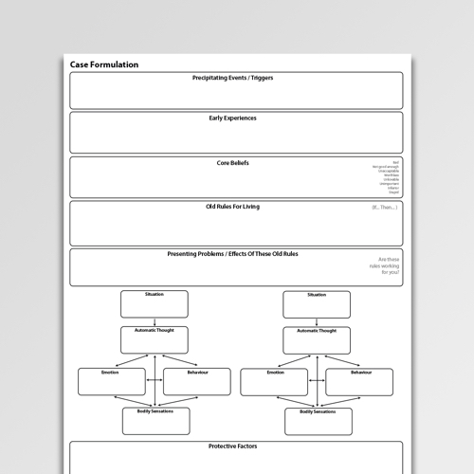
Formulation
a unique map or hypothesis of presenting problems or situations which integrate information from assessments within a coherent CBT framework drawing upon theory and evidence based practice

Slide 33

Socratic dialogue/ guided discovery
Is a style of questioning to both gently probe for people’s meanings and to stimulate alternative ideas.
Notes:
It involves exploring and reflecting on styles of reasoning and thinking and possibilities to think differently. CBT is not about trying to prove a client wrong and the therapist right, or getting into unhelpful debates – rather by skilfully collaborating, clients come to see for themselves (discover) that there are alternatives.

Slide 34

Homework
The client tries things out in between therapy sessions, putting what has been learned into practice. This is referred to as homework and sometimes includes behavioural experiments.

Slide 35

Cognitive Therapist
It is both highly structured (although always based on a formulation of the relationship between the client’s presenting problems and underlying cognitive and/or behavioural processes) and flexible due to the constant evaluation of the outcome of the interventions.
Cognitive therapists do not usually interpret or seek for unconscious motivations but bring cognitions and beliefs into the current focus of attention (consciousness) and through guided discovery encourage clients to gently re-evaluate their thinking.

Slide 36
Summary
Mode/Delivery of Therapy
Overview of CBT
Individual Therapy
Group Therapy
Online Approaches
Speciality
Working with Trauma
Children and Young People
Eating Distress
Addictions
Other
Depression, Anxiety, Phobia, OCD others.
It is a form of therapy that addresses problems in a direct and targeted way.
It focuses on a shared model of understanding, using a psycho-educational approach, open sharing of the formulation and teaching of self-evaluation and management skills.
Its potency as a model is shown by its increasing use and accumulating recommendation by a range of evidence-based guidelines (NICE, NHS)

Slide 37
Resources
Electronic
Journal Article
Albert Ellis Institute http://albertellis.org/
Beck Institute https://beckinstitute.org/
MIND https://www.mind.org.uk/information-support/drugs-and-treatments/cognitive-behavioural-therapy-cbt/about-cbt/
BABCP British Association of Behavioural Cognitive Psychotherapist (Check out their Podcasts https://www.babcp.com/What-is-CBT
Others NHS Guidelines/ Nice Guidelines
Peer Reviewed Studies and Articles
Additional Reading: A critique
Binnie, J. and Spada, M. (2018) Let’s put the “T” back into CBT. Mental Health Review Journal VOL. 23 NO. 4 2018, pp. 240-245. DOI 10.1108/MHRJ-02-2018-000

Slide 38

New Cognitive Approaches (Third Wave)
Mindfulness Based Stress Reduction (MBSR)
Mindfulness Based Cognitive Therapy (MBCT)
Dialectical Behavioral Therapy (DBT)
Schema Therapy (ST)
Compassion Focus Therapy
Acceptance and Commitment Therapy (ACT)
Trauma Focused Cognitive Behavioral Therapy (TfCBT)
Others

Slide 39
On-Campus Session
QA/Quiz (Group)
CBT Worksheets
Case Study Application -
Journal Article – on your Leganto Reading list
Lunch
Review the Group Contract
Skills Work Group Work –
Mini presentation on placements
Evaluation

Slide 40

Reflective Quote
“Cognitive therapy seeks to alleviate psychological stresses by correcting faulty conceptions and self-signals. By correcting erroneous beliefs we can lower excessive reactions.”
— Aaron T. Beck

