Slide 1
ECGE4006P/C
Addysg ar gyfer Datblygu Cynaliadwy a Dinasyddiaeth Fyd-eang(ADCDF)
Education for Sustainable Development and Global Citizenship (ESDGC)

Slide 2
Trosolwg o’r Modiwl / Module Overview
Prif nod y modiwl hwn yw adeiladu ymdeimlad o berthyn i ddynoliaeth gyffredin a’n helpu i ddod ac i greu ‘dinasyddion egwyddorol gwybodus o Gymru a’r byd’.
Nod natur y dysgu sy'n seiliedig ar brosiectau yw eich grymuso ni ac unrhyw blant/pobl ifanc y byddwch yn gweithio gyda i gymryd rôl weithredol i wynebu a datrys heriau byd-eang a dod yn gyfrannwr rhagweithiol i fyd mwy heddychlon, goddefgar, cynhwysol a diogel.
The primary aim of this module is to build a sense of belonging to a common humanity and help us to become and create ‘ethical informed citizens of Wales and the world’.
The project-based nature of the learning aims to empower you and any pupils/young people that you will work with to assume an active role to face and resolve global challenges and to become a proactive contributor to a more peaceful, tolerant, inclusive and secure world.

Slide 3
Amcanion y modiwl / Module aims
Datblygu ymwybyddiaeth a gwerthfawrogiad myfyrwyr o heriau cyfoes sy'n berthnasol i'r ddisgyblaeth sy'n wynebu unigolion, sefydliadau, cymunedau a chymdeithas, o safbwynt lleol, cenedlaethol a byd-eang.
Datblygu datryswyr problemau creadigol drwy gymhwyso gwybodaeth i broblemau byd go iawn.
To develop students’ awareness and appreciation of contemporary challenges relevant to the discipline facing individuals, organisations, communities and society, from a local, national and global perspective.
To develop creative problem-solvers through the application of knowledge to real-world problems.

Slide 4
Deilliannau Dysgu / Learning Outcomes
Ar ôl cwblhau'r modiwl hwn yn llwyddiannus, dylai'r myfyriwr allu:
Nodi a gwerthuso materion hanesyddol a chyfoes a'u heffaith ar y gymdeithas fyd-eang heddiw.
Defnyddio arferion cydweithio priodol i reoli gwrthdaro a chefnogi penderfyniadau effeithiol.
Gweithredu technegau Meddwl dylunio i ymchwilio i broblemau er mwyn cynhyrchu a gwerthuso atebion.
Upon the successful completion of this module, the student should be able to:
Identify and evaluate historical and contemporary issues and their impact on today's global society.
Apply appropriate collaborative working practices to manage conflict and support effective decision making.
Implement Design Thinking techniques to investigate problems in order to generate and evaluate solutions.

Slide 5
Trosolwg o’r sesiwn / Session overview
Beth yw dinesydd byd-eang?
Safbwyntiau byd-eang mewn addysg?
Sut all ADFDC a Chwricwlwm i Gymru 2022 hyrwyddo dealltwriaeth datrysiadau disgyblion i ‘broblemau dyrys’
What is a global citizen?
Global perspectives in education?
How ESDGC and Curriculum for Wales 2022 can promote understanding of and solutions to ‘wicked problems’

Slide 6
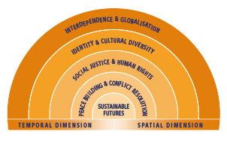
Beth yw safbwyntiau byd-eang mewn addysg?
Cyd-ddibyniaeth a globaleiddio – dealltwriaeth o'r cysylltiadau cymdeithasol, economaidd a gwleidyddol cymhleth rhwng pobl a'r effaith y mae newidiadau'n ei chael ar ei gilydd
Hunaniaeth ac amrywiaeth ddiwylliannol – dealltwriaeth o ddiwylliant eich hun, a bod yn agored i ddiwylliant pobl eraill
Cyfiawnder cymdeithasol a hawliau dynol – dealltwriaeth o effaith anghydraddoldeb a gwahaniaethu, pwysigrwydd sefyll dros ein hawliau ein hunain a'n cyfrifoldeb i barchu hawliau pobl eraill
Adeiladu heddwch a datrys gwrthdaro – dealltwriaeth o bwysigrwydd adeiladu a chynnal perthnasoedd cadarnhaol ac ymddiriedus a ffyrdd o wrthdaro
Dyfodol cynaliadwy – dealltwriaeth o'r ffyrdd y gallwn ddiwallu ein hanghenion presennol heb leihau ansawdd yr amgylchedd na lleihau gallu cenedlaethau'r dyfodol i ddiwallu eu hanghenion eu hunain.
Gallwn gysylltu hyn â Deddf Llesiant Cenedlaethau'r Dyfodol (Cymru), 2015

Slide 7
What are global perspectives in education?
Interdependence and globalisation – an understanding of the complex social, economic and political links between people and the impact that changes have on each other
Identity and cultural diversity – an understanding of self and one’s own culture, and being open to the culture of others
Social justice and human rights – an understanding of the impact of inequality and discrimination, the importance of standing up for our own rights and our responsibility to respect the rights of others
Peace building and conflict resolution – an understanding of the importance of building and maintaining positive and trusting relationships and ways conflict can be prevented or peacefully resolved
Sustainable futures – an understanding of the ways in which we can meet our current needs without diminishing the quality of the environment or reducing the capacity of future generations to meet their own needs.
We can link this to the Wellbeing of Future Generations Act (Wales), 2015

Slide 8
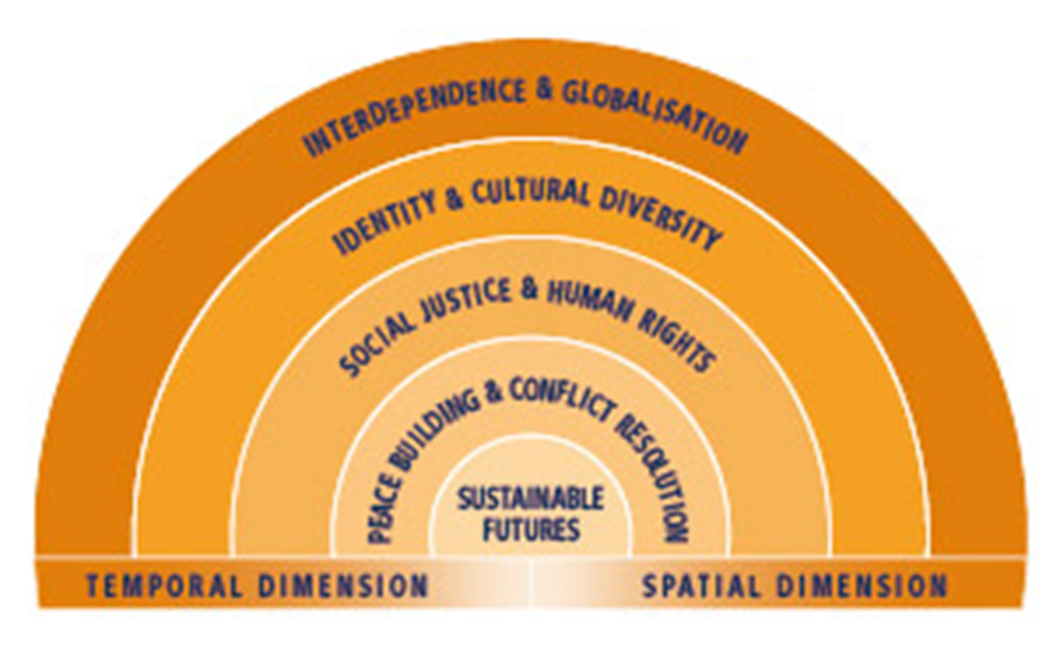
Perthnasol i’r problemau dyrys yn uned 1? – sut?
Relevant to the wicked problems in unit 1? – how?
Newid Hinsawdd – Cyfiawnder Amgylcheddol
Gwahaniaethau (cenedl, hil) – Cyfiawnder Cymdeithasol
Iechyd, Cyfoeth a Hapusrwydd – Lles
Automeiddio – Esblygiad Peiriannau
Climate Change – Environmental Justice
Discrimination (race, gender) – Social Justice
Health, Wealth and Happiness – Wellbeing
Automation – the rise of the machines

Slide 9
Y Nodau Byd-eang 2025 / The Global Goals 2025

Slide 10
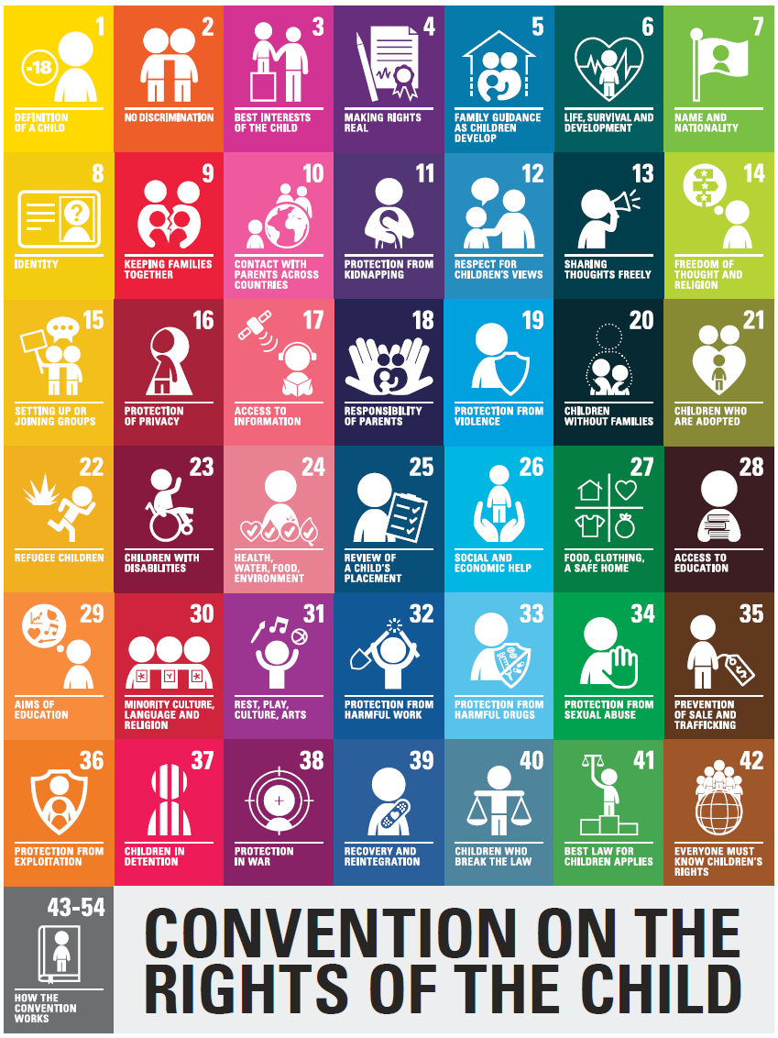
Polisi rhyngwladol / International policy
(1989)

Slide 11
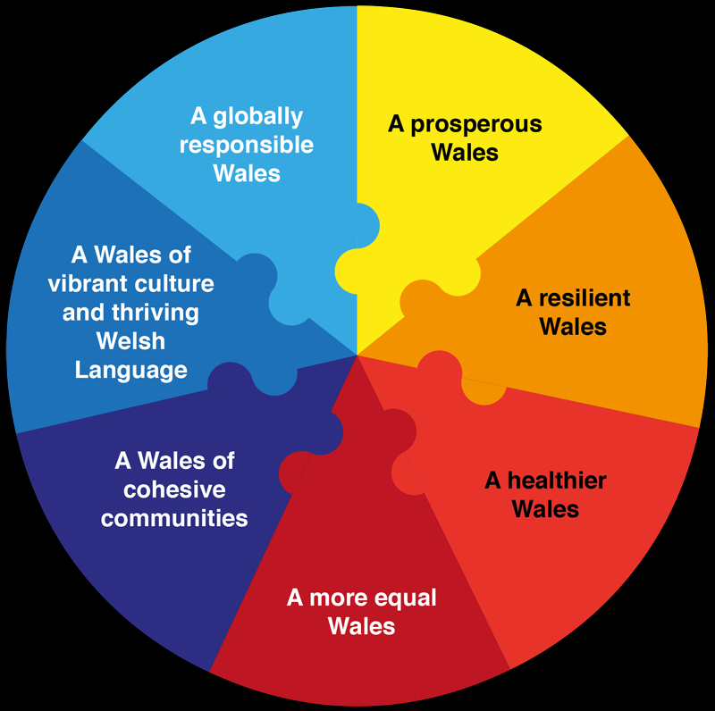
Polisi Cymreig / Welsh policy
Deddf Llesiant Cenedlaethau’r Dyfodol (Cymru) 2015
Wellbeing of Future Generations Act (2015)
Cwricwlwm i Gymru 2022
Curriculum for Wales 2022

Slide 12

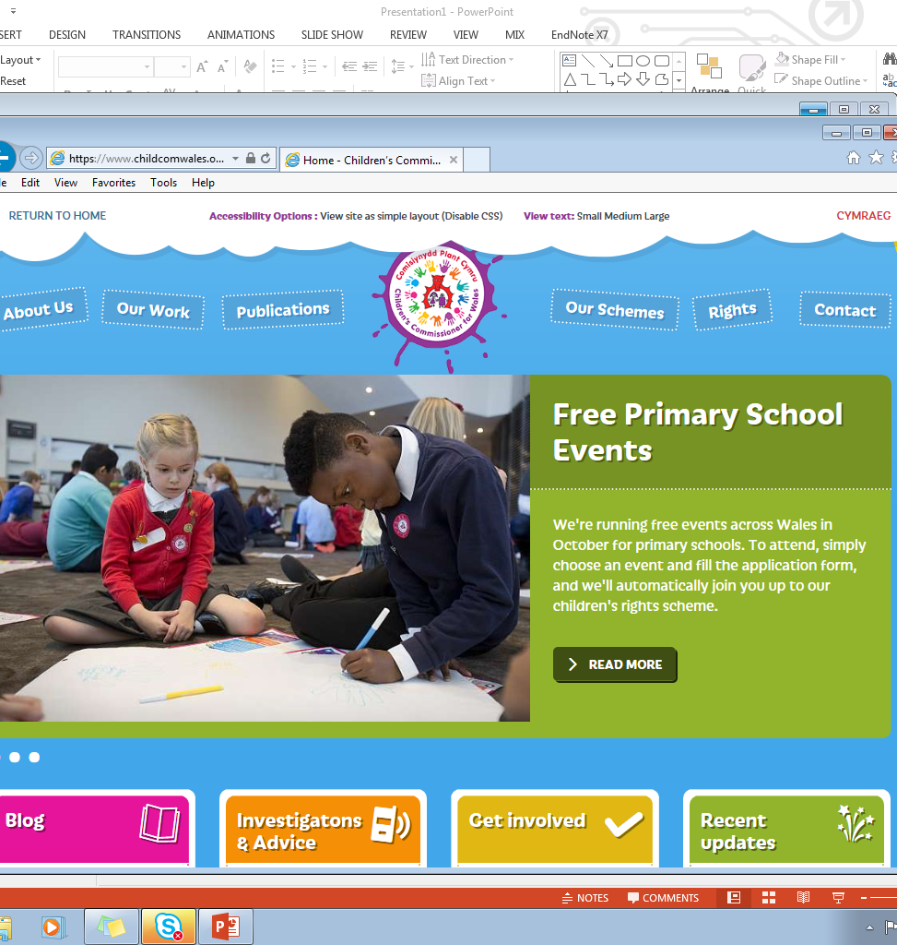

Slide 13
ADCDF / ESDGC
What is Education for Sustainable Development and Global Citizenship?
Discuss and create a statement which reflects your initial beliefs about ESDGC.
Beth yw Addysg ar gyfer Datblygu Cynaliadwy a Dinasyddiaeth Fyd-Eang?
Trafodwch ac ysgrifenwch ddatganiad sy’n adlewyrchu eich syniadau cyntaf am ADCDF.
Notes:
Post-its
13

Slide 14

Diffiniad Allweddol / Key Definition
“datblygiad sy’n diwallu anghenion y presennol heb gyfaddawdu gallu cenedlaethau’r dyfodol i ddiwallu eu hanghenion eu hunain.”
Adroddiad Brundtland 1987
“development which meets the needs of the present without compromising the ability of future generations to meet their own needs.”
Brundtland Report 1987

Slide 15
Diffiniadau eraill…/ Other definitions……
‘Global citizenship is about understanding the need to tackle injustice and equality, and having the desire and ability to work actively to do so. Global citizenship is a way of thinking and behaving. It is an outlook on life, a belief that we can make a difference.’
Young and Comins (2002:12)

Slide 16

The Earth provides enough to satisfy everyone’s needs, but not for everyone’s greed.
Mahatma Gandhi

Slide 17

Beth yw ADCDF? / What is ESDGC?
Mae ADCDF yn ymwneud â phethau rydyn ni'n eu gwneud bob dydd.
Mae'n ymwneud â'r materion mawr yn y byd – megis newid yn yr hinsawdd, masnach, adnoddau a disbyddu amgylcheddol, hawliau dynol, gwrthdaro a democratiaeth – a sut maent yn ymwneud â'i gilydd ac i ni.
Mae'n ymwneud â sut rydym yn trin y ddaear a sut rydym yn trin ein gilydd, waeth pa mor bell ar wahân yr ydym yn byw.
Mae'n ymwneud â sut yr ydym yn paratoi ar gyfer y dyfodol.
Mae gan bawb ohonom ran i'w chwarae.
ESDGC is about things we do every day.
It is about the big issues in the world – such as climate change, trade, resource and environmental depletion, human rights, conflict and democracy – and about how they relate to each other and to us.
It is about how we treat the earth and how we treat each other, no matter how far apart we live.
It is about how we prepare for the future.
Everyone of us has a part to play.

Slide 18

Nid yw ADCDF yn … / ESDGC is not …
bwnc ar wahân
gyfres o gysyniadau neu destunau ar wahân
gyfyngedig i’r ystafell ddosbarth
gyfrifoldeb i ddim ond un athro yn yr ysgol
ymwneud â trosglwyddo set o atebion i ddysgwyr
a separate subject
a series of separate concepts or texts
limited to the classroom
the responsibility of only one teacher in the school
about transferring a set of solutions to learners

Slide 19
Mae ADCDF yn gallu ysgogi plant oherwydd… ESDGC can motivate children because…
Mae’n cynnig cyd-destunau diddorol, amserol, go iawn sy’n berthnasol i ddysgwyr a chyfle cyffrous i ddatblygu sgiliau.
Mae llawer o’r cynlluniau presennol mewn ysgolion fel EcoSgolion, Ysgolion Iach, Ysgolion Masnach Deg, a’r gwahanol fathau o bartneriaethau rhyngwladol ar gyfer ysgolion, yn cyfrannu at ADCDF.
It provides interesting real life, topical contexts which learners can relate to, and an exciting opportunity for developing skills.
Many of the existing school schemes, such as EcoSchools, Healthy Schools, Fairtrade schools and the various types of international school partnership contribute to ESDGC.

Slide 20
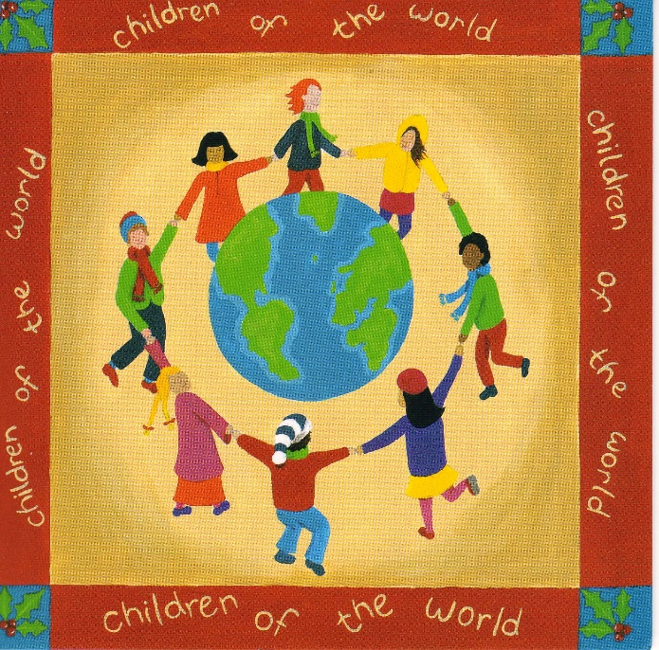
Y ffordd ymlaen… / The way forward……
“Education is the most
powerful weapon you can
use to change the world.”
Nelson Mandela

Slide 21

DINYASYDDIAETH BYD-EANG Global Citizenship
Education for global citizenship helps enable young people to develop the core competencies which allow them to actively engage with the world, and help to make it a more just and sustainable place.
(Oxfam Education, 2014)
Notes:
Watch the UNESCO video. Give students time to write their own definition of global citizenship and then demonstrate the Oxfam explanation.

Slide 22
Beth mae’n ei olygu i gael safbwynt byd-eang?
What does it mean to have a global perspective?
‘A global perspective is the capacity and predisposition for a person to think with complexity taking into account multiple perspectives, to form a unique sense of self that is value based and authentic, and to relate to others with respect and openness especially with those who are not like her…. [with a] sense of people, nation, and world beyond themselves’ (Finn, McNamara, 2011: p. 259).
1st definition of global: all-encompassing, all-inclusive
2nd definition of global: relating to the whole world; worldwide.
Diffiniad 1af o fyd-eang: hollgynhwysol, hollgynhwysol
2il ddiffiniad o fyd-eang: sy'n ymwneud â'r byd i gyd; byd-eang.
Notes:
Insert a map of your country.

Slide 23
Beth yw dinesydd byd-eang?
What is a global citizen?
Watch the video below.
What is your definition?
https://www.youtube.com/watch?v=XVSgbU6WVSk
Gwyliwch y fideo isod.
Beth yw eich diffiniad?
https://www.youtube.com/watch?v=XVSgbU6WVSk

Slide 24
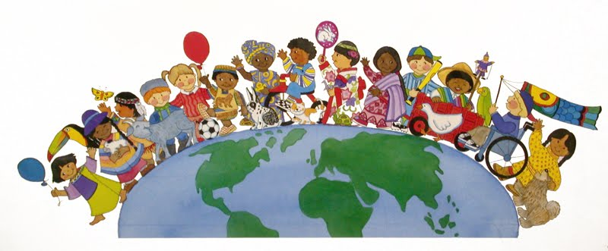
Plant fel Dinasyddion Byd-eang
Children as Global Citizens
“The academic field of childhood studies has opened up new space in which to understand children’s citizenship as more than just passive membership in political regimes.
The field’s emphasis on children’s agency, voices, and participation makes it possible to understand and examine children and youth as active contributors to political life.”
(Conrad, 2009; Invernizzi and Williams, 2008; James and Prout, 1997; Roche, 1999; Thomas, 2007; cited in Wall, 2019)
.

Slide 25
Plant fel Dinasyddion Byd-eang
Children as Global Citizens
“This recent focus on children’s political “participation” generated many fruitful studies of the ways in which children and young people are exercising citizenship on their own behalf, such as through
civil rights,
social media,
grassroots campaigning,
children’s commissioners,
child and youth parliaments,
children’s labor movements, and the like.”
(Austin, 2010; Cockburn, 2013; Hartung, 2017; James, 2011; Smith and Bjerke, 2009; cited in Wall, 2019)

Slide 26

CiG2022: Y pedwar diben yw y bydd pob plentyn a pherson ifanc yn:
CfW2022: The four purposes are that all children and young people will be:
Dysgwyr, uchelgeisiol, galluog, sy’n barod i ddysgu drwy gydol eu hoes.
Cyfranwyr mentrus, creadigol, sy’n barod i chwarae eu rhan yn llawn yn eu bywyd a’u gwaith.
Dinasyddion egwyddorol, gwybodus, sy’n barod i fod yn ddinasyddion i Gymru a’r byd.
Unigolion iach, hyderus, sy’n barod i fyw bywyd gan wireddu eu dyheadau fel aelodau gwerthfawr o gymdeithas.
Ambitious, capable learners who are ready to learn throughout their lives.
Enterprising, creative contributors who are ready to play a full part in life and work.
Ethical, informed citizens who are ready to be citizens of Wales and the world.
Healthy, confident individuals who are ready to lead fulfilling lives as valued members of society.
Ble mae ADCDF yn ffitio yn Cwricwlwm i Gymru 2022?
Where does ESDGC fit in
Curriculum for Wales 2022?

Slide 27

Tasg ymcwhil Research task
Pa ‘Feysydd Dysgu a Phrofiad’?
Pa ‘Ddatganiadau o’r Hyn Sy’n Bwysig’?
Pa ‘Gamau Cynnydd’?
Which ‘Areas of Learning and Experience’?
Which ‘What Matters Statements’?
Which ‘Progression Steps’?

Slide 28

Pam addysgu ADCDF? / Why teach ESDGC?
Yn rhoi dealltwriaeth i ddysgwyr o effaith eu dewisiadau ar bobl eraill, yr economi a'r amgylchedd.
Herio dysgwyr i weld sut y gallant gyfrannu at fywydau pobl eraill.
Yn creu cysylltiadau rhwng materion lleol, cenedlaethol a rhyngwladol – anelu at gydraddoldeb ar draws y meysydd hyn.
Creu sgiliau cynaliadwy o fewn cymunedau
Gives learners an understanding of the impact of their choices on other people, the economy and the environment.
Challenges learners to see how they can contribute to the lives of others.
Makes links between local, national and international issues – aiming for equality across these areas.
Creation of sustainable skills within communities
Notes:
Can you think of an example of some way children in schools can become aware of the impact of their choices on other people, the economy or the environment. Maybe getting them to think about choosing fair trade products, choosing to recycle, choosing to live in a green way – walking to school instead of bus/car, choosing to buy locally instead of in a supermarket – how will this affect the local town/business.
It also aims to encourage schools to challenge learners to engage in culturally diverse experiences, critically evaluate their own values and attitudes, and develop skills that will enable them to challenge injustice, prejudice and discrimination.
Impact of their choices eg. If they know that electricity comes at the press of a switch and water at the touch of a tap, but if they are not taught to ask questions about the why and how of this, they will become yet another gereration committed to unsustainable practices.
Impact of their choices – one school monitor electricity consumption this data viewed half hourly, daily weekly and monthy so that pupils can see the impact of their actions throught heir use of the system
How can they contribute to the lives of others? Oxfam water week, operation xmas child, singing at local old peoples’ home. Helping out in a charity, scouts.
Understanding the impact of their choices locally on national and international – eg shopping locally, less air miles
Sustainable skills within community – the things that will affect the community in the future. Growing own food, buying locally, supporting local business, speaking welsh to sustain the language, looking after ourselves better – less strain on nhs.

Slide 29
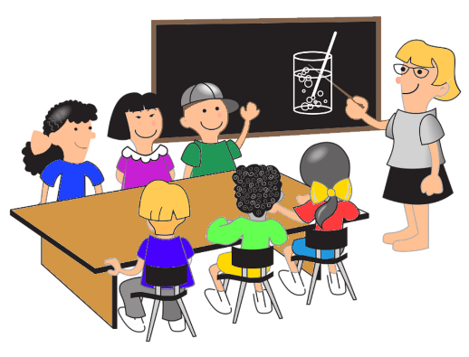
Rôl Ysgolion / Role of Schools
Cydlynu ac ymgorffori ADCDF fel rhan o ethos, addysgeg a threfniadaeth eu sefydliad
Rhoi negeseuon ADCDF clir yn y ffordd y caiff yr ysgol ei threfnu a'i rheoli
Integreiddio ADCDF ar draws yr ysgol gyfan, gan gynnwys yr holl athrawon, staff ategol, llywodraethwyr a'r partneriaethau allanol y mae'r ysgol yn eu ffurfio gyda sefydliadau a'r gymuned leol
Ei gwneud yn ofynnol i'w "wneud" yn ogystal â'i addysgu
Co-ordinate and embed ESDGC as part of the ethos, pedagogy and organisation of their institution
Give clear ESDGC messages in the way the school is organised and managed
Integrate ESDGC across the whole school, involving all teachers, ancillary staff, governors and the external partnerships that the school forms with organisations and the local community
Required to “do” it as well as teach it
Notes:
How might these things look? Passion and conviction, philosophical dimention. Sustainability at heart of the school and ethos which pervades all aspects of the school and its external relationships.
Successful schools often inward looking, focussed on attainment and good management and the gloval dimension is low on priorities. But sustainable schools look owtward to engage their local communities and have a global perspective. This wider, more inclusive vision is also seen in the strong pupil voice and involvement of pupils in decision making.
Can they think of examples?
What do we mean ‘required to do as well as teach it’ – key qualiities are that school leaders are optimistic and owtward looking. Tlhey are conscious of the place of the school in the local and global community they have a sytemic understanding of the world and their place in it and can communicate this to others. They understan the interconnectedness of society, the environment and individuals within these contexts.
Everyone in the school aware of sustainablility - pupils responded well to tasks that involved practiacal activieies inside and outside the clas and enabled them to research, plan and implement projects that made a clear difference to the school and local communityl
Across national curriculum subjects - high level of engagement of te pupils in work they perceived as relevant to their lives and future well – being.

Slide 30

7 thema ADCDF / ESDGC 7 Themes
Yr amgylchedd naturiol
Defnydd a gwastraff
Newid hinsawdd
Cyfoeth a thlodi
Hunaniaeth a diwylliant
Dewisiadau a phenderfyniadau
Iechyd.
Ystyriwch sut mae rhai materion addysgol
byd-eang yn cyd-fynd â'r themâu hyn?
The natural environment
Consumption and waste
Climate change
Wealth and poverty
Identity and culture
Choices and decisions
Health.
Consider how some global educational issues fit into these themes?
Notes:
Task – students to fit in their global problems into these categories

Slide 31
Rhai gweithgareddau ADCDF ar gyfer safbwyntiau byd-eang mewn addysg
Examples of ESDGC activities for global perspectives in education
Creu dealltwriaeth am faterion amgylcheddol
Dysgu ffeithiau am anghydraddoldebau addysgol a chymdeithasol, e.e. meithrin partneriaeth ag ysgol yn Zambia
Dysgu am wahanol ddiwylliannau
Archwilio hawliau a chyfrifoldebau mewn cymunedau ar lefelau lleol, cenedlaethol a byd-eang e.e. CCUHP
Datblygu penderfyniadau gwybodus a'r gallu i gymryd camau meddylgar, cyfrifol yn lleol ac yn fyd-eang e.e. Masnach Deg
Datblygu'r gallu i fod yn ddinasyddion llwyddiannus, effeithiol a hyderus nawr ac yn y dyfodol e.e. dysgu am gyfranogiad gwleidyddol
Creating understanding about environmental issues
Learning facts about educational and social inequalities, e.g. forging partnership with school in Zambia
Learning about different cultures
Exploring rights and responsibilities within communities at local, national and global levels e.g. UNCRC
Developing informed decision making and ability to take thoughtful, responsible action locally and globally e.g. Fairtrade
Developing ability to be successful, effective and confident citizens now and in future e.g. learning about political participation

Slide 32





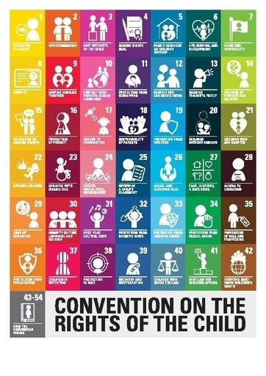


(PONT, 2020)
(IIF, 2016)
(PCF, 2016 b)
(HHE, 2019)
(Sustran, 2017a)
(AYPH, 2020)
(Keep Wales Tidy, 2020)
(Size of Wales, 2020)

Slide 33
Pa mor effeithiol yw strategaethau ysgolion i hyrwyddo ADCDF?
How effective are school strategies in promoting ESDGC?
Meysydd llwyddiant
Areas of success
The number of fundraising events the pupils participate in increases every year.
The children’s views and opinions are listened to and the school facilitates the children’s requests to support campaigns where it is appropriate.
The children are affected by events in the news, and are becoming ethical citizens who are concerned about the welfare of the planet and all its inhabitants.
Mae nifer y digwyddiadau codi arian y mae'r disgyblion yn cymryd rhan ynddynt yn cynyddu bob blwyddyn.
Gwrandewir ar farn a safbwyntiau'r plant ac mae'r ysgol yn hwyluso ceisiadau'r plant i gefnogi ymgyrchoedd lle bo hynny'n briodol.
Mae digwyddiadau yn y newyddion yn effeithio ar y plant, ac maent yn dod yn ddinasyddion moesegol sy'n pryderu am les y blaned a'i holl drigolion.

Slide 34
Pa mor effeithiol yw strategaethau ysgolion i hyrwyddo ADCDF?
How effective are school strategies in promoting ESDGC?
Criticisms
Beirniadaeth
White saviour is a term used to describe white people wanting to help non-white people to fulfil their own needs (Bakar, 2019)
In promoting ESDGC, are schools fuelling white saviourism by encouraging fund raising activities?
The children are very quick to solve the problems of the world by raising money.
Mae sawrus gwyn yn derm a ddefnyddir i ddisgrifio pobl wyn sydd am helpu pobl nad ydynt yn wyn i ddiwallu eu hanghenion eu hunain (Bakar, 2019)
Wrth hyrwyddo ADCDF, a yw ysgolion yn ysgogi saviourism gwyn drwy annog gweithgareddau codi arian?
Mae'r plant yn gyflym iawn i ddatrys problemau'r byd drwy godi arian.

Slide 35
Cyfeirnodau / References
ACCAC. (2002). Education for Sustainable Development and Global Citizenship: Why? What? How? Birmingham: ACCAC
Bakar, F. (2019). What is a white saviour complex? Available at: /https://metro.co.uk/2019/03/06/what-is-a-white-saviour-complex-8793979/ (Accessed: 10 March 2020)
Clarke, P. (2010) Education for Sustainability. Available online: https://www-dawsonera-com.ezproxy.uwtsd.ac.uk/readonline/9780203136621 (Accessed 23/8/21)
Estyn (2014) ESDGC Progress in Education for Sustainable Development and Global Citizenship. Available online: https://www.estyn.gov.wales/sites/default/files/documents/ESDGC%3A%20Progress%20in%20education%20for%20sustainable%20development%20and%20global%20citizenship%20-%20June%202014.pdf (Accessed 23/8/21)
Fine, J.B. and McNamara, K.W. (2011).Community redefined: School leaders moving from autonomy to global interdependence through short-term study broad. Frontiers: The Interdisciplinary Journal of Study Abroad. 2011; 21: 254–274
Global Education, (2014). What are global perspectives?, © 2012 Commonwealth of Australia. http://www.globaleducation.edu.au/global-education/what-are-global-perspectives.html
Grover, S. (2004). Secondary education as a universal human right, Education and the Law, Vol. 16, No. 1, March 2004
Hicks (2012) Sustainable Schools, Sustainable Futures : A resource for teachers. Available at: http://www.teaching4abetterworld.co.uk/docs/download18.pdf
Kiely, R. (2005). Globalization and poverty, and the poverty of globalization theory. Current Sociology, 53(6), 895.
OXFAM (2015). Education for Global Citizenship A guide for schools. Oxford: OXFAM.
Ridley, K. (2005). Thinking skills in the early years: a literature review. Available at: http://www.leeds.ac.uk/educol/documents/150445.htm/ (Accessed: 11 February 2020)
Stirling, S. (2001) Sustainable Education: Re-visioning Learning and Change. Green Books Ltd: Devon
Sustrans (2017c). Education. Available at: https://www.sustrans.org.uk/for-professionals/education/ (Accessed 8 February 2020)

Slide 36
Cyfeirnodau / References
UNESCO Teaching and Learning for a Sustainable Future. Available at: http://www.unesco.org/education/tlsf/mods/theme_gs/mod0a.html (Accessed 23/8/21)
UNESCO (2016). C R E AT IN G S US TA IN A B L E F U T U R E S FOR A L L Education for people and planet: Sustainable Development Goals United Nation Educational, Scientific and Cultural Organization
UNICEF (2016). The United Nations Convention on the Rights of the Child. London: UNICEF
United Nations (unknown date a). Education for Sustainable Development and Global Citizenship. Available at: https://sustainabledevelopment.un.org/partnership/?p=2373/ (Accessed: 7 March 2020)
United Nations (2019). Sustainable Development Goals. Available at: https://www.un.org/sustainabledevelopment/(Accessed: 14 January 2020)
Wall, J. (2019) ‘Theorizing children’s global citizenship: Reconstructionism and the politics of deep interdependence’, Global Studies of Childhood, 9(1), pp. 5–17..
Ward, S. (2013) A Student’s Guide to Education Studies. Routledge: London
Welsh Assembly Government (2008). ‘Education for Sustainable Development and Global Citizenship: A Common Understanding for Schools’. Cardiff: Welsh assembly Government.
Welsh Government (no date) Out of Classroom Learning. Available online at: http://gov.wales/dcells/publications/publications/guidanceandinformation/outofclassroomlearning/outofclassroomlearninge.pdf?lang=en (Accessed 23/8/21)
Welsh Government (2020 a). Curriculum for Wales. Available at: https://hwb.gov.wales/curriculum-for-wales/ (Accessed: 12 March 2020)
World Education Blog (2016). ESDGC logo. Available at: https://gemreportunesco.files.wordpress.com/2016/10/4-7.jpg?w=680&h=694/ (Accessed: 8 March 2020)
Zajda, J. (ed.), (2010) Global Pedagogies: Schooling for the Future, Globalisation, Comparative Education and Policy Research 12, Chapter 2 (Abdullahi, S.A.)

