Slide 1
Exercise Physiology
for Health, Fitness, and Performance
Fifth Edition
Chapter 11:
The Cardiovascular System
Denise L. Smith • Sharon A. Plowman

Slide 2
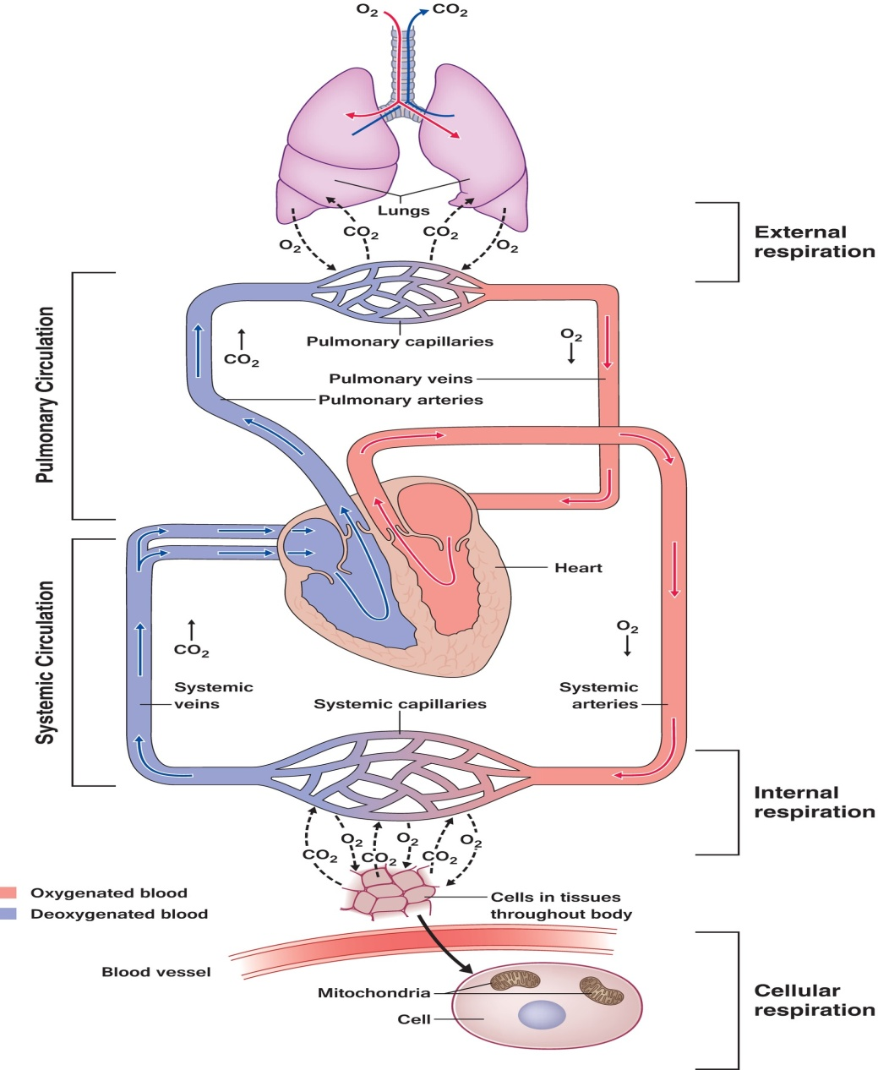
I. Introduction
The cardiovascular system includes the heart, vessels, and blood

Slide 3
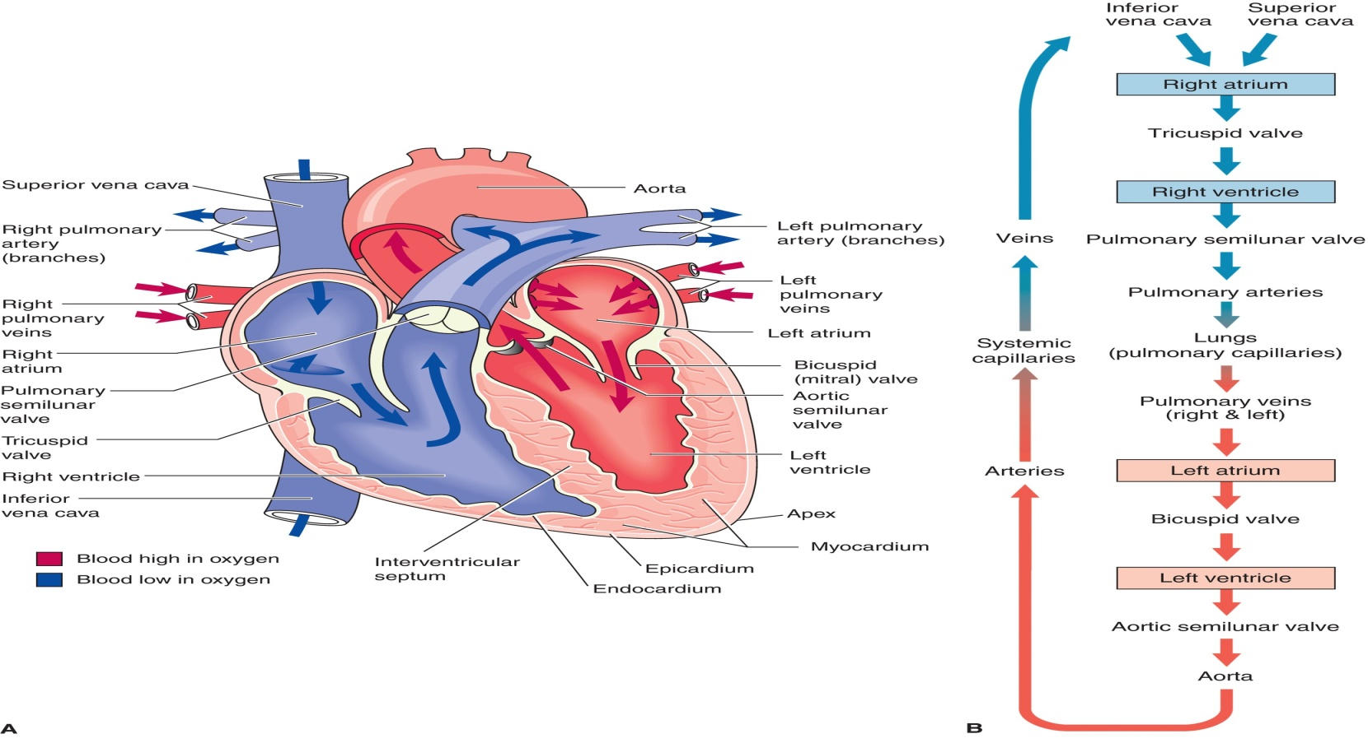
II. Overview of the CV System
A. The Heart
1. Macroanatomy

Slide 4
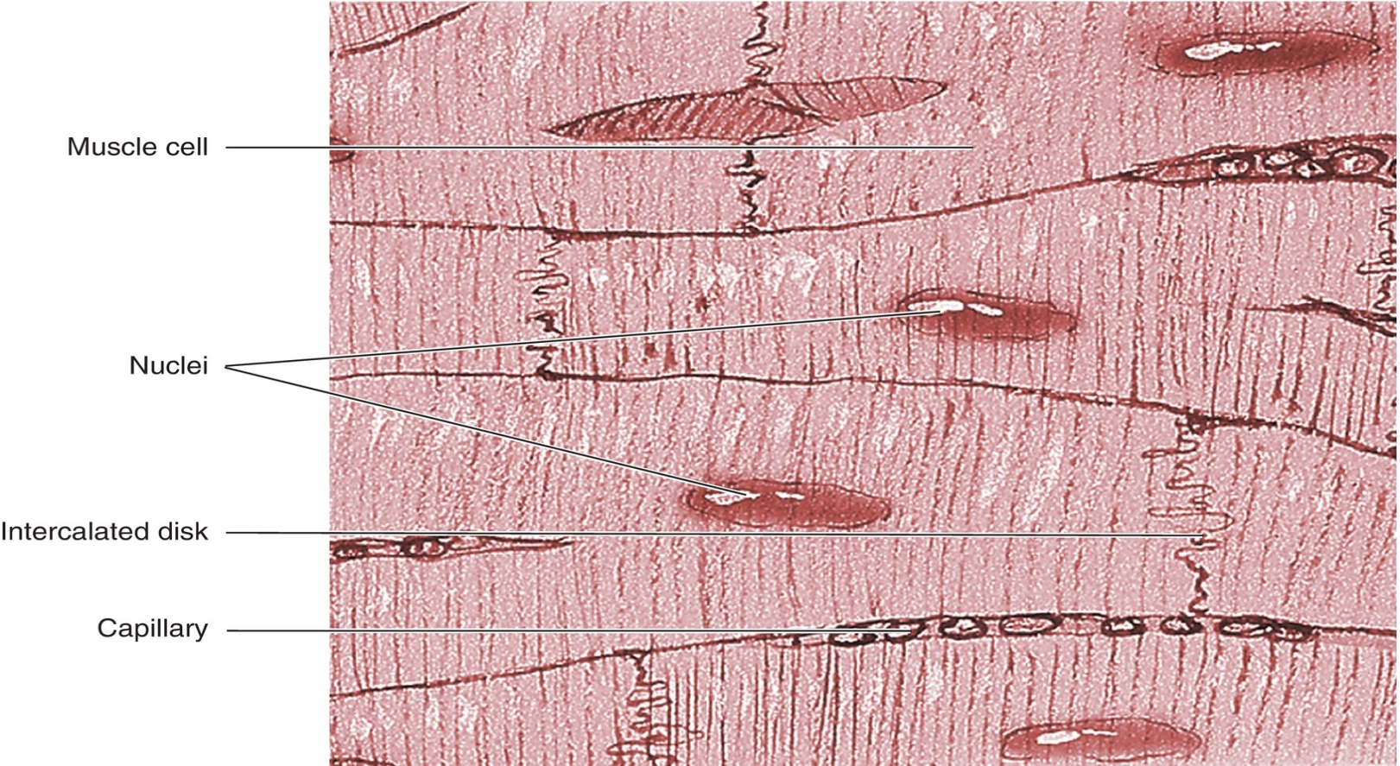
II. Overview of the CV System (cont.)
2. Microanatomy

Slide 5
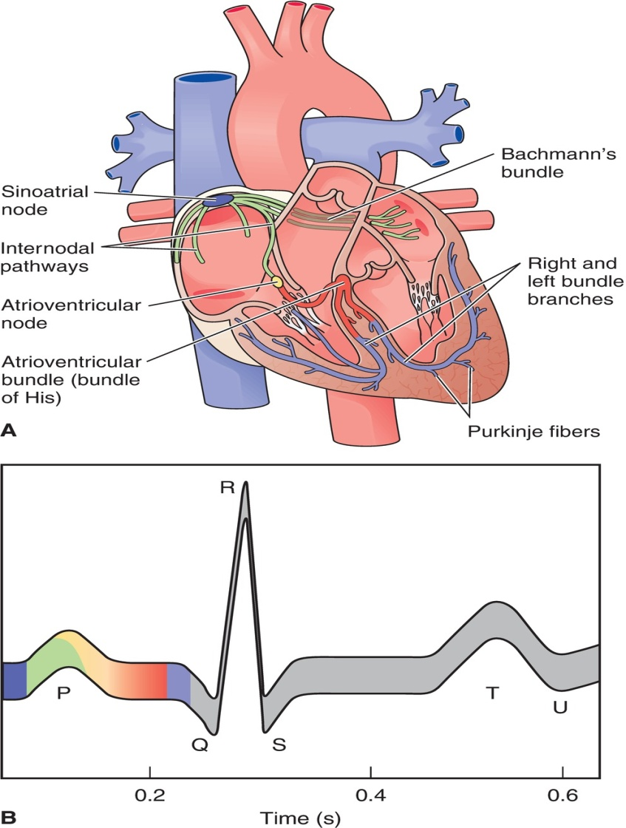
II. Overview of the CV System (cont.)
3. Excitable tissue
4. Electrocardiogram

Slide 6
II. Overview of the CV System (cont.)
5. Cardiac Cycle—one complete sequence of contraction and relaxation of the heart

Slide 7
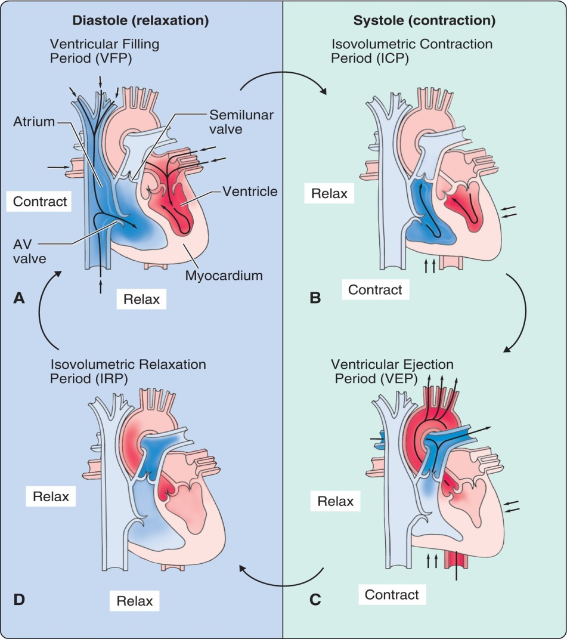
Periods of the Cardiac Cycle
Ventricular filling period (VFP)
Isovolumetric contraction period (ICP)
Ventricular ejection period (VEP)
Isovolumetric relaxation period (IRP)

Slide 8
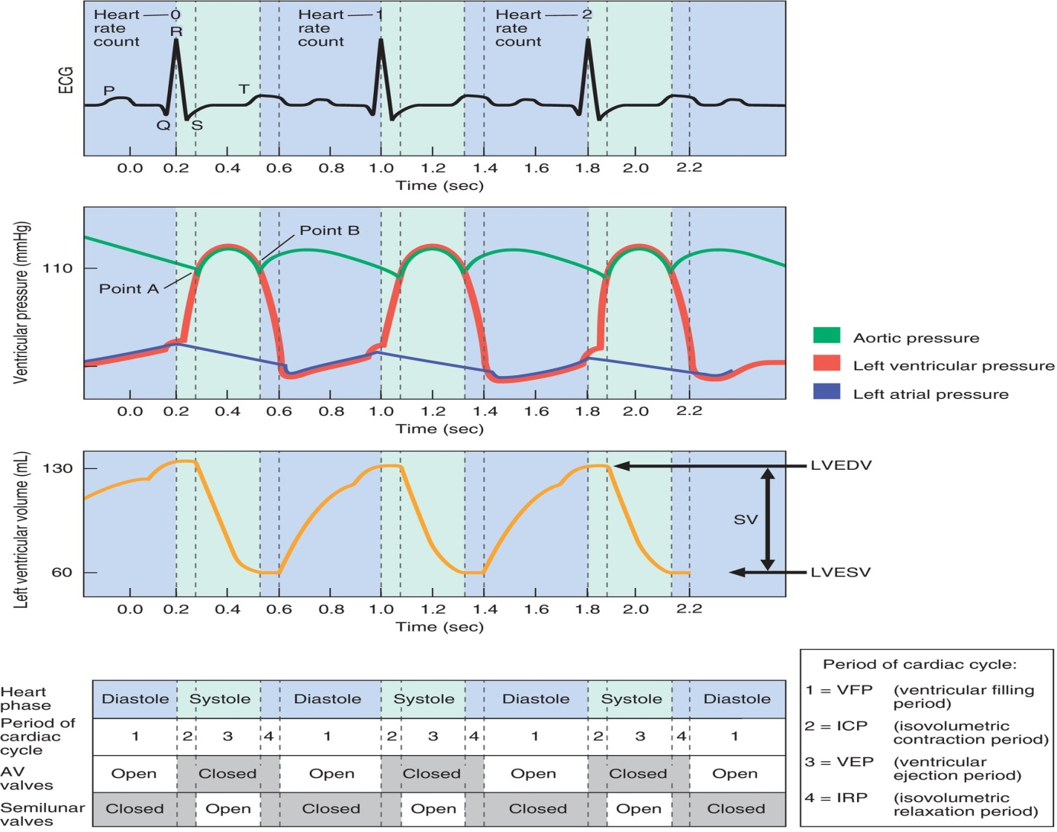
Graphic Summary of the Cardiac Cycle

Slide 9
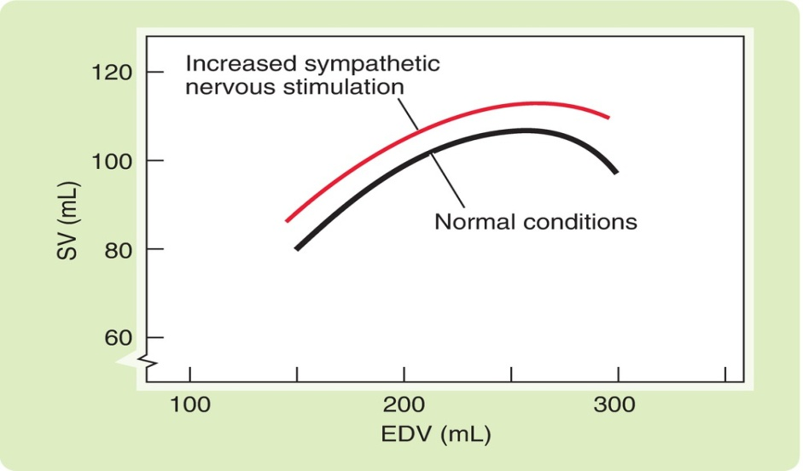
II. Overview of the CV System (cont.)
6. Stroke Volume—amount of blood ejected from the ventricles with each beat of the heart
SV = LVEDV−LVESV
EF = (SV/LVEDV) × 100

Slide 10
II. Overview of the CV System (cont.)
7. Cardiac Output—The amount of blood pumped per unit of time, in liters per minute
Q = SV × HR
Reflects blood flow through the entire cardiovascular system

Slide 11
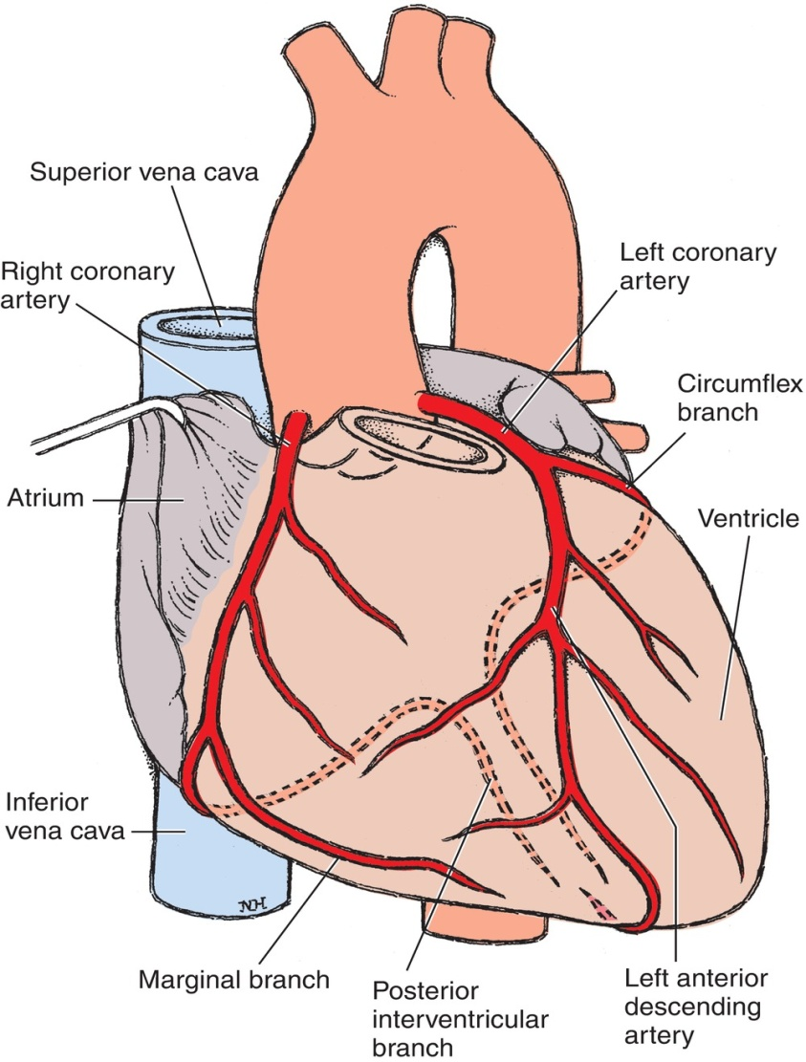
II. Overview of the CV System (cont.)
Coronary circulation
9. Myocardial oxygen consumption—estimated by RPP

Slide 12
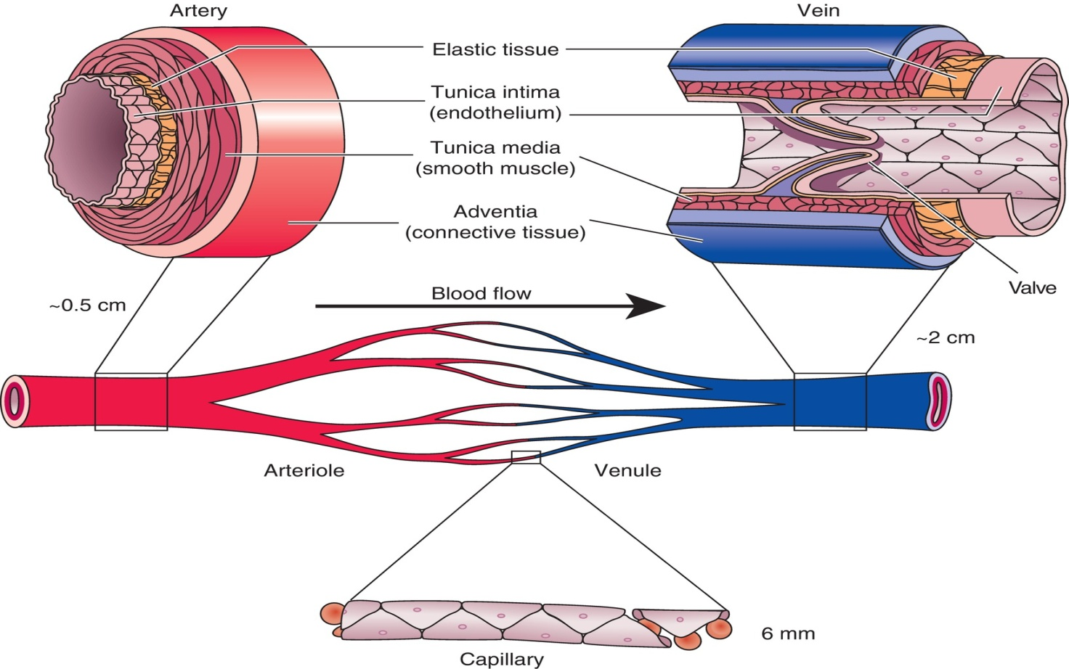
II. Overview of the CV System (cont.)
B. The Vascular System

Slide 13
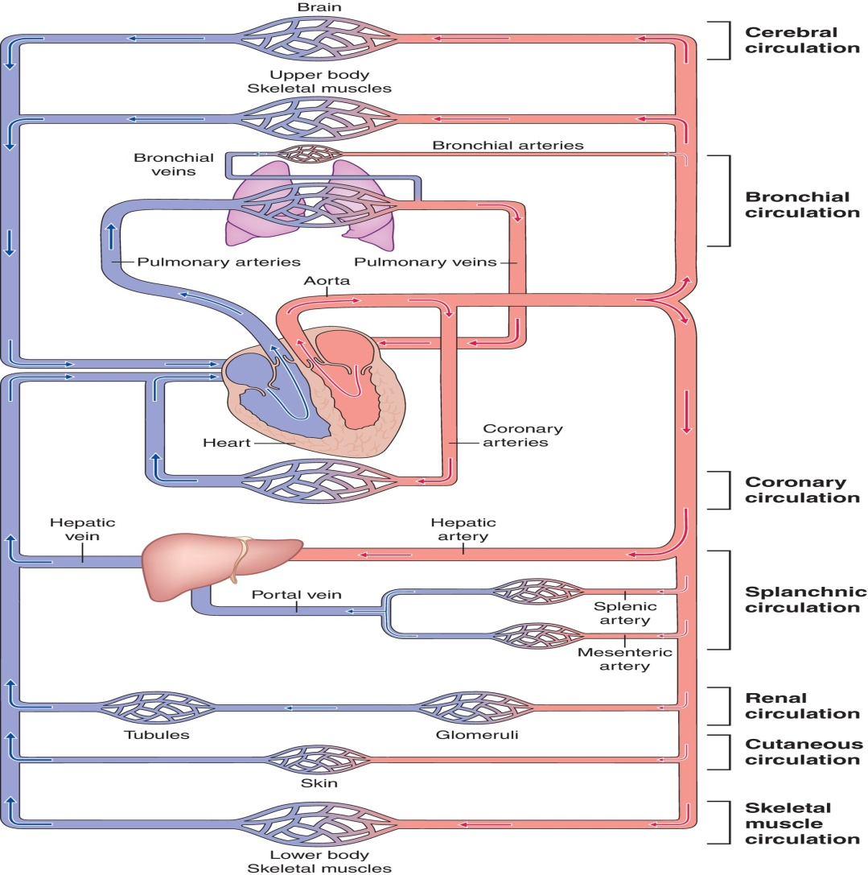
Schematic of the Vascular System

Slide 14
II. Overview of the CV System (cont.)
1. Arteries
MAP = (PP/3) + DBP₂
MAP = (PP/2) + DBP₁

Slide 15
II. Overview of the CV System (cont.)
2. Arterioles
Resistance vessels—another name for arterioles due to their ability to vasodilate and vasoconstrict; changing diameter allows them to control the flow of blood to an organ or tissue

Slide 16
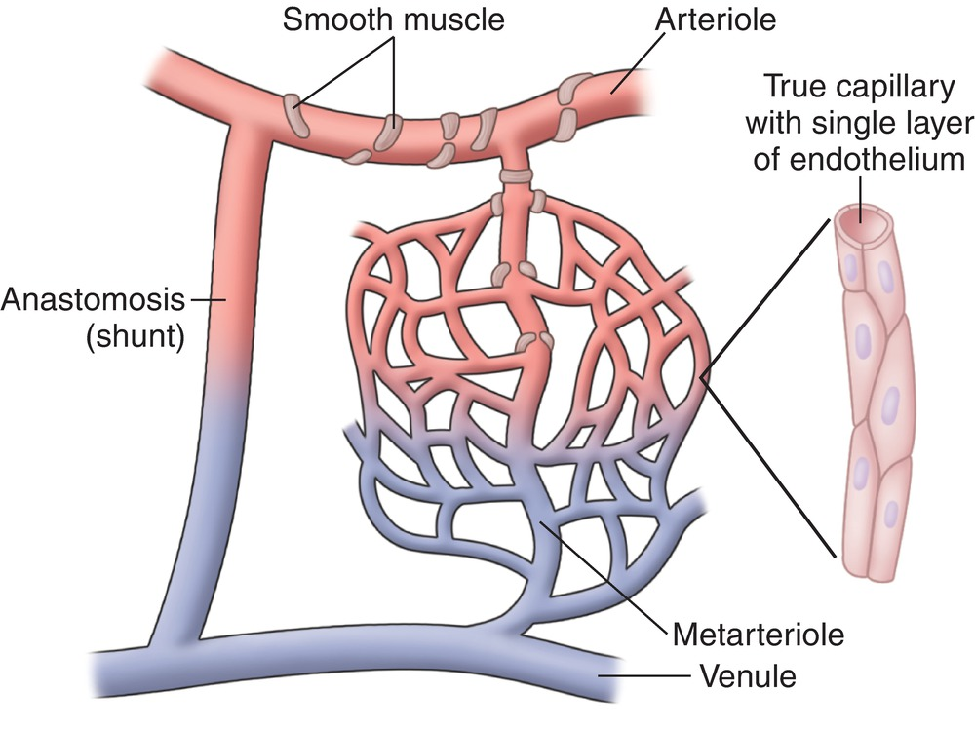
II. Overview of the CV System (cont.)
3. Capillaries

Slide 17
II. Overview of the CV System (cont.)
4. Venules
5. Veins
Capacitance vessels—another name for veins, owing to their distensibility, which enables them to pool large volumes of blood and become reservoirs for blood

Slide 18
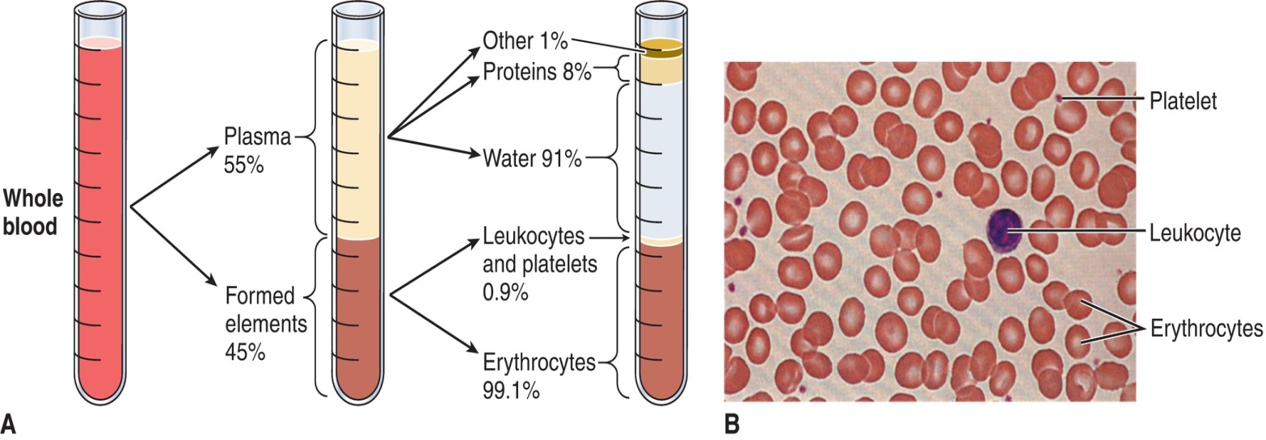
II. Overview of the CV System (cont.)
C. Blood
Hematocrit—the ratio of blood cells to total blood volume, expressed as a percentage

Slide 19
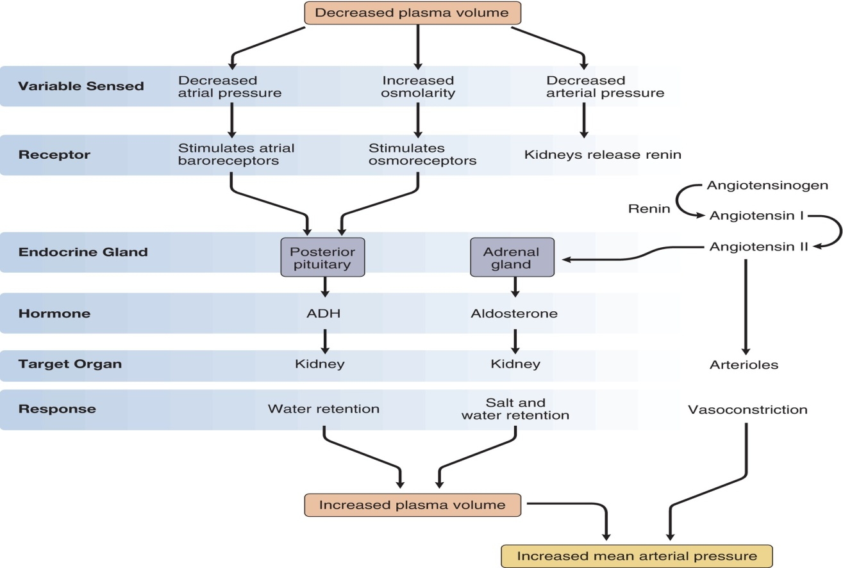
II. Overview of the CV System (cont.)
D. Hormonal Control of Blood Volume

Slide 20
III. Cardiovascular Dynamics
A. Cardiac Output
B. Mean Arterial Pressure (MAP)
C. Total Peripheral Resistance (TPR)
Q = MAP/TPR
•

Slide 21
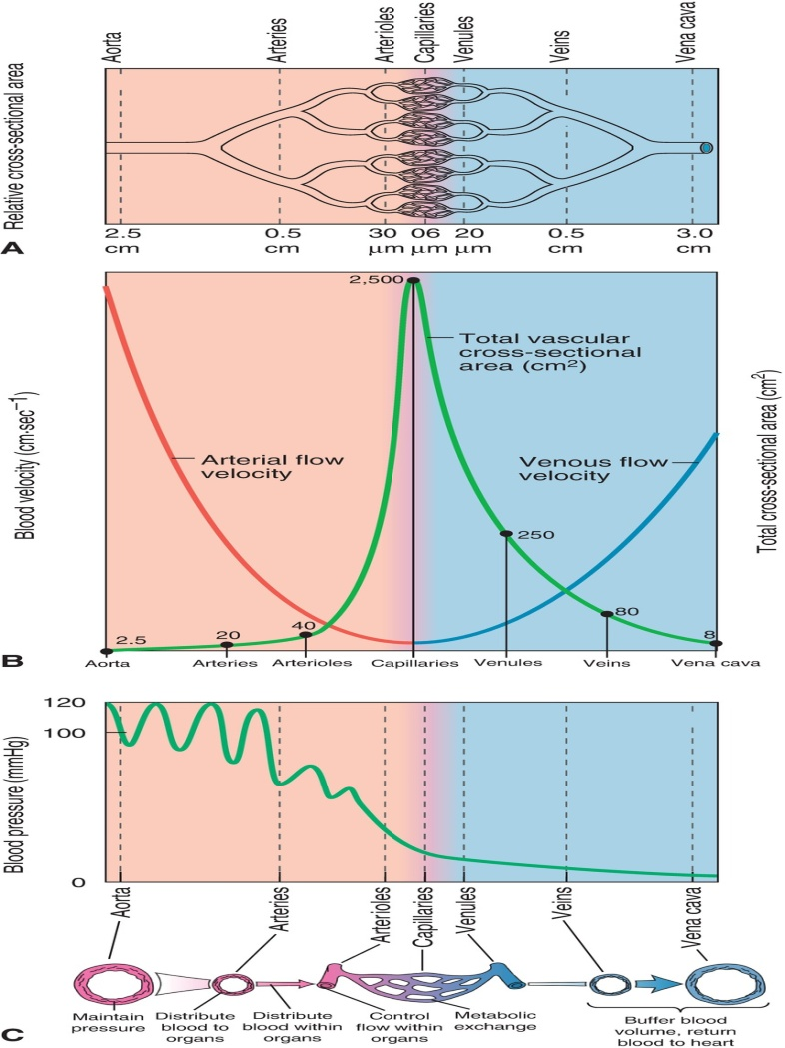
III. Cardiovascular Dynamics (cont.)
D. Principles of Blood Flow

Slide 22
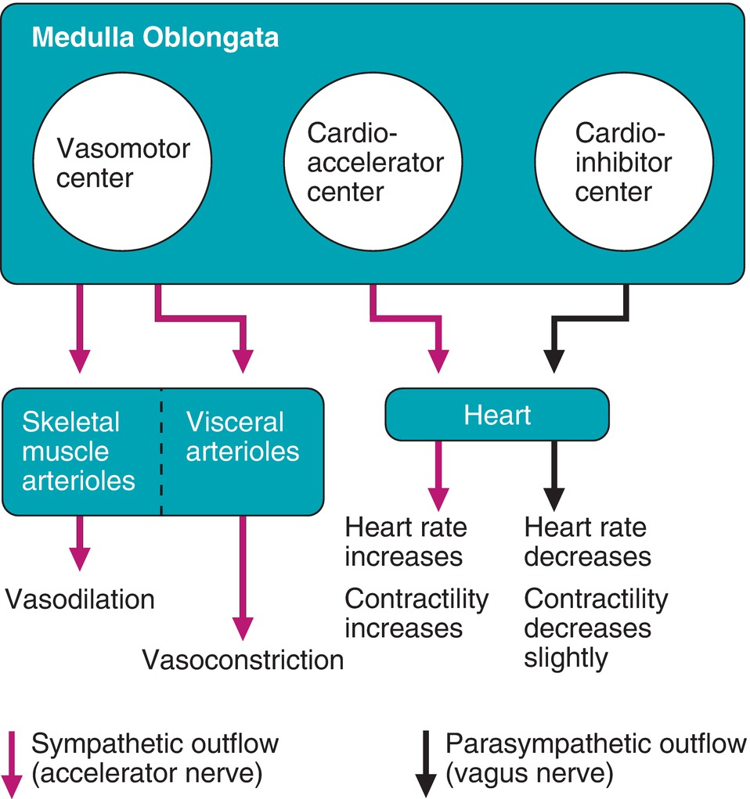
IV. Regulation
A. Neural Control

Slide 23
IV. Regulation (cont.)
B. Anatomical Sensors and Factors Affecting Control
1. Higher brain centers
2. Systemic receptors
a. Baroreceptors
b. Stretch receptors
3. Chemoreceptors
4. Muscle joint receptors

Slide 24
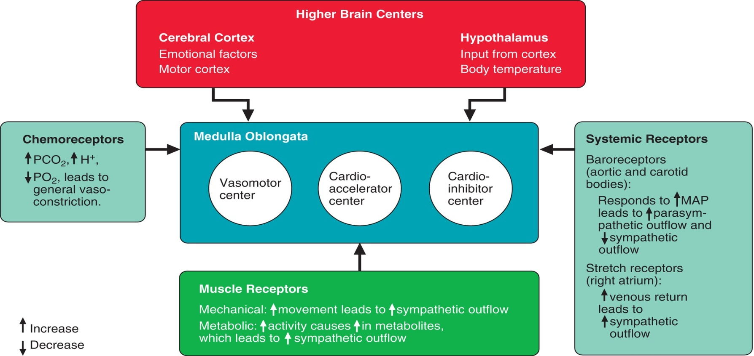
Factors Affecting Neural Control of Cardiovascular Function

Slide 25
IV. Regulation (cont.)
Neurohormonal Control
  Epinephrine/norepinephrine
  Aldosterone/ADH

Slide 26
V. Measurement of CV Variables
A. Cardiac Output
Fick equation
Q = (VO₂/a-vO₂diff)
•
•

Slide 27
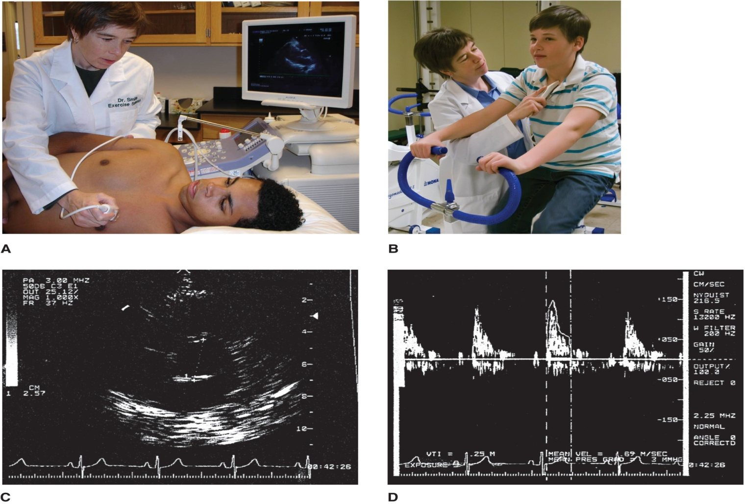
V. Measurement of CV Variables (cont.)
B. Stroke Volume

Slide 28
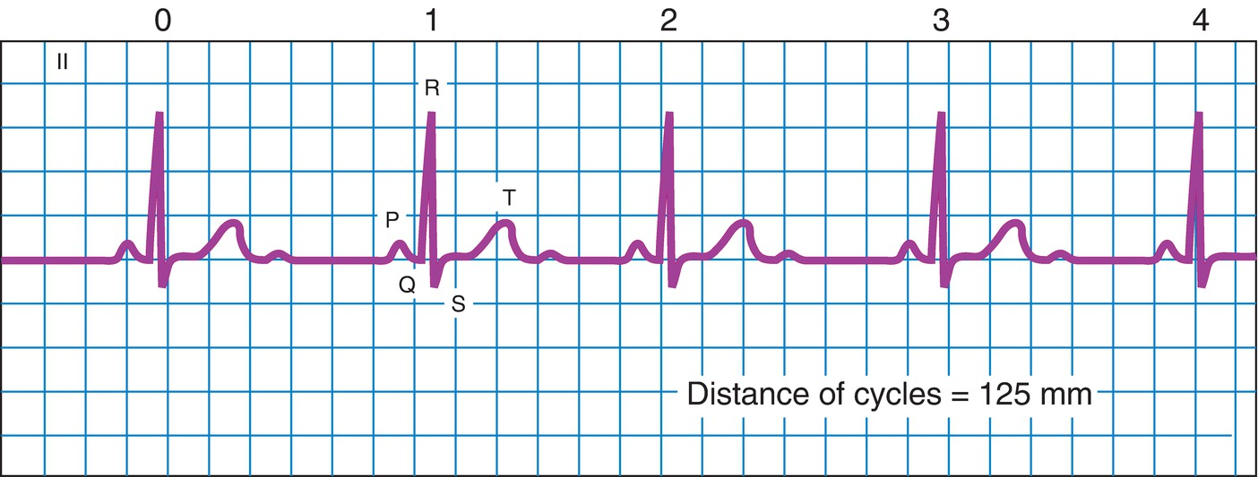
V. Measurement of CV Variables (cont.)
C. Heart Rate

Slide 29
V. Measurement of CV Variables (cont.)
•
D. VO₂max—greatest amount of oxygen that the body can take in, transport, and utilize during heavy exercise
VO₂max = (HR max) × (SV max) × (a-vO₂ diff max)
Field tests of VO₂max
•
•

Slide 30
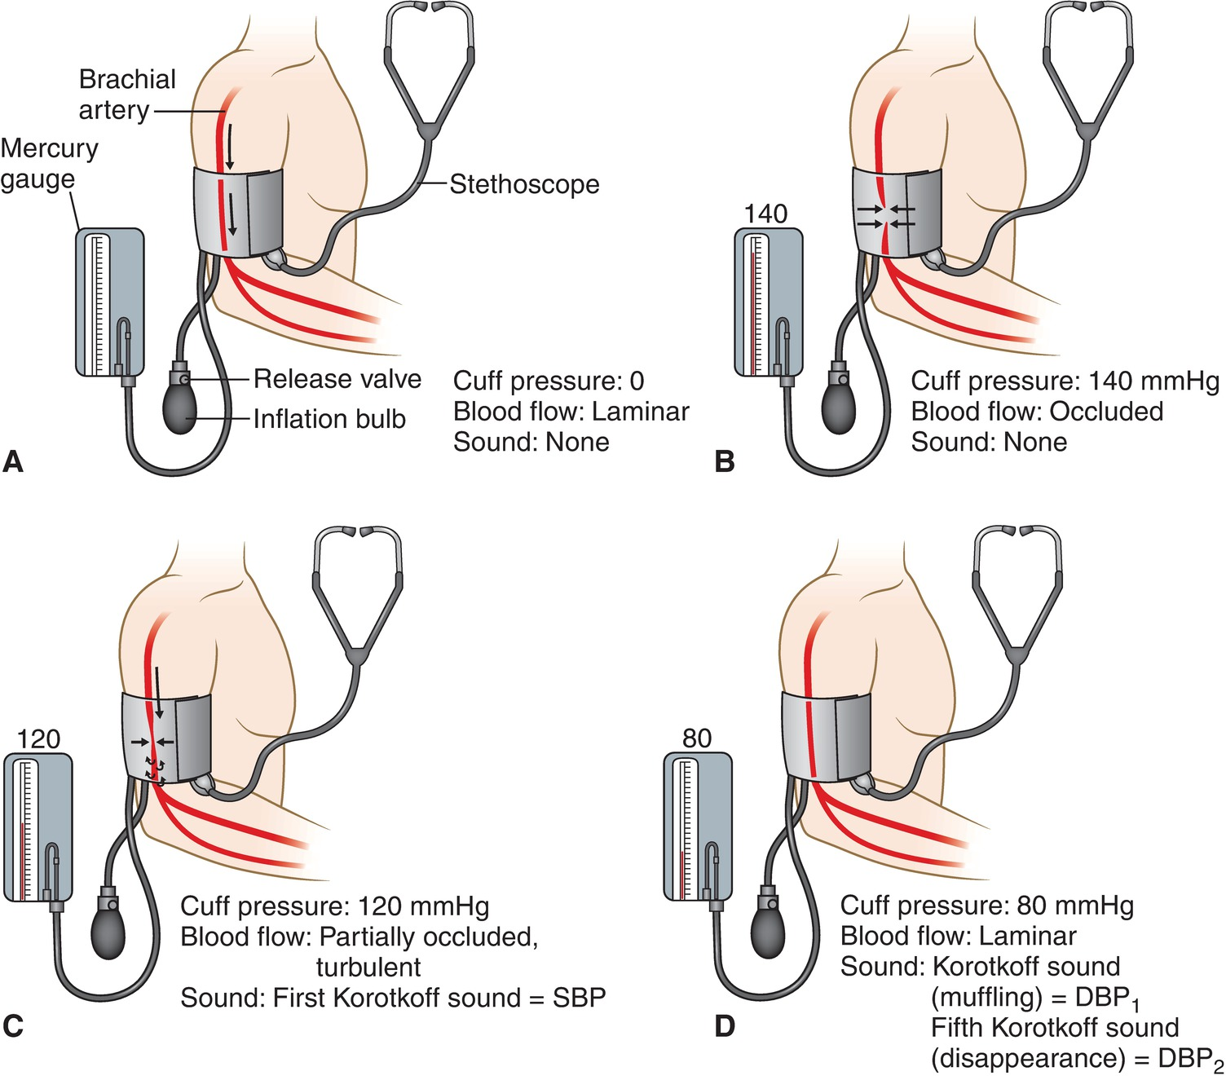
V. Measurement of CV Variables (cont.)
E. Blood Pressure

