Slide 1

Programme: BSc Health and Social Care
Module: Community Care and Development
Module Code: BMHP6022
Lecturer: Jolly Nwankwo
Assessment Title: Component 1: PP Presentation
Student: Elizabeth Cuffie (1913507)

Slide 2
Acknowledgement
I confirm that I have not used any AI tools in the research and creation of this
assignment. I confirm that I have not presented any AI generated materials as my own
work. I confirm I have copies of my drafts, notes, and other resources I used, which I
may be asked to provide in evidence.

Slide 3

Introduction
Community
A community is a category of people with many and various characteristics who are connected by social ties with a division of ordinary perspectives, working together as part of a team in a geographical location or settings.
(Mac Queen Kim, et al 2016).

Slide 4

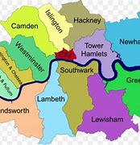
Introduction
The aim of this community project is to identify and address some Health and Social Care needs in the London Borough of Southwark Council. This Borough is in the Southeast of London, United Kingdom.
According to Southwark Borough council website,2024,The borough has been prehistoric from the 12th until the 19th century and was controlled by the metropolitan board of works.it is one of 32 boroughs in London, and was formed under the government Act 1963.
The borough’s full legitimate name is ; The Mayor and Burgesses of London borough of Southwark, but it is well known as Southwark

Slide 5
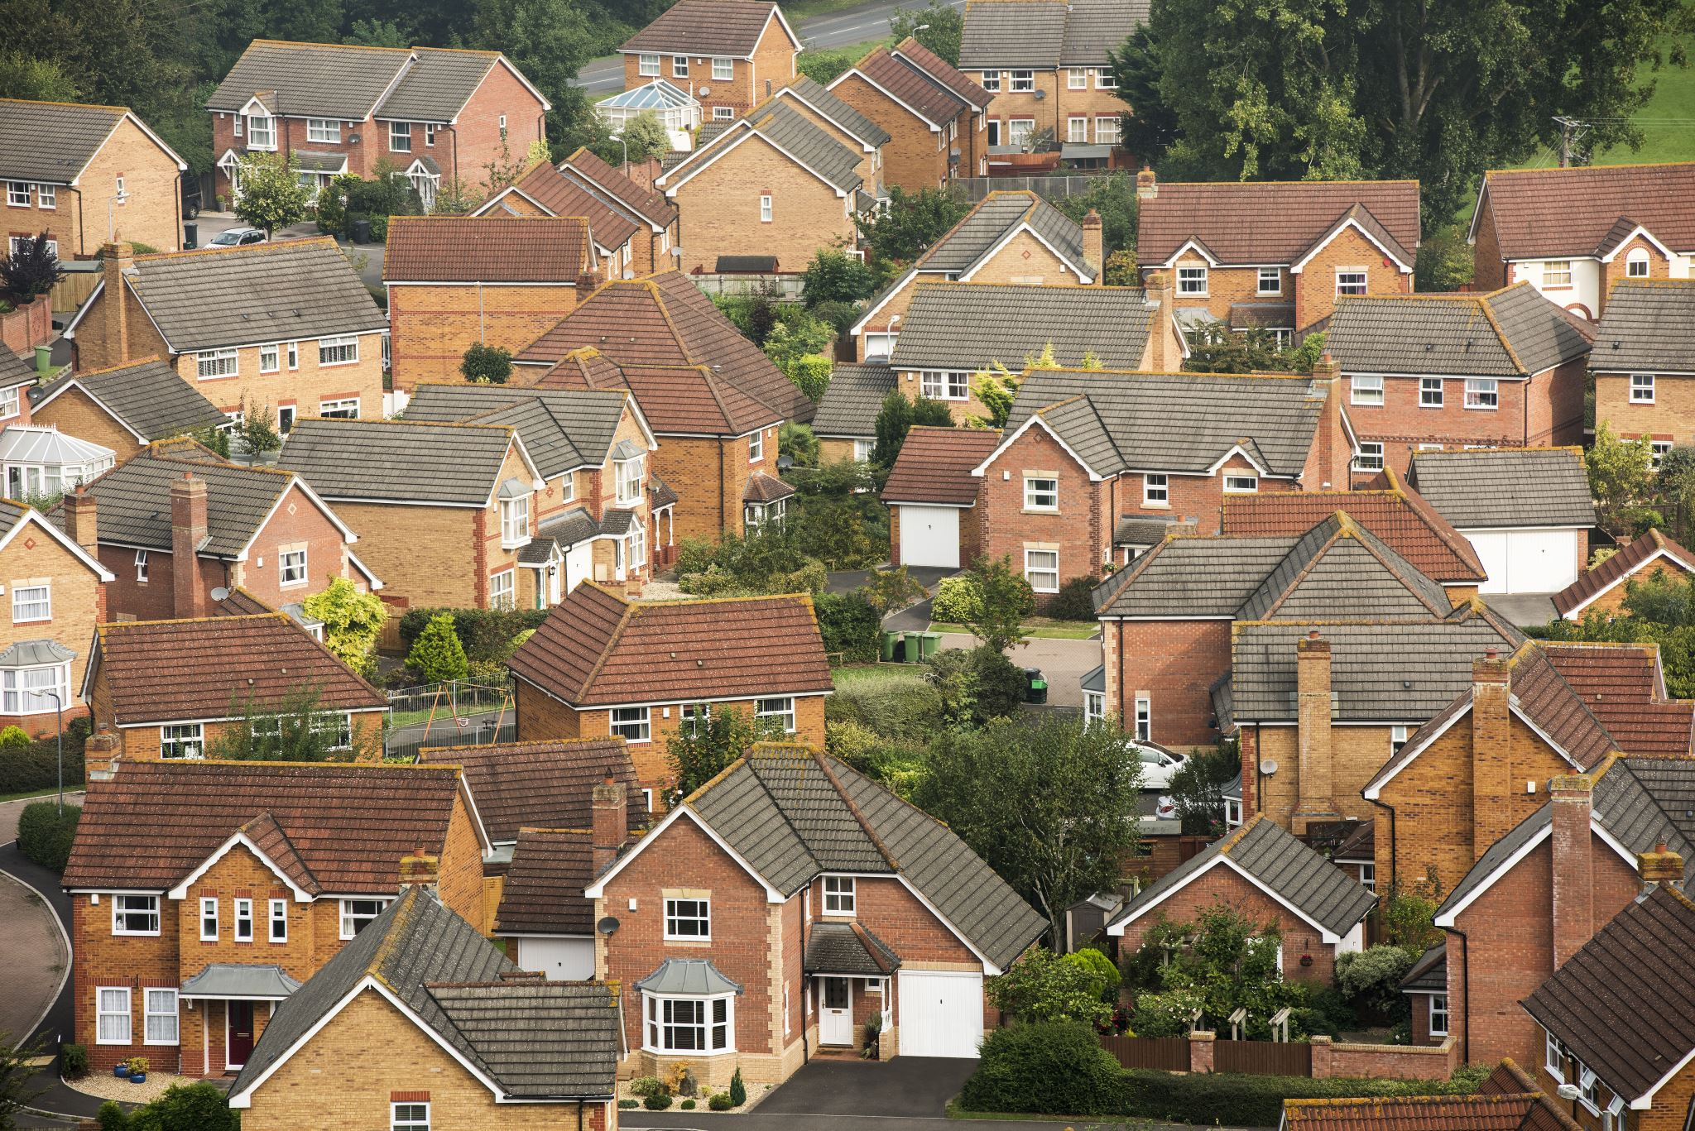
Health and social Care needs in Southwark Council
Here are some of the Health and Social Care needs in Southwark Council:
Child Poverty
Housing crises
Crime
Air Quality
Infant Mortality
Health Care use
Adult Social Care
Mortality etc.
For this community project I will be focusing on tackling Housing crises
State of the borough report, (2021).

Slide 6

Demographics by Population,
According to the mid 2022 population figures published by office for national statistics,(ONS) Southwark Council population is 311,913. it grows by 1.7% each year.
48.5% of 311,913 are male whilst 51.5% are female.
The recent 2021 census shows that 51.4% of the population living in Southwark is mainly white, the remaining 48.6% is non white.
Black people are the biggest group of minority living in Southwark, which is 25.1%. (Varbs,2023).

Slide 7

Demographics by ethnicity
White - 158,220 people or 51.4%
Black - 77,299 people or 25.1%
Asian - 30,540 people or 9.9%
Mixed - 22,151 people or 7.2%
Other - 19,430 people or 6.3%
(Census 2021)

Slide 8
Demographics by Religion
The table below shows the religious groups in Southwark:
Christian - 133,299 people or 43.3%
Buddhist - 2,965 people or 1.0%
Hindu - 3,444 people or 1.1%
Jewish - 1,243 people or 0.4%
Muslim - 29,633 people or 9.6%
Sikh - 632 people or 0.2%
Other - 136,423 people or 44.3%

Slide 9

Community Stakeholders involve in Housing.
community organisations- ( Homeowners Association)
campaign groups- (Southwark Homelessness forum)
trade unions – (Housing Association)
faith groups- (Religious leaders eg pastors Imams)
residents’ groups- (Private & Council tenants
Local Authority (Council)
Councillors

Slide 10
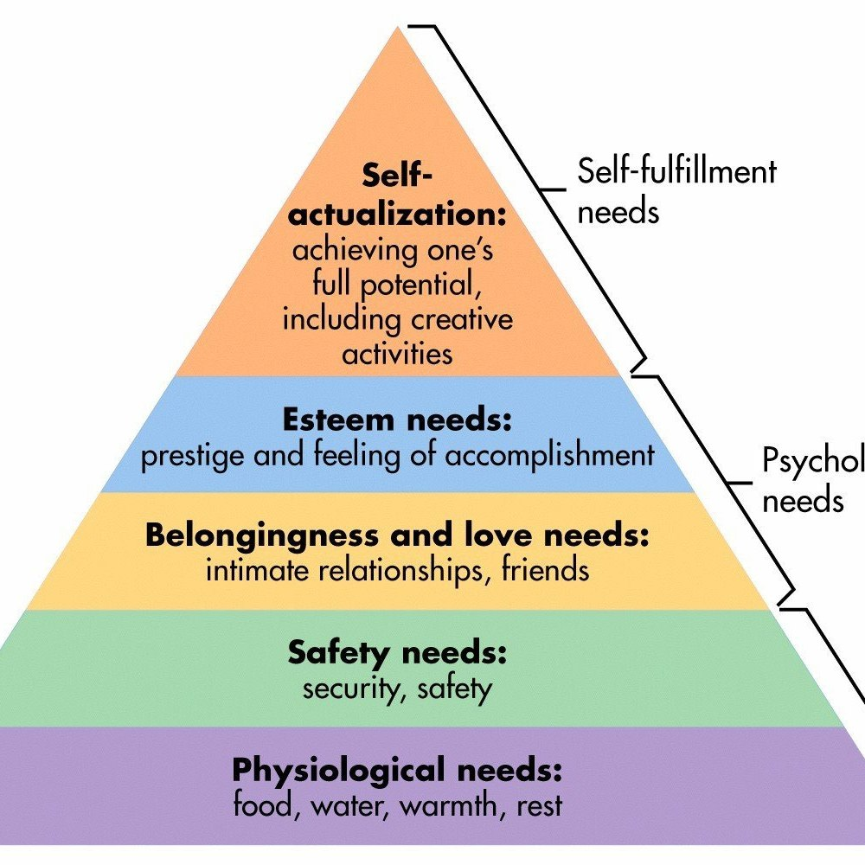
Theories: Maslow’s hierarchy of needs.
Esteem needs
Belonginess and love needs
Physiological needs
Safety needs
(Mind for life.org 2018)

Slide 11

Social media platforms will be used in my project
Instagram
Facebook
WhatsApp
Twitter
(Vecteezy 2024)
# Build more affordable housing

Slide 12

Legislation and Policies supporting my Housing project
Human Right Act 1998
Housing Act 2004
Social Housing(Regulation) Act 2023
Landlord and Tenant Act 1985
Housing and Regulation Act 2008
Housing and Planning Act 2016
(legislation.gov.uk 2024)

Slide 13

Barriers /obstacles to my community development project.
Increased In population
Lack of infrastructure
Lack of supply
Planning system
Ineffective tax system
Benefit system
Insufficient Funding
Lack of stakeholder's engagement
Skills shortage
Housing instability
(Clker.com 7 years ago)

Slide 14
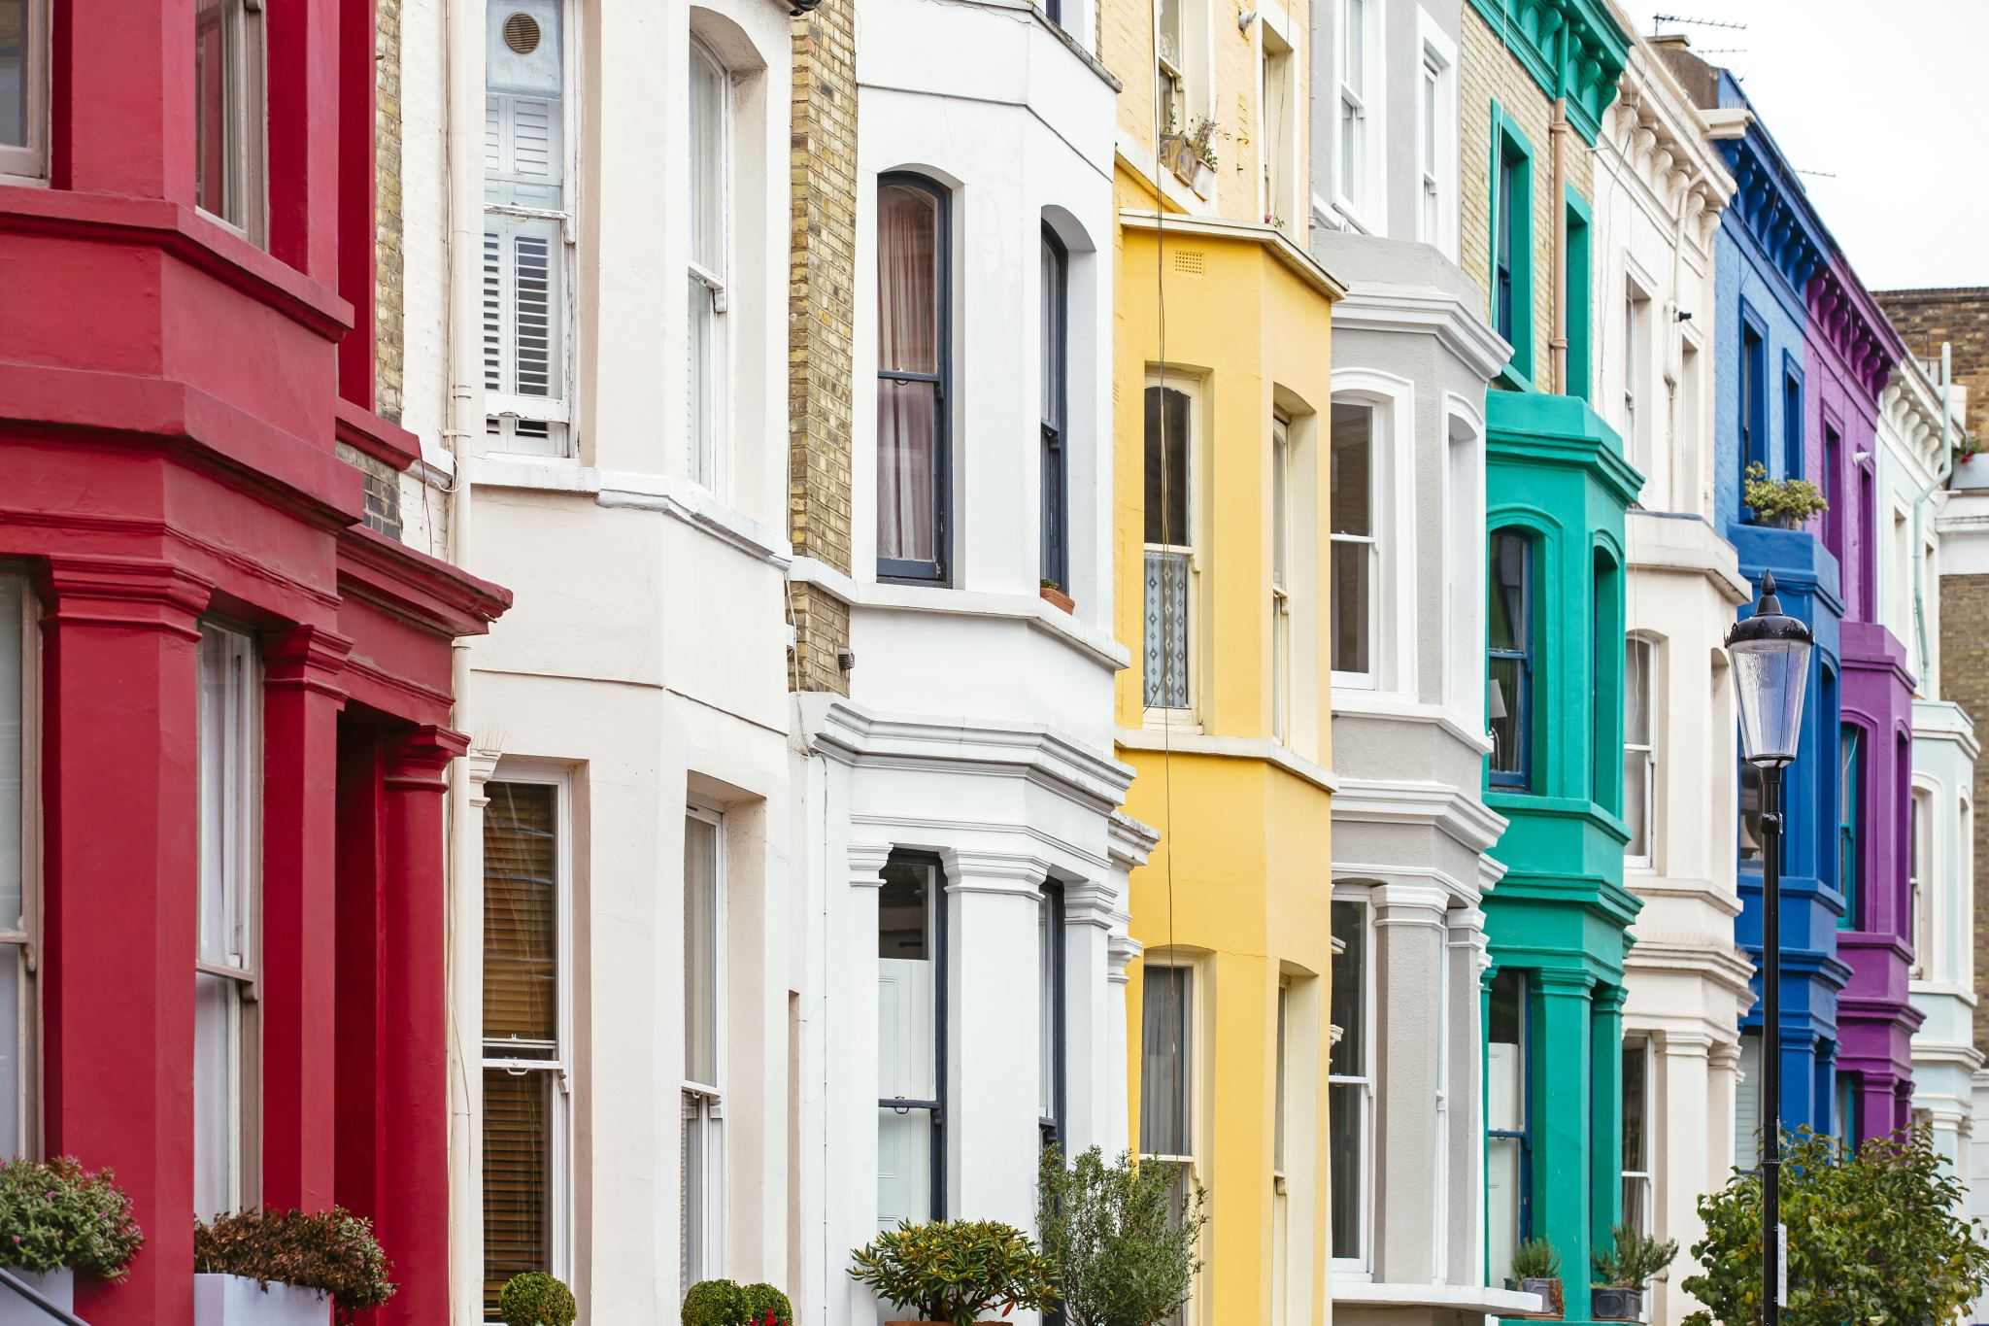
Recommendations
Housing problem in Southwark council has been ongoing for a long time, despite the council’s hard work to address this issue, it is still an ongoing issue.
The council needs to:
Build More council homes.
Address poor quality housing and overcrowding.
Encourage people to go to work and pay their rent.
Build more retirement homes for the elderly.
Making provision for migrant.
Scheme for downsizing.

Slide 15
Conclusion
Housing crises is a major concern in London as a whole. Southwark borough council is one of 32 boroughs in London that has shortages of social housing. With a growing population, the demand for council housing keeps increasing each year. This can be tackled by building more affordable houses to meet the demand of the growing population. Proper planning should also be put in place. and more charities should get involve to raise funds to build more houses. Young families should also be encouraged to go to work so that they can pay rent to the council. In doing so, the council can have funds to put into social housing.

Slide 16
References Cont’nd
Clker.com (7years ago) Barrier clip art Clker.com Available at: images of barriers - Search Images (Accessed 14th November 2024).
Deposit photos.com (2024)Sociology stock photos Available at: Sociology Stock Photos, Royalty Free Sociology Images | Depositphotos (Accessed 9th November 2024).
Encylopedia (2024) Southwark London borough council Available at:Southwark London Borough Council – Wikipedia (Accessed 25th November 2024.
Favpng.com (4years ago) London borough of southwark Available at:london borough of southwark map - Search Images (Accessed 21st November 2024).

Slide 17
References
Legislation.gov.uk (2024) social housing regulation Act 2023 Available at: The Social Housing (Regulation) Act 2023 (Consequential and Miscellaneous Amendments) Regulations 2024 (Accessed 11th November 2024).
Mindforlife.org (2018)Hierarchy –of needs-maslow’s. Available at: list and explain maslow's hierarchy - Search Images (Accessed 13 November 2024.
Mac Queen KM et al (2016) promotin Public Health Available atWhat Is Community? An Evidence-Based Definition for Participatory Public Health – PMC (Accessed 28th November 2024).
Southwark,gov.uk (2024) Housing support Available at:Housing support | Southwark Council (Accessed 7th November 2024).
Southwark,gov.uk (2024) State of the borough report Available at:403 Forbiddenmordengov.southwark.uk (Accessed 27th November 2024).

Slide 18
References Cont’nd
South.gov.uk (2024) Southwark council logo Available at:southwark council logo - Search Images (Accessed 24th November 2024).
Varbes (2023) demographics of Southwark Available at: Southwark Demographics | Age, Ethnicity, Religion, Wellbeing (Accessed 10th November 2024).
Vecteezy (2024) 2024 best social media icon. Available at social media logo vector - Search Images
(Accessed 10th November 2024).
Wereparent.com (nd) Istock image Available at: iStock_89333691_SMALL.jpg (691×693)(Accessed 15th November 2024).

Slide 19
References Cont’nd
Wereparent.com (nd) Istock image Available at: iStock_89333691_SMALL.jpg (691×693)(Accessed 15th November 2024)

