Slide 1

LCHS4010
Psychology in Health and Social Care
Student NAME: Andrei Niqoule Dimayuga
Student NUMBER:2515167
TEACHER NAME: Peace ukachukwu
Acknowledging the use of AI tools, I confirm that I have not used any AI tools in the research and creation of this assignment. I confirm that I have not presented any AI-generated materials as my own work.

Slide 2
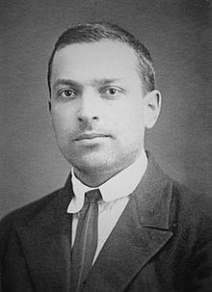
How Lev Vygotsky's Sociocultural Theory Helps Us Understand Isaac's Growth

Slide 3

Case Study: Introducing Isaac
Isaac is a 4-year-old child currently experiencing complex environmental transitions and delays.
Observed Concerns: Severe language delay, withdrawal from peer play, separation distress from his mother, and struggle to join group activities.
Family background: Disrupted support system, raised by a single mother addressing post-natal depression
Recent Challenge: Physical relocation resulting to instability care arrangements.
Purpose of Presentation: How Vygotsky’s theory to understand Isaac’s challenges and create practical strategies.

Slide 4
Theoretical Concepts:
Vygotsky’s Sociocultural Theory
“Social interaction plays a crucial role in children's cognitive development and brain structure”
The More Knowledgeable Other (MKO)
An MKO represents anyone with a higher skill level than the learner (Parent, Teacher or Peer). A person who guides the learning process.
Zone of Proximal Development
Refers to the difference between what a child can achieve independently and what they can achieve with guided support (University of Reading, 2020)
Systematic Scaffolding
A temporary adjustable support framework provided by the More Knowledgeable Other (MKO). The support is gradually reduced as the child develops independent skills.
“Language is a psychological tool that supports thinking and self-regulation. Learning is shaped by culture, routines and shared activities”
University of Reading (2020), Early child Development & Care (2023)

Slide 5

Vygotsky’s Ideas And Isaac’s Experience
Responsive Communication: Language delays are best addressed through interactive conversations rather than through isolation.
Pretend Play: Adult-guided play significantly improves a child's self-regulation, emotional control, and behavioural flexibility.
UK Policy Integration: Structured modelling, comment-based play and intensive communication strategies. This is in line with DfE and Public Health England Guidelines.
Department of Education and Public Health England (2020)

Slide 6
Looking At Isaac’s Environment
And Situation:
Disrupted Care & Lack of MKOs
Fractures Scaffolding: Frequent Shifts in the environment meant Isaac lacked consistent figures to daily routines.
Maternal Post-Natal Depression: Limits emotional co-regulation cycles, reducing the quality of language modelling at home.
Language & play deprivation
Reduced Language Exposure: Being deprived of essential verbal interaction hinders internal processes and slows down the structure of internal thinking.
Play-based Withdrawal: without a supported play entry, Isaac withdraws further language and cognitive learning opportunities.
Department of Education (2020), York & Scarborough NHS Trust (20206)

Slide 7

The Interaction Of Nature & Nurture
Biological Factors (Nature):
People with certain traits of brain development may be more sensitive. This means they may react strongly to stress, showing behaviours like wanting to run away from problems or seeking comfort from others.
Environmental Factors (Nurture):
The quality of caregiving, stable relationships, and secure attachments act as protective factors that help individuals regulate their emotions and behaviour.
* Vygotsky clearly shows how cultural/ environmental scaffolding shapes neurological development.
Bradford District Care (2025) , DfE and PHE (2020)

Slide 8
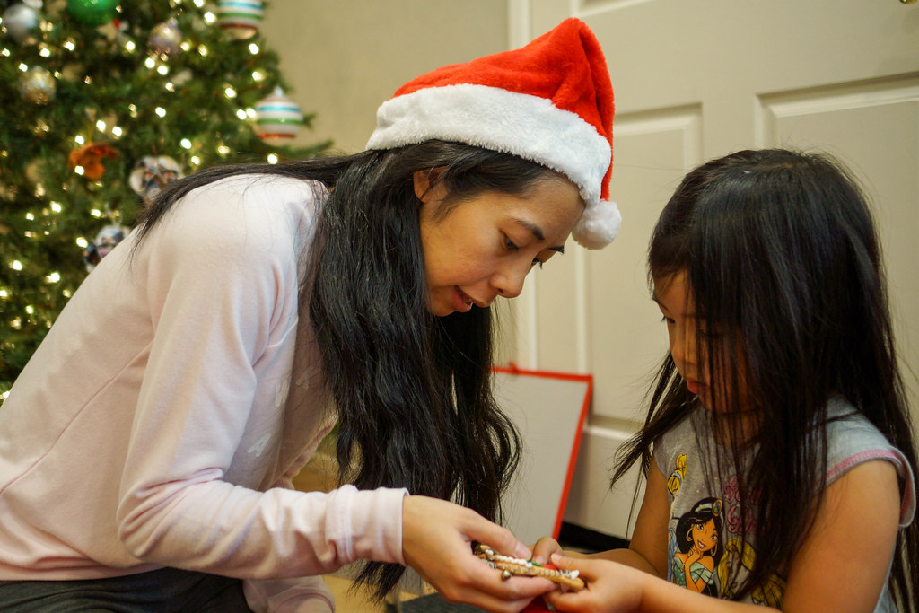

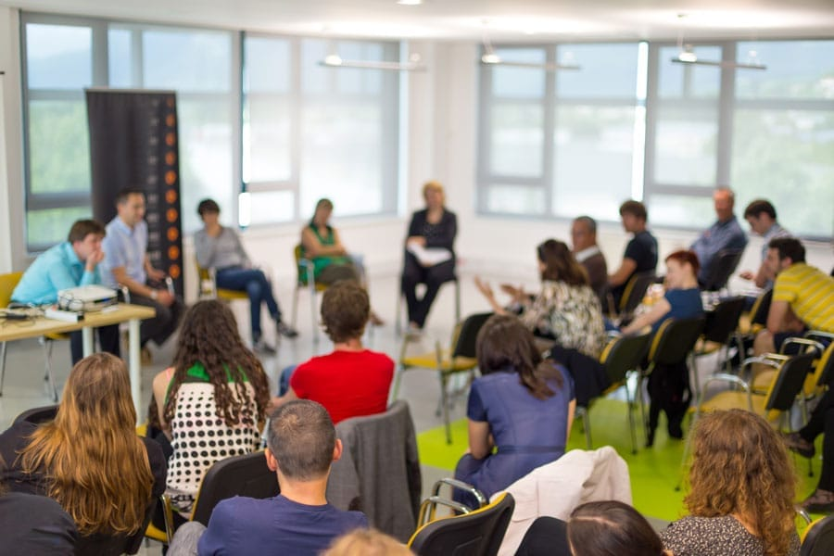

Multi-agency Strategies
INTERVENTION AREA | Practical steps | Cultural and social factors
Attachment-Based | A key-person, establish daily visual timetables and emotional coaching | Ensures a predictable, emotionally secure base
Play & Language Rich | Introduce an adult guided play, model play talk, commenting and interactive reading. | Play that helps children grow with support, model private language tools.
Parental Empowerment | Home language interaction guides, visuals home routines, maternal mental health referrals. | Restores the home-based primary MKO role.
Multi Agency care | SALT referral, unified communication goals across agencies (SENCO,social care, parent, teacher ,etc) | Ensure consistency in the coordinate framework.

Slide 9
Critical Analysis Of Vygotsky’s Sociocultural Theory
Strengths
Social Interaction & Language directly support SLCN development
ZPD assists in setting “just right” communicative goals.
Promotes culturally sensitive, relational classroom approaches.
Limitations
The Theory works best when the child has a stable relationship with adults.
Cultural expectations vary; the theory may not fit every family’s learning or communication style.
Adults may give too much help, which can limit children’s independence.
Cultural, Social & Contextual Considerations
Home language is an important cultural tool for learning
Practitioners should avoid deficit thinking and build on the child’s cultural strengths (Wigan Council 2020)
Communication styles differ across communities, such as storytelling traditions, eye contact and turn-taking
London Diverse Communities Relevance
Flexible enough to adapt to different cultural expectations and family practices
Supports children from different socioeconomic backgrounds
London’s multilingual children benefits from the theory that values language as a cultural tool.
Department of Education(2020), Wigan Council (2020), Bury Council (2024)

Slide 10
Conclusion:
Isaac’s development shows how much children benefit from patient guidance, shared play, and calm emotional support. With adults modelling language and helping him manage feelings, Isaac becomes more confident and more able to join in learning.
His mother has also been supported through small, practical steps. Practitioners have shown her simple pretend‑play routines she can copy at home, given her reassurance when she feels unsure, and encouraged her to take part in short, positive interactions with Isaac. These small actions help her feel more confident and strengthen their bond. With consistent support from both the setting and his mother, Isaac can build emotional security, communication skills, and A stronger sense of trust.

Slide 11
Reference:
Department of Education and Public Health England (2020). Guidance to improve speech, language and communication in early years.
Available at www.gov.uk/government/publications/best-start-in-speech-language-and-communication (Accessed on 5 July 2026)
Department of Education (2020). Best start in speech, language and communication.
Available at https://assets.publishing.service.gov.uk/media/5f9be9c48fa8f57f3b4cb075/BSSLC_Supporting-evidence.pdf (Accessed on 6 July 2026).
University of Reading (2020). Theories of child development. Available at www.reading.ac.uk/education/-/media/project/our-main/schools-departments/education/documents/offer-holders/early-years-2024-25/pg28-theories-of-child-development_article.pdf (Accessed on 1 July 2026)
Smolucha, L. & Smolucha, F. (2021). Vygotsky’s theory in play: early childhood education. Early Child Development and Care. Available at https://doi.org/10.1080/03004430.2020.1843451, (Accessed on 4 July 2026).
National Library of Medicine (2023), Space for development of self‑regulation, Available at: https://pmc.ncbi.nlm.nih.gov/articles/PMC10766374/ (Accessed: 5 July 2026).
Bury Council (2024) Expressive language – getting more help (KS1). Available at: https://www.bury.gov.uk/schools-and-learning/send-graduated-approach-toolkit/setting-and-school-staff/school-age/graduated-approach/ks1/communication/expressive/more-help.(Accessed: 5 July 2026).
York and Scarborough Teaching Hospitals NHS Foundation Trust (2020). How to support children with language difficulties at home. Available at: https://www.yorkhospitals.nhs.uk (Accessed on 4 July 2026).
Bradford District Care NHS Foundation Trust (2025). Children aged four to five years: Strategies to support speech, language and communication. Bradford: Bradford District Care NHS Foundation Trust. Available at: https://www.bdct.nhs.uk/children-aged-four-to-five-years/ (Accessed: 5 July 2026).
Wigan Council (2020). Strategies to support children with speech, language and communication needs.
Available at: https://www.wigan.gov.uk/Docs/PDF/Business/Professionals/Raising-Attainment/Strategies-to-support-children.pdf (Accessed: 5 July 2026).
North East London NHS Foundation Trust (2026) Language pathway. Available at: https://www.nelft.nhs.uk/language-pathway/ (Accessed: 4 July 2026).

Slide 12

Q & A

