Slide 1
Principles of Learning and Teaching
Page 1 – Front cover
Page 2 – Operant conditioning
Page 3 – Operant conditioning within the classroom
Page 4 – Client centred therapy
Page 5 – client centred therapy within the classroom
Page 6 – Reference list

Slide 2
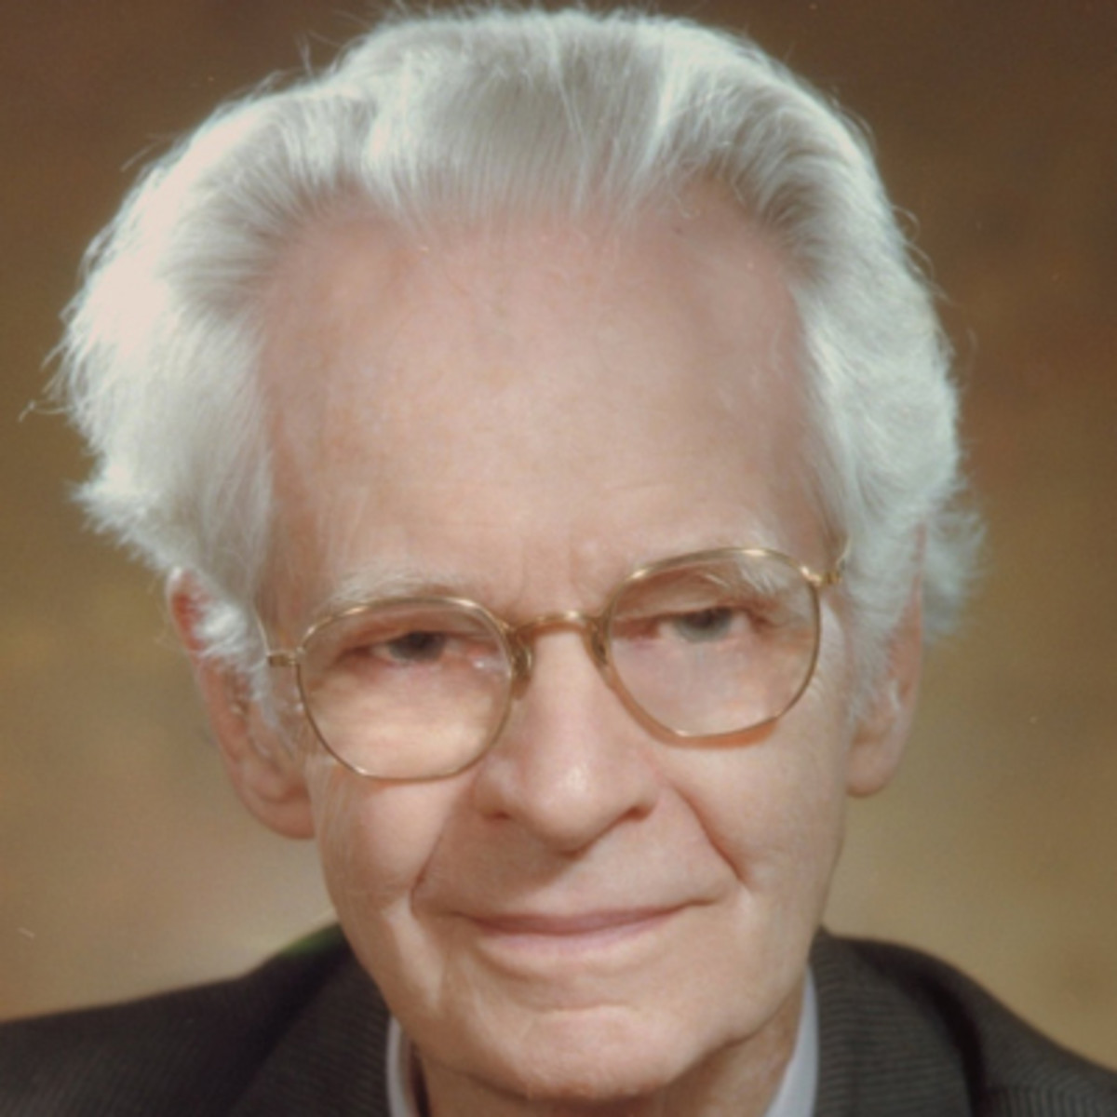
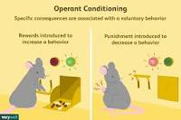
Operant conditioning
Operant conditioning is a method of learning that occurs through rewards and punishment (Skinner, 1938)
Skinner is famous for his research into learning and behaviour and based his theory on operant conditioning, carrying out many experiments on animals. One of his most well known experiments was using a rat in a box he called
The ‘Skinner box’. A lever that released food was placed in the box and it wasn’t long before the rat knew to press the lever for food, Skinner referred to this as an operant response, the food acting as a positive reinforcer for the rats behaviour.
According to skinner ‘The term Operant refers to any active behaviour that operates within the environment to create a consequence’ (Cherry,2019).
B.F Skinner biography, (2019)
Cherry,(2019)

Slide 3
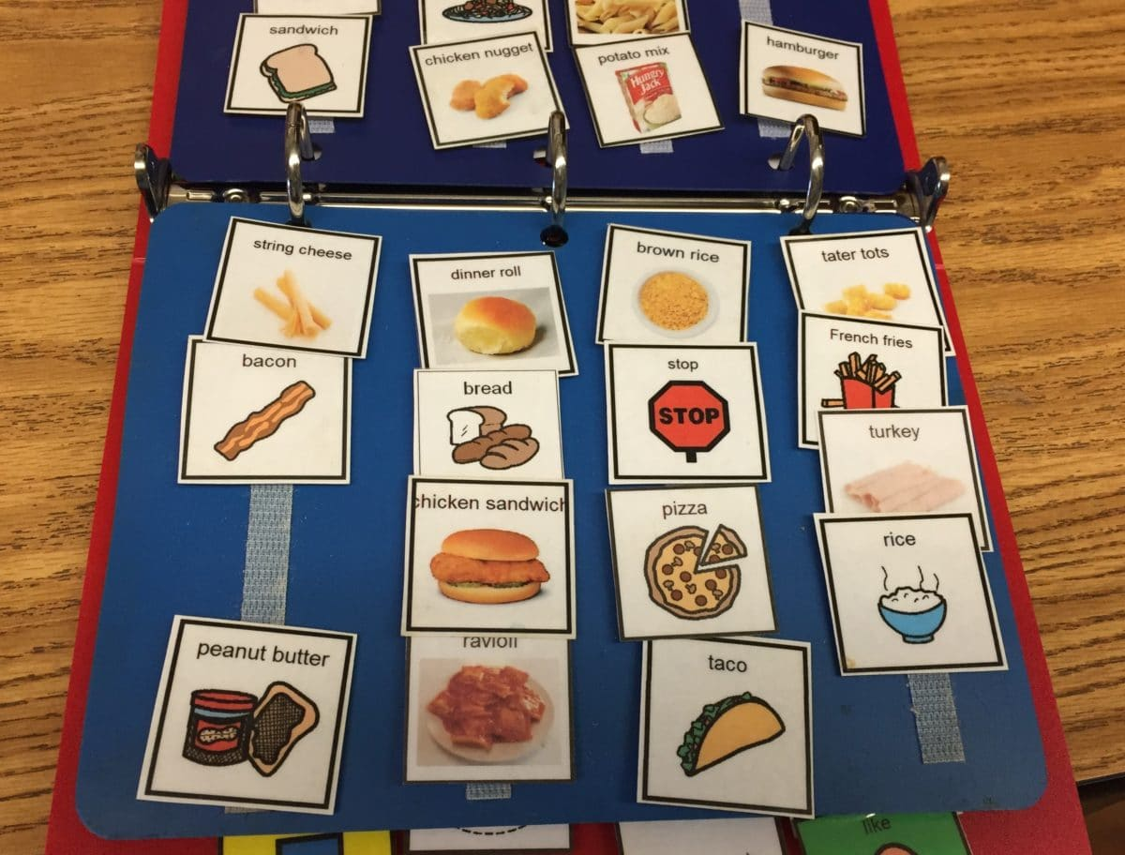
Operant conditioning within the classroom
B.F Skinners theory of operant conditioning is still used widely within educational settings, It is incoportated into the classrooms every day and still proves really successful in aiding the development and behaviour control of many pupils.
Pec’s
What is it??
Picture exchange communication is a form of communication developed by Andy Bondy and Lori Frost to promote language development. It involves children exchanging a picture for a desired item, Pecs is often used in a class with pupils with autism .
(Vaughn,2019)
ABC Charts
ABC charts are a form of applied behaviour analysis, based on Skinner’s work. Skinner developed this to observe stimulus, response and reinforcement. Abc charts are often used within classrooms, often with children with Autism or challenging behaviour.
These charts are used daily within my setting and help record behaviours happening on a daily basis
These charts offer staff a ‘systematic way to look at Antecedent for the behaviour, the behaviour is the way in which the pupil responds to the antecedent and the consequence is the action that followed the behaviour’ (Webster,2019).
Andy Bondy a behaviourist and Lori Frost a speech and language pathologist developed the Pec’s language development system using B.F Skinner’s theory, they believed that language could be developed through the operant conditioning theory. So when a child receives something they like when they exchange a picture this behaviour is likely to be repeated
(Vughn,2019)
Allen, (2016)
Skinner defines verbal behaviour as, behaviour reinforced through mediation of other people’. (Skinner, Pg 2 (2014). When using PEC’s within a classroom a staff member is acting as the mediator and reinforcing the child’s behaviour/Communication by giving them the item they have requested when they pass over the picture, this is Similar to Skinner’s experiment with the rats pressing lever for food, children give a picture in order to receive something they like. This is the very early stage of developing a child’s language and communication skills.
‘By carrying out a functional assessment (ABC chart) you are learning about the child the child before you intervene, rather than basing interventions on trial and error, the functional assessment process should guide you to the development of a more individually tailored support plan/ (Addison, 2019)
‘Behaviour which is effective only through the mediation of other persons has so many distinguishing properties that a special treatment is justified’ (Skinner,2014)

Slide 4
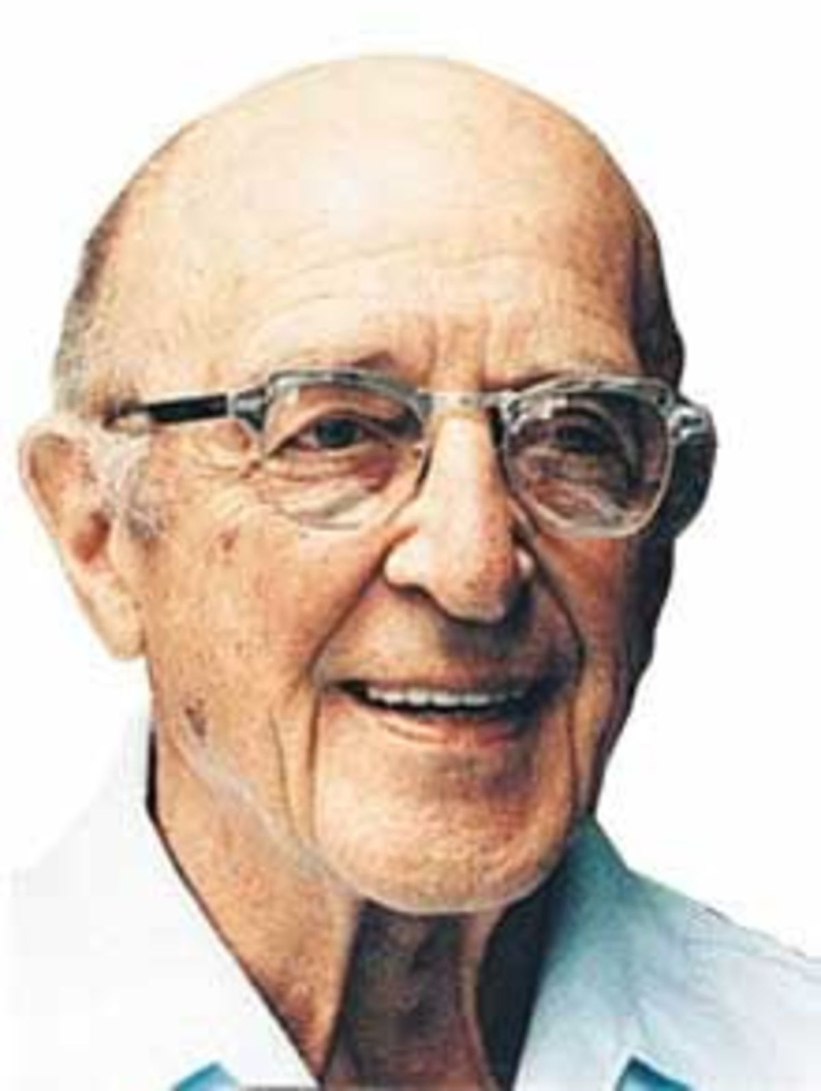
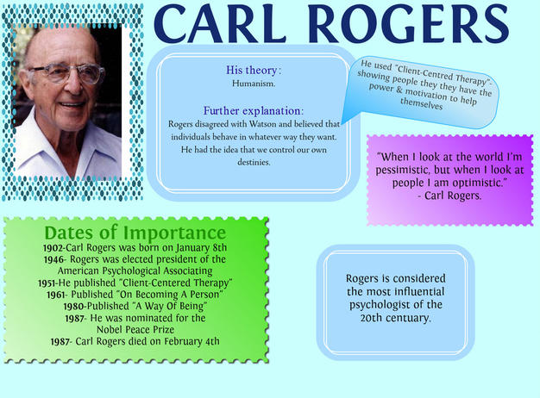
Client Centred therapy
Rogers was an American psychologist born in 1902. He was born in the united states and was well known for his client centred approach therapy. He was one of six children and aged just 20 he began to show a keen interest in psychology. He became a very well known psychologist writing many books and winning lots of awards.
‘Rogers was best known for creating what is know as client centred therapy, a non directive approach that places the client in control of the therapeutic process’ (Cherry,2019@
Psychology today (2011)
(Meresca,2018)

Slide 5

Client centred therapy and how its used within the classroom
Carl Rogers client centred approach is used daily within my setting. It’s a School of 55 pupils with profound and multiple learning difficulties so many of Rogers’s theories apply in many ways to these pupils.
Unconditional Positive regard
Proud cloud/Reward charts
Rogers talks of the importance of having an unconditional positive regard towards his clients. Every pupil should be treated with acceptance and staff should adopt a non Judgmental approach with each individual child. Within my setting we use lots of praise daily often incorporated into songs as many of the pupils respond really well to music. We have a proud cloud in the classroom where pupils will have their photograph on the wall when they have achieved something that week, We also use rewards charts and have a celebratory assembly once a week.
Client centred approach
Intensive interaction
Rogers talks of the importance of client centred therapy. Within my setting Dave Hewitt’s concept of intensive interaction is used on a daily basis. This form of therapy is used mostly with children on the autistic spectrum. This therapy revolves solely around the individual child, encouraging them to lead the session however way they wish, so a child centred therapy. Intensive interaction teaches pupils to communicate in their own way, building relationships between pupil and staff. It’s an excellent way to encourage the pupils to be themselves, showing them acceptance and stepping into their world instead of enticing them into ours.
(Talksense, 2019)
Multi disciplinary team
Throughout my setting many pupils are supported by a multi disciplinary team, this is a team of specialists all involved with catering for pupils with complex needs. This team can involve school nurses, physiotherapists, speech and language specialists and occupational therapists. This team focuses solely on the pupil and ensures the best care is given so again linking to Roger’s client centred approach. This team can help each pupil reach their full potential.
Professor Laura Winter an expert in educational psychology at the university of Manchester suggests that ‘ the concept of unconditional positive regard is growing in popularity in mainstream and special educational schools, it dates back to the 1950’s and links to the work of carl rogers, it means treating every human as equals instead of saying they are only good if they behave in a certain way’
(Halliday, 2018)
‘Intensive interaction makes use of the range of interactive games that have been shown to occur in interactions between infants and their primary care givers’
(Melanie Nind, Dave Hewitt 2012, pg 6)

Slide 6
Reference list
- Addison,.M , (2019) Challenging behaviour-supporting change. Available at: https://www.challengingbehaviour.org.uk/learning-disability-files/02---Finding-the-Causes-of-Challe Wenging-Behaviour-Part-2.(Accessed on 24th October, 2019)
- Allen,.S, (2016), Start thinking of communication now. Available at: https://www.theautismhelper.com/start-thinking-communication-now. Accessed on 23rd October 2019)
- Bates,.B (2016) Learning theories simplified published by Sage
- Cherry,.K, (2019),Pathology and life quotes from Carl Rogers. Available at https://www.verywellmind.com/carl-rogers-quotes-2795693.
- (Accessed 21st October 2019)
-Cherry,.K,(2019),What is operant conditioning and how does it work? Available at: https://www.verywellmind.com/operant-conditioning-a2-2794863.(Accessed 25th October 2019)
-Grace,E (2019) B.F Skinner behavioural theory, Available at https://kidsdevelopment.co.uk (Accessed on 24th October 2019)
-Halliday, J (2018) The guardian. Available at https://theguardian.com/education/2018/feb/27/schools-discipline-unconditional-positive-regard (Accessed 20th October 2019)
-Meresca, C (2018) Available at https://www.berkshirepsychotherapist.co.uk (Accessed 25th October 2019)
-Saul, M (2016) Burrhus Frederick Skinner- Operant conditioning. Available at https://infoalesnudo.com (Accessed on 21st October 2019)
-Sarkis, A S (2011) 6 Amazing things that rogers gave us, Available at https://www.psychologytoday.com (Accessed 22nd October 2019)
Skinner B.F (1904-1990) Biography psychologist Available at https://www.biography.com/scientist .b.fskinner (Accessed 25th October 2019)
-Skinner, BF (2014) Verbal behaviour B.F Skinner foundation
-Webster, J (2019) Available at https://www.thoughtco.com/abc-antecedent-behaviour-and-consequence (Accessed 26th October 2019)

