Slide 1
Usability Engineering
ACCB6017
Workshop 1 – The Human I

Slide 2
Aims
To build upon students’ interface design skills to give the ability to apply and analyse techniques of usability engineering.

Slide 3
Learning Outcomes
Upon successful completion of this module, the student will be able to:
Research and evaluate cognitive and social information processing
Select, apply and analyse critically techniques of interface evaluation
Synthesize a solution to a complex design problem from the concepts and principles of usability engineering and software development
Critically analyse, individually and as part of a team exercise, input and output hardware appropriate for specialised applications, for example for use by disabled people, and for three-dimensional modelling applications

Slide 4
Indicative Content
Cognitive aspects of information: perception: sensory inputs and the human memory system; concept formation and knowledge representation; cognitive processing: attention, reasoning,
The social aspect of information: semiotics and language; verbal and non-verbal languages
Interface evaluation methods (for example, observation, verbal protocol analysis, structured expert reviewing).
The scope and role of usability engineering methods (for example, task analysis, GOMS, communicating sequential processes).
Usability engineering methodologies to create a suitable interface and their relation to the software design process.
I/O devices for specialised design needs (for example, 3-dimensional interfaces and interfaces for users with disabilities).

Slide 5
Assessment
100% Coursework
Coursework 1 (50%):
  Case study looking at the initial design and evaluation of an interface for a computer game
  Fulfils outcomes 1, 2 and 3
  15:00, 8th December 2023
Coursework 2 (50%):
  Further development and testing of the interface developed for coursework 1
  Fulfils outcomes 1, 2 & 3
  15:00, Friday 12th January 2024

Slide 6
Recommended Books
 | Reading List entry
Essential | Shneiderman, B (2017) Designing the User Interface: Strategies for Effective Human-Computer Interaction (6th Edition), Addison-Wesley
Further | Rogers Y, Sharp, H, & Preece, J (2015) Interaction Design: Beyond Human-Computer Interaction. 4th Edition, John Wiley & Sons, Inc
Further | Lazar, J., Fend, JH and Hochheiser, H (2017) Research Methods in Human-Computer Interaction 2nd Edition, Wiley
Further | MacKenzie, S. (2014) Human-Computer Interaction: An Empirical Research Perspective, Morgan Kaufmann
Further | BCS Human Computer Interaction Group Proceedings

Slide 7
How Do You Take In Information?

Slide 8
The Human
Humans are limited in their capacity to process information
Humans receive information and give responses via a limited number of channels: visual, auditory, haptic and movement
Information is stored in memory:sensory memory, short-term (working) memory, long-term memory
Information is processed and applied through reasoning, problem-solving, skill acquisition and error
Users share common abilities but are individuals with individual differences that should not be ignored
It is easier to redesign a computer interface than it is to redesign a human
Notes:
This lecture provides a brief overview of cognitive psychology. In order to design something for a user we need to know the user’s abilities in much the same way we need to know the abilities of the computer that our software will run upon. We cannot change the design of the human, therefore we change the design of the software.

Slide 9
Input-Output Channels
Input occurs via the senses
Output occurs via motor control of parts of the body
Main input senses
  Vision
  Hearing
  Touch
Main output ‘devices’
  Fingers
  Eyes
  Head
  Voice
  …
Notes:
Taste and smell are not at present considered viable senses to use for human input from a computer.
Most of us use our hands as our output devices to a computer, but how do you output information if you have no hands or no control over your hands? A wide variety of other methods can be used, and we will look at some of these in lecture 12.
The study of how information gets from the outside world to the brain is called psychophysics.

Slide 10
Vision
Vision takes place in two stages
  Receiving sensory information from the outside world
  Processing and interpreting the information
The sensory apparatus (the eye) put limits on what we can perceive
The interpretive system (the brain) allows us to make inferences from incomplete information
Need to understand both systems in order to create a good interface

Slide 11
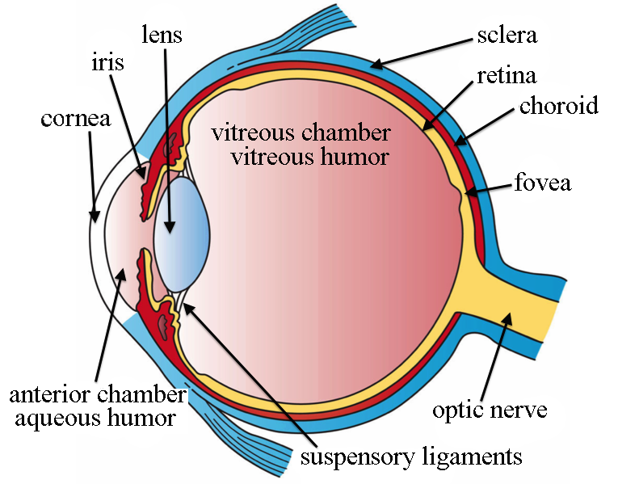
The Human Eye
The retina is covered with light-sensing cells
  Rods and cones
Rods are sensitive to light
  No colour detection
  Very good in low light levels (night vision)
  Prone to saturation (temporary blindness entering a bright room)
  Peripheral vision
  120 million per eye
Notes:
Image: By Artwork by Holly Fischer - http://open.umich.edu/education/med/resources/second-look-series/materials - Eye Slide 3, CC BY 3.0, https://commons.wikimedia.org/w/index.php?curid=24367145

Slide 12
The Human Eye
Cones are sensitive to colour
  Less sensitive than cones therefore tolerate more light
  Red, green, blue (also yellow, discovered 2002)
  Resolve fine detail
  6 million per eye
Notes:
Image: By Artwork by Holly Fischer - http://open.umich.edu/education/med/resources/second-look-series/materials - Eye Slide 3, CC BY 3.0, https://commons.wikimedia.org/w/index.php?curid=24367145

Slide 13
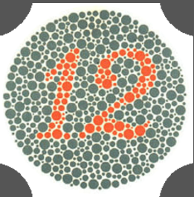
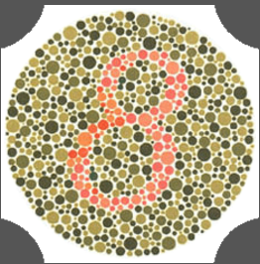
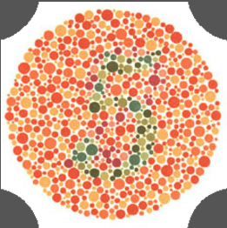
Ishihara Test
This is used for the diagnosis of colour vision deficiency

Slide 14

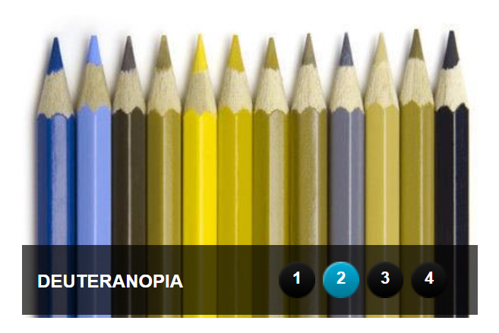
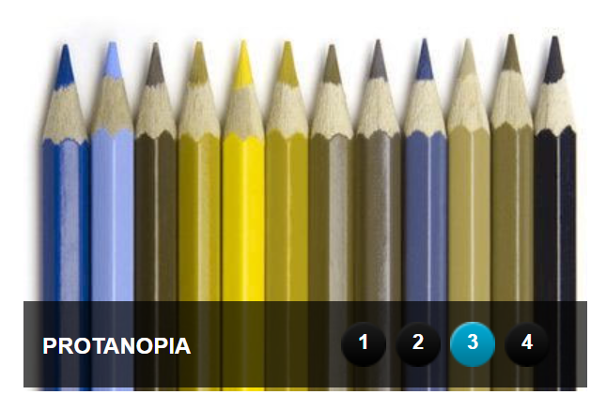
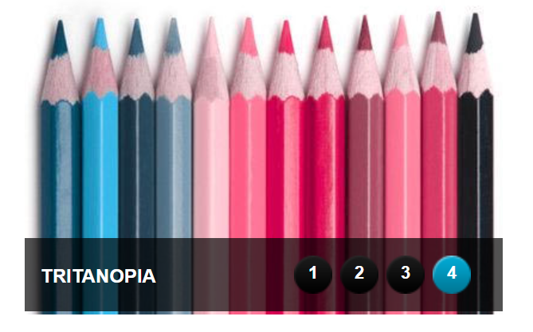
Colour Blindness
-Green
-Blue
-Red
Notes:
Image: https://www.colourblindawareness.org/colour-blindness/

Slide 15
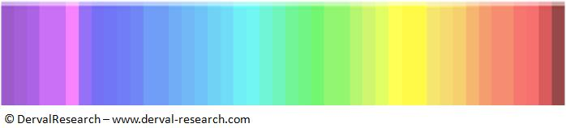
Colours Test

Slide 16
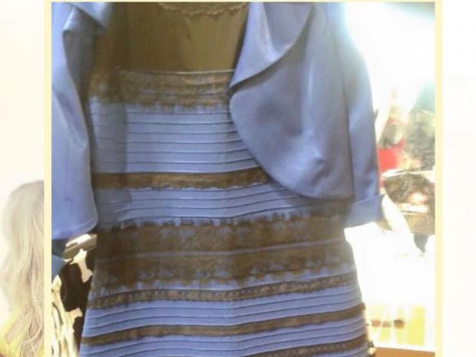
The Dress
Black and blue or gold and white?

Slide 17
Size, depth and distance
Size is measured in terms of visual angle
  Objects of same size at different distances have different visual angle
  Objects of different size at different distances may have the same visual angle
Need to use knowledge of world and other visual clues to judge size correctly
Visual angle measured in degrees or minutes of arc
Notes:
A notable Guinness advert has a man walking away from a bottle in the foreground of the picture only to bump into it in the background It’s actually huge and in the background but we assume it’s small and in the foreground.

Slide 18
Visual angle
Notes:
The same size object at different distances produces different visual angles, while different sized objects at different distances produce the same visual angle

Slide 19
Visual acuity
Visual acuity is the ability to perceive fine detail
Normal vision
  Single line with a visual angle of 0.5 seconds of arc
  Two lines separated by 30 seconds of arc
  Maximum normal visual acuity
Notes:
Individuals may vary from this if they have abnormally good eyesight, but we will look at individual variation later on.

Slide 20
Colour
Colour is made up of three components
  Hue, dependent upon wavelength
  Intensity or brightness
  Saturation or the amount of white in the colour
Can differentiate approximately
  150 hues
  7 million combinations of hue, intensity and brightness
  11 colours
Green acuity highest, blue acuity lowest
8% males, 1% females have some form of colour deficiency
Notes:
Although we can differentiate 7 million colours with training, we only have basic colour names for 11: red, orange, yellow, green, blue, purple, black, white, pink, grey, olive
Visual acuity for colour vision is dependent upon the number of cones sensitive to that colour in the retina. Only 3-4% of the cones are sensitive to blue, therefore blue acuity is less than green or red.

Slide 21
Intensity
Notes:
As intensity increases, so does the brightness of the colour

Slide 22
Saturation
Notes:
As saturation increases the colour becomes less white

Slide 23
Brightness
Brightness is a subjective measure of the light level.
Related to luminance, a physical quantity measured with a photometer
Contrast is the ratio of two levels of brightness
The visual system compensates for changes in brightness automatically via the pupil
Visual acuity increases with increased luminance, but so does flicker
  At low luminance flicker occurs at approx 50Hz
  At high luminance flicker occurs below 50Hz
  Flicker is more easily detected with peripheral vision
Notes:
The eye can function is great variety of brightness conditions - e.g. bright daylight to a dark night looking at the faintest stars. The pupil expands or contracts to regulate the amount of light entering the eye depending upon the local brightness.
Flicker is best perceived by the cones, hence in the peripheral vision. If you’re using a large luminous screen you may see flicker around the edges. This also explains why a flashing object at the edge of a screen is easily visible.

Slide 24
Visual processing
Visual processing is the action of the brain upon the input signals generated by the eye to turn them into a meaningful image
What we see is guided by our expectations, e.g. objects remain the same size no matter at what distance they are viewed
The brain is very good at taking incomplete information and inferring a complete image from it
This means that it’s easy to trick the brain…
Notes:
The processing of the visual data is performed by the brain.

Slide 25
Muller-Lyon Illusion
Which line is longer?
Notes:
Both are the same, but because the lower image is wider overall the brain decides that the line is longer

Slide 26
Ponzo Illusion
Which block is longer?
Notes:
Both are the same size, but because we think the ladder is being viewed in perspective, the further block must be larger than the nearer one.

Slide 27
Is this text correct?
The quick brown fox
jumps over the
the lazy dog

Slide 28
Reading
Very big topic!
The eye moves in jerky saccades and rests in fixations - 94% of time spent in fixations
Information is collected during fixations
Normally there are 3-5 fixations per line of text
Eye sometimes moves backwards - regressions
The more complex a text, the more regressions
Adults read native language at approx 250 words per minute
Reading a screen is more difficult than reading a page
Bright letters on a dark screen are easiest to read
Notes:
Lots of research has been carried out on reading using eyetracking devices. Adult read at 250 words per minute so there isn’t enough time to scan letter by letter. Instead, the shape of the word is recognised so anything that changes the shape (INCLUDING WRITING IN CAPITALS!) slows down the reading process.
High contrast text is easier to read than low contrast text. Dark letters on a bright background (positive contrast) is best if there is no flicker, otherwise use bright letters on a dark background (negative contrast).

Slide 29
Hearing
Hearing is generally considered secondary to vision
Much more information is gathered by the ears than we normally realise
The pinna (the flappy bit on the side of the head) acts as a funnel to channel sound into the ear.
Can locate sounds by calculating the time delay between the sound arriving at each ear
Notes:
Close your eyes. What can you hear? You can not only hear a lot of noises, you can identify them and can also tell where the sounds are coming from.
The timbre of a sound can be determined by 4 different features: Attack, Decay, Sustain and Reverberation

Slide 30
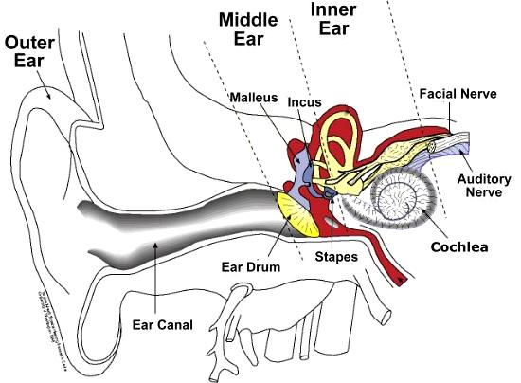
Notes:
The ear is composed of three section, the outer, middle and inner. The outer consists of the pinna and the ear canal, which focus sound down towards the ear drum. Vibrations of the eardrum are then passed through the middle ear via the malleus (hammer), incus (anvil) and stapes (stirrup) bones. The movement of the stapes causes pressure waves to be set up in the fluid of the cochlea which are detected by hairs and the signals sent to the brain along the auditory nerve.

Slide 31
Sound
Sound has three basic components
  Pitch or frequency
  Loudness or amplitude
  Timbre or shape of the sound
Musical timbre is not the same as auditory timbre
Auditory timbre depends on
  Attack
  Decay
  Sustain
Musical timbre depends on harmonic frequencies as well as ADS (sometimes known as reverberation)
Notes:
Whereas light is a transverse electromagnetic wave form with the colour depending on the wavelength, sound is caused by longitudinal pressure waves.

Slide 32
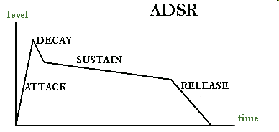
ADSR
ADSR – Attack, Decay, Sustain, Release

Slide 33
Processing sound
Human hearing range is from approx 20Hz to 15kHz
  Dogs can hear higher (ultrasonic) sounds
  Elephants communicate using lower (infrasonic) sounds
At low frequencies can distinguish changes as small as 1.5Hz
Frequency discrimination lessens with increasing frequency
Hearing range decreases with age and injury
Brain can filter sounds very efficiently, e.g. the cocktail party effect
Auditory illusions exist in the same way as visual illusions
Notes:
The cocktail party effect shows how efficient the brain is at filtering information. In a room with many conversations going on you can focus entirely on your own local conversation yet still hear your name being mentioned somewhere across the room.
Most hearing problems are due to the hairs of the cochlea stiffening with age or being destroyed. Higher frequencies are generally lost first in aging. Loss due to damage can occur anywhere in the range and is often due to damage from loud noises, e.g. pneumatic drills, engines, guitar amplifiers, drumkits, nightclubs…

Slide 34
Touch
Touch is also known as haptic perception
Generally used as an unconscious feedback mechanism
  The pressure exerted by keys as you type (haptic)
  The sense of location of the mouse (kinaesthetic)
  Vibration in mobile phones and games machines
Notes:
Kinaesthesia is also the part of haptic perception that allows touch typists to type without looking at the keyboard - they ‘know’ where there fingers are.
To show the variation in sensitivity try the two point test. Take two pencils and hold them about 12mm apart. press them to you fingers and to other parts of your arm. Your fingertips will be able to feel two points, whereas your arm will only feel one.

Slide 35
Touch
Indirect stimulus through receptors in the skin
  Mechanoreceptors (pressure)
  Thermoreceptors (heat)
  Nocioreceptor (pain, intense heat, intense pressure)
Sensitivity varies across the body; the fingertips are about 10 times as sensitive as the forearm
Notes:
Kinaesthesia is also the part of haptic perception that allows touch typists to type without looking at the keyboard - they ‘know’ where there fingers are.
To show the variation in sensitivity try the two point test. Take two pencils and hold them about 12mm apart. press them to you fingers and to other parts of your arm. Your fingertips will be able to feel two points, whereas your arm will only feel one.

Slide 36
Movement
Movement has two important features
  Speed
  Accuracy
Speed (reaction time) is dependent upon two things
  Processing time
  Movement time
Notes:
If we want a high reaction speed to a stimulus we therefore want to provide a large target area to respond to that stimulus. It might be better to display menu items as a pie chart where frequently-used commands are given larger sections of pie. Alternatively we can rely on training an familiarity by putting the most commonly-needed commands at the top of the menu and assume that the user will rapidly learn where to aim the mouse.

Slide 37
Movement
Reaction time lowers with age but can be improved with training
  Audio: 150 ms
  Visual: 200 ms
Short reaction times generally lead to poor accuracy
Movement does not have to be performed with the hands
Notes:
If we want a high reaction speed to a stimulus we therefore want to provide a large target area to respond to that stimulus. It might be better to display menu items as a pie chart where frequently-used commands are given larger sections of pie. Alternatively we can rely on training an familiarity by putting the most commonly-needed commands at the top of the menu and assume that the user will rapidly learn where to aim the mouse.

Slide 38
Exercise
The Train Ticket Dispenser
  Imagine that you are going on a train journey. You plan to buy your ticket at the station from one of the ticket machines.
  Design an interface for the machine that will allow you to buy a ticket of your choice.
  Evaluate how well it works by considering the sensory information you get from it as you use it. Does it give you all the information you need? Is it easy to use?

Slide 39
Coming Soon
More on the Human
Homework:
  Read the Wikipedia article on
    Perception (https://en.wikipedia.org/wiki/Perception)
  If a link looks interesting, follow it. Try to spend an hour reading around the topic on Wikipedia.

