Slide 1
AI ACKNOWLEDGEMENT
AI Acknowledgement:
I conﬁrm that I have not used any AI tools in the research and creation of this assignment. I conﬁrm that I have not presented any AI generated materials as my own work. I conﬁrm I have copies of my drafts, notes, and other resources I used, which I may be asked to provide in evidence.

Slide 2
Celtic Connections: Welsh Heritage and Arts Festival
Name: Moryom Begom Qureshi
Student ID: 2238616

Slide 3
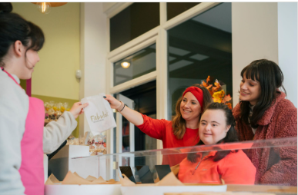
Introduction
Celebrating Welsh creativity and culture
Immersive history, arts, and traditions (Travel Trade, 2025).
Highlighting identity via Celtic legacy
Visitor engagement at national and international level (Visitwales, 2025).

Slide 4
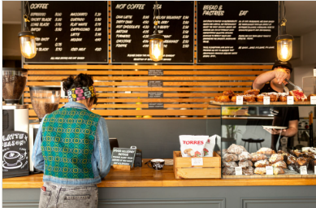
Content and Context in Events
Live performances, exhibits, traditional storytelling
Heritage festival with creative art showcases
Craft demos by Welsh artisans, curators (LCWG, 2025).
Emphasis on Welsh language and culture
Historical re-enactments and folk dances
Unique local and national collaboration (Cymru, 2025).

Slide 5
Market Factors
Target Audience: Tourists, cultural enthusiasts, artists School groups and heritage visitors Demand Indicators: Rising cultural tourism post-COVID trend Increased interest in immersive history (Gómez and Martínez-Ruiz, 2021). | Competition: Llangollen Eisteddfod, similar local events Marketing Channels: Tourism boards and school networks Social media, local radio, heritage sites (Ali et al., 2020).

Slide 6
Operational Factors
Venue: St Fagans National Museum Rich cultural backdrop and heritage setting Outdoor and indoor space availability Human Resources: Curators, performers, student volunteers Craft experts and historic interpreters (Michelle, 2025). | Resources: Sound crew for folk performances Exhibition booths and activity areas Coach hire for school groups Logistics: Limited parking, good public transport (Dolnicar, 2020).

Slide 7
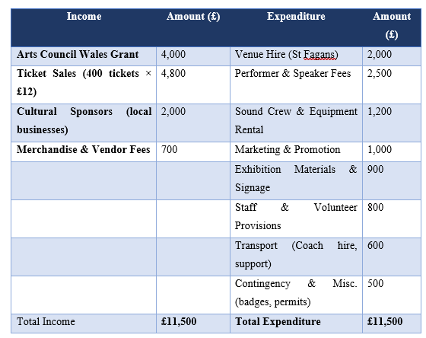
Financial Feasibility
Estimated Budget: £11,500 (mid-range)
Celtic Connections: Financial Feasibility Overview

Slide 8
SWOT Analysis
Strengths: Authenticity, Welsh folk heritage focus Strong institutional and community support (Cardiff, 2025). Weaknesses: Weather impact on outdoor elements Parking limitations at heritage venue (Sharath Kumar, 2023). | Opportunities: Position Wales as cultural destination Boost arts education, local tourism (Cheng, 2021). Threats: Competing events and rising costs Public transport disruptions possible (Pappas, 2019).

Slide 9
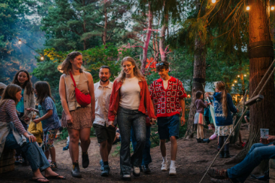
Strategic Fit with Year of Croeso
Focus on warm cultural welcome
Multisensory heritage and art immersion
Connects visitors to local communities (Cymraeg, 2024).
Reflects Welsh identity and pride
Strengthens youth and arts engagement (NEW, 2024).

Slide 10
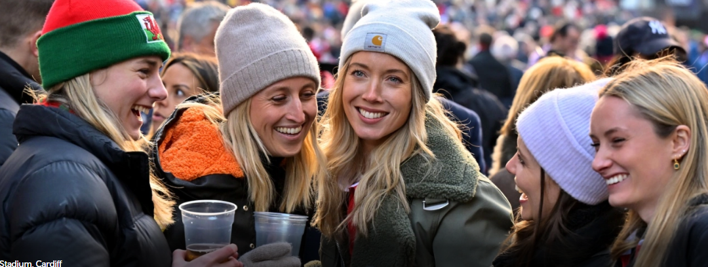
Background Research
Visit Wales 2025: Croeso campaign
High tourist interest in living heritage
Support from cultural funding bodies (CMC, 2025).
Feedback from previous heritage festivals
Lack of consistent Celtic-themed event (Adeotravel, 2025).

Slide 11

Feasibility Justification
Aligns with Welsh cultural goals
Professional venue with expert staff
Accessible, well-structured, funded format
Interest from educators and tourists
Engaging for families, schools, creatives (Dramaticheart, 2025).

Slide 12
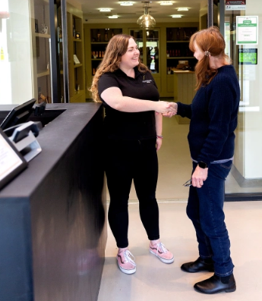
Measurable Outcomes
Visitor feedback and satisfaction surveys
Media coverage and online impressions
Engagement metrics from schools and partners (Salon, 2023)
Artist and vendor participation rates
Social media tags and mentions tracked (IBIS, 2024)

Slide 13
Timeline
Phase 1: Planning and Outreach (May–June)
Phase 2: Marketing & Booking (July–Aug)
Phase 3: Delivery & Operations (Sep)
Phase 4: Evaluation & Reports (Sep)

Slide 14
References
Adeotravel (2025) Year of Croeso [Online] Available at: https://adeotravel.com/partners/year-of-croeso/ [Accessed: 11 May 2025].
Ali, A., Rasoolimanesh, S.M. and Cobanoglu, C. (2020) 'Technology in tourism and hospitality to achieve sustainable development goals (SDGs)'. Journal of Hospitality and Tourism Technology. pp. 177-181. Available at: https://shura.shu.ac.uk/26757/9/Ali_TechnologyTourismHospitality%28AM%29.pdf [Accessed: 27 January 2025].
Cardiff (2025) Year of Croeso in Wales [Online] Available at: https://traveltrade.visitwales.com/useful-information/toolkit/year-of-croeso [Accessed: 9 May 2025].
Cheng, Y. (2021) ', February. Analysis on the Opportunities and Challenges of Unilever’s Differentiated Competition by Using SWOT and PEST. In 6th International Conference on Economics, Management, Law and Education (EMLE 2020)'. Atlantis Press. pp. 280-284.
CMC (2025) Year of Croeso: Weather-Proofing Fund for Tourism Attractions 2025-2026 [Online] Available at: https://cardiffmusiccity.wales/2025/05/07/year-of-croeso-weather-proofing-fund-for-tourism-attractions-2025-2026/ [Accessed: 12 May 2025].
Cymraeg (2024) Croeso’ i bawb! A warm Welsh ‘Welcome! [Online] Available at: https://www.gov.wales/croeso-i-bawb-warm-welsh-welcome [Accessed: 8 May 2025].
Cymru (2025) Gwerin Ifainc: Project aims to ensure Welsh folk traditions flourish [Online] Available at: https://nation.cymru/culture/gwerin-ifainc-project-aims-to-ensure-welsh-folk-traditions-flourish/ [Accessed: 9 May 2025].
Dolnicar, S. (2020) 'Market segmentation analysis in tourism: a perspective paper'. Tourism Review. pp. 45-48.
Dramaticheart (2025) 2025: Join us for the Year of Croeso [Online] Available at: https://dramaticheart.wales/blog/2025-join-us-for-the-year-of-croeso/ [Accessed: 12 May 2025].
Dwivedi, Y.K., Ismagilova, E., Hughes, D.L. and Carlson, J. (2021) 'Setting the Future of Digital and Social Media Marketing research: Perspectives and Research Propositions'. International Journal of Information Management. pp. 1–37.
Gómez, M.A. and Martínez-Ruiz, M.P. (2021) 'The impact of COVID-19 on hotel marketing and communication strategies'. Journal of Hospitality and Tourism Management. pp. 227-233.
IBIS (2024) Festivals in the UK [Online] Available at: https://my.ibisworld.com/uk/en/industry-specialized/SP0.087/key-success-factors [Accessed: 12 May 2025].
LCWG (2025) Light Springs through the Dark: A Vision for Culture in Wales [Online] Available at: https://www.gov.wales/sites/default/files/publications/2019-06/arts-and-culture-vision-statement-light-springs-through-the-dark.pdf [Accessed: 10 May 2025].
Michelle, L. (2025) What Is A High-Value Customer? [+How To Retain Them] [Online] Available at: https://thecmo.com/marketing-strategy/high-value-customers/#:~:text=Improved%20customer%20lifetime%20value%20(CLV,term%20engagement%2C%20often%20fostering%20community. [Accessed: 4 Arpil 2025].
NEW (2024) 2025 marks the Year of Croeso – in Wales. [Online] Available at: https://www.northeastwales.wales/2025-marks-the-year-of-croeso-in-wales/ [Accessed: 10 May 2025].
Pappas, N. (2019) 'Tourism Managemen'. Tourism Management. pp. 12-22.
Salon, P. (2023) The Importance of a Project Management Timeline [Online] Available at: https://pamsalon.medium.com/the-importance-of-a-project-management-timeline-af3c086f987e [Accessed: 12 May 2025].
Sharath Kumar, P.K.B. (2023) 'SWOT ANALYSIS'. International Journal of Advanced Research. pp. 744-748.
Travel Trade (2025) Year of Croeso Campaign Toolkit [Online] Available at: https://traveltrade.visitwales.com [Accessed: 7 May 2025].
Visitwales (2025) 2025: Year of Croeso [Online] Available at: https://industry.visitwales.com/get-involved/visit-wales-themed-year-campaigns/year-croeso [Accessed: 10 May 2025].

