Slide 1


STUDENT NAME: CHERRY SPENCER.
STUDENT NUMBER: 2315880.
ASSIGNMENT TITLE: VIVA VOCE.
MODULE TITLE: DIGITAL TRANSFORMATION IN THE HEALTH AND CARE PROFFESSIONS.
MODULE CODE: BMHP6026.
LECTURER’S NAME: ZAKIYYAH AHMED.

Slide 2


Telemedicine: Digital Innovation in UK Health and Social Care.
Telemedicine is the delivery of healthcare services where distance is a critical factor, using information and communication technologies(ICT) to support diagnosis, treatment, prevention, and ongoing patient care." (World Health Organization,2022).
Telemedicine was introduced in the 1920s, but its modern foundations were built by NASA in the 1960s. (Jafarzadeh et al., 2022; Bashshur, Doarn and Frenk, 2020).
KEY AREAS:
Provided remote medical support to astronauts in space using satellite technology.
Demonstrated feasibility of long-distance healthcare.
Paved the way for digital integration within modern healthcare systems.

Slide 3




Core Definitions & Scope
The Concept
WHO Definition
Applications
The transmission of medical information via text, audio, video, and medical images to provide care without physical interaction (Stoumpos, Kitsios and Talias, 2023).
Delivery of healthcare where distance is a critical factor, using ICT for diagnosis, treatment, and prevention (WHO, 2022).
Includes virtual appointments, electronic transmission of CT/MRI scans, pathology slides, and real-time monitoring (Jafarzadeh et al., 2022).

Slide 4
UK Implementation
Rapid adoption within the NHS was accelerated by the COVID-19 pandemic to maintain service continuity (Greenhalgh et al., 2020; NHS England, 2023).
(Greenhalgh et al., 2020; NHS England, 2023)
Primary Care: GP video and telephone calls (Greenhalgh et al., 2020; NHS England, 2023).
Chronic Management: Diabetes & Heart Disease (World Health Organization, 2022; Stoumpos, Kitsios and Talias, 2023).
Mental Health: Tele rehabilitation programs (Werkmeister et al., 2024).
Specialist Services: Palliative care (World Health Organization, 2022; Jafarzadeh et al., 2022).

Slide 5


Impact on Healthcare Professionals
Opportunities
Improved team collaboration and flexibility (Stoumpos, Kitsios and Talias, 2023).
Creation of new roles in IT and cybersecurity. (NHS England, 2023; Stoumpos, Kitsios and Talias, 2023).
Enhanced communication between specialists and GPs. (World Health Organization, 2022).
Challenges
Resistance due to preference for face-to-face consultations. (Alashek and Ali, 2024).
Requirement for new digital skills and training. (Malik et al., 2025; NHS England, 2023).
Concerns over legal liability and patient privacy. (Florea et al., 2022).
"Success depends on staff training and technical support." (Malik et al., 2025)

Slide 6
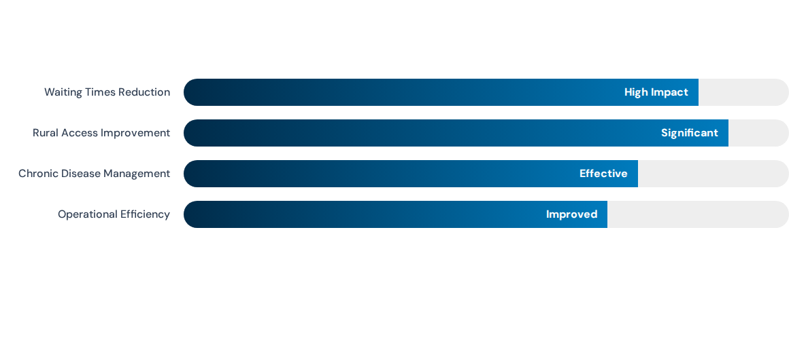
Positive Impact on Service Delivery
Telemedicine streamlines healthcare processes and reduces travel costs while maintaining care during crises
(World Health Organization, 2022; Wade et al., 2010).

Slide 7
Barriers and Negative Outcomes
Digital Inequality: Lack of reliable internet or devices in rural/poor communities.
Security Risks: Vulnerability to cyberattacks and data breaches.
Clinical Limits: Not suitable for physical exams or surgery.
Fragmented Care: Reduced personal bonds with healthcare professionals.
(Florea et al., 2022; Jafarzadeh et al., 2022).

Slide 8
Patient and Service User Perspective
The Benefit of Convenience
Allows access from home, saving time and money. This is vital for:
•
Elderly populations with mobility issues.
•
Mental health users (home environment comfort).
•
Rural residents far from hospitals.
Encourages independence through health apps and wearable devices (Elhakeem et al.,2022).

Slide 9
Challenges for Vulnerable Users
Risk of Missed Diagnosis: Professionals cannot physically assess the patient.
Impersonal Interaction: Some find online consultations disconnected and lacking emotional support.
Digital Literacy: Disadvantaged populations may struggle with the correct digital device and connectivity.
Privacy Concerns: Lack of confidential space at home for private medical discussions (Alashek and Ali, 2024; Elhakeem et al., 2022).

Slide 10
CONCLUSION:
Overall, telemedicine has transformed healthcare accessibility and service delivery within the NHS. However, its long-term success depends on reducing digital inequalities, strengthening cybersecurity, investing in workforce training, and maintaining person-centred care through a hybrid model (World Health Organization, 2022; Stoumpos, Kitsios and Talias, 2023).

Slide 11
Reference List
Alashek, W.A. and Ali, S.A. (2024) Satisfaction with telemedicine use during COVID-19 pandemic in the UK: a systematic review. Libyan Journal of Medicine, 19(1). Available at: DOI (Accessed: 26 June 2026).
Bashshur, R., Doarn, C.R. and Frenk, J. (2020) 'Telemedicine and the COVID-19 pandemic', Telemedicine and e-Health, 26(5), pp. 571–573.
Ekeland, A.G., Bowes, A. and Flottorp, S. (2010) 'Effectiveness of telemedicine: a systematic review of reviews', International Journal of Medical Informatics, 79(11), pp. 736–771. Available at: DOI (Accessed: 26 June 2026).
Elhakeem, M. et al. (2022) 'Patients’ experience and satisfaction using telemedicine', Health Science Reports, 5(6).
Florea, M. et al. (2022) 'Telemedicine challenges and barriers', Journal of Family Medicine and Primary Care, 11(3), pp. 879–886.
Greenhalgh, T. et al. (2020) 'COVID-19: a remote assessment in primary care', BMJ, 368.
Jafarzadeh, F. et al. (2022) 'Applications of telemedicine', Journal of Family Medicine and Primary Care, 11(3), pp. 879–886.
Malik, T., Ong, S.C. and Butt, M.D. (2025) 'Enhancing healthcare access through telehealth: patient-centred insights from Pakistan’s primary care sector', BMC Health Services Research, 25(1). Available at: DOI (Accessed: 26 June 2026).
NHS England (2023) Digital transformation in healthcare. Available at: NHS England website (Accessed: 26 June 2026).
Stoumpos, A.I., Kitsios, F. and Talias, M.A. (2023) 'Digital transformation in healthcare: technology acceptance and its applications', International Journal of Environmental Research and Public Health, 20(4). Available at: DOI (Accessed: 26 June 2026).

Slide 12
Wade, V.A., Karnon, J., Elshaug, A.G. and Hiller, J.E. (2010) 'A systematic review of economic analyses of telehealth services', Journal of Telemedicine and Telecare, 16(2), pp. 59–63. Available at: DOI (Accessed: 26 June 2026).
Werkmeister, S. et al. (2024) 'Environmental factors for sustained telehealth use in mental health services: a mixed methods analysis', International Journal of Telemedicine and Applications, 2024, Article 8835933. Available at: DOI (Accessed: 26 June 2026).
World Health Organization (2022) Consolidated telemedicine implementation guide. Geneva: World Health Organization. Available at: WHO telemedicine guide (Accessed: 26 June 2026).

