Slide 1

Welcome to the module!
By Zita Draper

Slide 2
Content
Aims and Learning Objectives
How will these sessions run?
Scheme of Work.
The Moodle page.
Teams
Assignments
Activities
Thank you, any questions?

Slide 3
Aims and Learning Objectives
The aim of today's session is to introduce you to the module and how these sessions will run.
By the end of today's session students should be able to demonstrate their understanding of what the course entails.

Slide 4
How will these sessions run?
2-hour lecture Pre recorded.
2-hour workshop.
You are required to ensure that you engage in these lessons.

Slide 5
Scheme of work
Date | Topic | Notes
23/05/2024 | Welcome to the module/ Assignment 1/ What is legal process?
30/05/2024 | Case Citations / Parliament/ Government/ Judiciary
06/06/2024 | Assignment Guidance/Uk Constitution
13/06/2024 | Draft session – Online
20/06/2024 | Human Rights | Assignment 1 due on the 21st June 2024 by 23:59pm
27/06/2024 | Reading week
04/07/2024 | Police Powers/ CPS/ Criminal Justice system/ Youth offending service/ Probation
11/07/2024 | Civil Justice system/ Alternative dispute resolution
18/07/2024 | Law reform
25/07/2024 | Drop-in session – Online | Assignment 2 due on the 26th July 2024 by 23:59pm

Slide 6
The Moodle page
Where you will access the content for the module. Under the tile '' Zita Draper's Group''.
Here you will also find the assignment and the Turnitin link for your assignments.
You should only submit your assignments under this tile.
If you have any further questions, please let me know.

Slide 7
Microsoft teams
This is where you are also able to contact me.
Check the team's page and ensure that you turn on notifications.

Slide 8

Expectations
Engagement in lessons.
Attendance in lessons.
Tell you tutor if you are unable to attend their class.
Respect other students and staff in the classroom.
You must stay for the full duration of the class, or you will be marked as absent.

Slide 9

Activities

Slide 10

Question 1
What is legal process?
Discuss in groups and prepare to feedback to the class.
Everyone must share their answer.

Slide 11

Legal Process is....

Slide 12


Slide 13
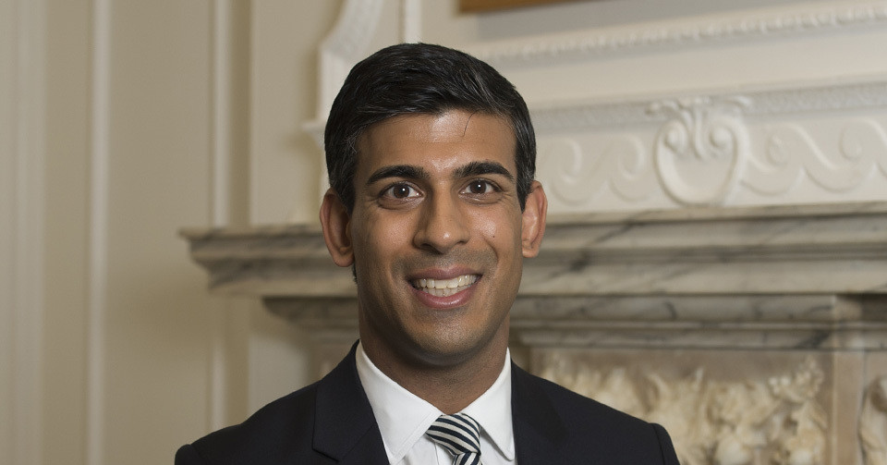

Slide 14
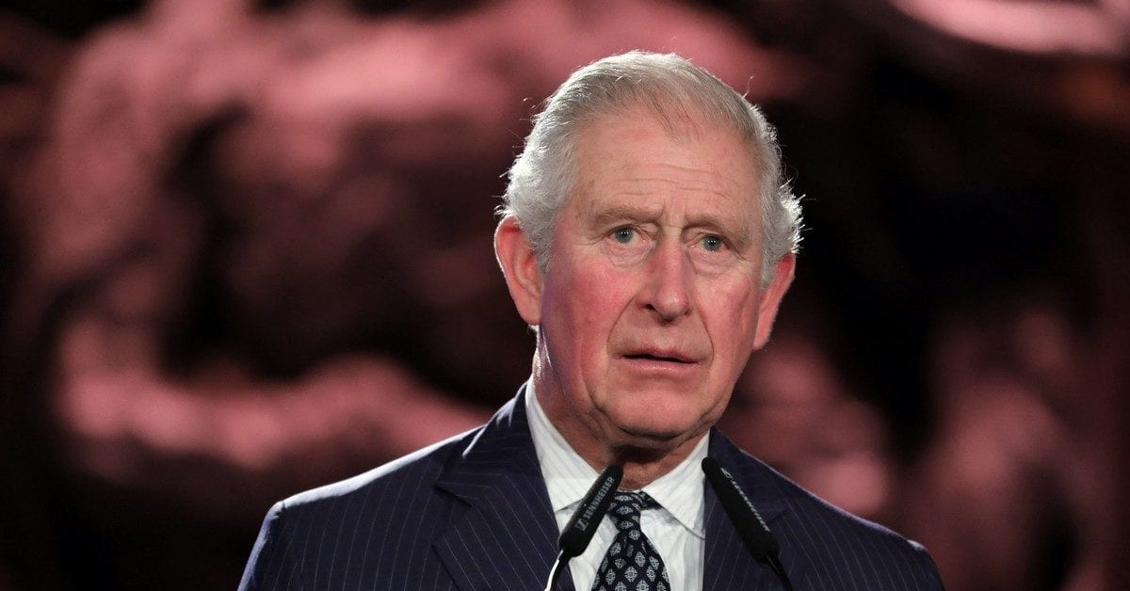

Slide 15


Slide 16


Slide 17


Slide 18
Activity
Research task- Research what types of laws there are in the United Kingdom and give examples of these piece of legislation.
You have 20 minutes to do this and prepare to feedback to the class.

Slide 19

A few notes before we start!
You must remember that there are three different legal systems within the United Kingdom.
There is the English and Welsh justice system.
There is the Scottish justice system.
There is the Norther Ireland Justice system.

Slide 20
What is law?

Slide 21
What is law?
Laws/ statutes that govern the way we must act within society and we must follow these laws.
But we also have other things such as a code of conduct. Is this law?
Does it have consequences?

Slide 22
Lets test
If a student misbehaves in school, what is the punishment?
If you speed in your car, what is the punishment?

Slide 23
So, what is law?
‘’One of the key defining characteristics of law is that it is created and enforced through governmental institutions. Laws are created by institutions of the state’’.
Notes:
But we must also note that we can also have regulations which can change, an example is the covid 19 pandemic and the regulations introduced during this time.

Slide 24
Where does the law come from?
Legislation/ statute.
Two types.
Primary legislation.
Secondary legislation also known as secondary/subordinate legislation.

Slide 25

Primary legislation
Act of parliament.
Created by parliament.
Main source of Uk law.
An example is the Offences Against the Persons Act 1861.

Slide 26

Secondary legislation
Also known as delegated/ secondary/ subordinate.
Includes how legislation is applied.
Made by government ministers.
An example is the Covid-19 pandemic and the legislation
implemented at that time.
Wales had different regulations compared to England.

Slide 27
Others
Case law (Precedent)
International law.
European Convention on Human Rights 1998.

Slide 28
Case law
Created by Judges.
Also known as precedent.
Reason for the decision in the case.
Apply the law which is clear but needs to be interpreted in another way.
Case example; Airedale NHS Trust v Bland [1993].
Other courts will follow the reasoning in a case depending on which court the case is heard in.

Slide 29
International law
Laws that govern relations between different countries.
Includes relations between states, individuals, the states and organisations.
‘’ The UK signs international treaties, they are binding in international law but not in domestic law’’.
This means that you cannot bring a case under international law in England and Wales.
European Convention on Human Rights is international legal system.

Slide 30
European Union
European Economic Community
Legal system which is binding on the domestic legal systems.
Could bring cases on the basis of EU law in the United Kingdom.
European Union (Withdrawal) Act 2018.

Slide 31
Different types of laws
Public v Private law.
Public law – state and private individual.
One example is the Human Rights Act 1998.
Private law – Individual and individual.

Slide 32
Continued…..
Criminal law v Civil Law.
Criminal law – punishment.
Proof beyond reasonable doubt.
Crown prosecution service.
Civil law – Rights and duties owed by both individuals and organisations to each other.
An example is duty of care in tort law.
Burden on the claimant – Balance of probabilities.

Slide 33
Common law and equity
Developed over the years.
Reasoning in cases becomes precedent.
Only remedy in common law in the past was damages.

Slide 34
Equity
‘’During the 13th century a parallel court system emerged in the Court of Chancery and began to develop its own body of law which became known as equity. The meaning of equity is fairness, and this reflects the fact that the Catholic Church lawyers who established this court were seeking to develop legal principles based on a wider sense of justice. Like common law, courts of equity set out written judgments in individual cases but introduced new legal concepts such as the mortgage, where an owner of land could borrow money and the lender could take possession of it if the debt was not repaid. The concept of the trust enabled property to be looked after by an adult, whilst its owners, who were often children, retained their ownership rights.
It is important to note that equity did not attempt to cover every area of law. It introduced new legal concepts where there were gaps in the common law and was used when the application of common law resulted in decisions which were considered to be unfair. So, for example, even in the law of contract, some of the cases and legal principles are derived from equity.’’

Slide 35
Continued
Judicature Acts 1873-75- common law and equity have merged.
Where there is conflict equity prevails.
Because of the court of chancery we now have elements such as the trusts and mortgages which form part of property law.

Slide 36
Equitable maxims
Created by the court of chancery
As part of the reasoning in a case. (Legal reasoning)
However, if court feel that the common law principles are satisfactory, they will not look at equitable maxims.

Slide 37
Continued
Some of the key maxims include;
‘’He who comes to equity must come with clean hands’’.
‘’He who seeks equity must do equity’’.
“Equity follows the law.”

Slide 38
Equitable remedies
Injunctions
Specific performance
Recission
Rectification

Slide 39
Legal persons
Someone who is able to act in law.
Examples include solicitors.
Legal persons include organisations, companies and many more.
Notes:
England and Wales have a common law system.

Slide 40
Summary
Sources of Uk law.
Primary and secondary legislation.
Case law/ precedent.
International law.
ECHR.

Slide 41
Thank you!
Any Questions?

