Slide 1
Defining Heroes in Myth
1800573

Slide 2
Introduction
Heroic Code
Gaining the status of a Hero
What the impact was on the citizen body
The mirage

Slide 3
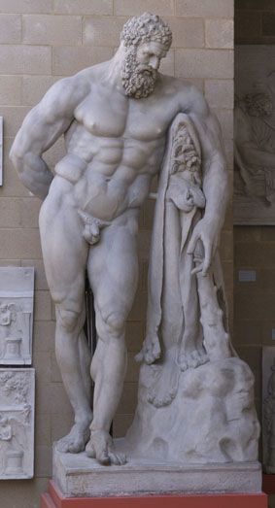
Heroic Code
Gaining the Status of a Hero
  Aid of the supernatural
What this entailed
  Leadership
  Arete
  Piety
  Battlefield skills
  Loyalty
  Respect
  Humility
  Humanity
“That left Hippolochus – and they say that I am his son. He sent me to Troy and often used to tell me always to be the best and excel all others and never disgrace our forefathers who were by far the best men in Ephyre and Lycia.” [Hom. Il. 6.206-210]
Fig.1:
Lysippus, c.360-310 BCE. Farnese Hercules. Roman copy of lost original. H: 317cm.

Slide 4
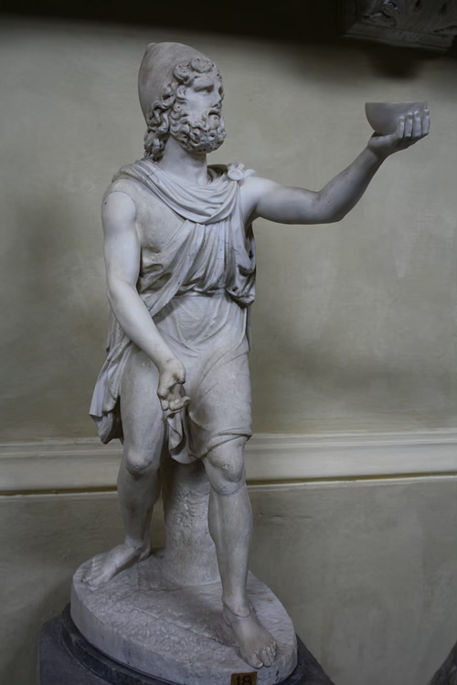
Odysseus and Jason
Odysseus
  Like Achilles, often seen as a prime example of a hero
    Homeric Mould
    Achilles as a flawed hero
  Key components
    Follows the Heroic Code
    Is flawed
  Aid of the supernatural
Jason
  Falls under the Heroic Code
    Self-questioning
    Is flawed
  Aided by the supernatural
Fig.2:
Anon, 2nd Century BCE. Roman Statuette of Odysseus offering wine to Polyphemus.

Slide 5
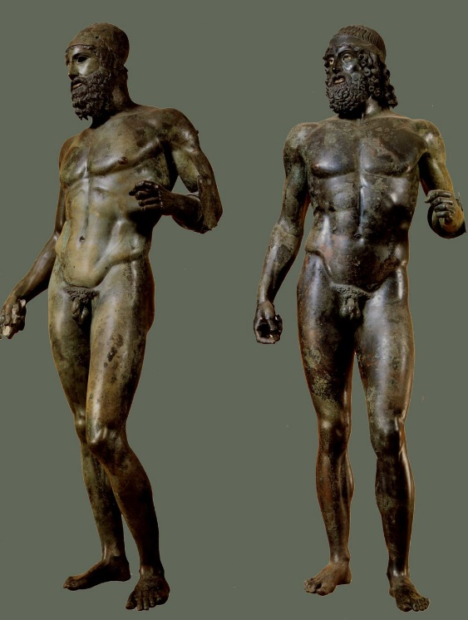
Impact on Greece
Idealisation
  Statuary
  Arete
Real life “heroes”
  Tyrannicides – democracy.
  “I shall wreathe my sword in myrtle bough
  As Harmodius and Aristogeiton did
  When they laid the tyrant low
  And to Athens gave equality.” [Athenaeus. 15.10]
Inclusion in religion
  Sacred calendars
  Cults
    Bones (e.g. bones of Orestes)
    “On the level plain of Arkadia there is a place, Tegea, where two winds blow continually through harsh necessity. Blow matches blow, and suffering lies upon suffering. There the life-giving earth holds the son of Agamemnon: Take him- and you will be master of Tegea” [Herodotus. 1.67.2-4].
Fig.3:
Anonymous, c.460-450 BCE, The Riace Warriors, original bronze works found off the coat of Riace in 1972. H: 197cm and 198cm

Slide 6
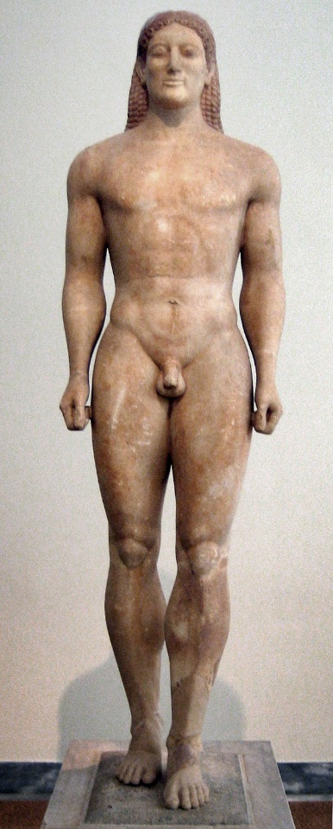
Impact on Greece
Heroic fiction
  Homeric Epics
Kouroi
  Fallen soldiers
  Movement to the underworld
  Arete
Fig 4:
Anon, c.530 BCE. Anavyssos Kouros. Also known as Kroisos Kouros, as a grave marker for Kroisos. Made from Parian marble. H: 195cm.

Slide 7
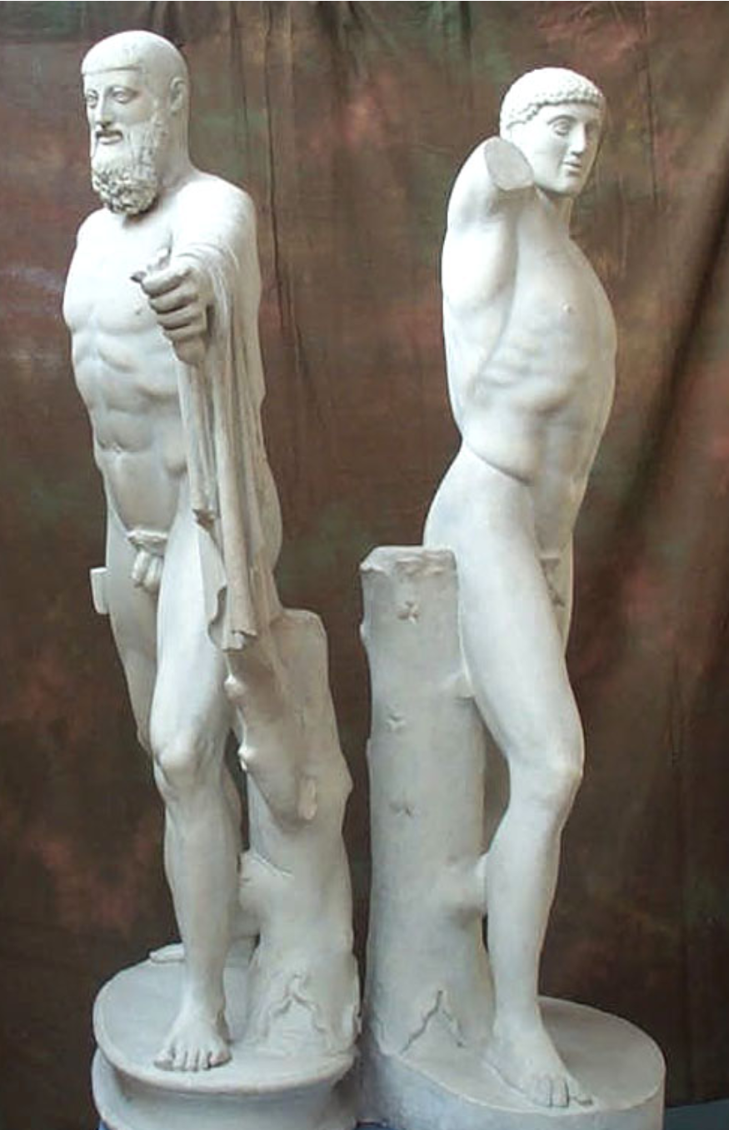
The Mirage
Taking things at face value
  Return to the Tyrannicides
  Thucydides, History. 6.53-54.
  “Indeed, the daring action of Aristogeiton and Harmodius was undertaken in consequence of a love affair, which I shall relate at some length, to show that the Athenians are not more accurate than the rest of the world in their accounts of their own tyrants and of the facts of their own history.
  Pisistratus dying at an advanced age in possession of the tyranny, was succeeded by his eldest son, Hippias, and not Hipparchus, as is vulgarly believed. Harmodius was then in the flower of youthful beauty, and Aristogeiton, a citizen in the middle rank of life, was his lover and possessed him.
  Solicited without success by Hipparchus, son of Pisistratus, Harmodius told Aristogeiton, and the enraged lover, afraid that the powerful Hipparchus might take Harmodius by force, immediately formed a design, such as his condition in life permitted, for overthrowing the tyranny.” [Thuc.6.54.1-3]
Problems with sources
Distorted view of the past
  Sparta
Fig.5:
Kritios and Nesiotes, c.477BCE. The Tyrannicides: Harmodius and Aristogeiton. Roman copy (c.484BCE) of original lost bronze. H: 190cm.

Slide 8
Conclusion
Heroic Code
Impact of the Mirage on modern scholars and opinions
The impacts of the heroic image upon Greece

Slide 9
Bibliography
Ancient Sources
Apollonius Rhodius, Argonautica. R.C. Seaton (trans.), 1912. Loeb.
Athenaeus, The Deipnosophists. C.D. Yonge (trans), 1854. http://www.attalus.org/old/athenaeus15c.html
Euripides, Medea. James Morwood (trans), 1997. New York: Oxford University Press.
Herodotus, The Histories. Hude (trans), 1927. Abingdon: Routledge.
Homer, The Iliad. E.V. Rieu (trans), 1950. London: Penguin Group.
Homer, The Odyssey. E.V. Rieu (trans), 1946. London: Penguin Group.
Thucydides, The Peloponnesian War. J.M. Dent and E.P Dutton (trans), 1910. London and New York.
Cartledge, P., 2011. Ancient Greece: A Very Short Introduction. Oxford: Oxford University Press.
Castriota, D., 1992. Myth, Ethos, and Actuality: Official Art in Fifth-Century B.C. Athens. Wisconsin: The University of Wisconsin Press.
Daux, G., 1983. Le calendrier de Thorikos au Musée J. Paul Getty. L'Antiquité Classique, Année 1983, 52, pp. 150-174
Dillon, M., Garland, L., 2010. Ancient Greece: Social and Historical Documents from Archaic Times to the Death of Alexander the Great. Oxford: Routledge.
Fox, R.L., 2006. The Classical World: An Epic History of Greece and Rome. London: Penguin Group.
Hornblower, S., 1992. The Greek World 479-323BC. Oxford: Routledge.
Hunter, R. (1988). 'Short on Heroics': Jason in the Argonautica. The Classical Quarterly, 38(2), 436-453.
Lawrence, S.,2005. Ancient Ethics, the Heroic Code, and the Morality of Sophocles' Ajax. Greece & Rome, 52(1), 18-33.
Kershaw, S.P., 2007. The Greek Myths: Gods, Monsters, Heroes and the Origin of Storytelling. London: Robinson.
Osborne, R., 2000. Classical Greece. Oxford: Oxford University Press.
Pomeroy, S.B., Burstein, S.M., Donlan, W., Roberts, J.T., Tandy, D.W., 2015. A Brief History of Ancient Greece. Oxford: Oxford University Press.
Rutherford, R., 2005. Classical Literature: A Concise History. Oxford: Blackwell Publishing.
Sage, M.M., 1996. Warfare in Ancient Greece. London: Routledge.
Stuttard, D., 2014. A History of Ancient Greece in Fifty Lives. London: Thames and Hudson.
Waterfield, R., 2018. Creators, Conquerors, and Citizens: A History of Ancient Greece. Oxford: Oxford University Press.
Wees, H.V., 2004. Greek Warfare: Myths and Realities. London: Bloomsbury.

Slide 10
Images
Figure 1: Lysippus, c.360-310 BCE. Farnese Hercules. Roman copy of lost original. H: 317cm. Accessed: 22/02/2021:
https://museum.classics.cam.ac.uk/collections/casts/farnese-herakles
Figure 2: Anon, 2nd Century BCE. Roman Statuette of Odysseus offering wine to Polyphemus. Photo by Cartwright, M. (2013, May 09). Odysseus. World History Encyclopedia. Accessed 28/05/2021: https://www.worldhistory.org/image/1201/odysseus/
Figure 3: Anonymous, c.460-450 BCE, The Riace Warriors, original bronze works found off the coat of Riace in 1972. H: 197cm and 198cm. Curator Collection, image 8. Accessed 01/04/2020 at https://curiator.com/art/unknown/riace-warriors-460-450-bc
Figure 4: Anon, c.530 BCE. Anavyssos Kouros. Also known as Kroisos Kouros, as a grave marker for Kroisos. Made from Parian marble. H: 195cm. Accessed 15/02/2021: https://en.wikipedia.org/wiki/Kroisos_Kouros#/media/File:Kouros_anavissos.jpg
Figure 5: Kritios and Nesiotes, c.477BCE. The Tyrannicides: Harmodius and Aristogeiton. Roman copy (c.484BCE) of original lost bronze. H: 1.90m. Accessed 27/05/2021: https://museum.classics.cam.ac.uk/collections/casts/harmodios-and-aristogeiton-tyrant-slayers

