Slide 1
Student Name: Ioana Avramescu
Student ID: 2514739
Lecturer’s Name: Chijioke Uba
Module Code: LCLM 4004
Module Name: Problem Solving and Decision-Making
Component 1: Green Haven Florists

Slide 2
Good morning
My name is Ioana and I will provide you with an overview of Green Havan Florist and the issues they are encountering.
Many thanks in advance for your time and attention.

Slide 3
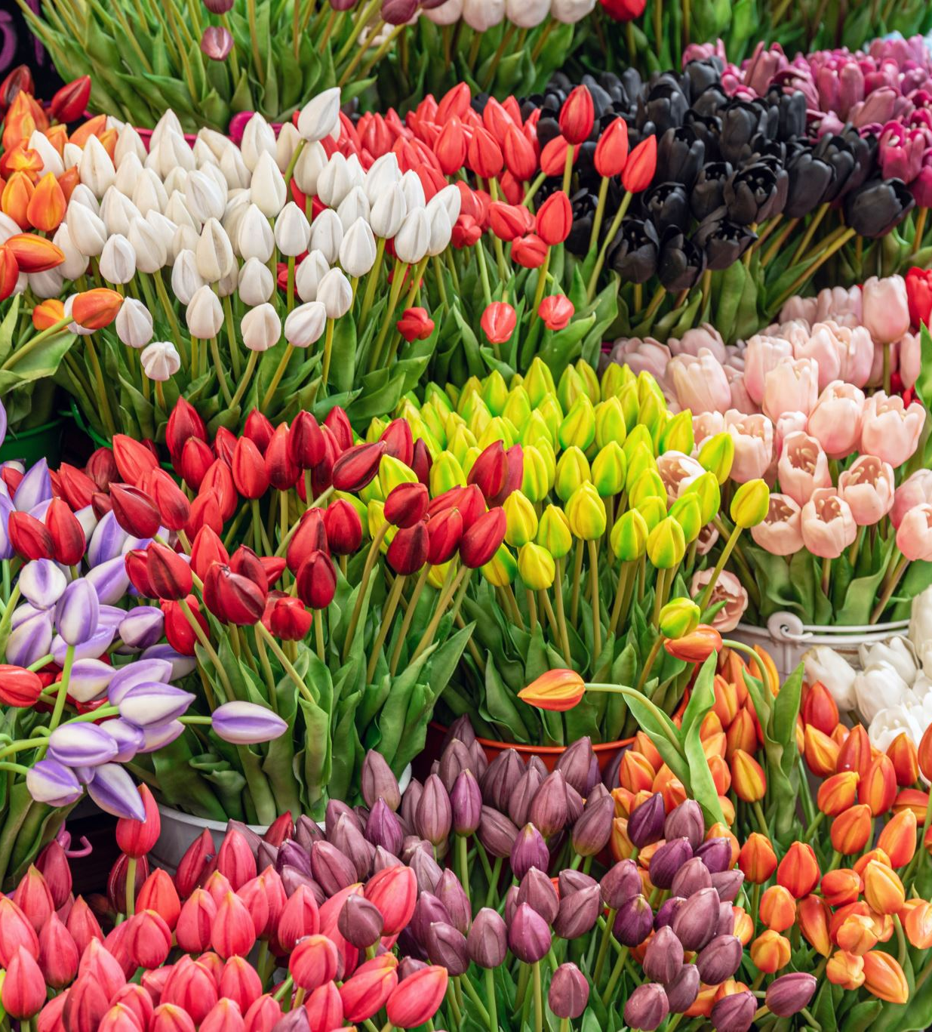
Green Haven Florist
Green Haven Florists is an independent flower shop in Norwich, founded in 2016 by Liam and Priya Patel.
The business became well‑known for its bespoke floral designs, sustainable materials, and strong community presence.
After several successful years, the shop is now facing falling in‑store sales, rising costs, and tougher competition from online retailers and new local florists.
Liam and Priya are seeking to understand these challenges so they can adapt and secure the future of their business.
Green Haven Florist Case Study (2026). University of Wales Trinity Saint David.

Slide 4
Green Haven Florists’ core problem is a 30% decline in in‑store sales, the result of
External Factors
  Changing consumer behaviour: Customers prefer online shopping, convenience, lower prices, and fast delivery
  Declining high‑street activity
  Rising supply costs: increased price of imported flowers
  New competition
Internal Factors
Outdated digital presence: the website is difficult to navigate
Limited marketing capability: no social media presence
Restricted service offering: no flexible delivery and subscription options
The decline in sales is caused by a combination of market changes, rising costs, and internal limitations. The scope of the problem is therefore both operational and strategic, affecting revenue, competitiveness, and long‑term sustainability.

Slide 5
5W2H model
Application of 5W2H to identify the produce and discuss its nature and impact
What? | Where? | When? | Who? | Why? | How? | How much?
What effect is it having? | Where is the problem occurring? | When was the problem first noticed? | Who is impacted by the problem? | Why is the problem happening? | How serious is the problem? | How much money is being lost?
A 30% decline in in‑store sales | Norwich | Over the last 12 months | Liam and Priya (owners) | Customers are shifting to online shopping | Limited digital presence | 30% drop in in-stores revenues
- Raising operational costs | High Street | High Street footfall dropping | Walk in customers | Lower prices for competitors | Outdated website | Increased costs for imported flowers
Increased competition |  | When new competitors entering the market | New competitors | Increased flower costs Website outdated | Higher cost for materials

Slide 6
PESTEL Framework – Overview & Critique
PESTEL is a Framework for analysing macro‑environmental external factors (Political, Economic, Social, Technological, Environmental, Legal) that supports strategic planning and long-term decision making, identifies external opportunities and threats, used in business strategy, market entry, or public policy (Mindtools, 2024)
Criticisms: oversimplifies complex environments, risk of information overload, subjective interpretation, can became outdated quickly, ignores internal organisational factors (Professional Academy – Pestel Explained)

Slide 7
PESTEL FRAMEWORK
Political Factors | Economic Factors | Social Factors | Technological Factors | Legal Factors | Environmental Factors
Import regulations and post‑Brexit trade conditions have increased the cost of imported flowers. Local high‑street regeneration policies have been slow, contributing to reduced foot traffic in the area. | Inflation and supply‑chain disruptions have raised the cost of fresh flowers and sustainable packaging. Customers are favouring cheaper and online retailers. A 30% drop in in‑store sales has created significant pressure on cash flow and profitability. (Oxford College of Marketing – PESTEL Analysis Overview) | Consumer behaviour has shifted toward online shopping (IFPA, 2026) Customers also expect convenience and competitive pricing. Customers now compare more options online before choosing a florist. | Competitors use digital marketing and visually appealing social media, while Green Haven’s website is outdated and hard to navigate. Customers expect modern features such as online ordering, flexible delivery, and subscription services. Lack of digital marketing skills limits the shop’s visibility. | Compliance with environmental packaging standards adds operational costs. Employment and health‑and‑safety regulations continue to shape staffing and in‑store operations. | Commitment to sustainable materials increases costs, especially as eco‑friendly packaging becomes more expensive. Climate‑related disruptions affect flower availability and pricing, particularly for imported varieties (CIPD – Environmental Analysis Tools).
Here is the tabular PESTLE analysis of Olive Tree Bistro.
Ensure that you reference all the sources you have used in this discussion on this slide.

Slide 8

A critique of the Cause-and-Effect model
A visual tool used to identify root causes of a problem by grouping them into categories (e.g., People, Process, Materials, Environment) (Ishikawa (1985) What is Total Quality Control?);
ASQ – Cause and Effect Diagram Guidance
MindTools – Fishbone Diagram Overview
Benefits: simple, visual, easy to use, encourage teamwork
Criticism: can simplify complex problems and does not provide solutions

Slide 9
Methods
Machines
People
Poor or limited digital marketing activity
Outdated website
Prefer online shopping
Changing trends
Poor user experience
Prefer lower prices and fast delivery
30% decline in in-stores sales
Supply chain disruptions
Slow adaptation to changes
Nearby business are closing, especially on the High Street
Imported flowers costly
No customer satisfaction metric
Local economic downturn
Materials
Measurement
Environment

Slide 10
Key Findings
External pressures are driving decline
Customer behaviour has shifted
Digital weaknesses are harming competitiveness
Sustainability remains a strength but increases costs

Slide 11

Reference List:
2025 Floral Consumer Trends. Available via OWTSD Reading List.
International Fresh Produce Association (2026) 2025 Floral Industry Trends: A Comprehensive Look Back & Forward. Accessed from https://www.freshproduce.com/resources/floral/2025-floral-industry-trends/ on 14.02.2026
Brooks, I., Weatherston, J. and Wilkinson, G. (2011) The International Business Environment: Challenges and Change. 2nd edn. Harlow: Pearson.
Cut Flowers Market Size and Share. Available via UWTSD Reading List.
Cut Flowers Market Size and Share / Industry Report, 2030
Institute of Leadership & Management (2013) Cause-and-Effect Analysis.
Institute of Leadership & Management (2013) 5W2H Model.
Institute of Leadership & Management (2013) Solving Problems and Making Decisions. 5th edn. Amsterdam: Pergamon Flexible Learning.
Brooks, I. et al. (2011) Chapter 2: Macro and Microenvironments.
Green Haven Florist Case Study (2026). University of Wales Trinity Saint David.
MindTools – PEST/PESTEL Framework Guide.
MindTools (2024).
ASQ – Cause and Effect Diagram Guidance.
Pestel Analysis (2025). Discover what PESTLE means, and use our PESTLE analysis template and example to explore the external influences on your organisation. Accessed from PESTLE analysis | CIPD on 14/02/2026.

Slide 12
Thank you for listening

Slide 13


