Slide 1
The Role of the Event Manager
By Natalie Beard

Slide 2
ABOUT EVENTS
Donald Getz describes a planned as a temporal phenomenon with a beginning and an end, whereby the programme or schedule is usually planned in detail in advance and publicised in advance (Getz, 2007).
It is believed by some events experts that the growth of events is linked to the experience economy (Getz and Page, 2016). And now there is a bigger demand for experiences rather than material items, there is now a bigger demand for Events Organisers.

Slide 3

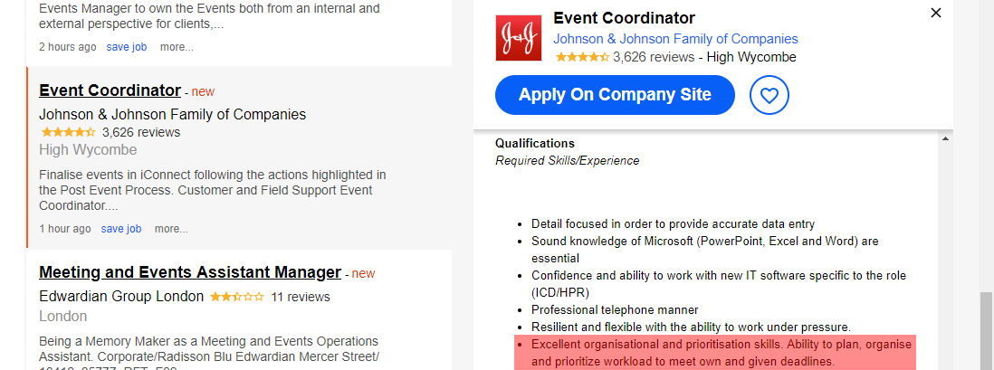
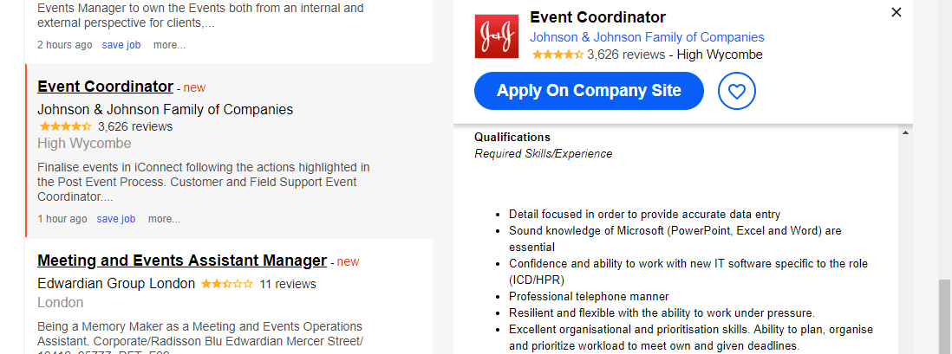
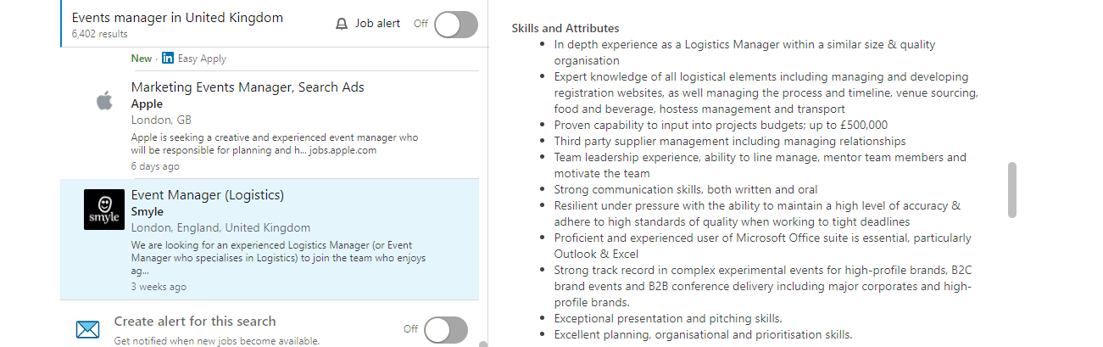
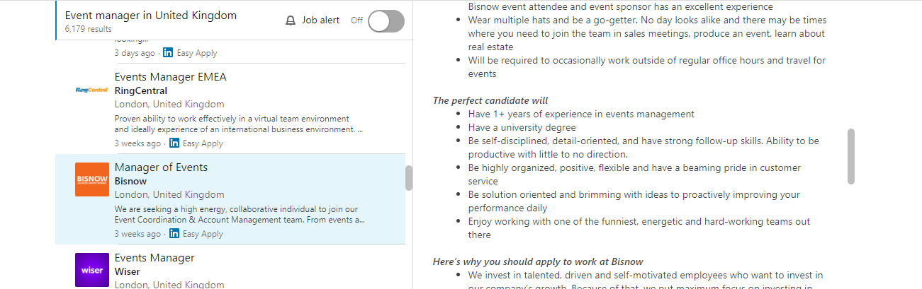
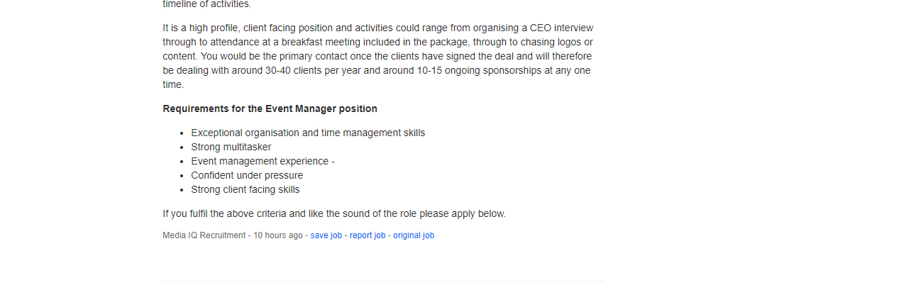
Skills
Organisational
03
Sources: Indeed.com / LinkedIn

Slide 4

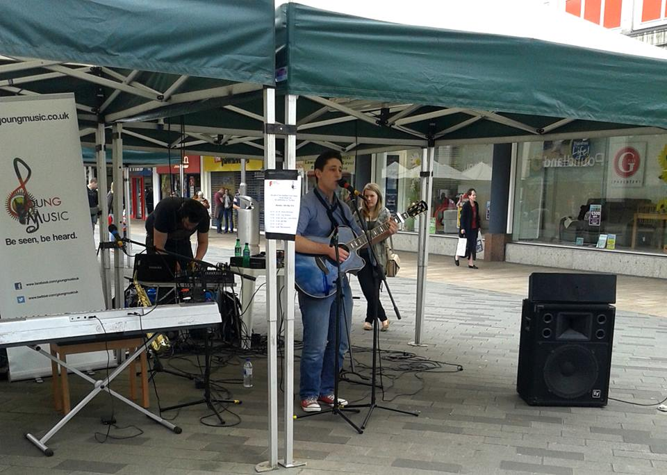
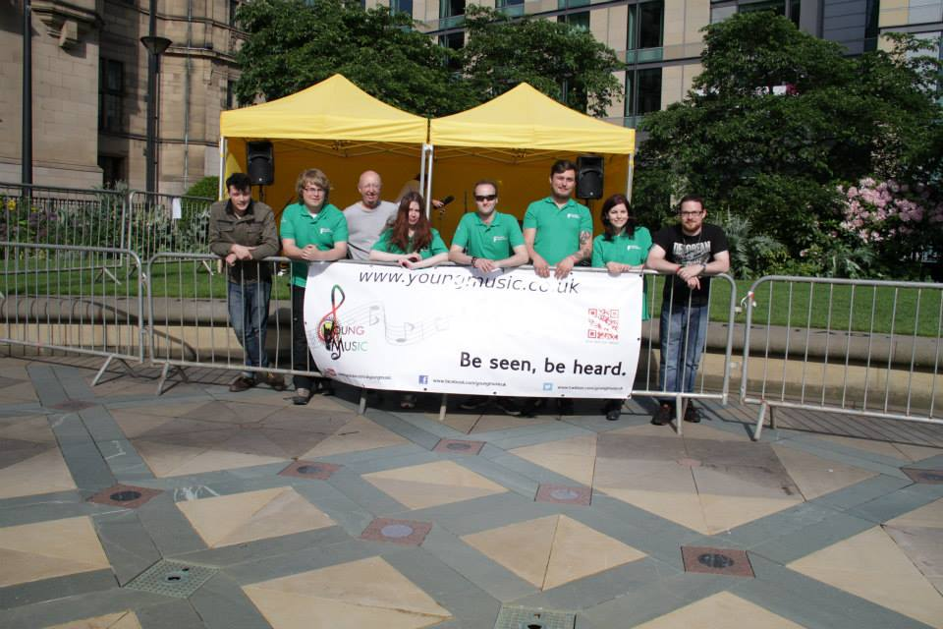
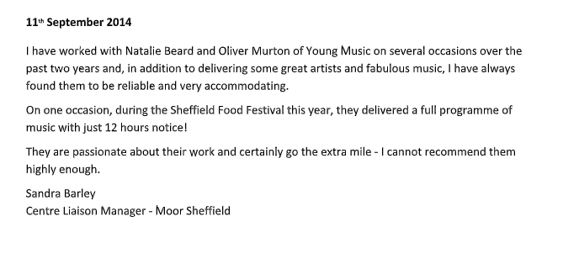
Skills
Organisational
Flexibility!
03

Slide 5

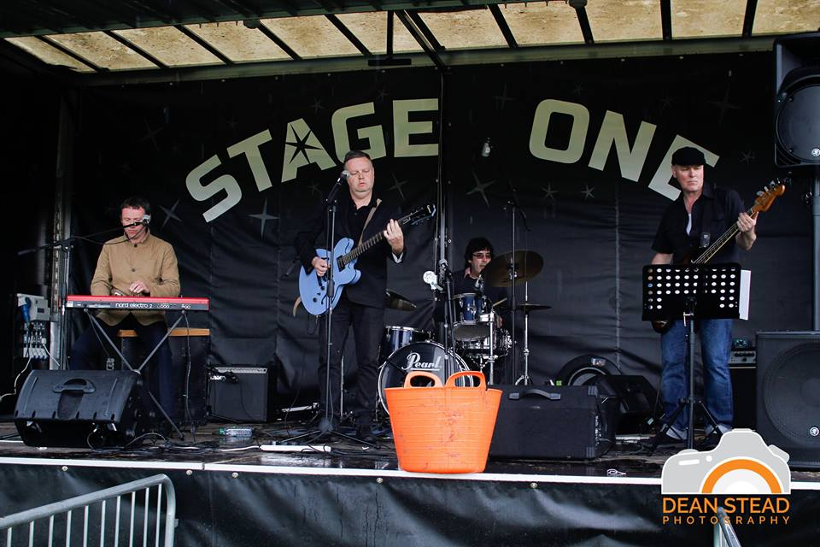
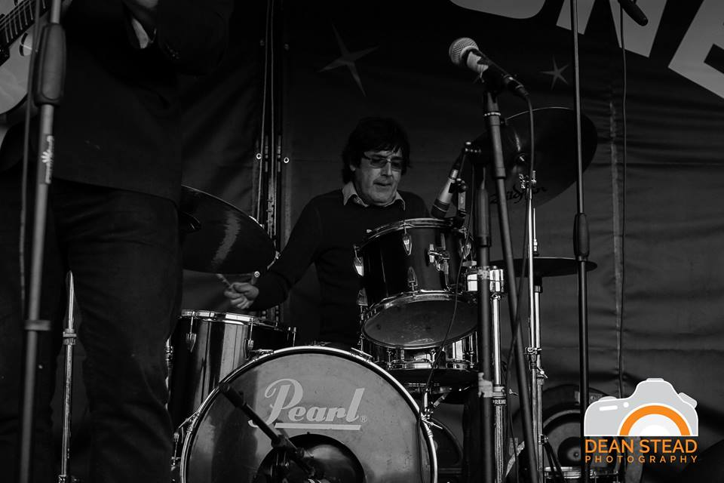

Skills
Health and Safety!
The ability to work well under pressure
03

Slide 6
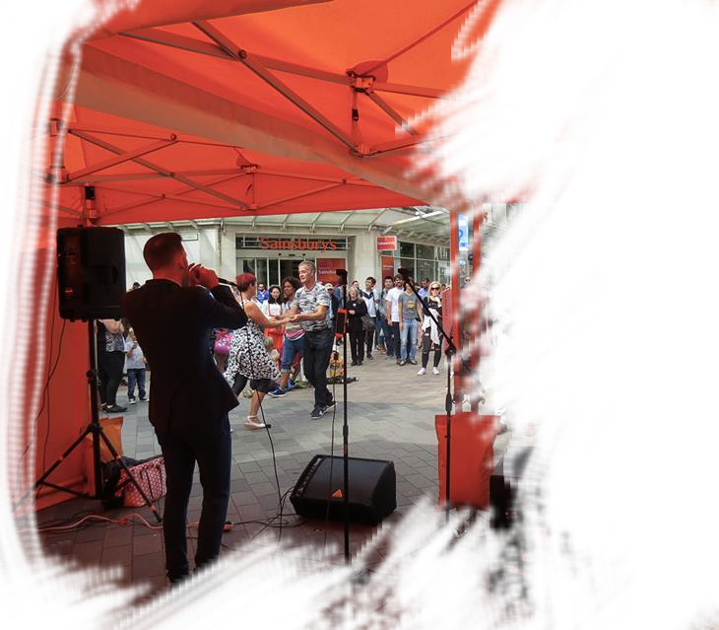
Skills
Communication
Leadership / Teamwork
Relationship Building
Administration
Time Management
03

Slide 7
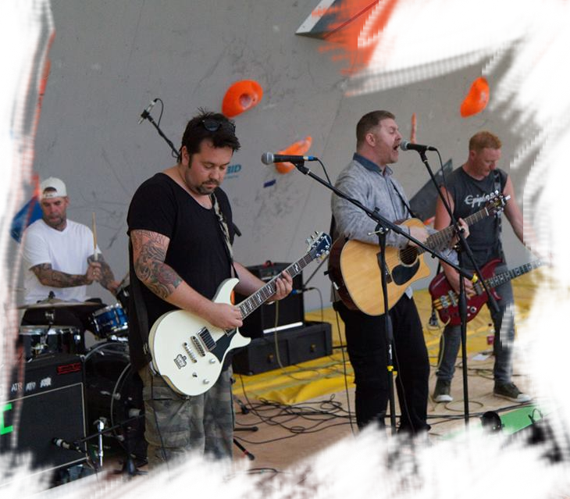
Skills
Institute of Management (Coulson and Coe, 1991) identified the qualities that future events managers should possess.
These included
The ability to communicate
Flexibility
Adaptability
A broad perspective on organisational goals
A balanced perspective overall and an understanding of the business environment.
03
Sources: Events Management- 3rd Edition-Glenn Bowdin, Johnny Allen, William O’Toole, Rob Harris, Ian McDonnell

Slide 8

Skills
Further, nine out of ten believed that Events Managers should
Have an ability to assume greater responsibility
Contribute to teamwork
Handle uncertainty
Be aware of ethics and values and have a commitment to ongoing learning
03
Sources: Events Management- 3rd Edition-Glenn Bowdin, Johnny Allen, William O’Toole, Rob Harris, Ian McDonnell

Slide 9
What does an events manager do?
Initiation
Planning
Implementation
Shutdown
Feasible
Demand
Funding
Catering
Health and Safety
Transport
Entertainment
Venue
Hiring of Staff
Sources: Events Management- 3rd Edition-Glenn Bowdin, Johnny Allen, William O’Toole, Rob Harris, Ian McDonnell

Slide 10
Thank you!
Any questions?

Slide 11
References
References
Bowdin, G., Allen, J., O'Toole, W., Harris, R. and McDonnell, I. (2010). Event Management. 3rd ed. Oxford: Elsevier Butterworth-Heinemann.
Getz, D. (2007). Event Studies: Theory, Research and Policy for Planned Events. 1st ed. Oxford: Butterworth-Heinemann.
Getz, D. and Page, S. (2016). Event studies. 3rd ed. Oxon: Routledge.
Indeed. (n.d.). Event Manager. [online] Available at: https://www.indeed.co.uk/jobs?q=events%20manager&start=20&vjk=f5a1ea2c63e18b7e [Accessed 21 Jan. 2019].
LinkedIn. (n.d.). Event Manager. [online] Available at: https://www.linkedin.com/jobs/search/?keywords=event%20manager&location=United%20Kingdom&locationId=gb%3A0 [Accessed 21 Jan. 2019].

