Slide 1
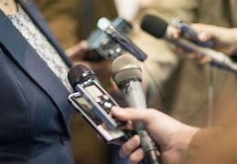
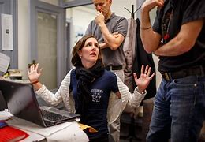
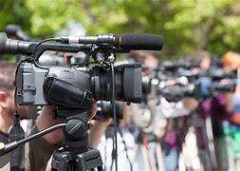
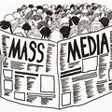
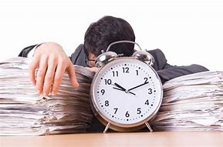
Journalism
By: Eugenia

Slide 2
OUTLINE
My future career
Skills needed for my future career
References

Slide 3


Introduction
This is the career path that I'm actively working towards. Journalism is the act of gathering information and presenting them clearly for others to understand; in simpler terms this is when an individual collates a bunch of data and pick our key information they would like their viewers to read.
There are many skills that I will need to help me reach a step closer towards my dream job: on the following slides I will be mentioning a few of the key skills that the job requires.
Notes:
I am very interested in this field as I feel like there is a lot of things going on in the world that people are not aware of. When I say the world, very often it’s closer than we think for example, our community/ city.
A lot of this have to do with the media but I think that there’s not enough reporters/journalist to do the job so I would like to be a part of this field so I can help make a difference.

Slide 4
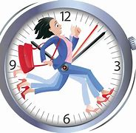
Time management
This is the ability to manage time effectively to get certain task done on schedule. I already have this skills but need to perfect if better as being a journalist means that I will have a lot of data to collect and I need to make sure that I get everything that I need on time and in order so that I can report to my viewers what I need them to know.
There are many different effects that can occur is this skill is not used correctly (please see table below)
Pros | Cons
Less stress | More agitated
Better focus | Less productivity
more free time | More procrastination
Easier task due to planning | More distractions
Notes:
If I have the ability to organise my time better then that means that everything will be done on time. As a journalist this is very important because there’s a lot of information that you need to report but such little time. If I manage my time poorly then I will have less productivity in my work. Maybe some key points will even go a miss because I didn’t plan my time properly to collect the data that I need- also in general poor time management means more procrastination.

Slide 5
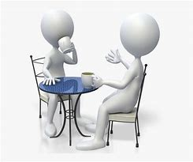
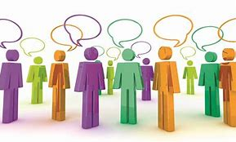
Communication
As a journalist it’s very important that I master this skill. Communication is common for a person to understand but I will need to develop better communication skills in terms of breaking down language barriers.
As a journalist I will have the opportunity to come in contact with a variety of people: not just for gathering information from locals but, I will come into contact with people such as: celebrities, news agents and maybe even presidents and royalties.
I will need to know how to use a range of different communication skills to speak with them differently- this is also a sign of respect and in many cultural the way in which you present yourself such as body language and tone of voice, says a lot about you as a person.
Notes:
Language barriers pose as a threat in this field of work as not everyone I will come across will be able to speak the same language as me. It’s vital that I am able to interpret what’s going on around me as it will help with my report to prevent a non bias review.

Slide 6
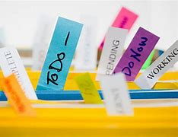
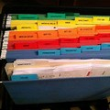
Organisation
Being organise means that you have a plan which includes a time and place for everything.
This skill will follow me through my carer as I will need to complete a lot of task in order to write my columns and post my reviews. I already have an understanding of this skills and practice it as often as I can. From this skill I would say the main two points that I would like to work on are the following:
Delegation- everyone loves to complete certain task by themselves but in this field, the more people I can tell to complete a certain task the better it is for me as I will meet deadlines and have every information that I will need.
Strategic planning- anything can go wrong in any business. Having advanced planning and a back up plan is always beneficial as it averts crisis moments.

Slide 7
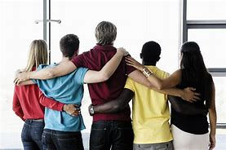
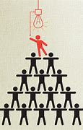
Team work
Team work is when a group of two or more individuals come together to get a task done.
This is a skill that I feel that I have comfortably gotten better at. This skills is greatly needed when it comes to being a journalist: the main reasons for this are:
Good leadership- having someone in-charge to delegate task to each person is a necessity. One person can get the work done but with others come together and help, the work flow is much better. The leader is able to move around freely and see if anyone needs a help- which is important because as a team everyone needs to work together to collate data to provide a whole report.
Better productivity- this is a huge advantage point as you’re able to share more ideas. Everyone will be focussed on what needs doing and getting it done.

Slide 8
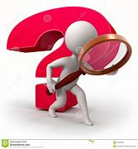
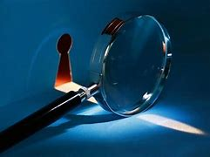
Investigative/ reporting
Working towards my career I have not yet acted on this skill but in due time I will need to. This is because as journalist I will have to really go out looking for the truth especially when it comes to exposing things that are illegal; maybe I will even need to disguise myself in order to get the truth that I need to publish my findings.
Before, technology this was easier said than done as there was more trust being reporters/journalist and company owners but not there is the GDPR law which unfortunately doesn’t just protects people who are not doing the right thing but it also means that it will restrict me from finding out what I really need.

Slide 9
References
What is Journalism? - Definition, Roles & Issues - Video & Lesson Transcript | Study.com
Time Management Training Course - Revolution Learning and Development Ltd
What is Teamwork & Why Is It Important? (3 Reasons & Examples) (freshbooks.com)
https://www.media.ba/en/istrazivacko-novinarstvo-novinarstvo/what-investigative-reporting#:~:text=Here%20are%20some%20of%20the%20common%20definitions%3A%201,setting%20right%20the%20injustices.%20...%20More%

