Slide 1
Developing Critical Analysis
Academic Study Skills – Birmingham

Slide 2
In this session:
Introduce critical thinking
Describe the CRAAP test
Consider potential points of critical analysis
Signpost to useful resources available at UWTSD

Slide 3



What do we mean by ‘critical thinking’?
Chatfield (2018, p6) outlines that critical thinking is when we are, "setting out actively to understand what is going on by using reasoning and evaluating evidence..."
As academic writers we may be critical of :
Information sources
Arguments
Theories
Findings of studies
Models or frameworks
Notes:
Chatfield, T (2018) Critical Thinking, London: Sage Publications Ltd – free text often given to our students – physical copies available in QP

Slide 4
Critical thinking
There are several processes and tools that can be used when applying critical thinking to your work.
Evaluating the strengths and weaknesses of evidence
Reflecting on the evidence to see if there are missing ideas or facts
Pulling different ideas together (synthesising) to create new ideas
Applying evidence to real situations
Justifying ideas, decisions and opinions with evidence from synthesised sources of information
Notes:
Here are some examples of how critical thinking can be defined and explained (Cottrell, 2017; Bottomley and Pryjmachuk, 2018):
Identifying other people’s ideas and comparing different ideas and evidence without bias
• Evaluating the strengths and weaknesses of evidence
• Reflecting on the evidence to see if there are missing ideas or facts
• Pulling different ideas together (synthesising) to create new ideas
• Applying evidence to real situations
• Justifying ideas, decisions and opinions with evidence from synthesised sources of information

Slide 5

Suitability of a source of information
When you search for information, you are going to find lots of it . . . but is it good information?

Slide 6
What can we critique?
Aim to a have a critical eye as you read any information source:
Journal Articles
Academic textbooks
Specialist organisation websites

Slide 7
What is CRAAP test?
The CRAAP Test was developed by Blakeslee (2004). It is a list of questions to help you evaluate the information you find.
Currency
Relevance
Authority
Accuracy
Purpose
Notes:
Currency: The timeliness of the information.
·When was the information published or posted?
·Has the information been revised or updated?
·Does your topic require current information, or will older sources work as well?
Are the links functional?
Relevance: The importance of the information for your needs.
·Does the information relate to your topic or answer your question?
·Who is the intended audience?
·Is the information at an appropriate level (i.e. not too elementary or advanced for your needs)?
·Have you looked at a variety of sources before determining this is one you will use?
·Would you be comfortable citing this source in your research paper?
Authority: The source of the information.
·Who is the author/publisher/source/sponsor?
·What are the author's credentials or organizational affiliations?
·Is the author qualified to write on the topic?
·Is there contact information, such as a publisher or email address?
nDoes the URL reveal anything about the author or source? examples: .com .edu .gov .org .net
Accuracy: The reliability, truthfulness and correctness of the content.
·Where does the information come from?
·Is the information supported by evidence?
·Has the information been reviewed or refereed?
·Can you verify any of the information in another source or from personal knowledge?
·Does the language or tone seem unbiased and free of emotion?
·Are there spelling, grammar or typographical errors?
Purpose: The reason the information exists.
·What is the purpose of the information? Is it to inform, teach, sell, entertain or persuade?
·Do the authors/sponsors make their intentions or purpose clear?
·Is the information fact, opinion or propaganda?
·Does the point of view appear objective and impartial?
·Are there political, ideological, cultural, religious, institutional or personal biases?

Slide 8
Online – Be critical - Domain names
.org
A non-profit organisation - .org.uk confirms that the organisation is also UK based
.co.uk
A UK based company
.com
A commercial company
.gov
A verified government site
.ac.uk
An academic institution – usually a university
.net
This used to mean ‘network’ and could only be used by a verified network – now it can be used by anyone.
Notes:
Highlight to students what a ‘domain name’ is, how they would spot it in the URL address for a website and which ones from the list would be most reliable?
Highlight the additional importance of – https – to indicate a secure site.

Slide 9
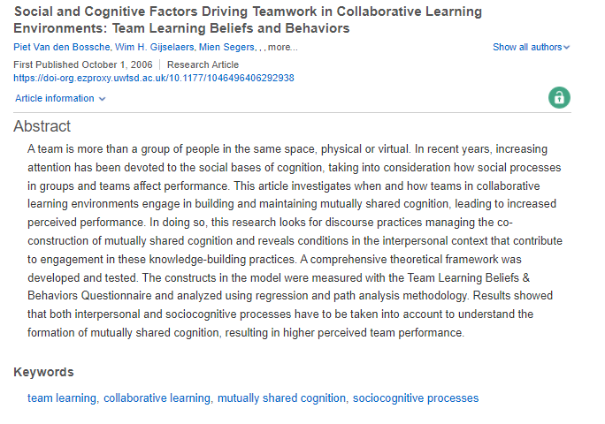
Abstracts - scan reading critically.
Year of Publication – is this current?
The research aims are made clear. Are these relevant to what you are researching?
Specific research focus stated – is this clear and relevant?
Any measurement method share, e.g. Questionnaires - do these capture the data effectively?
Analysis method described. - Does this reflect common practice? Can you compare the results with those of other studies using the same analysis tools?
Results and conclusion briefly stated. - Are these finding robust? Are these generalisable?
Notes:
Briefly outline the purpose of an Abstract and that these are present in nearly all journal articles and research studies.
Explain that this is a traditional way of setting out an abstract but that some publications now include subheadings to aid the reader – see the Reeves et al (2017) example.

Slide 10
Being critical
Clearly, showing that you are critically thinking is important for meeting academic expectations.
Descriptive Statements
“The report states”,
“The study found”,
“ We report no need”,
“The paper is thorough”,
“We have an autocratic leadership team” ,
“George experienced head trauma”
Analytical Statements
“There seems to be..”
“The study appears to show…
“Individual may experience..”
“The findings could indicate..”
Notes:
Analytical/evaluative statements can include more tentative language choices to show there are other possibilities: Seem to, appear to, may, tend to, could result

Slide 11
Critical Analysis – possible points of focus
What are the advantages and disadvantages of using a particular model or framework?
Can the findings of a study be applied to the UK context or the context of your case study?
In empirical studies, was the sample representative?
What do other researchers say? Do they agree with points or disagree?
Has a model or framework become irrelevant? Why do you think that? Support your points.
Notes:
These boxes illustrate some possible points of critical analysis – allow students to ask about their own work and what are they attempt to critical analyse?

Slide 12


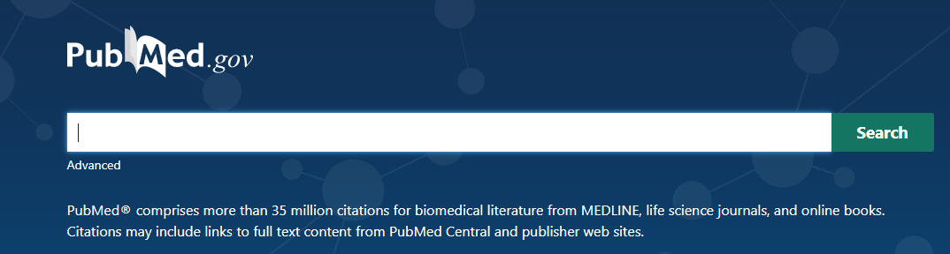


Where can you find relevant literature?
The UWTSD Library is a great place to start.
Google SCHOLAR is another good tool – but avoid using standard Google.com
https://www.uwtsd.ac.uk/library/
https://scholar.google.co.uk/
https://pubmed.ncbi.nlm.nih.gov/
https://advantage-marketline-com.ezproxy.uwtsd.ac.uk/HomePage
https://www.ons.gov.uk/
Notes:
Both pubmed and marketline are accessible via the UWTSD library
There are also the ‘Getting started’ guides on the UWTSD Library - https://www.uwtsd.ac.uk/library/student-essentials/getting-started-guides/

Slide 13
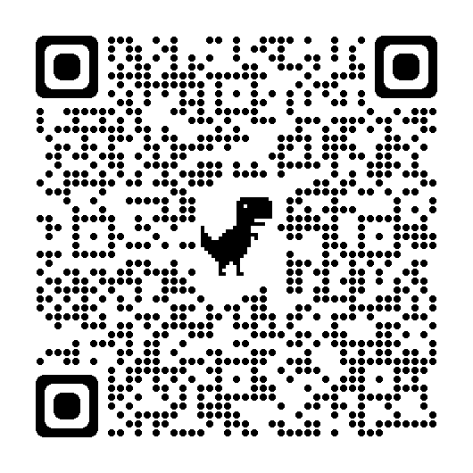

For further guidance on critical engagement - Book a one-to-one with an Academic Liaison Librarian
Notes:
https://www.uwtsd.ac.uk/library/student-essentials/book-an-appointment/
https://outlook.office365.com/owa/calendar/AcademicServices121@uowtsd.onmicrosoft.com/bookings/

Slide 14
Summary:
Introduced critical thinking
Described the CRAAP test
Considered potential points of critical analysis
Signposted to useful resources available at UWTSD

