Slide 1
Reflective Practice
Hywel Ainsworth
1500795

Slide 2
Introduction
This presentation will be looking at reflecting upon my own personal story and considering the journey that I have taken to reach this point in my life.
I will also be critically reflecting on a particular transition in my life and have chosen and image that resonates with my growing edge.
I have also identified a reflective model that I can relate to and have applied this to my own reflective process. I have chosen to use Kolb’s cycle of reflective practice.

Slide 3
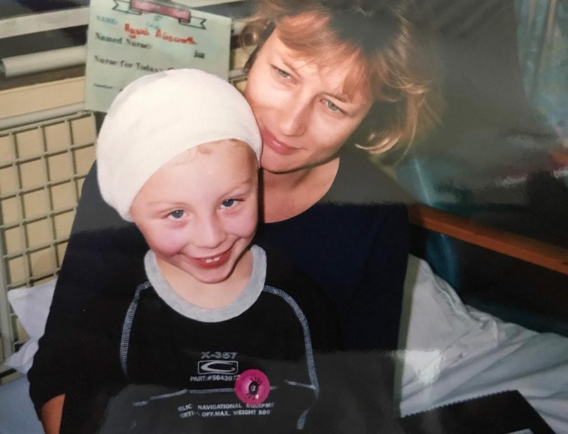
Cholesteatoma
Cholesteatoma has impacted on me since I was born, affecting my language and developmental growth from the earliest age. I was five years old when I had my first surgery for the condition and following diagnosis of it in my other ear at age 6, continued to have multiple operations every year until I was 15.
This journey had an enormous impact on me in the short term but its legacy has in part defined the person that I am today. From age 5 to 15 I was off school for long periods of time due to having multiple operations to remove the continual growth of the cholesteatoma. Recovery time was typically at least one week. The impact on my education, my social interactions, the opportunity and ability to form friendships, was significant.

Slide 4
Cholesteatoma
To me this was normal, I accepted it as part of my everyday life. I thought that everybody else was experiencing the same as me. I attended a primary school which at the time didn’t have specialist facilities to support children with hearing difficulties.
As a result of not understanding the majority of what was going on around me and of me being misunderstood, my behavior could be disruptive. The lack of understanding of my condition and support available resulted in me being considered a badly behaved child with my parents being called into school a number of times.
My parents moved me to a school with a specialist unit for the deaf and hearing impaired and from that point I was supported for the rest of my primary and secondary school education.

Slide 5

My Growing Edge…
Having cholesteatoma has taught be how to be more patient with other people and walk with them in times of need, rather than walking away.
It has taught me the importance of compassion, empathy and understanding, and how best to be compassionate, empathetic and understanding to people like me who stand on the sidelines of life.

Slide 6
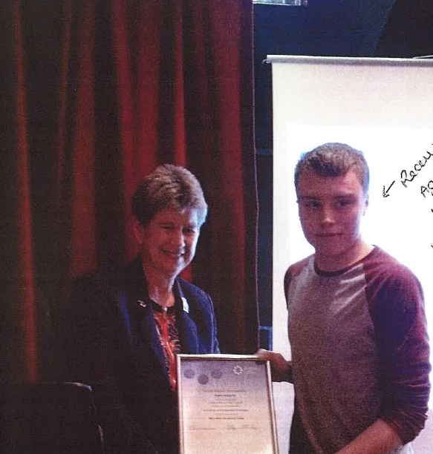
Volunteering work within Youth Work…
I started volunteering in my local youth club when I was 15 years old, via my GCSE Workskills course. As a result of this I was offered an opportunity to volunteer in my local youth club beyond the Workskills placement.
This photo is of me receiving an award for my volunteering work.
I clearly remember the importance of the support given to me by the youth workers in the centre and my family in my decision to apply to study for a degree in Youth Work at University.

Slide 7
Volunteering within Youth Work
From a young age I had a desire, maybe it was a vocation, to help and support people and felt a sense of achievement when doing so. The happiness and satisfaction I gain in helping people achieve their own positive outcomes cannot be underestimated. I have no doubt that my motivation to follow this course was in great part due to the difficult and often lonely childhood that I experienced.
Throughout my university degree I became sure of the path that I wanted to take within youth work and the difference that I wanted to make to young people.

Slide 8
Relating to my Growing Edge
I chose my journey through youth work as my growing edge because there is still so much to be learned, improved upon and developed with this.
Beyond my BA degree I went on to gain a Masters degree and despite now having three years employment experience in the sector, there is there is still so much I need to learn and so many ways in which I want to develop my skills and professional capabilities.
One of the ways that I am pushing ahead and stretching the margins is by taking every opportunity for relevant training and CPD to support and develop me within my role.
As I find new areas of professional interest, I remain open to developing my career along related but different lines. At this point, I don’t know if my current role is where I will stay, but I do know that my experiences as a child related above will play a big part in career choices that I make.
.

Slide 9
Reflection
Reflection and reflective practice is an important part of any professional looking to improve their practice.
Hargreaves & Page (2013, p.g 2) suggests that ‘Reflection and reflective practice help professionals to develop and critique their own practice’.
Reflecting on practice is also important as it allows practitioners to see things through new eyes and allows practitioners to unpick what is happening.
Stedmon, & Dallos (2009, p.g 4) back this up by noting It is argued that reflective practice involves complex processes that allow us to see things in new ways, viewed through the lenses of our different models for understanding therapy’.

Slide 10
The Importance of Reflective Practice
Reflective practice plays a big part in the development of staff and individuals.
Reflection plays a key role for people in identifying events that have gone on within their day to day life and be able to unpick it.
Being able to reflect on our journey we have taken is important and able to look at our journey through different eyes is also important. This is backed up by Bolton, G., (2014, p.g 2) who suggests that
‘When we embark on this journey, we have the four lenses mentioned earlier. Viewing what we do through these different lenses alerts us to distorted or incomplete aspects of our assumptions that need further investigation.’
It is important that when critically reflecting to be able to look for these distortions and to be able to address these distorted aspects of our assumptions.

Slide 11
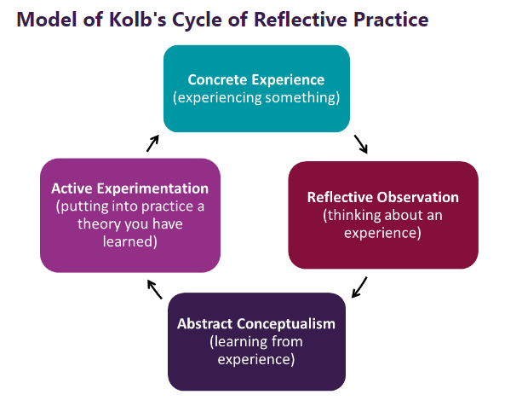
Reflective Model
Within this presentation I shall be using Kolb’s Reflective Model.
1) I have identified 2 examples within this presentation and discussed the learning I have had in relation to these.
2) I have been able to learn from both experiences in a positive way.

Slide 12
Reflective Model
3) Through reflecting on these experiences, I have been able to acknowledge what has gone well through these experiences, as well as identifying what did not go so well through these experiences.
4) Through completing this reflective model, I have been able to support myself, as well as being able to support others.

Slide 13
Summary
Within this presentation, I have reflected upon my own personal story and have considered the journey that I have taken to reach this point in my life.
I have also critically reflected on a particular transition in my life and have chosen and image that resonates with my growing edge.
I have also identified a reflective model that I can relate to and have applied this to my own reflective process.

Slide 14
References
Bolton, G., (2014) Reflective practice : writing and professional development 5th. ed., London: Sage. Chapter 1
No Author, Gibbs’ reflective cycle (1970) The University of Edinburgh. Available at: https://www.ed.ac.uk/reflection/reflectors-toolkit/reflecting-on-experience/gibbs-reflective-cycle (Accessed: 31 October 2023).
Hargreaves, J & Page, L. (2013). Reflective practice (1st ed.). Polity Press.
Stedmon, J & Dallos, R. (2009). Reflective practice in psychotherapy and counselling. Open University Press.

