Slide 1
BA International Hotel Management
M5X01924
Management and Organisational Behaviour

Slide 2

Previously…..
Define organisations and explored the organizational environment
Explored tools used to analyse the environment
Identified organizational structures
Discussed how organizational culture is created and sustained
Discussed factors affecting culture and how to change culture

Slide 3
In this Session…..
We will:
Discuss the theories related to organizational performance, including
Barriers to the effective functioning of an organisation.

Slide 4

Theories of Organizational Performance
There are many theories that are associated with organisational performance.

Slide 5
Theories of Organisational Performance
Beer’s Model
Organisational health Index
Hannan and Freeman’s Theory

Slide 6
Beer’s Model

Slide 7
Beer’s Silent Barriers
Beer (2009) identified 6 Barriers to Becoming a High-performance Company.
These barriers are called organisational silent killers.

Slide 8
Beer’s Silent Barriers
According to Beer (2009), "These silent killers are always lurking unseen but when there is a change in strategy, that is when they come to the fore -- forcing companies to overcome them if they are to boost performance.“

Slide 9
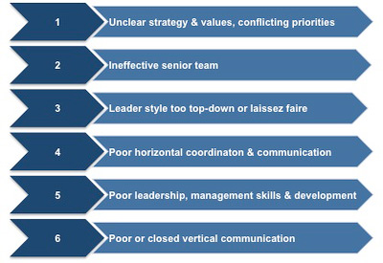
Beer’s Silent Barriers

Slide 10
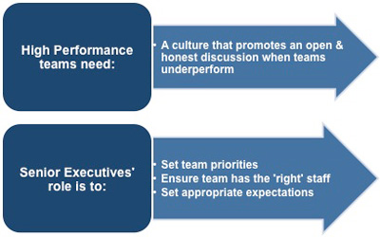
How to Overcome the Barriers?
Beer (2009) suggests the following:

Slide 11
Activity
Read the case study on SEIMENS and see if you can identify the “silent barriers” based on the given information.
Present your points to the class

Slide 12
Organisational health index (OHI)

Slide 13
What is OHI?
The Organizational Health Index (OHI) measures and tracks the organizational elements that drive performance.
It provides a simple but powerful road map for leaders and managers to improve organizational health.
e.g. McKinsey’s OHI

Slide 14
Mckinsey’s Organisational Health Index
“An organization’s health—its ability to align around and achieve strategic goals—is critical for long-term performance.
However, many leaders overlook organizational health because they lack a clear way to measure and improve it”.
(McKinsey, 2019)

Slide 15
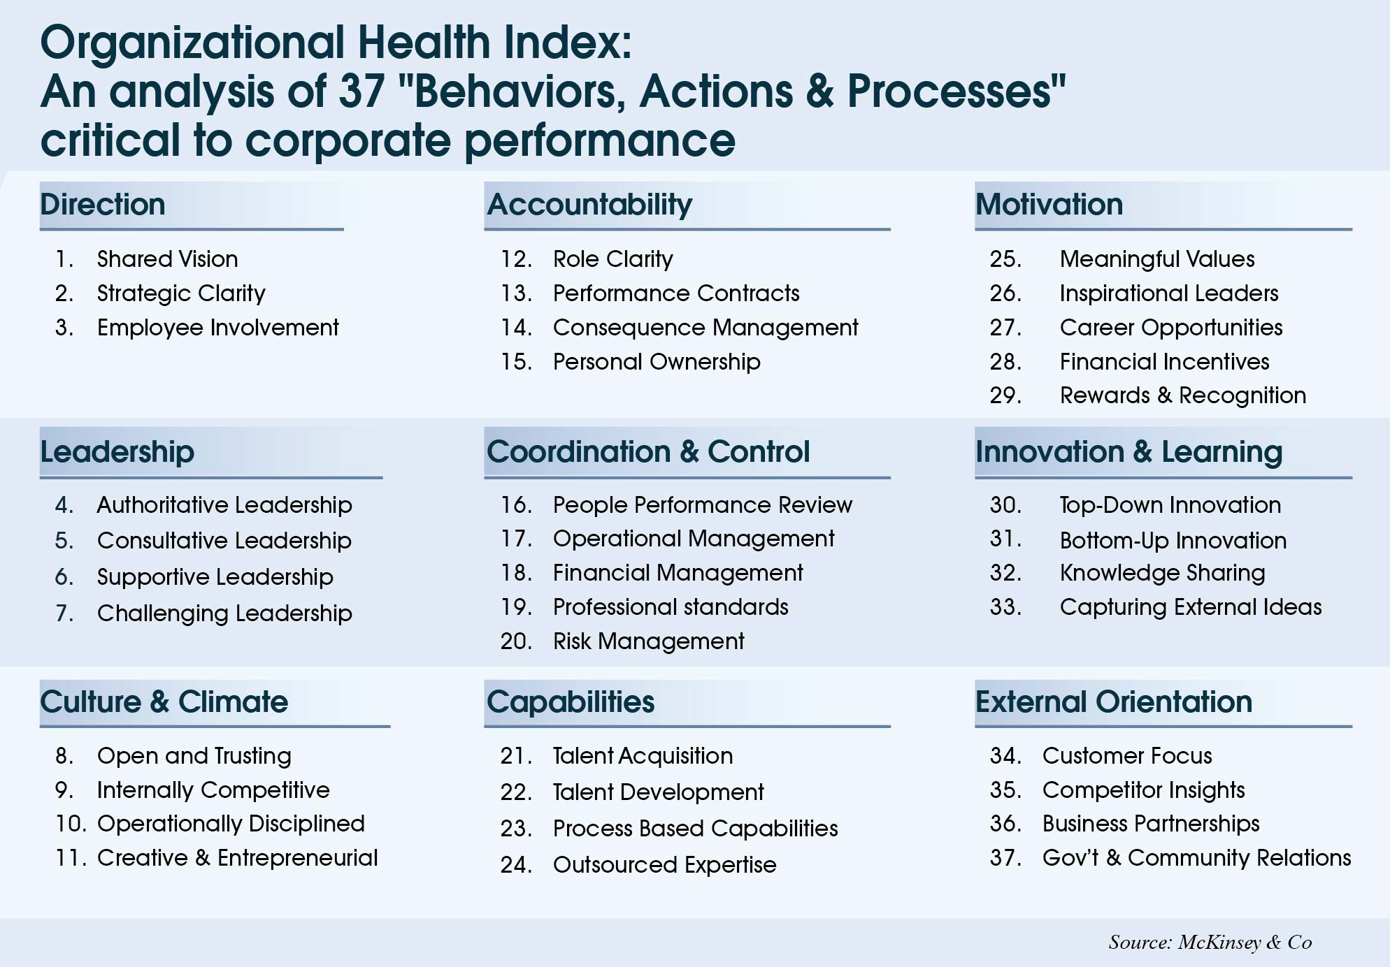

Slide 16
Activity
Conduct an organisational health check using the questionnaire available on Moodle.
(You may use the organisation that you are working / have worked before / the University)
Present your points to the class

Slide 17
Hannan and Freeman’s Theory

Slide 18
Hannan & Freeman’s Theory
Hannan and Freeman (1984) used the concept of organizational ecology to argue that organizational effectiveness depends on the environment in which the organization operates.
An organization that delivers adequate performance in a challenging environment may be more effective than an organization that performs well without encountering problems.

Slide 19
Hannan & Freeman’s Theory
Performance
Constraints
Adaptation
Inertia
Selection

Slide 20
1.Constraints:
Your company faces constraints from internal and external factors.
You may not have the money for optimal solutions or the people or raw materials you need, Your physical plant and equipment may be inadequate or you may face competition or regulatory action.

Slide 21
1.Constraints (cont’d):
Hannan and Freeman (1984) call such constraints one aspect of the environment, or ecology, in which your company operates.
The most effective organizations deliver the required performance, despite such constraints on their freedom to act in the most efficient manner possible.

Slide 22
2.Adaptation:
According to Hannan and Freeman (1984), one of the ways effective organizations deal with constraints that prevent them from reaching their goals is to adapt to their ecology.
If you don't have the money for the best and most efficient solution, you find a less expensive way to achieve the results you need.

Slide 23
2.Adaptation (cont’d):
If you don't have the people with the expertise you need, you can train the people you have to carry out the necessary work.
Effective organizations find ways to perform adequately by adapting to their environment and using the resources they have.

Slide 24
3.Inertia
Hannan and Freeman (1977) identified "organizational inertia" as the obstacle preventing organizations from adapting.
Such inertia can consist of physical plant that is hard to change, employees who are specialized in a particular field, the lack of knowledge or capability at the management level and the history of the company that resulted in a particular culture and attitude.

Slide 25
3.Inertia (cont’d):
To operate with high effectiveness, you have to recognize these limitations and consciously work to minimize their effect. Such a strategy leaves your company free to adapt to changing conditions and performance challenges.

Slide 26
4.Selection
According to the ecology concept, the most effective organizations are those that can adapt to constraints by performing well under challenging conditions.
Because all organizations eventually experience challenges, those that can successfully adapt are the ones that survive.

Slide 27
4.Selection
To ensure that your company survives this process of selection, you have to promote organizational characteristics that leave your company free to adapt to changes and difficult conditions.

Slide 28


Summary
Can you explain the tools that can be used to identify the factors that affect the performance of an organisation?

Slide 29
References
Beer, M. (2009). Sustain Organizational Performance through Continuous Learning, Change, and Realignment. In E. A. Locke (Ed.), Handbook of Principles of Organizational Behavior: Indispensible Knowledge for Evidence-Based Management (2nd ed.; pp. 537-555). Chichester, West Sussex, UK: Wiley.
Hannan, M. T and Freeman, J. (1984). Structural Inertia and Organisational Change, American Sociological Review, 49 (2), 149 - 164

