Slide 1

MBA – Master of Business Administration
LCMB7026
International Marketing: Principles and Practices
Notes:
Full-time students, a great university: No Exam / 10 modules 1 x month
Improve Your Workplace Skills Only way fail – can’t be bothered / we can’t be bothered
First module - Personal Development for Improvement: Always slides & Hand-outs

Slide 2
The Marketing Mix Concept
&
Market Segmentation
Notes:
Full-time students, a great university: No Exam / 10 modules 1 x month
Improve Your Workplace Skills Only way fail – can’t be bothered / we can’t be bothered
First module - Personal Development for Improvement: Always slides & Hand-outs

Slide 3
The Marketing Mix Concept
The firm’s marketing mix, is the set of marketing tools the firm uses to implement its marketing strategy.
The major marketing mix tools are classified into four broad groups, called the four (4) Ps of marketing: product, price, place and promotion.
The marketing mix offers an optimum combination of all marketing ingredients so that companies can realise goals for example profit, sales volume, market share, return on investment etc

Slide 4
The Marketing Mix Concept
Product:
Is a tangible object or intangible service that is produced or manufactured and offered to consumers in the market.
Price:
Is the amount a consumer pays for the product or service, normally an economic cost.

Slide 5
The Marketing Mix Concept
Place:
Represents the location where a product or service can be purchased, and can often be referred to as the distribution channel. This can include physical stores as well as virtual outlets online.
Promotion:
Represents the communications that marketers use in the marketplace including advertising, public relations, personal selling and sales promotion.

Slide 6
The Marketing Mix Concept
To deliver on its value proposition, the firm must first create a need-satisfying market offering (product).
It must then decide how much it will charge for the offering (price),
How it will make the offering available to target consumers (place).
Finally, it must engage target consumers, communicate about the offering, and persuade consumers of the offer’s merits (promotion).

Slide 7
The Marketing Mix Concept
The marketing mix is a set of controllable variables that the company can use to influence the buyers responses.
Marketing manager decides the level of marketing expenditure in order to achieve marketing objectives of the firm and after finalising the market budget it is decided that how to divide total marketing budget among various tools in the marketing mix.
Thus, the firm must blend each marketing mix tool into a comprehensive integrated marketing programme that communicates and delivers the intended value to chosen customers.

Slide 8
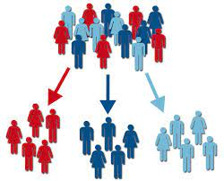
The Marketing Mix Concept
The intended value to chosen customers are reached through:
Market segmentation
Target market, and
Positioning

Slide 9
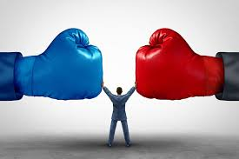
The Marketing Mix Concept
Market Segmentation:
Involves dividing a market into smaller groups of buyers with distinct needs, characteristics or behaviours that might require separate marketing strategies or mixes.
The company identifies different ways to segment the market and develops profiles of the resulting market segments.

Slide 10
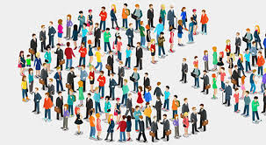
The Marketing Mix Concept
Market Segmentation:
Buyers in any market differ in their wants, resources, locations, buying attitudes and buying practices.
Through market segmentation, companies divide large, heterogeneous markets into smaller groups that can be reached more efficiently and effectively with products and services that match their unique needs.

Slide 11
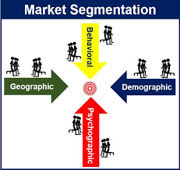
The Marketing Mix Concept
Market Segmentation :
There is no single way to segment a market.
A marketer has to try different segmentation variables, alone and in combination, to find the best way to view market structure.
The major variables that might be used in segmenting consumer markets are: geographic, demographic, psychographic and behavioural.

Slide 12
The Marketing Mix Concept
Segmentation Variable | Examples
Geographic | Countries, regions, cities, neighbourhoods, population density (urban, suburban, rural), climate.
Demographic | Age, life – cycle stage, gender, income, occupation, education, religion, ethnicity, generation.
Psychographic | Social class, lifestyle, personality.
Behavioural | Occasions, benefits, user status, usage rate, loyalty status.
Market Segmentation :
Major Segmentation Variables for Consumer Markets..

Slide 13
The Marketing Mix Concept
Geographic Segmentation:
This calls for dividing the market into different geographical units, countries, regions, cities or even specific neighbourhoods.
Demographic Segmentation:
This divides the market into segments based on age group, gender, family size, family life cycle, income, occupation, education, religion, ethnicity, generation and nationality.

Slide 14
The Marketing Mix Concept
Demographic Segmentation:
(i) Age and Life-Cycle Stage Segmentation.
This refers to dividing a market into different age and life-cycle groups.
Some companies focus on the specific age of life-stage groups. Foe example, Saga in the UK offers wide range of products and services, including insurance, homecare, holidays and magazine, exclusively for the over 50s.

Slide 15
The Marketing Mix Concept
Demographic Segmentation:
(ii) Gender Segmentation.
This refers to dividing a market into different segment based on gender.
Gender segmentation has long been used in marketing clothing, cosmetic, toiletries and magazines.
For example, P & G was among the first with secret deodorants and antiperspirants, a brand specially formulated for a woman’s chemistry, packaged and advertised to reinforce the female image.

Slide 16
The Marketing Mix Concept
Demographic Segmentation:
(ii) Gender Segmentation.
Likewise, Dove’s Men + Care line crafts a more masculine position by offering practical solutions to men’s personal care problem.
(iii) Income Segmentation.
This refers to dividing a market into different income segments.
The marketers of products and services such as motor cars, clothing, cosmetic, financial services and travel have long used income segmentation.

Slide 17
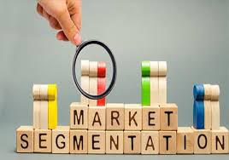
The Marketing Mix Concept
Demographic Segmentation:
(iii) Income Segmentation.
Many luxury hotels often provide special packages to attract the most affluent travellers, shoppers of high end brands.
Equally, some marketers use income segmentation to target low and middle income groups. Examples of these are budget retailers – Poundland, Poundshop, Aldi and Lidl.

Slide 18
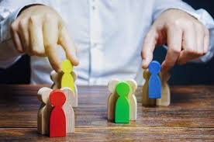
The Marketing Mix Concept
Psychographic Segmentation:
This refers to dividing a market into different segments based on social class, lifestyle or personality characteristics.
Essentially, people in the same demographic group can have very different psychographic characteristics.
This could take the form of lifestyle appeals (lovers of choice brands), personality variables (such as adventure seekers on holiday cruise).

Slide 19
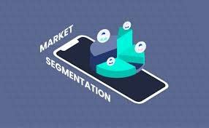
The Marketing Mix Concept
Behavioural Segmentation:
This refers to dividing a market into segments based on consumer knowledge, attitudes, uses of a product or responses to a product.
Many marketers believe that behavioural variables are the best starting point for building market segments.
These variables are occasion segmentation, benefit segmentation.

Slide 20
The Marketing Mix Concept
Behavioural Segmentation:
(i) Occasion Segmentation:
This reflects dividing a market into segments based on consumer knowledge, attitudes, uses, of product or responses to a product.
Occasion segmentation can help firms build up product usage. For example, Heinz and Campbell’s advertise soups more heavily in the cold winter months.
Likewise, B & Q runs special spring – time promotions for lawn and garden products.

Slide 21
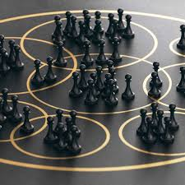
The Marketing Mix Concept
Behavioural Segmentation:
(ii) Benefit Segmentation:
This refers to dividing the market into segments according to different benefits that consumers seek from the product.
It requires finding the major benefits people look for in a product class, the kinds of people who look foe each benefit and the major brands that deliver each benefit.

Slide 22
The Marketing Mix Concept
Market Segmentation:
Marketers rarely limit their segmentation analysis to only one or few variables.
Rather, they often use multiple segmentation bases in an effort to identify smaller, better-defined target groups.
For example, a bank may not only identify a group of wealthy, retired adults but also, within that group, distinguish several segments based on their current income, assets, savings and risk preferences, housing and lifestyles.

Slide 23

Further Readings for Week 1.
Chapter 7 of …..
Kotler, P., Armstrong, G., Harris, L., C., & Piercy, N., (2017). Principles of Marketing: European Edition. 7th European Edition. Harlow: Pearson.
Case Study - Read:
Hotel Brand Differentiation - How major companies are using an array of brands to appeal to all

Slide 24
References.
Gordon, R. (2012). “Rethinking and retooling the social marketing mix, “Australasian Marketing Journal, Vol. 20 No. 2, pp. 122-126
Kotler, P., Armstrong, G., Harris, L., C., & Piercy, N., (2017). Principles of Marketing: European Edition. 7th European Edition. Harlow: Pearson.
Rick, W., & Niren, S., (2005). Finding the Best Marketing Mix, The Journal of Business Strategy; 26, 6
Singh, M (2012). Marketing Mix of 4P’S for Competitive Advantage, IOSR Journal of Business and Management, Vol 3 (6), pp. 40-45

Slide 25

Marketing Management
Any Question

