Slide 1
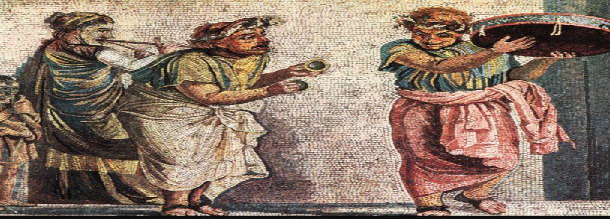
Murder, Mayhem and Megalomania: The Life and Times of the Emperor Nero
HPAH5037; HPAH6037
Science, Literary culture and the court

Slide 2
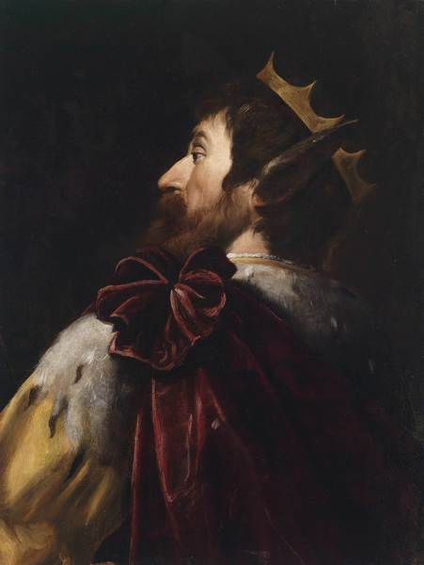
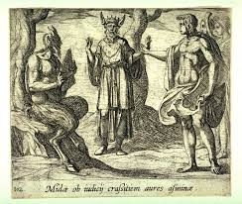
…We scribble something grand, behind closed doors,
One in verse, another in prose that only a generous
Lungful of air can exhale;
…you‘ll read to the audience from your
Tall seat, while you gargle with water to rinse your
Fickle throat, your expressive eyes moved to tears.
Then you‘ll watch as grown men tremble, their sober
Manner and tranquil voices gone,
...You know how to serve up warm tripe,
Make a shivering client the gift of a second-hand cloak,
Then say ‘I love the truth, tell me the truth about myself.’
How can I? Do you want me to say you‘re talking rubbish,
Baldy, you with your fat belly sticking out a foot and half?
O, two-faced Janus, never suffering gestures behind your back;
Pecking storks; nor waggling hands imitating donkey‘s ears;
…Roman? Should I be stirred, and toss a penny to every
Shipwrecked sailor who sings a song?...
…Whoever wants to move me with his lament will show
Genuine tears, not some tale he‘s drummed up overnight.
…Is there a single one that lacks ass’s ears?
- Persius Satires 1.

Slide 3
Culture in the Court of Nero

Slide 4
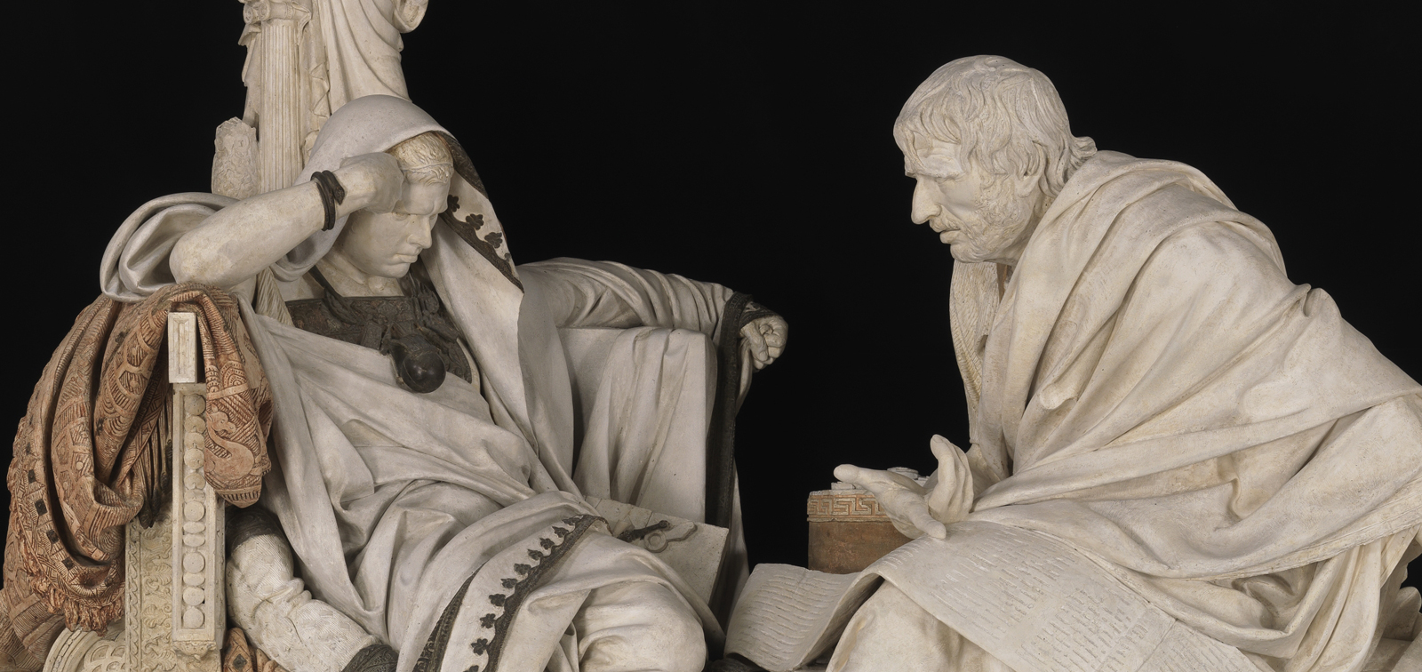
Nero’s literary and intellectual circle
After the death of Agrippina Nero seems to have developed a “reading circle”, which included aspiring poets.
He possibly also, in the company of Seneca, listened to leading philosophers debate their views.
Future Emperor’s in Nero’s circle
Marcus Salvius Otho
“…Nero and Otho were birds of a feather, although it had often been suggested that they also enjoyed each other‘s sexual favours.” – Suetonius Otho 2.
Marcus Cocceius Nerva
“But whoever is acquainted with the verses of the learned Nero, knows that Nerva is the Tibullus of our day.” – Martial Epigrams 8.70.
Titus Flavius Vespasianus
  Purportedly reprimanded by Nero’s freedman Phoebus for closing his eyes during one of Nero’s performances.
“…he affected also a zeal for poetry and gathered a group of associates with some faculty for versification but not such as to have yet attracted fame… Even to the teachers of philosophy he accorded a little time — but after dinner, and in order to amuse himself by the wrangling which attended the exposition of their conflicting dogmas. Nor was there any dearth of gloomy-browed and sad-eyed sages eager to figure among the diversions of majesty.” – Tac. Ann. 14.16.
Nero and Seneca, a plaster model sculpture by Eduardo Barrón González (it won he National Fine Arts exhibition in Madrid in 1904).

Slide 5
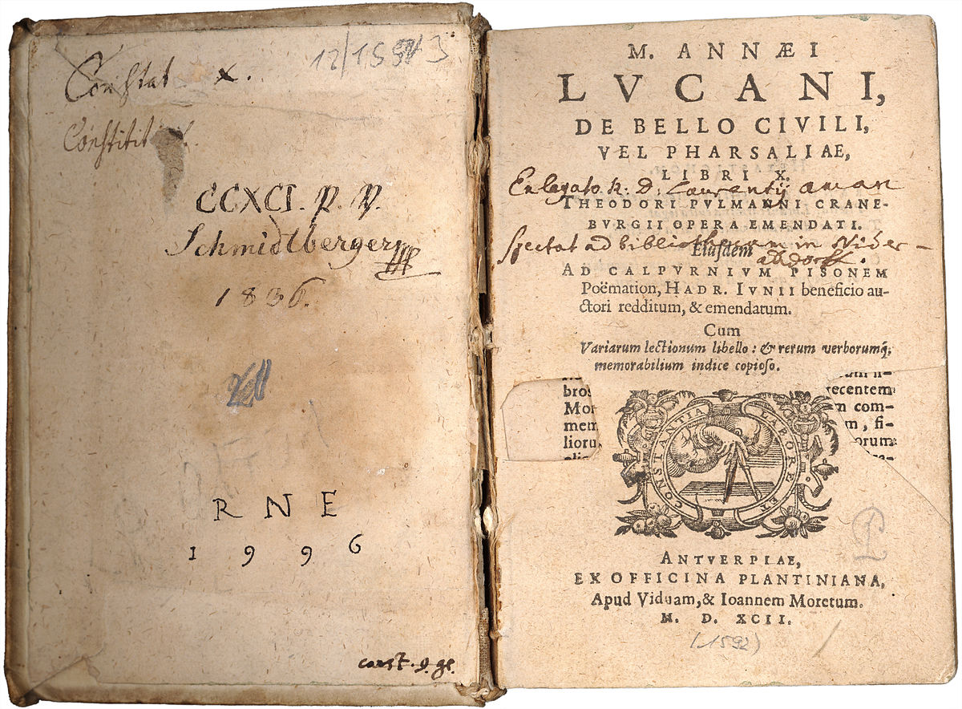
Literary sponsorship by Nero: Lucan
Marcus Annaeus Lucanus – AD 39-65.
Epic on the civil war between Caesar and Pompey – Bellum Civile – sometimes known as the Pharsalia.
Wrote works of prose and verse but mostly lost to us.
“Marcus Annaeus Lucanus of Corduba made his first appearance as a poet with a "Eulogy of Nero" at the emperor's Quinquennial Contests, and then gave a public reading of his poem on the "Civil War" waged between Pompey and Caesar.” – Suet. Life of Lucan.
“He was recalled from Athens by Nero and made one of his intimate friends, besides being honoured with the quaestorship…” – Suet. Life of Lucan.

Slide 6
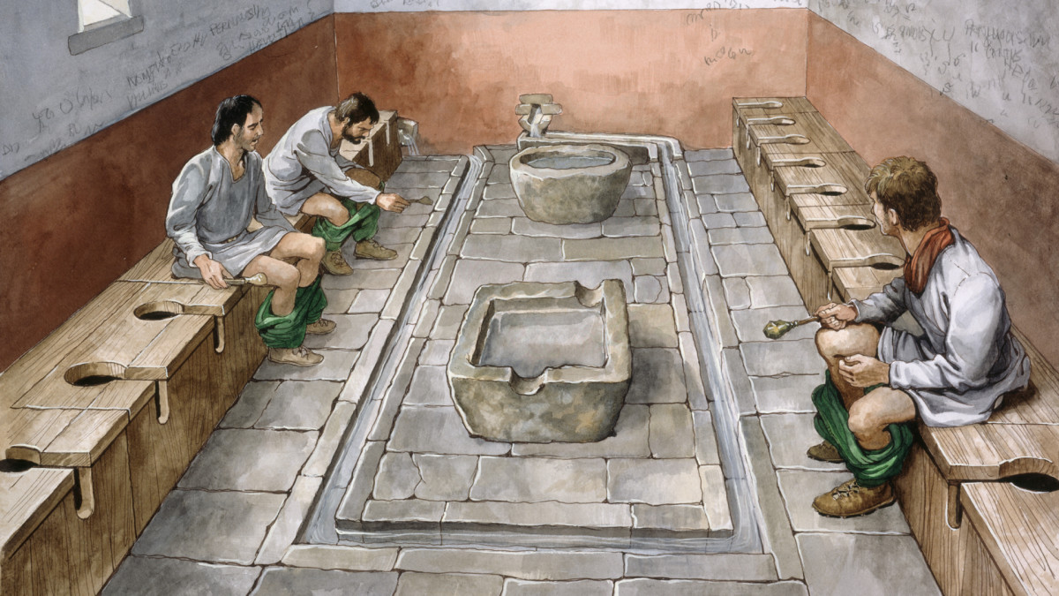
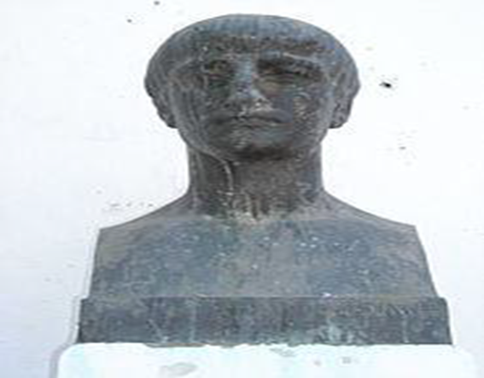
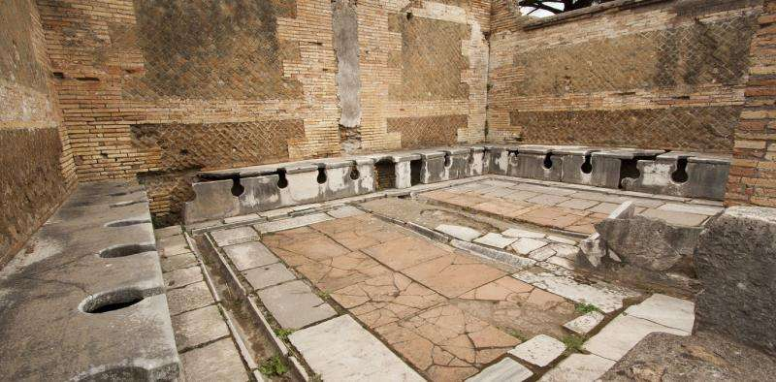
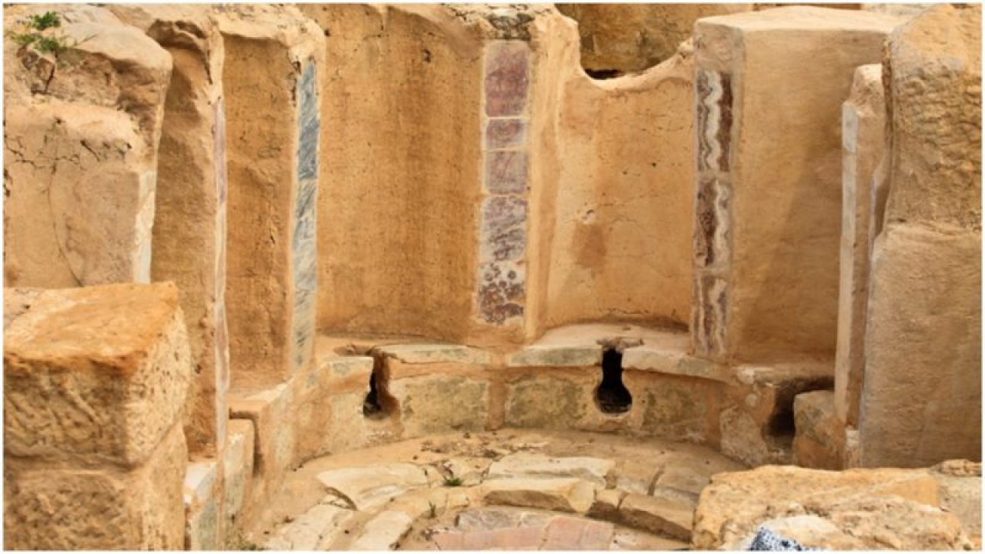
“…but he could not keep the emperor's favour. For piqued because Nero had suddenly called a meeting of the senate and gone out when he was giving a reading, with no other motive than to throw cold water on the performance..." – Suetonius Life of Lucan.
“…he afterwards did not refrain from words and acts of hostility to the prince, which are still notorious. Once for example in a public privy, when he relieved his bowels with an uncommonly loud noise, he shouted out this half line of the emperor's, while those who were there for the same purpose took to their heels:
"You might suppose it thundered 'neath the earth." – Suetonius Life of Lucan.
“Lucan had private motives to inflame him, since Nero was stifling the reputation of his poems and had ordered him not to seek publicity — for he had the vanity to count himself his peer.” – Tacitus Annals 15.49.
latrinae in Ostia Antica.

Slide 7
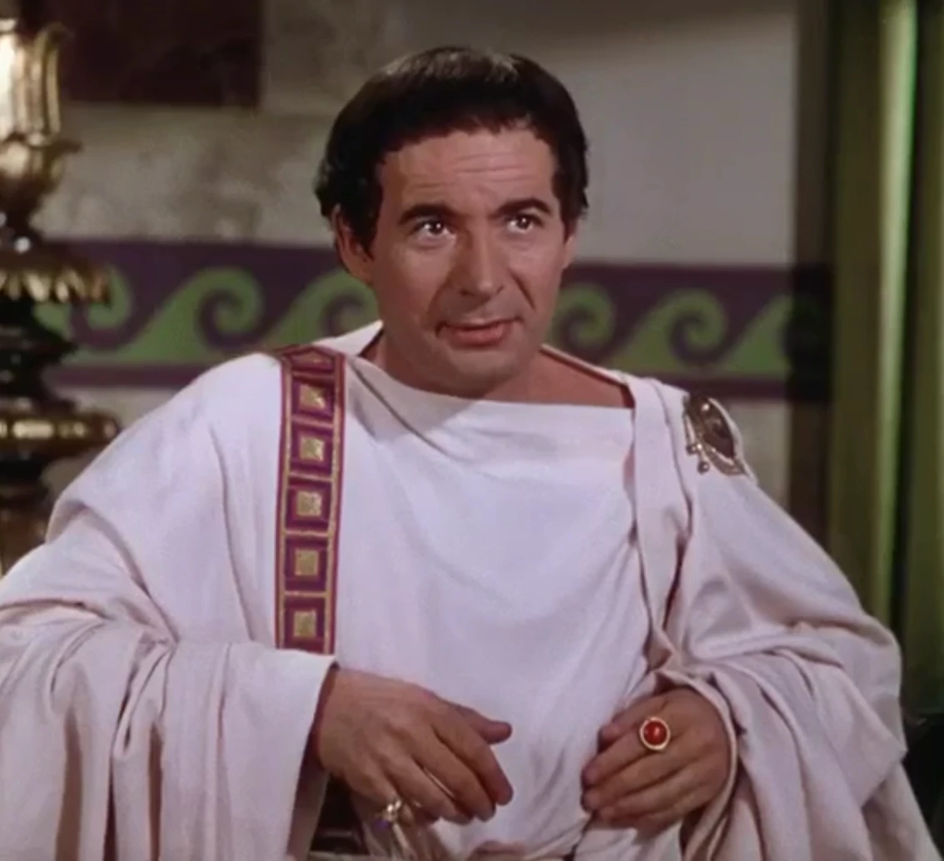
Gaius or Titus Petronius “Arbiter”?
Petronius, who received the moniker elegantiae arbiter / arbiter elegantiarum – arbiter of taste, is thought to be the author of the Satyricon (Satyrica).
Appreciation of Nero for parody and satire. Cf. the Apocolocyntosis.
Purported ability of Petronius to be able to make fun of Nero’s (excessive) spending habits – Plutarch How to Tell a Flatterer from a Friend 19.
“His words and actions had a freedom and a stamp of self-abandonment which rendered them doubly acceptable by an air of native simplicity…” – Tac. Ann. 16.18.

Slide 8
Other Significant Authors
Aulus Persius Flaccus – AD 34-62 - Satires.
Lucius Junius Moderatus Columella – AD 4 to c.70 - De Re Rustica.
Titus Calpurnius Siculus – c. reign of Nero - Ecologues and courtly poems.
Lucillius – c. reign of Nero - a Greek epigrammatists, credited with over a 100 poems preserved in the Greek Anthology - Consist of satirical jokes and descriptions of characters.
“Olympian Muses, daughters of Zeus, I would be finished had not Nero Caesar given me cash.” – Palatine Anthology 9.572.

Slide 9
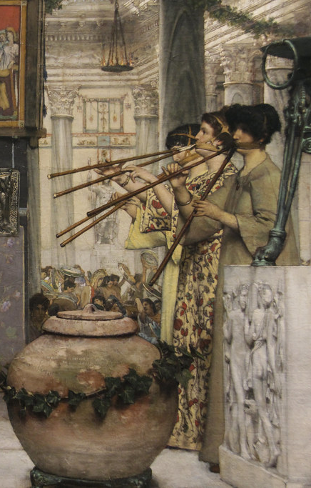
Neronia (AD 60)
“He was the first to establish in Rome a festival of competitions in music, athletics and horsemanship, modelled on the Greek ones and held every four years, which he called the Neronia… Men of consular rank, drawn by lot, organized the Neronia… At the prize-giving, Nero descended to the orchestra stalls where the senators sat to accept the laurel wreath for Latin oratory and verse, which had been reserved for him by unanimous vote of all the distinguished competitors. The judges also awarded him the wreath for a lyre solo, but he bowed reverently before them and said ‘Pray lay it on the ground before Augustus‘ statue’…” – Suetonius Nero 12.

Slide 10
Wider Cultural Developments

Slide 11
Intellectual and Technical Developments
Neronian era also appears to be one of heightened intellectual activity.
  Incidentally or encouraged by wider cultural impetus and economic investment?
Architectural and artistic developments:
  Internal space and light (domed ceilings); methods for painting stone (to enhance appearance, though began under Claudius); turtle-shell veneers (look like wood); “Fourth Style” wall-paintings; accelerated use of concrete.
Scientific and practical developments:
  Production of technical “handbooks”: Pliny the Elder collating materials for his Natural History (although finished under the Flavians); Seneca’s Natural Questions; Collumella De re rustica.

Slide 12
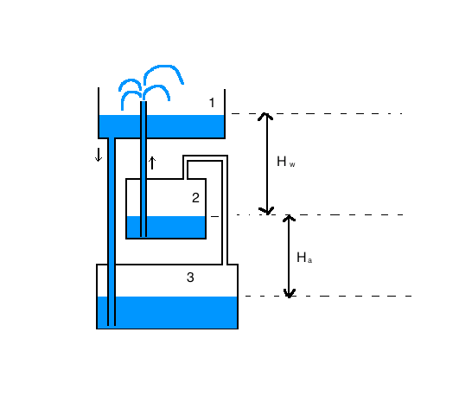
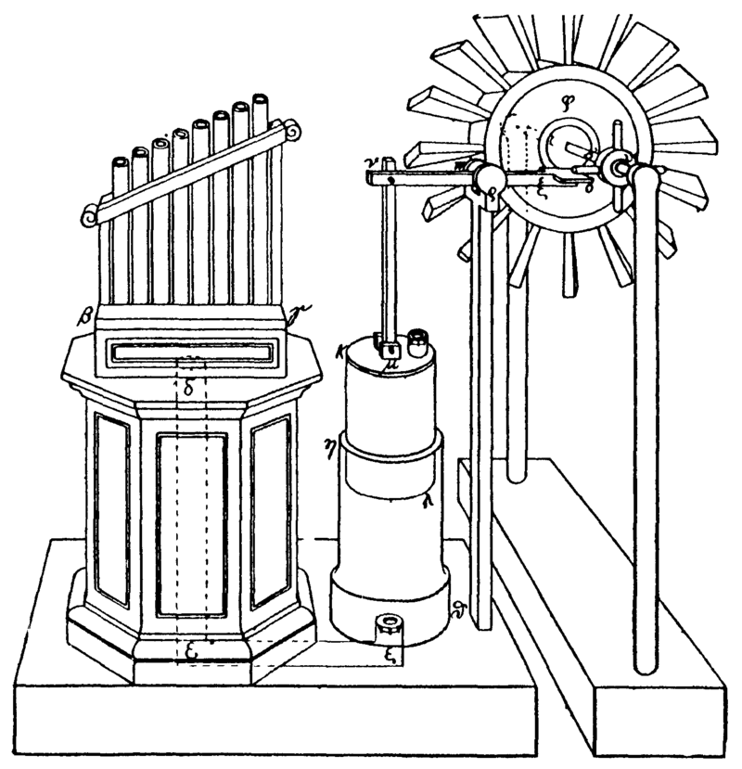
Heron of Alexandria (c. AD 10-70)
Based in Alexandria, in Roman Egypt.
Best known for his Mechanica (among other works).
Credited with mathematical and “engineering” developments:
  Heron’s formula (how to calculate the area of a triangle using it sides)
  A wind powered organ
  Heron’s fountain.

Slide 13
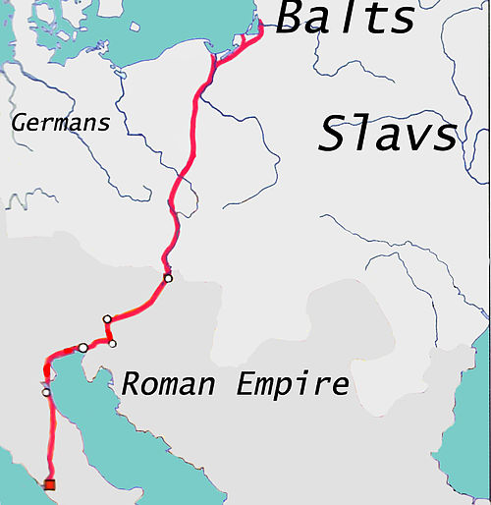
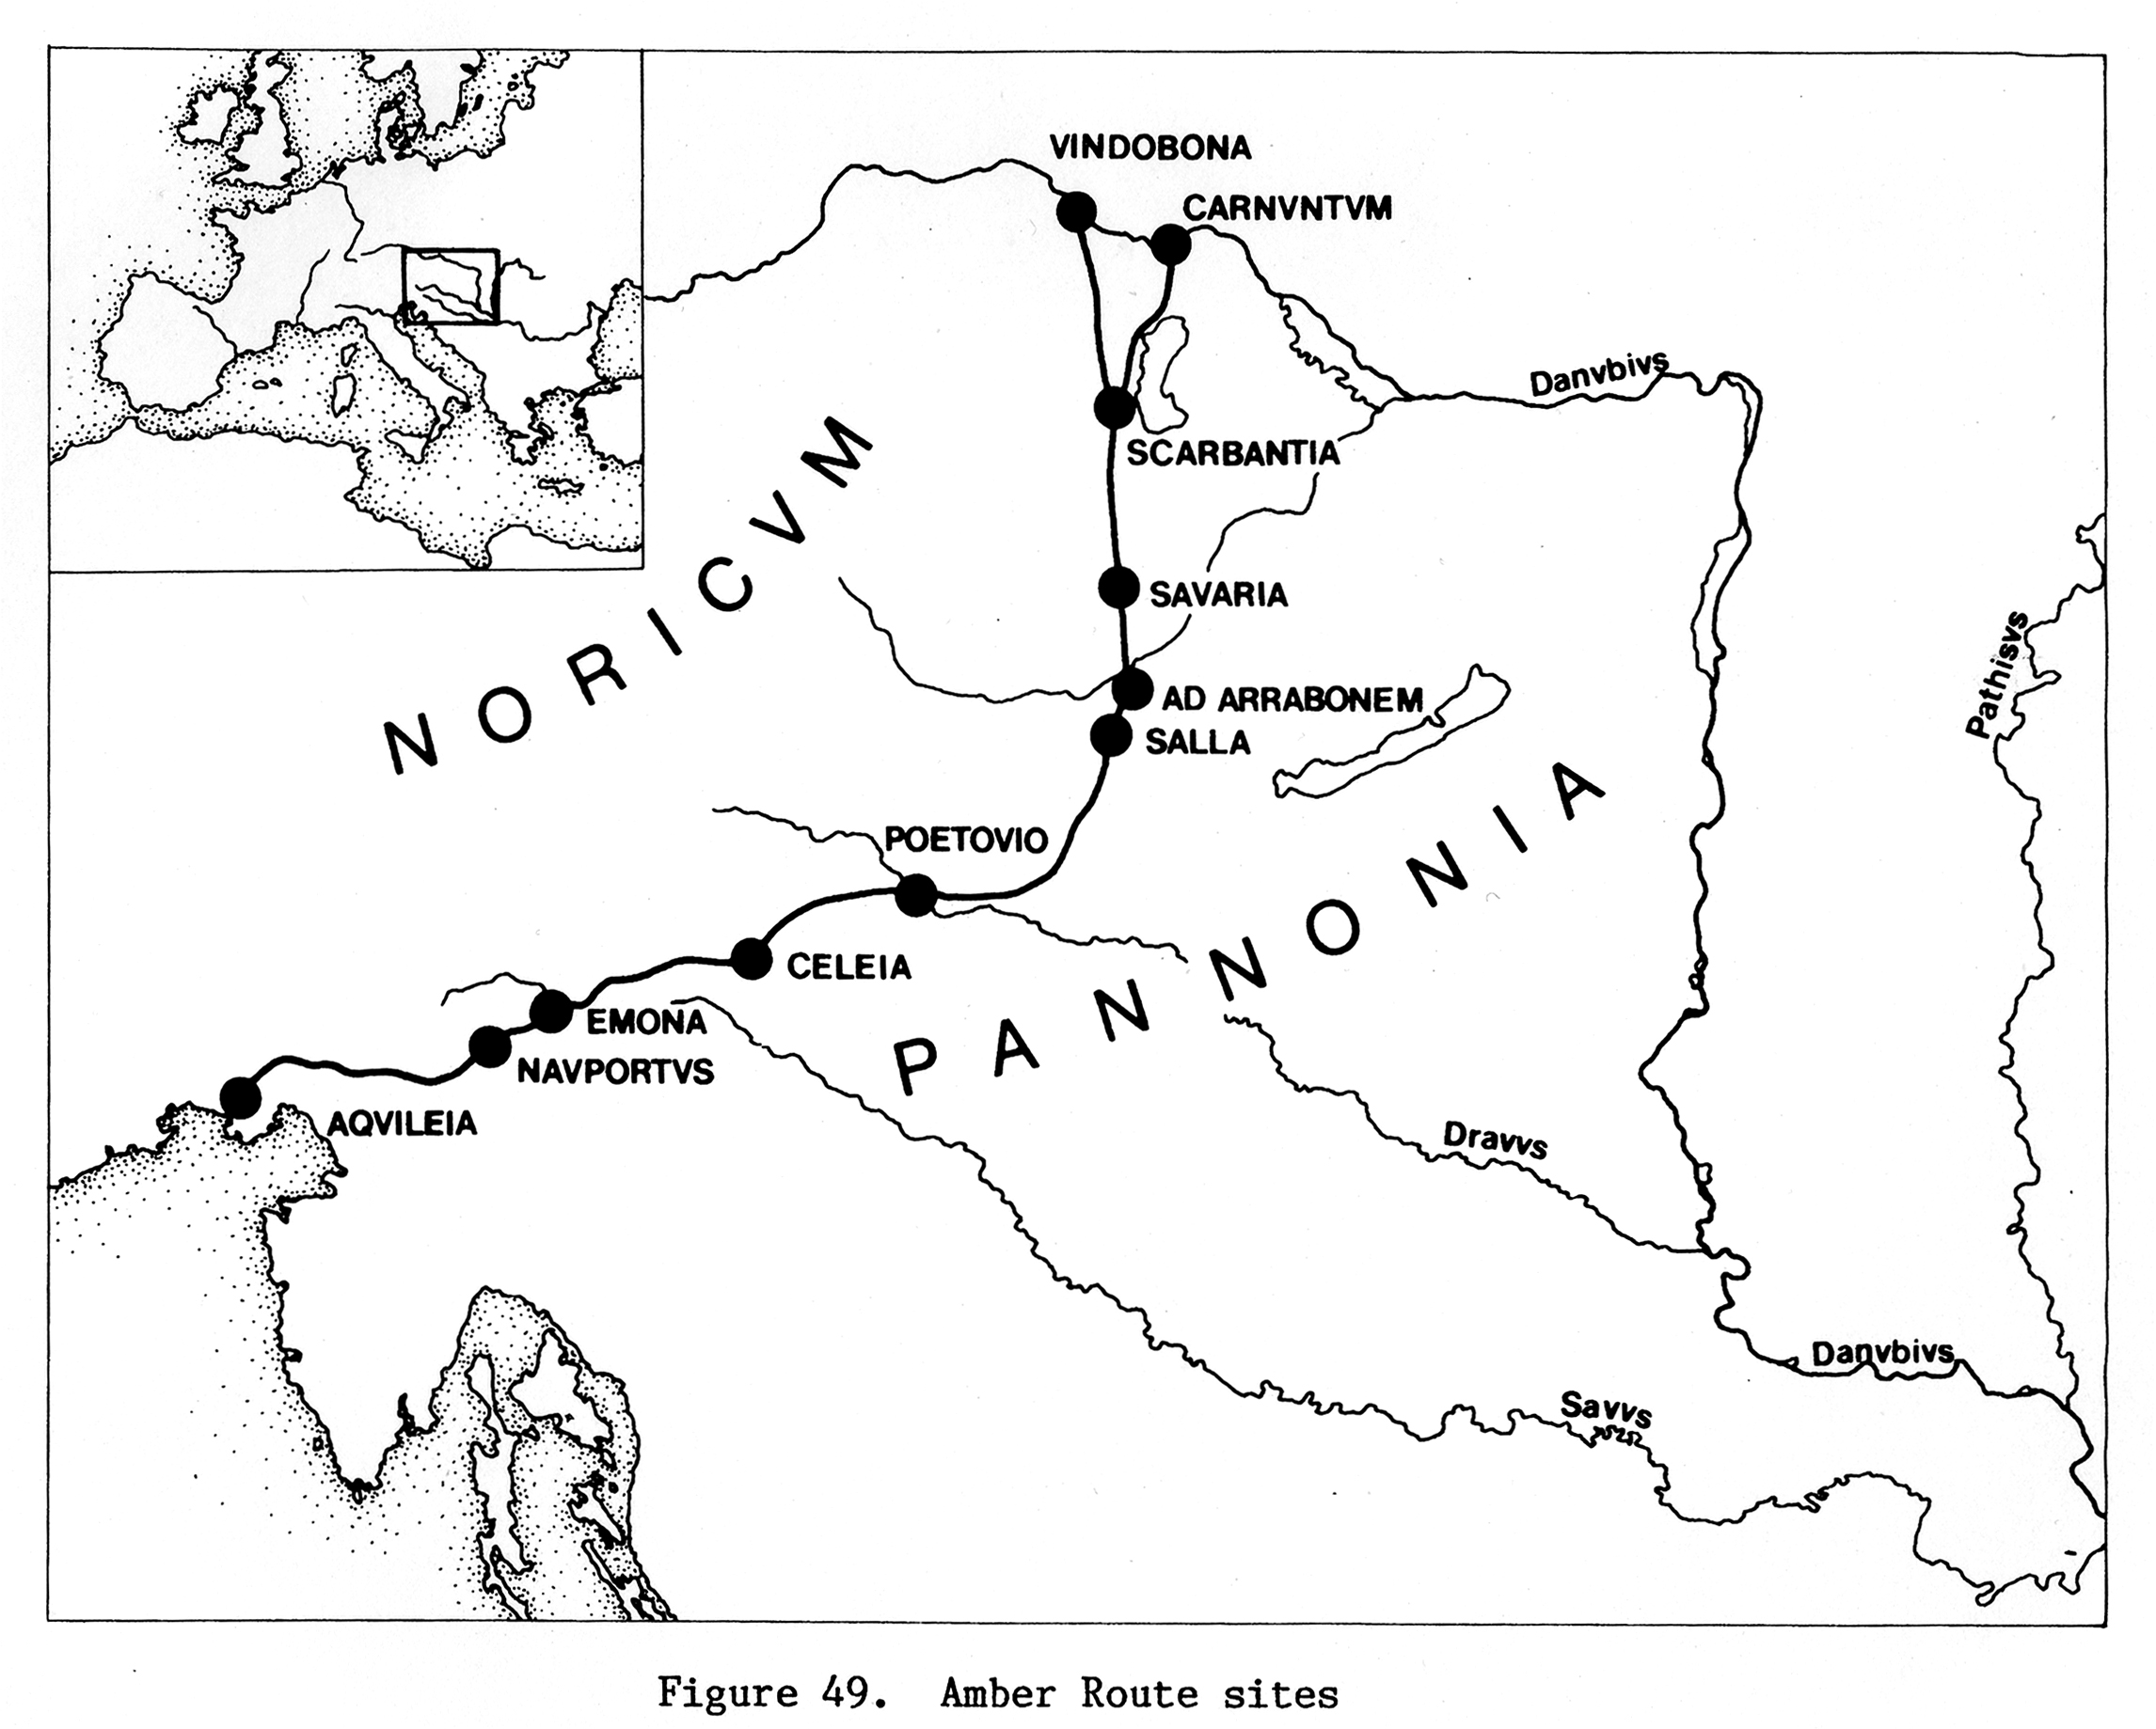
Geography
Continued expansion of knowledge about the world beyond the frontiers of the Mediterranean.
  Also reflected in literary fantasies/works, e.g. Antonius Diogenes’ Incredible Things Beyond Thule; digression in Lucan’s Pharsalia on North African snakes.
“From Carnuntum in Pannonia, to the coasts of Germany from which the amber is brought, is a distance of about six hundred miles, a fact which has been only very recently ascertained; and there is still living a member of the equestrian order, who was sent thither by Julianus, the manager of the gladiatorial exhibitions for the Emperor Nero, to procure a supply of this article.” – Pliny the Elder HN 37.11.45.

Slide 14
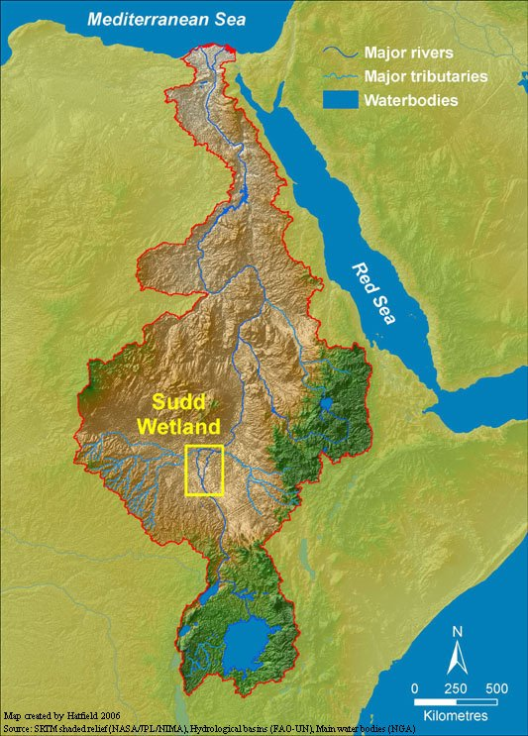
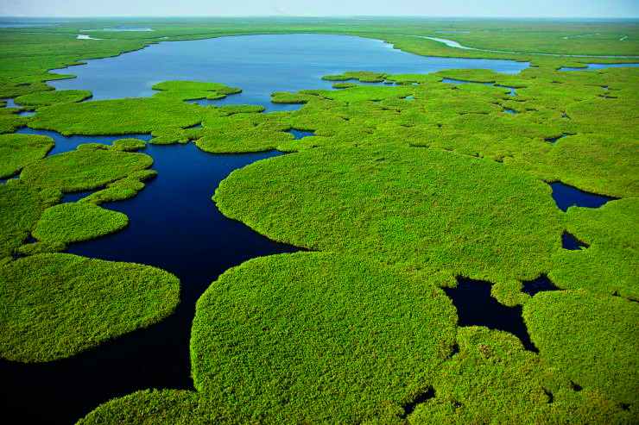
Campaign against the Ethiopians?
“In fact, I have listened to two centurions whom Nero sent to investigate the source of the Nile (just as he is very enthusiastic about the other virtues so he is especially devoted to the truth). They said that when they had been supplied with help by the king of Ethiopia [Meroë] and had been recommended to the neighbouring kings they completed a long journey and penetrated to very distant parts. “After many days,” so they said, “we came to huge swamps [swamp of the Sudd?], the way out of which neither the natives knew nor could anyone hope to know; the vegetation was so entangled in water and the water impassable on foot or by boat, because the muddy overgrown marsh does not support anything except a small boat large enough for only one man. There,” he said, “we saw two rocks from which a great quantity of river-water fell.” – Seneca Natural Questions 6.8.3-4.
“Nero, though angry at him, did not sail against him, nor yet against the Ethiopians or the Caspian Gates, as he had intended. He did, indeed, among other things, send spies to both places, but seeing that the subjugation of these regions demanded time and labour, he hoped that they would submit to him of their own accord.” – Dio Cassius 63.8.1-2.
“These are the names of places given as far as Meroë: but at the present day hardly any of them on either side of the river are in existence; at all events, the praetorian troops that were sent by the Emperor Nero under the command of a tribune, for the purposes of enquiry, when, among his other wars, he was contemplating an expedition against Ethiopia, brought back word that they had met with nothing but deserts on their route.” – Pliny NH 6.35.181

Slide 15
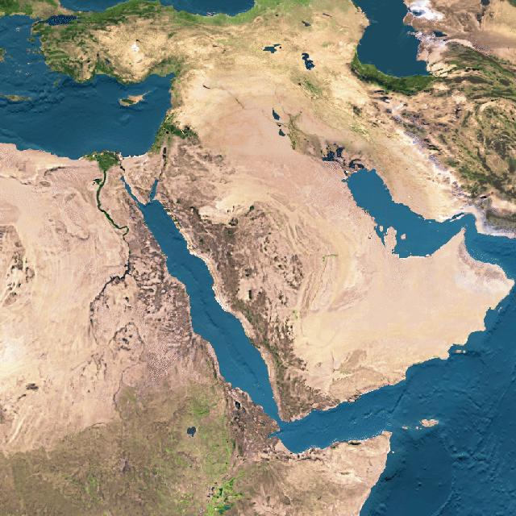
Roman Egypt
Meroë
Saba’
Hadhramaut
Himyar
Axum

Slide 16
Nero as an Author

Slide 17
Nero’s Literary Works (1)
“…Nero turned his hand to poetry and would dash off verses without any effort… but notebooks and loose papers have come into my possession which contain some of Nero‘s best-known poems in his own handwriting…” - Suetonius Nero 52.
“…my verses have formed the subject of many long discussions at your house… If the names of these private individuals are not enough, I may add those of the divine Julius, Augustus and Nerva, and that of Tiberius Caesar. I pass by the name of Nero, though I am aware that a practice does not become any the worse because it is sometimes followed by men of bad character, while a practice usually followed by men of good character retains its honesty.” – Pliny the Younger Epistles 5.3.
Nero is explicitly credited with writing songs and poems, and epics by Suetonius, Martial, Pliny the Younger.

Slide 18
Nero’s Literary Works (2)
Nero wrote an epic called the Troica –
“Hither, hither, ye Pierian Muses, approach in the fleet dance! Here flourishes the wealth of Helicon; here is your own Apollo! You too, O Troy, raise your hallowed ashes to the stars, and display this work to Agamemnon's Mycenae!” – Einsiedeln Eclogues 1.38-41.
“This Paris, according to Nero’s Troica, was the bravest, to the extent of surpassing everyone, even Hector, in the prize competitions at Troy…” – Servius on Aeneid 5.570.
“Nero continued to do many ridiculous things. Thus, on the occasion of a popular festival, he descended to the orchestra of the theatre, where he read some of his own Trojan poems; and in honour of these, numerous sacrifices were offered, as was the case with everything else that he did. He was now making preparations to write an epic narrating all the achievements of the Romans; and even before composing a line of it he began to consider the proper number of books, consulting among others Annaeus Cornutus, who at this time was famed for his learning…” - Dio Cassius 62.29.

Slide 19
Nero’s Literary Talent
“…he affected also a zeal for poetry and gathered a group of associates with some ability for versification but not such as to have yet attracted fame. They, after dining, sat with him, devising a connection for the lines they had brought from home or invented on the spot, and eking out the phrases suggested, for better or worse, by their master; the method being obvious even from the general cast of the poems, which run without energy or inspiration and lack unity of style.” – Tacitus Annals 14.16.
“…It is often claimed that he published other people‘s work as his own, but notebooks and loose papers have come into my possession which contain some of Nero‘s best-known poems in his own handwriting and have clearly neither be copied nor dictated: many erasures and cancellations, as well as words substituted above lines, prove that he was thinking things out for himself. Nero also took more than an average interest in painting and sculpture.” – Suetonius Nero 52.

Slide 20
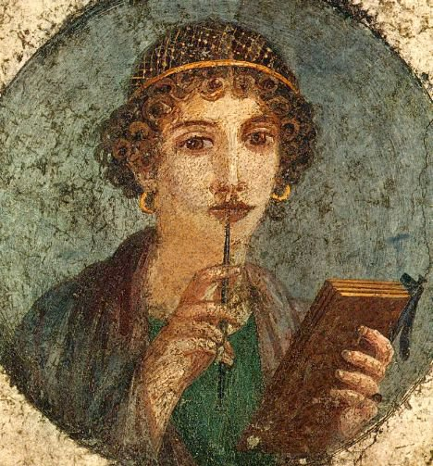
Julio-Claudian Literary Tradition
Julius Caesar (Dictator) – commentaries on his campaigns in Gaul and during the civil war – wrote An Essay on Analogy, a poem The Journey –
  “It is said in his boyhood and early youth he also wrote pieces called In Praise of Hercules and The Tragedy of Oedipus and Collected Sayings…” – Suet. Div Jul. 57.
Augustus – wrote numerous prose works including the Reply to Brutus’ Eulogy of Cato (finished by Tiberius), An Encouragement to the Study of Philosophy; wrote some verse works including a poem on Sicily, a collection of epigrams, and a tragedy titled Ajax but which he destroyed. - Suet. Div Aug. 83.
Claudius – wrote some historical treaties - Dio 60.2.1-2.

Slide 21
Nero as Actor, Singer and Musician

Slide 22
“Music formed part of his childhood curriculum, and he early developed a taste for it… soon after his accession, he summoned Terpinus, the greatest lyre player to sing to him… Then little by little, he began to study and practise himself, and he undertook all the usual exercises for strengthening his voice. He would also lie on his back with a slab of lead on his chest, use enemas and emetics to keep down his weight, and refrain from eating apples and every other food considered deleterious to the vocal cords. Finally encouraged by his progress, although his voice was weak and husky, he began to long to appear on the stage…” – Suetonius Nero 20.1.
“…he had, according to report, but a weak and indistinct voice, so that he moved his whole audience to laughter and tears at once. Beside him stood Burrus and Seneca, like teachers, prompting him; and they would wave their arms and togas at every utterance of his and lead others to do the same. Indeed, Nero had got ready a special corps of about five thousand soldiers, called Augustani; these would lead the applause, and all the rest, however loath, were obliged to shout with them. Thrasea was the single exception, since he would never help Nero in these matters; but all the rest, and especially the prominent men, assembled with alacrity, grieved though they were, and joined in all the shouts of the Augustani, as if they were delighted.” – Dio Cassius 61.20.2-4.

Slide 23
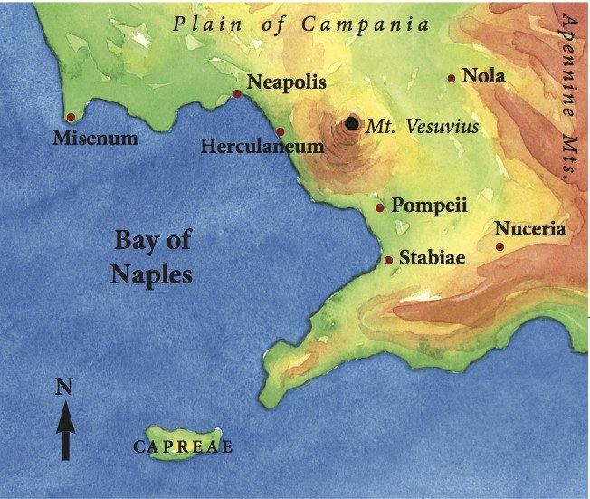
Nero’s Musical Debut (AD 64)
“His first stage appearance was at Neapolis [Naples]… He often performed at Neapolis, for several consecutive days too, and even while giving his voice a brief rest he could not stay away from the theatre, but went to dine in the orchestra, where he promised the crowd in Greek that, when he had downed a drink or two, he would give them something to make their ears ring” – Suetonius Nero 20.
“In the consulate of Gaius Laecanius and Marcus Licinius, a desire that grew every day sharper impelled Nero to appear regularly on the public stage — hitherto he had sung in his palace or his gardens at the Juvenile Games, which now he began to scorn as thinly attended functions, too circumscribed for so ample a voice. Not daring, however, to take the first step at Rome, he fixed upon Naples as a Greek city…” – Tacitus Annals 15.33.

Slide 24
Second Neronia – AD 65
“…the crowd clamoured to hear his heavenly voice… the guards on duty seconded the appeal; he delightedly agreed to oblige them. He wasted no time in getting his name entered on the list of competing lyre players, and dropped his ticket into the urn with the others. Praetorian prefects carried his lyre as he went up to play… he announced through Cluvius Rufus, a man of consular rank, that he was going to sing Niobe, which he did until almost the tenth hour.” – Suetonius Nero 21.1-3.
“…One of the soldiers, to be sure, on seeing him in chains, grew indignant, ran up, and set him free. Another in reply to a question, "What is the emperor doing?" replied, "He is in labour"; for Nero was then acting the part of Canace. Not one of them conducted himself in a way at all worthy of a Roman. Instead, because so much money fell to their share, they offered prayers that he might give many such performances, so that they might receive still more.” – Dio Cassius 63.10.2.

Slide 25

“…his favourite roles being those of Oedipus, Thyestes, Heracles, Alcmeon and Orestes. The masks that he wore were sometimes made to resemble the characters he was portraying and sometimes bore his own likeness; but the women's masks were all fashioned after the features of Sabina, in order that, though dead, she might still take part in the spectacle…” – Dio Cassius 63.9.5.

Slide 26
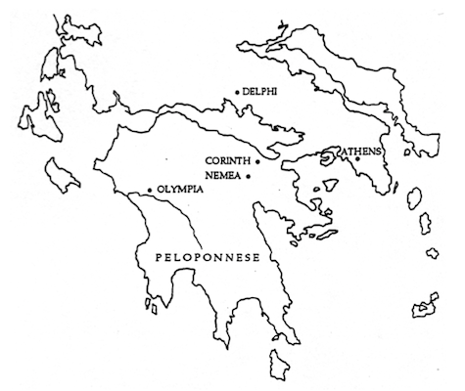
Nero in Greece

Slide 27
Pan-Hellenic Games
“…he headed for Achaia [Greece], as I mentioned above. His main reason was that the cities which regularly sponsored musical contests had adopted the practice of sending him every available prize for lyre playing; he always accepted these with great pleasure, giving delegates the earliest audience of the day and invitations to private dinners. They would beg Nero to sing when the meal was over… [he announced that] ‘The Greeks alone are worthy of my genius, they really listen to music.’ So he sailed off hastily...” – Suet. Nero 22.3.
Nero rearranges the schedule for some of the games so that they can all be held within one year:
  Olympian, Pythian, Isthmian, Actian (at Nikopolis in Epiris) games.
He breaks the convention at Olympia by introducing a musical competition to the athletics competitions.
Dates for Pan-Hellenic games
  Olympian – Last occasion, July-Sept. 65 – Next occasion 69
  Pythian – Last occasion, end Aug. 63 - Next occasion 67
  Nemean – Last occasion, July 66 - Next occasion 68
  Isthmian – Last occasion, April-May 65 - Next occasion 67

Slide 28
The Freedom of the Greeks
“On the eve of his departure, he presented the whole province with its freedom and conferred Roman citizenship as well as large cash rewards on the judges. It was during the Isthmian Games at Corinth that he stood in the middle of the stadium and personally announced these benefits.” – Suetonius Nero 20.1.
Record of his speech set up in Acraephia, dates 28th of November (year not specified, AD 66 0r 67 ?) – ILS 8794.

Slide 29
Olympic Triumph
“For his processional entry into Rome he chose the chariot race which Augustus had used in his triumph nearly a hundred years previously, and wore a Greek mantle spangled with gold stars over a purple robe. The Olympian wreath was on his head, the Pythian wreath in his right hand, and others were carried before him, with placards explaining where and against whom he had won them, what songs he had sung, and in what plays he had acted. Nero‘s chariot was followed by his regular claque, who shouted that they were Augustiani and the soldiers of his triumph.” – Suetonius Nero 25.

Slide 30
Nero as a Charioteer

Slide 31
“Horses had been Nero‘s main interest since childhood; whatever his tutors might do, they could never stop his chatter about the chariot races at the Circus… Very soon Nero set his heart on driving a chariot himself in a regular race, and after a preliminary trial in the palace gardens before an audience of slaves and common people he made a public appearance at the Circus Maximus...” – Suetonius Nero 22.
“In the consulship of Gaius Telesinus and Suetonius Paulinus [AD 66]… [an event of] disgrace took place. For one thing, Nero contended among the lyre-players, and after Menecrates, the teacher of this art, had celebrated a triumph for him in the Circus, he appeared as a charioteer…” - Dio Cassius 63.1.1.

Slide 32
“On several occasions at Olympia he drove a ten-horse chariot, a novelty for which he had censured King Mithridates in one of his own poems. He lost his balance and had to be helped in again; but though he failed to stay the course and retired before the finish, the judges nevertheless awarded him the prize.” - Suetonius Nero 24.
“When he had finished these ceremonies, he announced a series of horse-races, and carrying into the Circus these crowns as well as all the others that he had secured by his victories in chariot-racing, he placed them around the Egyptian obelisk. The number of them was one thousand eight hundred and eight. And after doing this he appeared as a charioteer…” Dio Cassius 63.21.1.

Slide 33
Reaction

Slide 34
Senators and Equestrians in the Arena
Suetonius claims Nero compelled 400 senators and 600 Roman knights to fight in the arena (not to the death) and acts as beast hunters (Nero 12).
Earlier parallels:
  “At the gladiatorial contest in the Forum, a man named Furius Leptinus, of praetorian family, fought Quintus Calpenus, an advocate and a former senator… In the theatrical performances, Decimus Laberius, a Roman eques, acted in his own play; but afterwards, having been given 500,000 sesterces and a gold ring… The racecourse at the Circus was extended at either end… the contestants were young noblemen who drove four-horse and two-horse chariots or rode on pairs of horses, jumping from back to back.” – Suet. Div. Jul. 39.
  “Chariot races and foot races and wild beast hunts took place in the Circus, and among the participants were several youths of distinguished family… Even Roman equites sometimes took part in stage plays and gladiatorial shows, until a senatorial decree put an end to this practice. After this no person of good family appeared in any show [except a dwarf named Lycius]…” – Suet. Div. Aug. 43.

Slide 35
Hostile Sources
Nero’s plays and poetry so bad that spectators would fain death to be allowed to leave – Dio 63.15.
People flattered Nero’s performances for rewards – Dio 63.10.3.
Sinister guards watching the reaction of audience and spies to report whose not there – Tac. Ann. 16.5.
“In the meantime, with the Quinquennial Contest hard at hand, the senate attempted to avert a scandal by offering the emperor the victory in song, adding a "crown of eloquence," to cover the stigma inseparable from the stage.” – Tac. Ann. 16.4.

Slide 36
Cultural Attitudes
Physical and intellectual pursuits as acceptable training for public life?
Acceptable for private relaxation?
Many musicians and actors slaves or of low status:
  “Through the whole of Greece it was accounted a great glory to be proclaimed a conqueror at Olympia; while to appear upon the stage, and become a spectacle to the public, was a dishonour to no one in that nation; but all these practices are, with us, deemed partly infamous, partly low-brow, and at odds with respectability.” – Cornelius Nepos Lives of Eminent commanders Preface.

Slide 37
Popular Reaction
“And the city rabble, at least, accustomed to encourage the posturing even of the ordinary actor, thundered approval in measured cadences and regulated plaudits. You might have supposed them to be rejoicing; and possibly rejoicing they were, without a care for the national dishonour!” – Tacitus Annals 16.4.
“But the spectators from remote country towns in the still austere Italy tenacious of its ancient ways — those novices in wantonness from far-off provinces, who had come on a public mission or upon private business — were neither able to tolerate the spectacle nor competent to their degrading task.” – (6.5.)

Slide 38
Modern Interpretations
Nero artistic activities and chariot-racing, in part, designed to win popular support at Rome, at expense of alienating senate. Generally successful, but undone by Nero‘s failure to maintain support of army commanders - (Manning).
Associates Nero‘s wearing of life-like masks, rather than conventional theatrical mask, with the death-mask tradition - (Slater).
Nero contrives to dramatise his crimes, tragic framework for acts of his principate - (Frazer. Jr.)

Slide 39
Bibliography
Frazer. Jr, R. M. 1966: ‘Nero the Artist-Criminal’, The Classical Journal 63 (1): 17-20.
Manning, C. E. 1975: ‘Acting and Nero’s Conception of the Principate’, Greece & Rome 22 (2): 164-175.
Slater, N. W. 1996: ‘Nero‘s Masks’, The Classical World 90 (1): 33-40.

