Slide 1
WEEK 10/6
Day Two, Session One
Unit 10
More about Discussions
Listening Practice

Slide 2
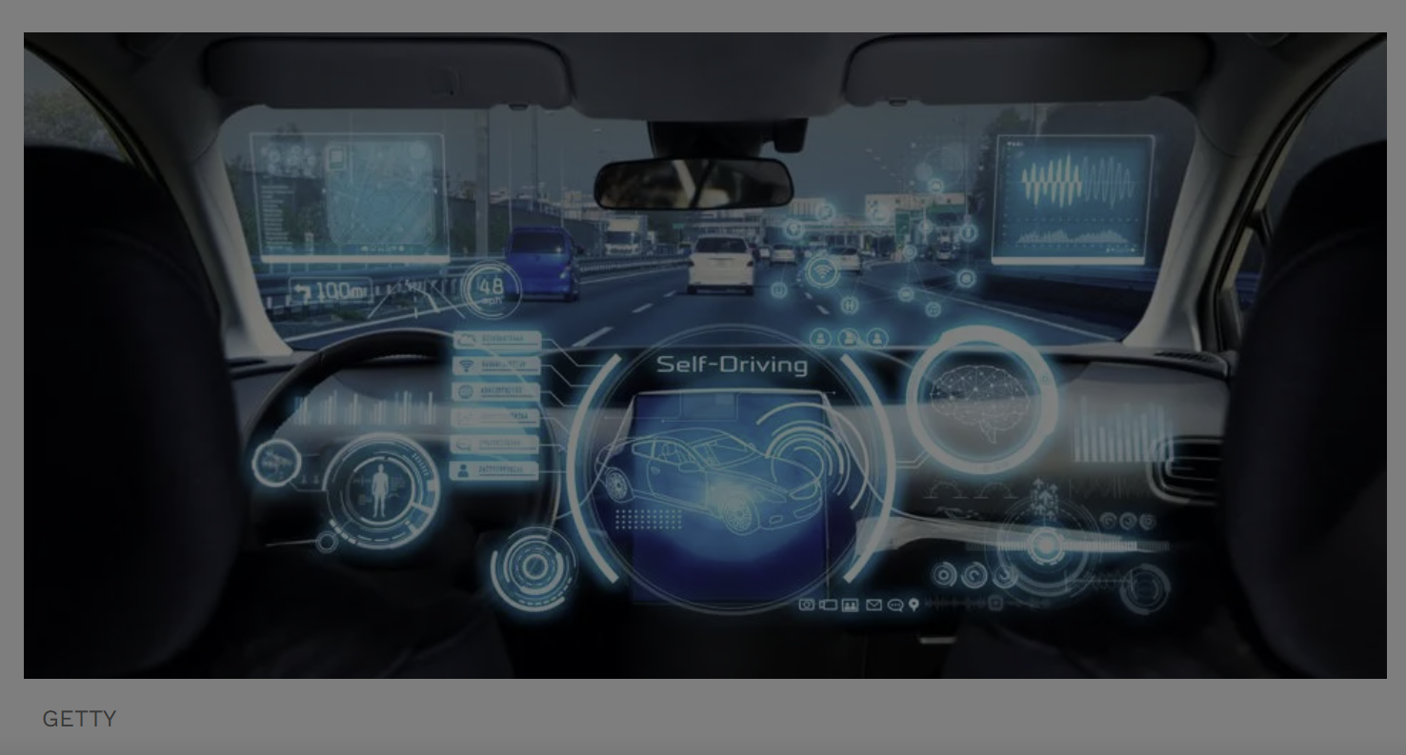
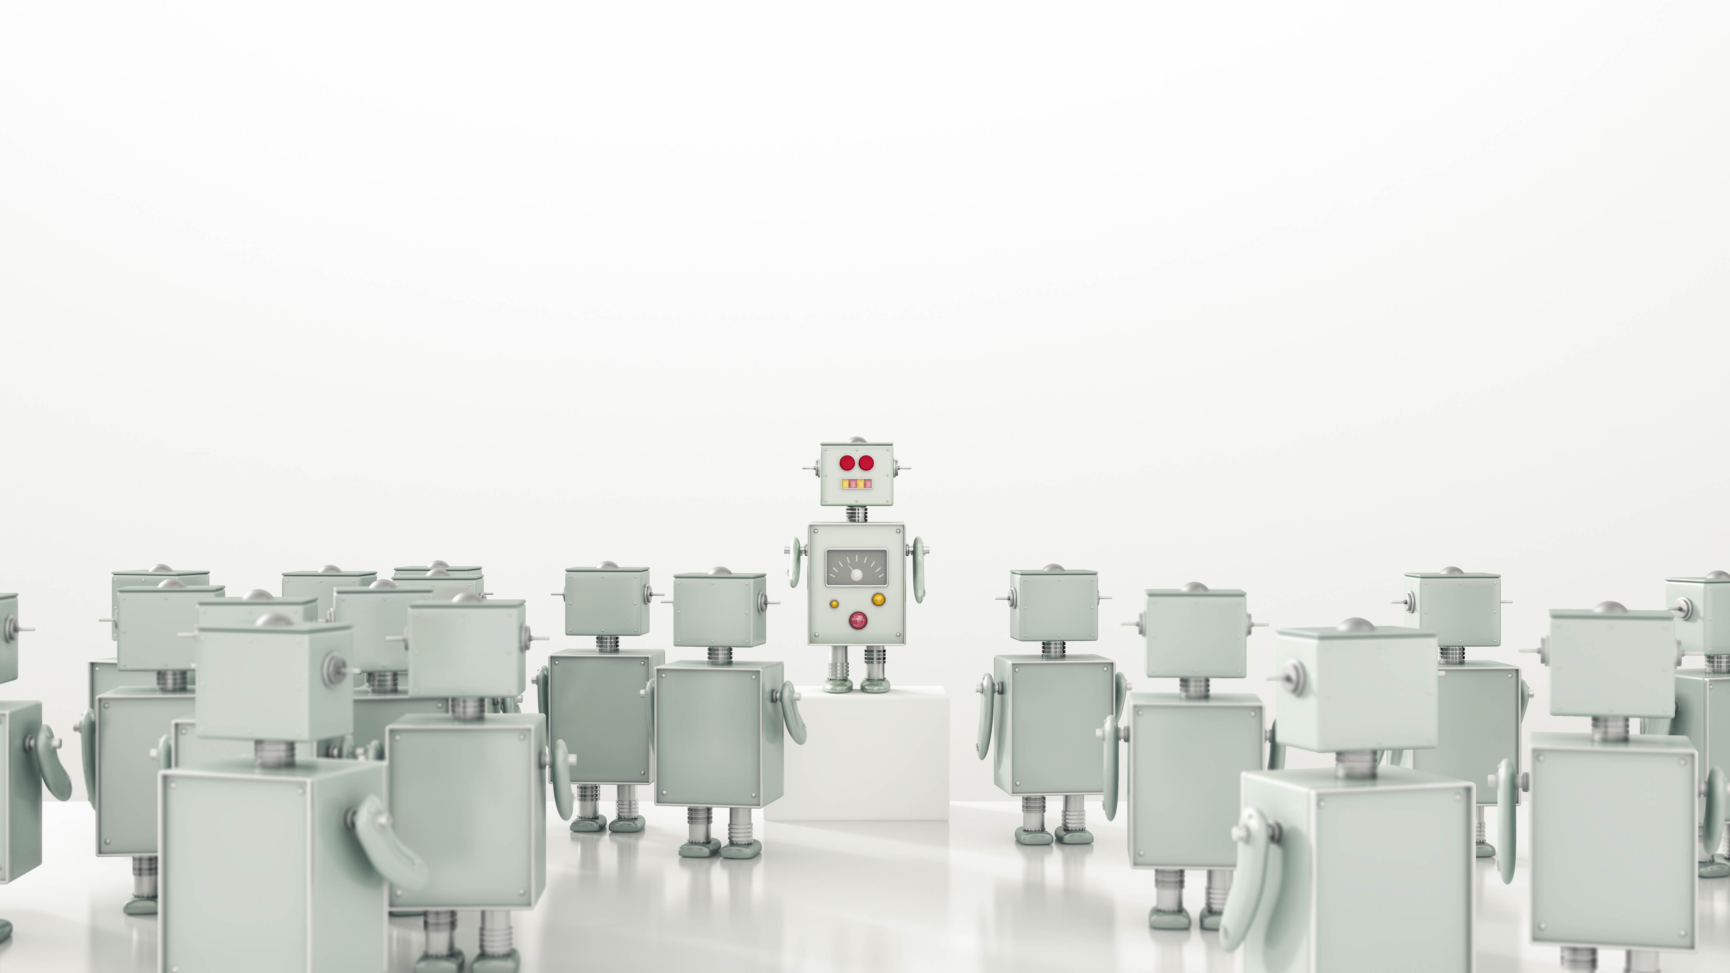

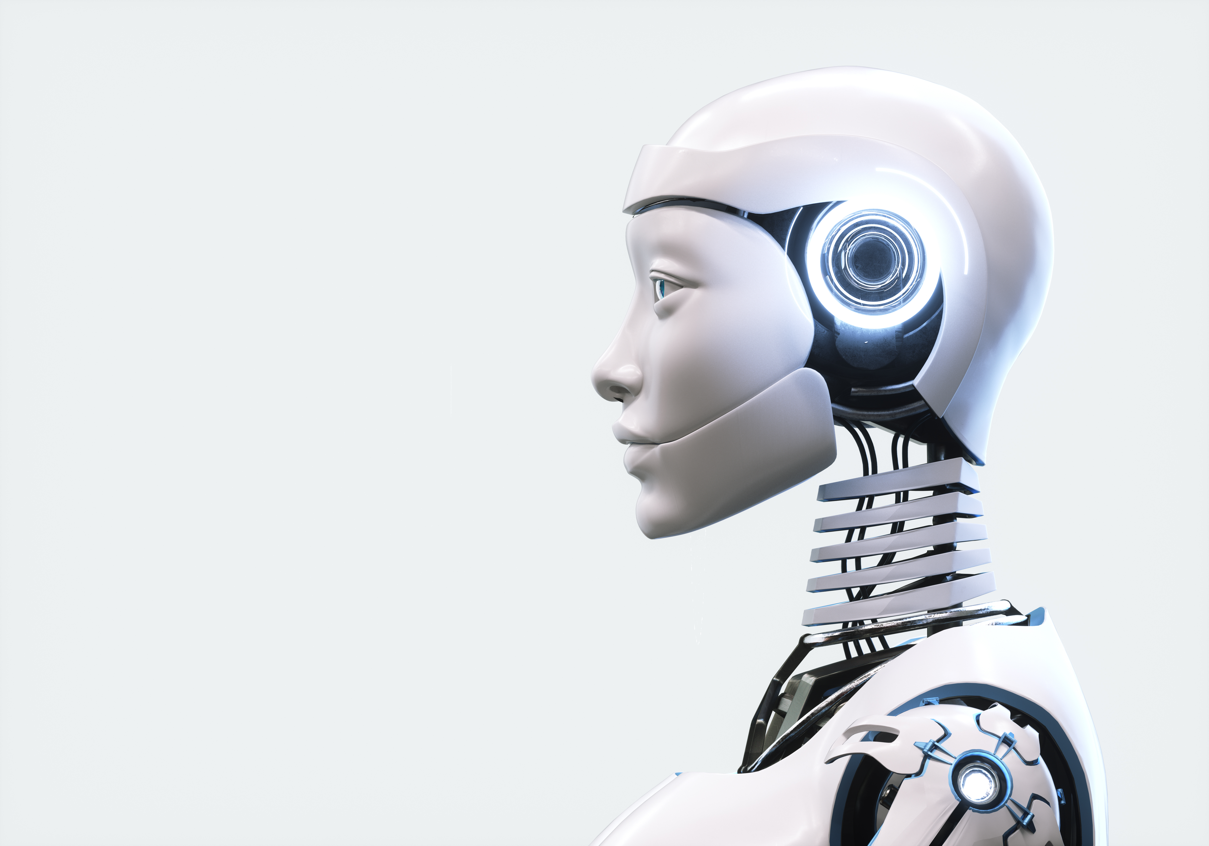
What’s the Best New Technology?
Driverless cars
Robotics
Big Data
AI

Slide 3
Drone-free Skies
How safe are drones?

Slide 4
Drone-free Skies
How safe are drones?
L&S e-book page 173

Slide 5
Bias
Giving your opinion – and not discussing in a balanced way
Selecting facts from only 1 side
Labelling things positively or negatively
Exaggerating – making something seem better or worse than it really is
Emphasising – using words like ‘absolutely’ or ‘extremely’
Repeating the same words or ideas so that the listener notices and remembers.

Slide 6
Notetaking Practice
L&S book page 174
How is bias being used?
Which groups of people might use bias?
How can we get a more balanced opinion?

Slide 7
Word Families
https://wordwall.net/play/35134/869/464

Slide 8
Stance and Perspective
R&W book page 185
Exercises 1 & 2
Now qualify each statement to make it true for you.

Slide 9

Take a lunch break

Slide 10
WEEK 10/6
Day Two
Session Two
Talking about the Future
Future Perfect
Practising Discussions

Slide 11
Expressing Perspective and Stance
The Benefits and Risks of New Technology.
Rank the ideas:
The most important first, in your view.
https://wordwall.net/play/77714/827/242

Slide 12
Find 3 verb tenses
R&W e-book page 183
Read the model opinion essay.
Underline all the verb tenses.
What can you infer from the text? What kinds of verb tense are most useful for an essay that discusses situations that refer to future changes?

Slide 13
The future perfect
By the year 2050, AI will have taken over many mundane jobs.
*mundane = boring and repetitive.
Will have taken
Will + have + third form of the verb
Take – took - taken

Slide 14
The future perfect
By the year 2050, AI will have taken over many mundane jobs.
Does AI do many mundane jobs now?
Will AI do many mundane jobs in the future?
If so, use the future perfect tense.

Slide 15
What might have changed by 2050?
What are your predictions?
Use will/might/could + have + the third form of the verb
R&W e-book page 184 – for more examples.

Slide 16
Practise Future Perfect
R&W e-book page 184
Exercise 1 & 2
Discuss the predictions

Slide 17
Discuss
There are more challenges and risks than benefits
to new technology

Slide 18
Self-Study
Vocabulary:
R&W book page 180 – Science Words.
Reading:
R&W book pages 176-179. New Technology
1-minute Video:
- Do any last-minute edits
Prepare a 1-minute introduction
Deadline for submission to the competition – Thursday 19th September at 12noon EDT (17:00/ 5pm UK time)
https://www.iemmys.tv/international-emmy-awards/other-awards/jcs-international-young-creatives-award/?utm_source=Linked+in&utm_medium=organic&utm_campaign=JCS_getready_2024&utm_id=JCS+Get+Ready

Slide 19
Self-Study
L&S workbook – Grammar: Future Perfect Progressive
R&W workbook – Grammar: Future Perfect Simple.
Portfolio
Each folder, and each file within a folder should be labelled:
Your Name/ Group [10PSE/6PSE], and the skill/task.
If you are missing any writing scores, you may use the score you get for today’s essay.

