Slide 1
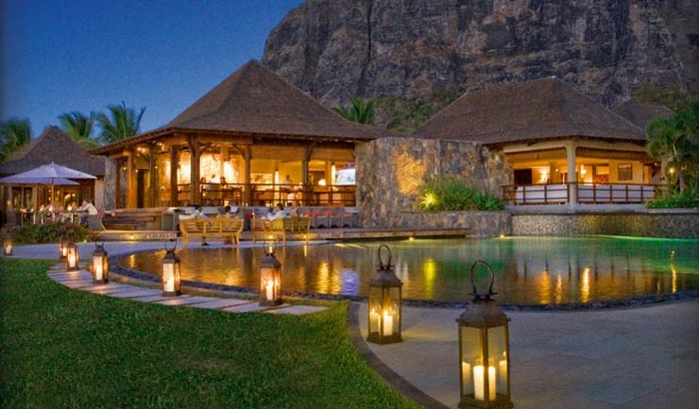
Title: Improving guest service at the main bar of Lux* Le Morne
Presented by: Yogeshsing Seegobin
Date: 11 April 2019
Notes:
Good morning ladies and gentlemen. I am Jimmy, assistant bar manager at Lux Le Morne and my study is about Improving guest service at the main bar of Lux Le Morne. Today, I will provide you an overview of my project.

Slide 2
Contents
BACKGROUND,JUSTIFICATION, AIM AND OBJECTIVES
METHODOLOGY
FINDINGS
CONCLUSION AND RECOMMENDATIONS
PERSONAL OUTCOME/ EXPERIENCE
Notes:
The presentation is going to cover the following topics. We are going to have a look at the Background, Justification, Aim and Objectives, following which we will go through the methodology. We shall then have a look at the findings, the conclusion and recommendations and lastly my personal outcome/ experience.

Slide 3
Background, Aim, Justification & Objectives
Background & Justification
Over the past years, there has been complaints regarding bar service at Lux Le Morne
Change in trends with time
Aims and Objectives
Guest satisfaction and expectation in line with new trends
Avoid guest complaints by finding the root of the problem
Provide a guest exceptional service by understanding their needs and demands
To understand team members’ expectations and find ways of improvement
Notes:
Starting with the Background and Justification, in fact over the past years it has been noted that there was a rise in complaints at the bar. Also, there are evolving trends in the bar industry and it is necessary for us to keep up to the pace of these changing trends. Hence, the aims and objectives of this study is to understand guest satisfaction and expectation in line with new trends (i.e. new gin bar and rum bar), to avoid guest complaints by finding the root of the problem, provide a guest exceptional service by understanding their needs and demands and lastly to understand my team members’ expectations and consequently find ways of improvement

Slide 4
Methods
Guest Survey
Qualitative information was collected to understand guests’ expectation on bar service via a questionnaire
Survey questionnaire was divided into 9 questions
70 respondents out of 100 respondents targeted did guest survey
Team Members Interview
Team members were interviewed to know their adaptation on new trends in service and expectations at the resort.
All interview was /shall remain private and anonymous.
Team members were interviewed; 40 respondents out of 103 team members
Question based on improvement on bar service and improvement of team members.
Notes:
The methodology adopted comprised a guest survey and team members interview.
Guest survey
Qualitative information was collected to understand guests’ expectation on bar service via a questionnaire divided into 9 questions. 70 respondents out of 100 respondents targeted did guest survey
Team members interview
Team members were interviewed to know their adaptation on new trends in service and expectations at the resort.
All interview was /shall remain private and anonymous. 40 out of 103 team members targeted participated in the interview. The questions were primarily based on ways to improve bar service and team members’ experience/ skills.

Slide 5
Findings
33% of guests said that there is a need for more team members in terms of service at beach where we have two pool bars
17% of guests believe there is a need for more well trained team members, in terms of product knowledge and guest expectations and who have excellent communication skills.
21% of guests felt that more music is required at the bar at aperitif time for sundowner.
Notes:
Guest feeling about what we need to bring to improve. This findings is based on question 3
33% of guests said that there is a need for more team members in terms of service at beach where we have two pool bars
17% of guests believe there is a need for more well trained team members, in terms of product knowledge and guest expectations and who have excellent communication skills.
21% of guests felt that more music is required at the bar at aperitif time for sundowner.

Slide 6
Findings (cont’d)
64% did like the bar service (nice presentation of menu, good knowledge, attention to details.
18% responded negatively; lack of attention, drinks took more time than expected, guests did not feel welcome while entering the bar.
18% did not answer as it was their first visit to the resort.
Notes:
The findings come the survey form of the guest needs and satisfaction section where guest gave their expectations.
64% did like the bar service (nice presentation of menu, good knowledge, attention to details.
18% responded negatively; lack of attention, drinks took more time than expected, guests did not feel welcome while entering the bar.
18% did not answer as it was their first visit to the resort.

Slide 7
Findings (cont’d)
51% of team members answered that the resort needs to have more staff.
26% of team members believe training should be to given to make continuous improvement
23% of team members answered we need to make changes by taking more well trained team members.
Notes:
This slide summarises the findings from 40 team members interviewed about improvement
51% of team members answered that the resort needs to have more staff.
26% of team members believe training should be to given to make continuous improvement
23% of team members answered we need to make changes by taking more well trained team members.

Slide 8
Conclusion & recommendations
Conclusion
In order to ensure that guests are satisfied, it’s vital to look for guest satisfaction and guest service on bar. To conclude, it is therefore important to be aligned with the trends and guest expectations such as more music, more staff and more staff training
Recommendations
To recruit more staff in the future and especially to recruit trained and skilled staff (with experience in the field)
To train the current staff on a regular basis; training should be an ongoing process since there is always new trends and new products
To include additional drinks on the bar menu and review the drinks offered yearly so as to ensure we match the current demands of guests

Slide 9
Personal and professional outcome
As a researcher, this study has been fruitful for my career growth.
I have been able to develop my skills with the use of IT tools
I have been able to improve my personal knowledge and bring my team together on improvement
Notes:
Improvement in skills is by tracking good guest service by our representatives.

Slide 10

Notes:
Thank you for your attention is there any question for me.

