Slide 1
LCBB4011 – Community Engagement
Creative problem solving in community enagagement

Slide 2

So far, we have looked at:
Tools used for community engagement
Planning and Designing community engagement,
The barriers and challenges of effective community planning and design.
Standards to consider in community projects
Importance of communication
Models of community engagement

Slide 3

At the end of the session, you will understand:
Problem laden nature of community work
Various problem-solving techniques that can be used in community development
Importance of decision-making styles/techniques

Slide 4
Problem-laden nature of community engagement work

Slide 5
Community Engagement – problems and barriers
Whilst important community engagement is important does not happen easily. It's common to see below issues in many community projects:
Lack of sustained interest: Community engagement projects often face challenges in maintaining long-term interest and participation from community members, leading to difficulty in achieving project goals.
Limited resources: Many community engagement projects struggle with limited funding and resources, hindering their ability to effectively implement initiatives and address community needs.

Slide 6
Community Engagement – problems and barriers
Communication barriers: Language barriers, cultural differences, and inadequate communication channels can impede effective engagement with diverse community groups, leading to misunderstandings and lack of trust.
Resistance to change: Some community members may resist proposed changes or initiatives due to fear of the unknown, entrenched beliefs, or vested interests, posing challenges to project implementation and success.
Evaluation and accountability: Measuring the impact and effectiveness of community engagement projects can be challenging, and lack of clear metrics or accountability mechanisms may hinder efforts to assess progress and justify resource allocation.

Slide 7
Community Engagement – problems and barriers (cont)
Power dynamics: Unequal power dynamics within communities or between community members and project organizers can hinder meaningful participation and decision-making, leading to feelings of marginalization and disempowerment.
Stakeholder conflicts: Conflicting interests among different stakeholders, such as community members, government agencies, and private organizations, can create tensions and obstacles to collaboration, jeopardizing project effectiveness.
Sustainability concerns: Without proper planning and support, community engagement projects may struggle to maintain momentum beyond initial phases, raising concerns about the long-term sustainability of project outcomes

Slide 8
How can we solve these problems?

Slide 9
Four key ‘methods’ to help you approach problem solving / solution finding!
Lateral thinking
Storyboard exercise
Mind mapping technique
Plus–Minus–Interesting (PMI) technique
(Doyle, 2017)

Slide 10
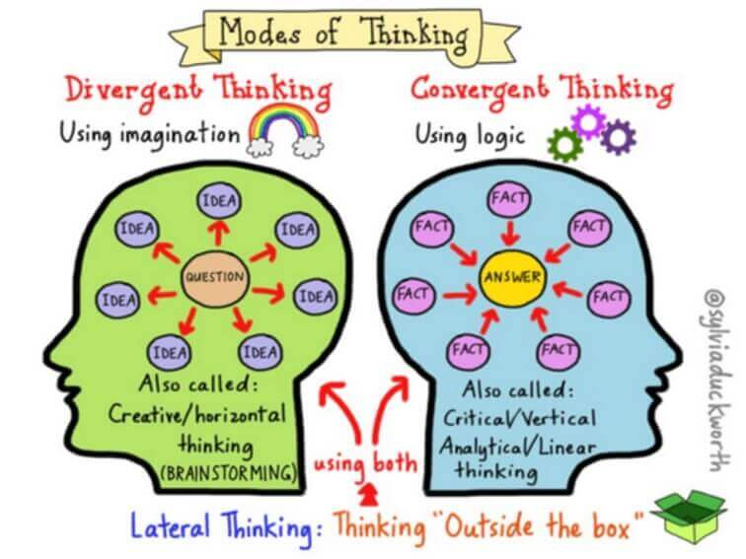
Technique 1: Lateral thinking

Slide 11
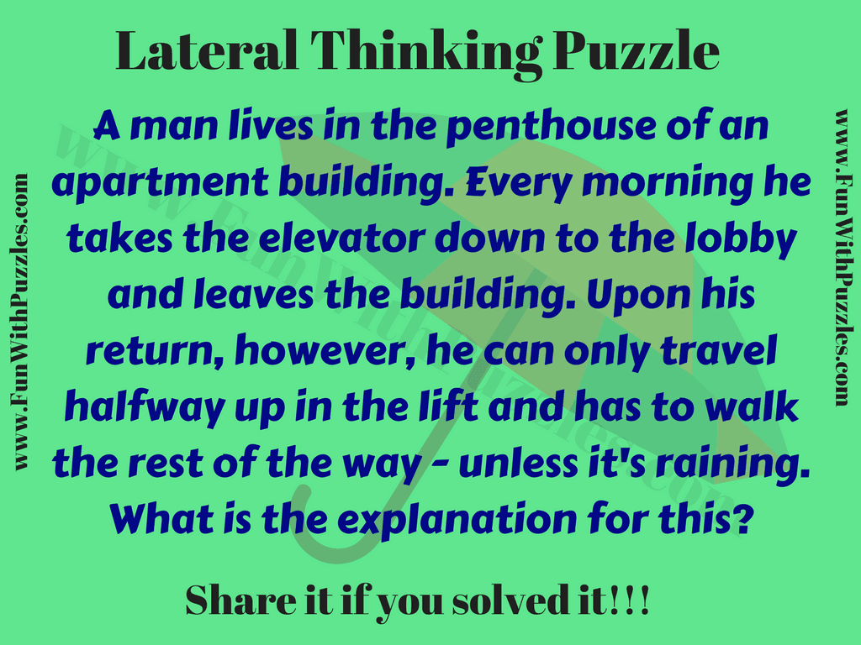

Slide 12
One of the possible answers is that the man is short, and he cannot press the higher-level floor buttons in the elevator. However, when it's raining, he always carries an umbrella and uses it to press the higher-level floors.

Slide 13
Nurturing lateral thinking in community projects
Foster a culture of openness and curiosity, encouraging individuals to explore unconventional ideas and perspectives.
Provide diverse stimuli and experiences to inspire creative thinking and challenge conventional assumptions.
Encourage brainstorming sessions where all ideas are welcomed without judgment, promoting a free flow of creative thought.
Emphasize the value of experimentation and risk-taking, encouraging individuals to explore new avenues and embrace failure as part of the learning process.
Facilitate interdisciplinary collaboration and exchange of ideas to stimulate cross-pollination of thoughts and perspectives.

Slide 14
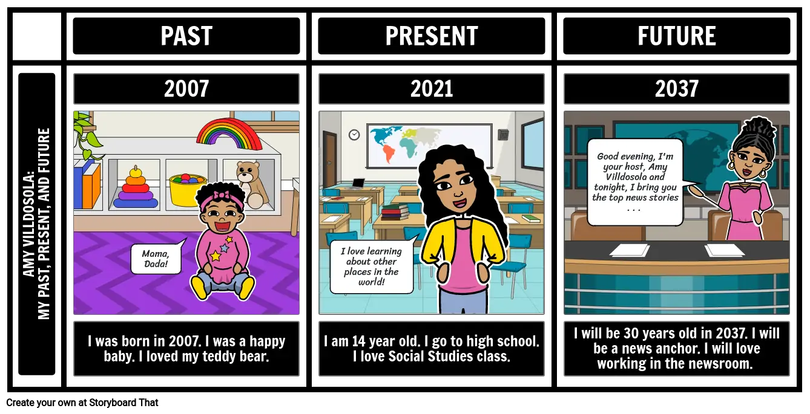
Technique 2: Storyboard exercise

Slide 15
Create a timeline for the problem you face (from/causes + now/ main issue + future success looks like

Slide 16
Using visual representations to aid memory and allow greater degree of linking complex things together

Slide 17
Using storyboard exercises in community work
Outline key project objectives and target audience.
Sketch visual representations of project milestones and key interactions.
Arrange storyboard frames in a logical sequence to depict the flow of the project.
Incorporate annotations or notes to provide context and detail for each frame.
Review and iterate on the storyboard with stakeholders to ensure alignment with project goals and vision.

Slide 18
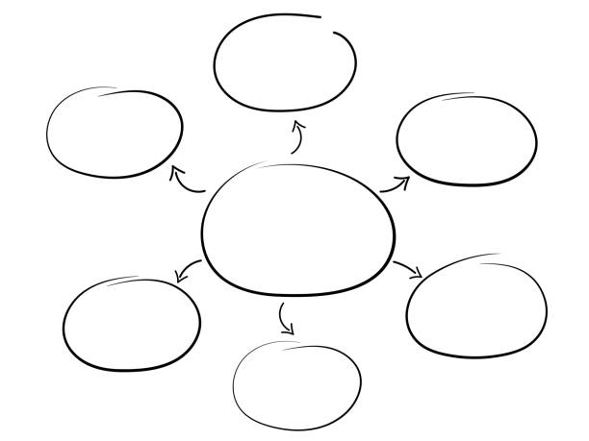
Technique 3: Mind mapping

Slide 19
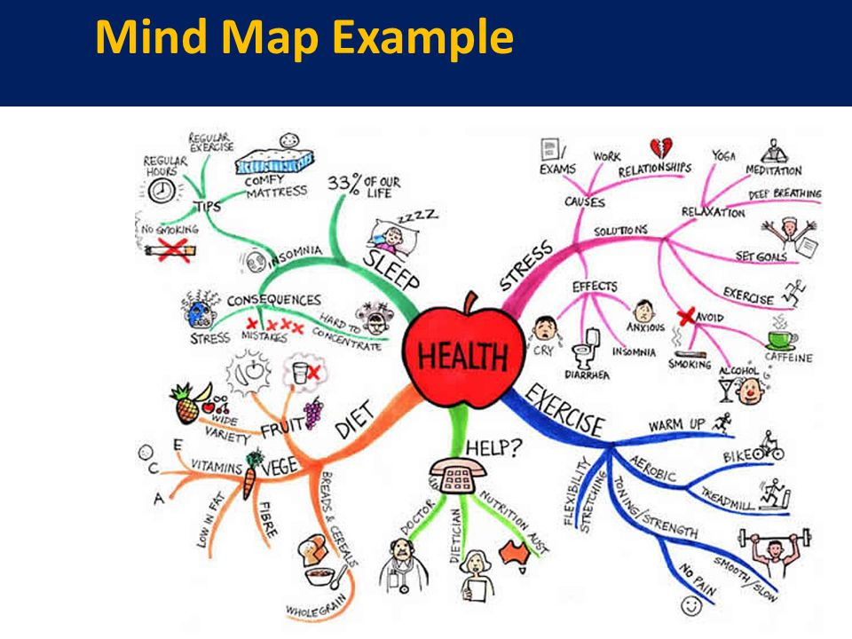

Slide 20
What decisions might you make based on this mind mapping ?

Slide 21
Activity – 20 min
Think about one of the wicked issues that the community engagement intends to tackle – youth unemployment
Create a solution mind map around the concept of youth unemployment that shows different solution paths on basis of different stakeholder
Think about :
  Who is affected by this issue? Who would benefit from this issue being solved?
  How can the people/entities identified above get involved?
  What kinds of solutions/support can each of them provide?

Slide 22
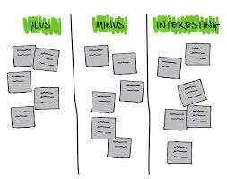
Technique 3: Plus Minus Interesting (PMI)

Slide 23
How to use PMI technique
Identify the topic or decision to be analysed.
List the Positive aspects (P) of the topic or decision.
List the Negative aspects (M) of the topic or decision.
List any Interesting points (I) related to the topic or decision.
Evaluate and prioritize each point based on significance.
Use insights gained from PMI analysis to inform decision-making or problem-solving processes.

Slide 24
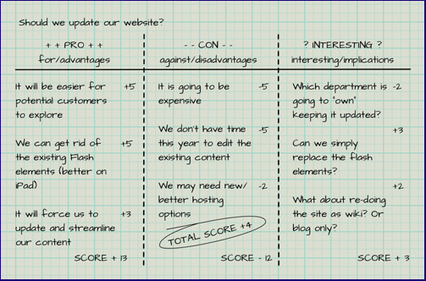
An example of PMI technique

Slide 25
Activity – 20 min
Use the PMI technique on the mind map that you have created to identify number of solutions to youth unemployment
Evaluate at least 3 different solutions to decide which one you will go with.

Slide 26
Case analysis
Refer to the report on social isolation to:
  Identify one problem area (only)
  Read (only) two cases listing
    Target audience
    Delivery/intervention
    Impact – financial and other
Which of the above problem-solving techniques can you use to solve the above?

Slide 27

Conclusion
Community engagement nurtures communities assets and strengths.
Advocates for sustainable community design, equity, inclusion, collaboration and participation.
Makes policy recommendations more effective and sustainable.
A win-win situation for everyone clamouring for lasting change.

Slide 28
Final activity – 20 min
Complete the CPD Log – Moodle.
Remember: this will be used in your reflection portfolio

Slide 29


Slide 30
References
Doyle, A., 2017. Adaptive challenges require adaptive leaders. Performance Improvement, 56(9), pp.18-26.

