Slide 1
Student Name:Eva stefan
Student ID: 2510915
Lecturer’s Name:Annamarie Dufficy
Module Code: LCLM 4004
Module Name: Problem Solving and Decision-Making
Component 1: Basil’s Bakery

Slide 2

Provide an Overview of your presentation.
(approx. 30 seconds)
Good afternoon. My name is eva stefan
In this presentation i will discuss the Basil bakery case study and look at the main problems affecting the growth of the business. I will use the fishbone diagram to identify the possible cause of the lack of sales growth.

Slide 3
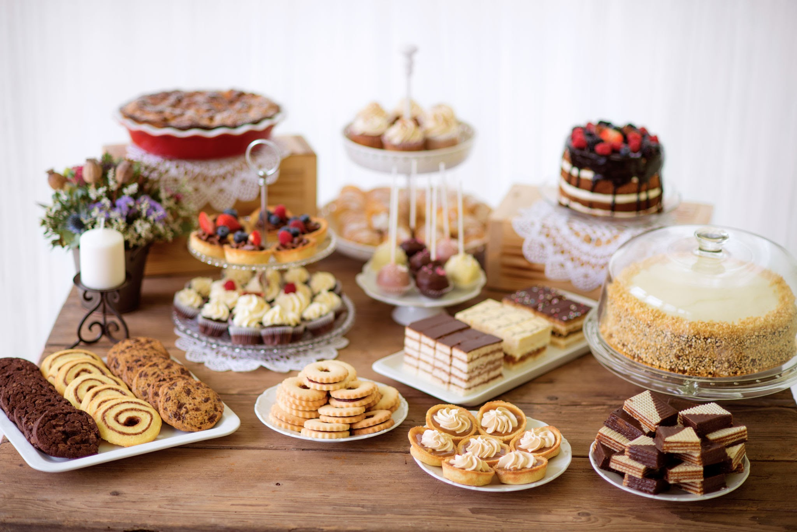
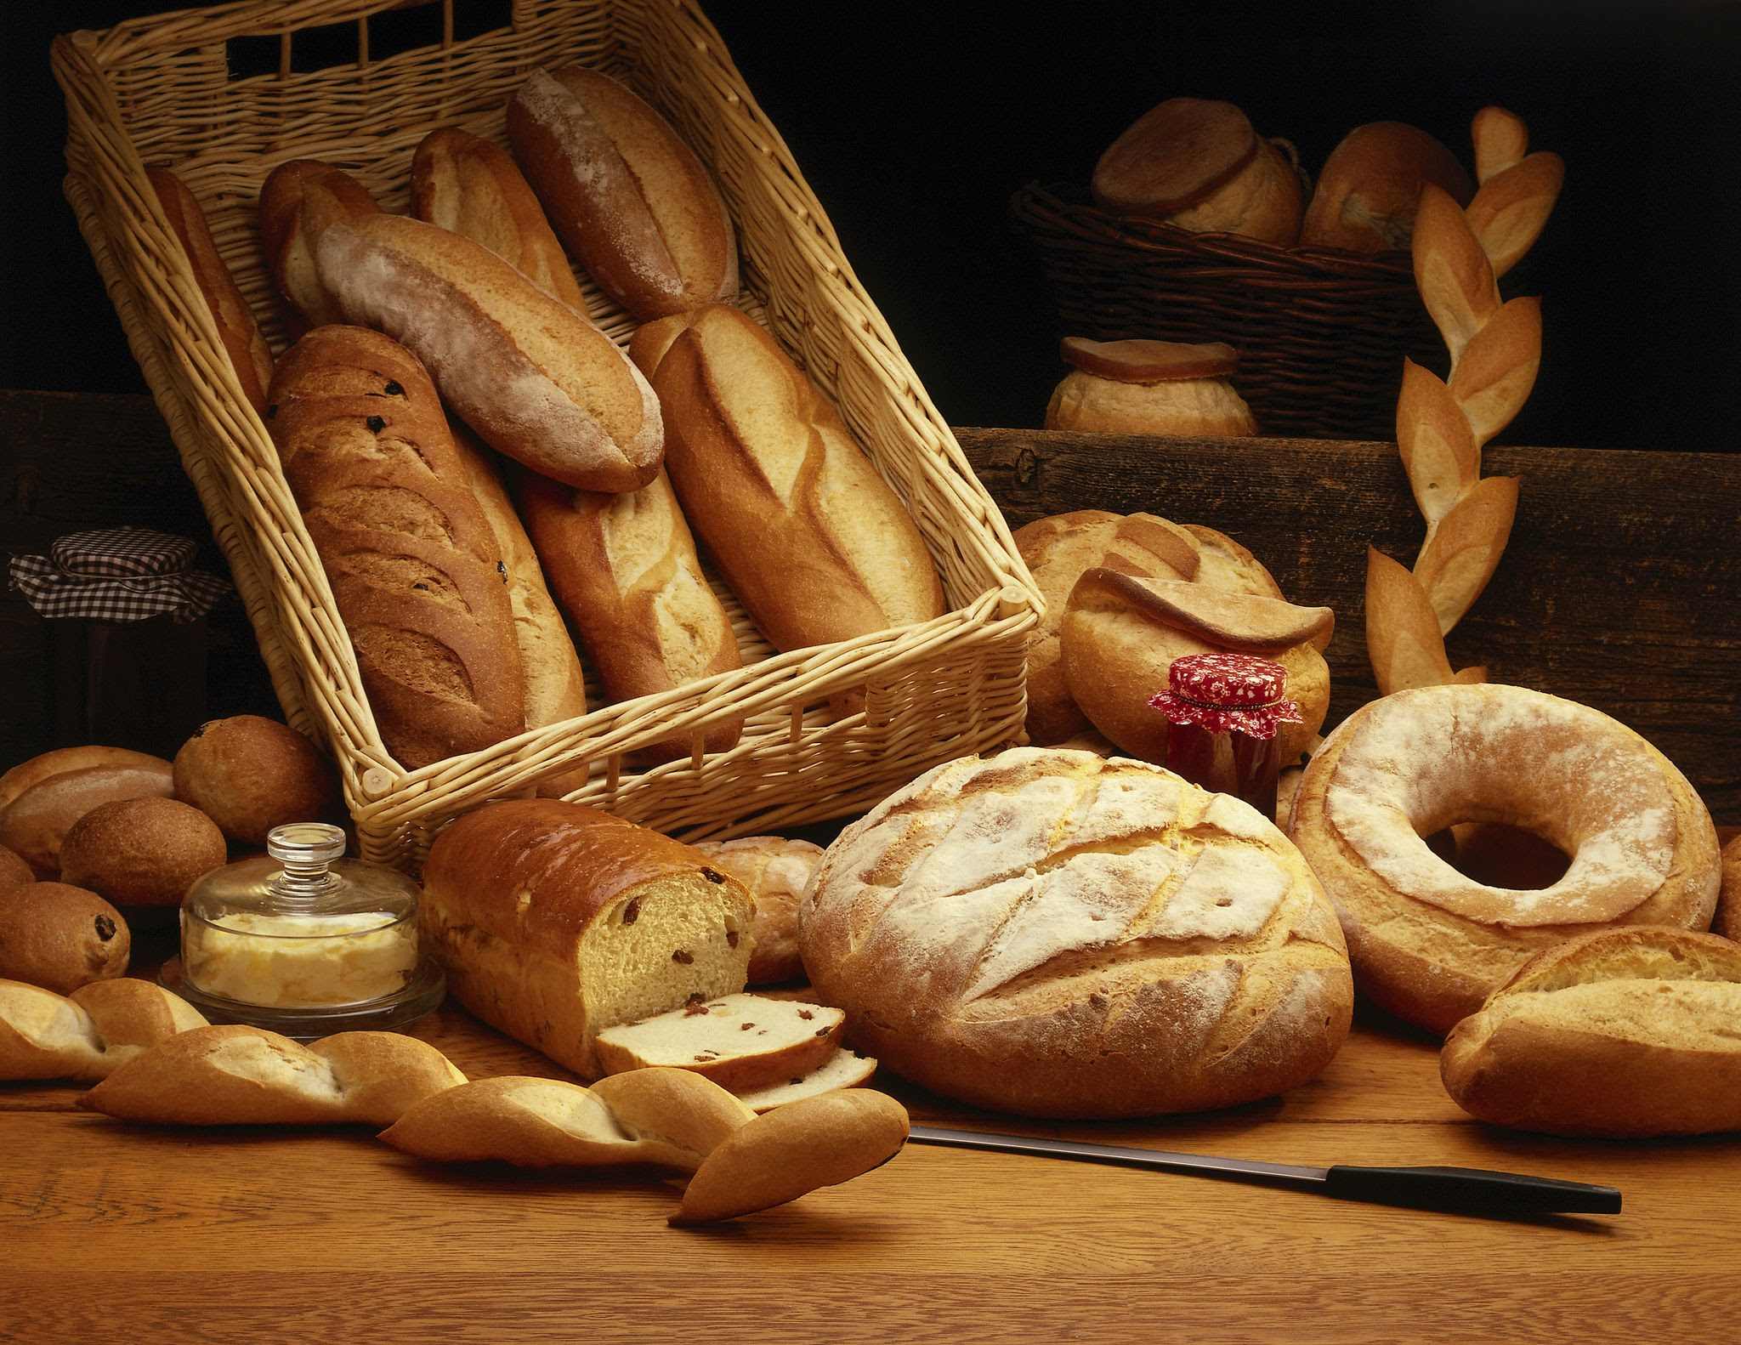
Provide an overview of Basil’s Bakery.
(approx. 30 seconds)
Basil’s bakery is a small business located in a retail park in coventry. This shop make cakes,pastries and bread using high-quality organic ingredients .This bakery is very famous and all the customers like to buy from this store because is very tasty .

Slide 4
Provide an insight into the problems Basil’s Bakery are facing. (approx. 1 minute)
The main problem was that it has been affected by covid-19 and has lost control over the pandemic .Before the pandemic ,the bakery shop was very popular and had lots of sales.During the covid-19 the customers numbers reduce and many office workers started working from home and this affected the bakery because there where few people were in the area to visit the bakery.

Slide 5
Provide a critique of the PESTEL Framework
(approx. 1 minute).
Pestel is a diagram to understand why and how a problem is happening. It helps business look at different reason for the problem .

Slide 6
Provide an application and discuss the information provided in your PESTEL Framework
(approx. 1 minute 30 seconds).
Here is the tabular PESTLE analysis of Olive Tree Bistro.
Political Factors | Economic Factors | Social Factors | Technological Factors | Legal Factors | Environmental Factors
Covid-19 restrictions Government rules | Rising cost Spending less | Home working Changing customer habits | Online order Social media | Health and safety rules Food safety laws | Organic ingredients Food wast

Slide 7
Provide a critique of the Cause-and-Effect model (approx. 1 minute).
In business it's called fishbone diagram because it looks like a fish skeleton.
It is use to find the problem
It helps businesses understand why problem is happening

Slide 8
Provide an application and discuss the information provided in your Cause-and-Effect diagram (approx. 1 minute 30 seconds).
Methods
Machines
People
Text:shop sale
Text:limited technology
Text:fewer customers
Text:limted way to reach customers
Text:online serivices
Text:working for home
Root Problem
Text:organic ingredients
Text:sales stopped growing
Text:covid-19 pandemic
Texthigher ingredients
Text:changes in customer demand
Text:changes the shopping habits
Materials
Measurement
Environment

Slide 9
Provide a summary of your Key Findings
(approx. 30 seconds)
Detail and discuss the key findings from your presentation:
    Key Finding 1: covid-19 impacted the bussiness
    Key Finding 2: lack of sales
    Key Finding 3: reduced customers
    Key Finding 4: fishbone diagram

Slide 10
Reference List:

Slide 11
Thank you for listening

Slide 12


