Slide 1
VLAN
Trunking Protocol

Slide 2
Objectives
The role of VTP in a converged switched network
The operation of VTP: VTP domains, VTP Modes, VTP Advertisements, and VTP Pruning.
Configure VTP on the switches in a converged network.

Slide 3
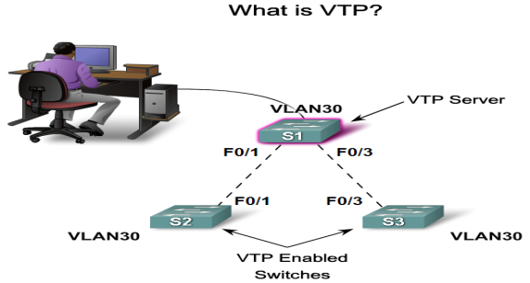
VLAN Trunking Protocol (VTP)
As the size of the network for a small- or medium-sized business grows, the management involved in maintaining the network grows.
VTP allows a network manager to configure a switch so that it will propagate VLAN configurations to other switches in the network.

Slide 4
Benefits
VLAN configuration consistency across the network.
Accurate tracking and monitoring of VLANs.
Dynamic reporting of added VLANs across a network.
Dynamic trunk configuration when VLANs are added to the network.

Slide 5
VTP Components
VTP Domain - Consists of one or more interconnected switches. All switches in a domain share VLAN configuration details using VTP advertisements. A router or Layer 3 switch defines the boundary of each domain.
VTP Advertisements - VTP uses a hierarchy of advertisements to distribute and synchronize VLAN configurations across the network.
VTP Modes - A switch can be configured in one of three modes: server, client, or transparent.
VTP Server - VTP servers advertise the VTP domain VLAN information to other VTP-enabled switches in the same VTP domain. VTP servers store the VLAN information for the entire domain in NVRAM. The server is where VLANs can be created, deleted, or renamed for the domain.

Slide 6
VTP Components
VTP Client - VTP clients function the same way as VTP servers, but you cannot create, change, or delete VLANs on a VTP client. A VTP client only stores the VLAN information for the entire domain while the switch is on. A switch reset deletes the VLAN information. You must configure VTP client mode on a switch.
VTP Transparent - Transparent switches forward VTP advertisements to VTP clients and VTP servers. Transparent switches do not participate in VTP. VLANs that are created, renamed, or deleted on transparent switches are local to that switch only.
VTP Pruning - VTP pruning increases network available bandwidth by restricting flooded traffic to those trunk links that the traffic must use to reach the destination devices. Without VTP pruning, a switch floods broadcast, multicast, and unknown unicast traffic across all trunk links within a VTP domain even though receiving switches might discard them.

Slide 7
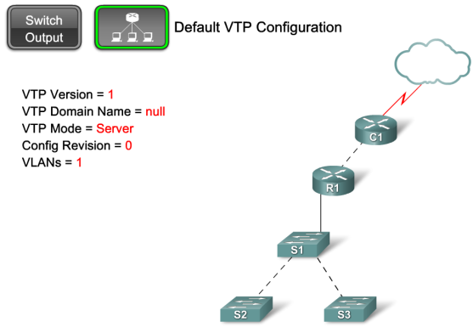
Default VTP Configuration
VTP has three versions, 1, 2, and 3. Only one VTP version is allowed in a VTP domain. The default is VTP version 1. A Cisco 2960 switch supports VTP version 2, but it is disabled.

Slide 8
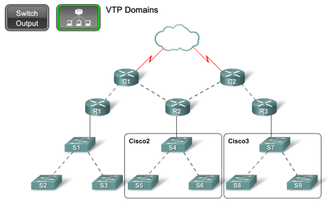
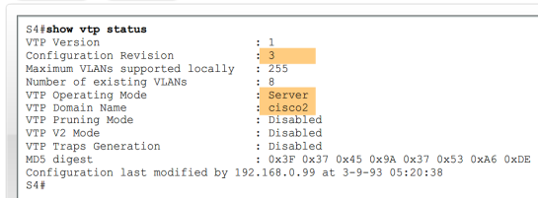
VTP Domain
VTP allows you to separate your network into smaller management domains to help reduce VLAN management.
An additional benefit of configuring VTP domains is that it limits the extent to which configuration changes are propagated in the network if an error occurs

Slide 9
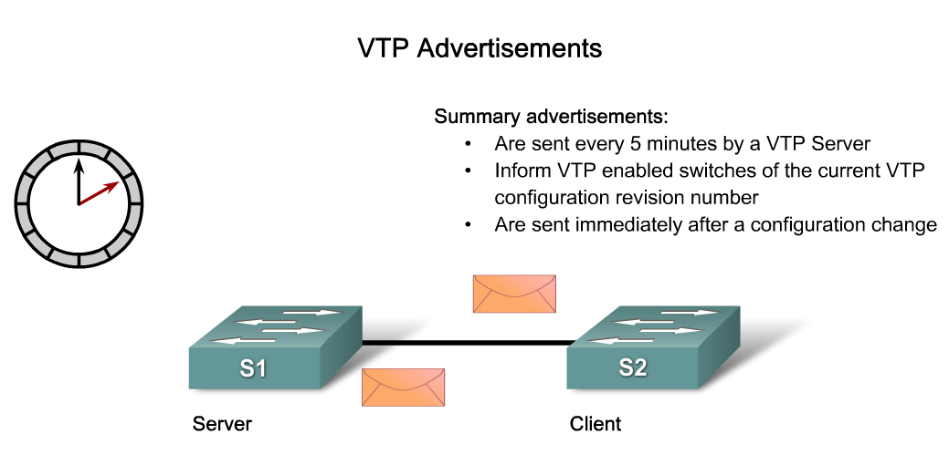
VTP Advertisements

Slide 10
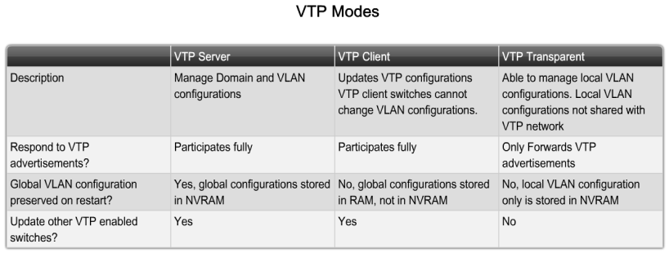
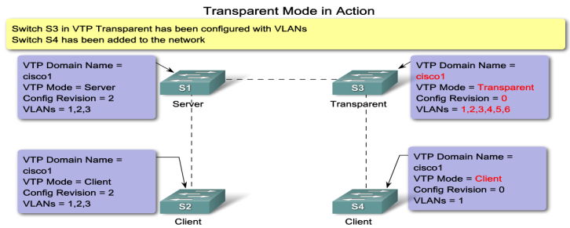
VTP Modes

Slide 11
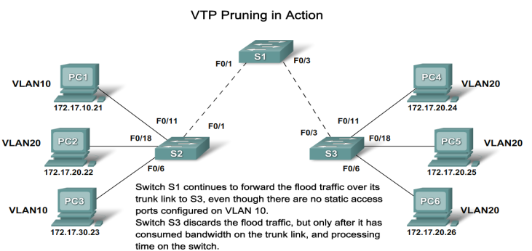
VTP Pruning
VTP pruning prevents unnecessary flooding of broadcast information from one VLAN across all trunks in a VTP domain.
VTP pruning permits switches to negotiate which VLANs are assigned to ports at the other end of a trunk and, hence, prune the VLANs that are not assigned to ports on the remote switch.

Slide 12
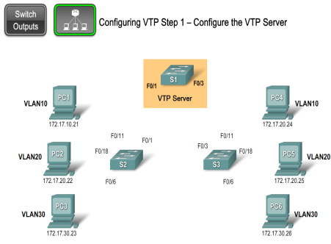
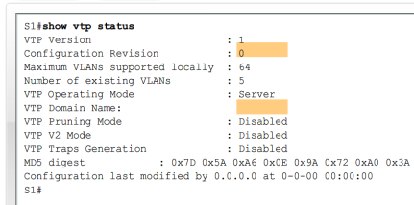
VTP Configuration

Slide 13
Common VTP issues
Incompatible VTP versions
VTP password issues
Incorrect VTP domain name
All switches set to VTP client mode

Slide 14
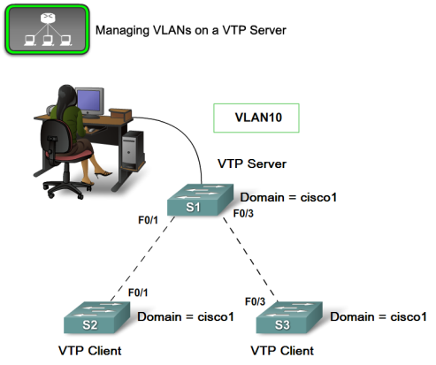
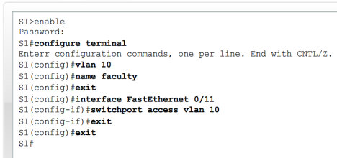
Managing VLANs on a VTP Server

Slide 15
Summary
VTP is a Cisco proprietary protocol used to exchange VLAN information across trunk links.
A switch can be in one of 3 VTP operating modes
  Client
    Cannot create, modify or delete VLAN
  Server
    Can create, modify & delete VLAN
  Transparent
  Can create, modify, & delete LOCAL VLAN
  Forwards VTP advertisements.

Slide 16
Summary
VTP pruning
  Limits unnecessary dissemination of VLAN information.
Verify VTP configuration
  Show VTP status
  Show interfaces trunk

