Slide 1
SJIE 5004
Celebrating Language and Culture – Belonging to Wales
Powerpoint 2

Slide 2

Cynnwys / Content
  Hanes
  Cefndir damcaniaethol
  Dwyieithrwydd
  History
  Theoretical background
  Bilingualism

Slide 3
Sut mae agweddau at yr iaith Gymraeg wedi newid dros amser?
How have attitudes to the Welsh language changed over time?

Slide 4
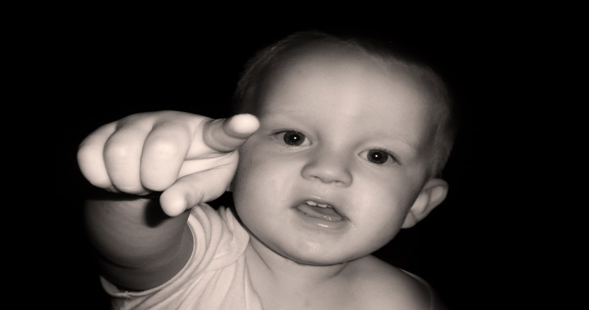
Hanes byr iawn o daith dwyieithrwydd yn Nghymru
A very brief history of the journey of bilingualism in Wales

Slide 5

Bilingualism in Wales
Dwyieithrwydd yng Nghymru
Yn wreiddiol yr iaith trechaf yn yr ardal a elwir nawr Ynysoedd Prydain
Traddodiad cryf o Gymraeg yn ysgrifenedig ac ar lafar
Llyfr Du Caerfyrddin
Originally the dominant language throughout the entire region that is now the British Isles
Strong oral and written tradition of Welsh
Black Book of Carmarthen

Slide 6
Deddf Uno 1536 yn dod a Lloegr a Chymru at eu gilydd, gan ddod â Chymru o dan rheolaeth Lloegr
Pa effaith gafodd hyn?
Gyda phartner, trafodwch pa effaith byddai dod â Lloegr o dan rheolaeth Ffrainc yn ei gael
The Act of the Union joined England and Wales in 1536, bringing Wales officially under the rule of England
What effect do you think this had?
With a partner discuss what effect bringing England under the rule of France would have

Slide 7
Historical and political context
Cyd destun hanesyddol a gwleidyddol
Adnabuwyd Cymraeg o hyd yn yr Eglwys
Yn 1563 awdurdododd Elizabeth y cyntaf i gyfieithu’r Beibl i’r Gymraeg
Dechreuodd yr Eglwys ysgolion yng Nghymru
However Welsh continued to be recognized in the Church
In 1563, Elizabeth the First authorized the translation of the Bible into Welsh
The Church established the schools in Wales

Slide 8
Historical and political context
Cyd destun hanesyddol a gwleidyddol
1847: William Williams, MP for Coventry, from Pumpsaint ( Carmarthenshire) asked for a government inquiry into education in Wales
The commissioners appointed reported that teachers in Wales were ‘drunk and illiterate’
The Treachery of the Blue Books
1847 : William Williams, Aelod Seneddol ( o Bumpsaint, Sir Gâr) yn gofyn am ymchwilad seneddol i addysg yng Nghymru
Y comisiynwyr yn adrodd fod athrawon Cymru yn feddw ac yn anllythrennog
Brad y Llyfrau Gleision

Slide 9
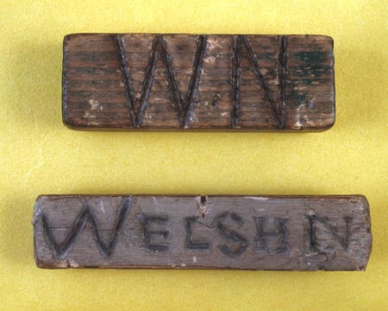
Historical and political context
Cyd destun hanesyddol a gwleidyddol
Deddf Addysg 1870: Ysgolion cyfrwng Saesneg yn orfodol drwy Gymryu
Welsh Not
Traweffaith?
1870 Education Act: English-medium schooling compulsory throughout Wales
Welsh Not
Impact?

Slide 10
Ar ddechrau’r 20fed ganrif, Saesneg oedd yr iaith oedd yn dominyddu yng Nghymru
Lleihad sylweddol yn y rhif o siaradwyr Cymraeg yng Nghymru
By the start of the 20th century, English had become the dominant language in Wales
A significant reduction in the number of Welsh speakers in Wales

Slide 11

Gyda phartner, trafodwch impact y Ddeddf Uno 1536 a Deddf Addysg 1870 ar y cyd-destunau canlynol
  Addysgol
  Gwleidyddol
  Cymuned
  Swyddi
  Personol
With a partner discuss the impact of the Act of Union 1536 and the 1870 Education Act on the following contexts
  Educational
  Political
  Community
  Jobs
  Personal

Slide 12
Bilingualism in Wales
Dwyieithrwydd yng Nghymru
1964- Sefydlu’r Swyddfa Gymreig gan y Llywodraeth yng Nghaerdydd gydag Ysgrifennydd Cymru
Awdurdod dros gynllunio economaudd, tai, parciau cenedlaethol, adeiladau hanesyddol a gweithgareddau diwylliannol
Mwy o gysylltiadau yn datblygu gyda’r Swyddfa Gymreig am hawliau’r iaith
In 1964 the Welsh Office was established in Cardiff, by the Government , with a Welsh Secretary of State
Administrative authority over economic planning, housing, local government, Welsh national parks, historic buildings and cultural activities
The Welsh Office became increasingly associated with Welsh language rights

Slide 13

Bilingualism in Wales
Dwyieithrwydd yng Nghymru
Rhoddodd Mesur yr Iaith Gymraeg (1967) statws cyfartall i’r iaith Gymraeg mewn llysoedd barn
Cafwyd Deddf Iaith yn ers hynny ( 1993 & 2011)
Sefydlwyd Bwrdd yr Iaith yn 1993 i hybu a hwyluso’r defnydd o’r iaith Gymraeg yn gyhoeddus
Welsh Language Act 1967 gave Welsh the same status as English in law courts
Further Welsh language Acts 1993 & 2011
The Welsh Language Board (1993) given official recognition to promote and facilitate the use of Welsh language in public life

Slide 14
Education Reform Act 1988
Deddf Diwygio Addysg 1988
Y Cwricwlwm Cenedlaethol
Cymraeg yn cael ei adnabod fel pwnc craidd mewn ysgolion cyfrwng Cymraeg yn 1988
( Llai na 30 mlynedd yn ôl)
Pwnc sylfaen ymhob ysgol arall yn Nghymru
National Curriculum
Welsh recognized as a “core subject” in Welsh-medium schools in 1988
( Less than 30 years ago)
Given status as a foundation subject for all other schools in Wales

Slide 15
Profiadau
Experiences
Trafodwch gyda phartner
Beth yw’ch profiad chi o’r defnydd o’r iaith Gymraeg
  Yn yr ysgol
  Adref
  Yn y gymuned
Discuss with a partner
What is your experience of the use of the Welsh language
  In school
  At home
  In the community

Slide 16

Heriau
Challenges
Gosoda Strategaeth ar gyfer yr Iaith Gymraeg (1996) bedair prif her o safbwynt hyrwyddo’r iaith-
cynyddu’r nifer o siaradwyr Cymraeg
darparu cyfleoedd i ddefnyddio’r iaith
newid arferion defnydd iaith, ac annog pobl i fanteisio ar y cyfleoedd a gynigir
cryfhau’r Gymraeg fel iaith gymunedol
The 1996 Strategy for Welsh Language sets out four main challenges in terms of language promotion:
1)increasing the number of people who are able to speak Welsh;
2)providing opportunities to use the language;
3) changing the habits of language use, and encouraging people to take advantage of the opportunities provided;
4) strengthening Welsh as a community language

Slide 17
Tasg/Task
Ydi’r materion a’r heriau yr un fath heddiw- 20 mlynedd yn ddiweddarach?
Yn ein cymunedau?
Yn ein Prifysgol?
Beth am y cyfrifiad diweddaraf?
Beth yw llun Cymru?
Beth yw llun Sir Gâr?/Sir Benfro
Are there the same issues and challenges relevant today- 20 years later?
In our communities?
In our University?
Find out about the latest census – what did that say about the Welsh language?
Nationally?
In Carmarthenshire?/
Pembrokeshire?

Slide 18
Ystyriaeth fer o fframwaith damcaniaethol am ddwyieithrwydd
A brief consideration of a theoretical framework of bilingualism

Slide 19
Cummins : BICS, CALP and CULP ( Shoebottom 2017)
BICS- Sgiliau Cyfathrebu Rhyngbersonol Sylfaenol
CALP- Hyfedredd Iaith Academaidd Gwybyddol
Dyw’r BICS a’r CALP ddim o angenrheidrwydd ar yr un lefel
CULP- Hyfedredd Gwaelodol Cyffredin Iaith
BICS- Basic Interpersonal Communication Skills
CALP- Cognitive Academic Language Proficiency
The BICS and CALP are not necessarily at the same level
CULP- Common Underlying Language Proficiency

Slide 20
Becoming bilingual
Dod yn ddwyieithog
Individual
NEED for Communication
Home
Community
Education

Slide 21

Becoming bilingual
Dod yn ddwyieithog
Mae dwyieithrwydd am iaith – cyfathrebu a rhyngweithio
Mae angen i blant siarad – mae angen iddynt rhyngweithio gyda’r oedolion yn eu bywyd yn ddyddiol
Bilingualism is about language - communication and interaction.
Children learn to speak because they need to interact with the adults in their lives on a daily basis.
( Baker 2014)

Slide 22
Mae plant yn caffael iaith yn naturiol
Cysylltiad rhwng yr unigolyn, addysg, y cartref a’r gymuned
Medr unigolyn fod yn ddwyieithog mewn diwylliant unieithog
Children acquire their languages in a natural way
Connection between the individual, education, the home and the community
An individual can be bilingual in a monolingual culture.
( Baker 2014)

Slide 23
Ffactorau pwysig
Important factors
Genir plant yn barod i fod yn ddwyieithog ac yn amlieithog
Mae iaith am gyfathrebu a hunaniaeth
Anogaeth gyson
Mae iaith yn cwmpasu iaith
Children are born ready to become bilinguals and multi-linguals
Language is about communication and identity
Continuous encouragement
Language surrounds language
( Baker, 2014)

Slide 24
Camau dysgu iaith
Steps in learning a language
Gwrando ac amsugno. (Y cyfnod mud)
Ymateb i gyfarwyddiadau.
Efelychu a chopio.
Rhoi cynnig ar 1-2 air neu
gymal
Listening and absorbing. (Silent Period)
Responding to instructions
Imitating and copying
Trying out 1-2 word phrases
(Baker 2014)

Slide 25
Camau dysgu iaith
Steps in learning a language
Geiriau enwi
Geiriau gweithredu
Rhoi enwau a gweithredoedd gyda’i gilydd
Rhoi cynnig ar frawddegau cyfan gyda chamgymeriadau
Cywiro camgymeriadau eu hunain
Naming words
Action words
Putting names and actions together
Trying out whole sentences with mistakes
Correcting mistakes themselves
(Baker 2014)

Slide 26
Trafodwch gyda phartner
Adlewyrchwch ar eich dysgu iaith personol chi
  Cyfleoedd
  Heriau
Adborth
Discuss with a partner
Reflect on your personal language learning
  Opportunities
  Challenges
Feedback

Slide 27
References
Baker, C. ( 2014) A Parents’ and Teachers’ Guide to Bilingualism. Bristol: Multilingual Matters
Cummins,J. ( 2013) The Intellectual and Cognitive Advantages of Bilingual Education. UWTSD: International Conference – Educational Society of the European Regions and the School of Welsh and Bilingual Studies, UWTSD 13.09.13
Ibrahim, N. (2011) How children become bilingual. Nayr Ibrahim: British Council Milan
Jones, D.V. and Martin-Jones, M. (2001) Bilingual Education and Language Revitalization In Wales : Past Achievements and Current Issues: University of Wales Aberystwyth
Roberts, D. T. (1998). The Language of the Blue Books. Cardiff: University of Wales
Shoebottom ( 2017) Second language acquisition - essential information. Available at http://esl.fis.edu/teachers/support/cummin.htm (Accessed 27.01.19)
Wales: ( 2013) The Cwricwlwm Cymreig, history and the story of Wales Final report. Cardiff: Welsh Government
Image of Cummins Iceberg- www.educ.ualberta.ca ( 2009)

