Slide 1
Changemakers: Creativity and value creation
BMPS5011
SADIE FRANCE

Slide 2
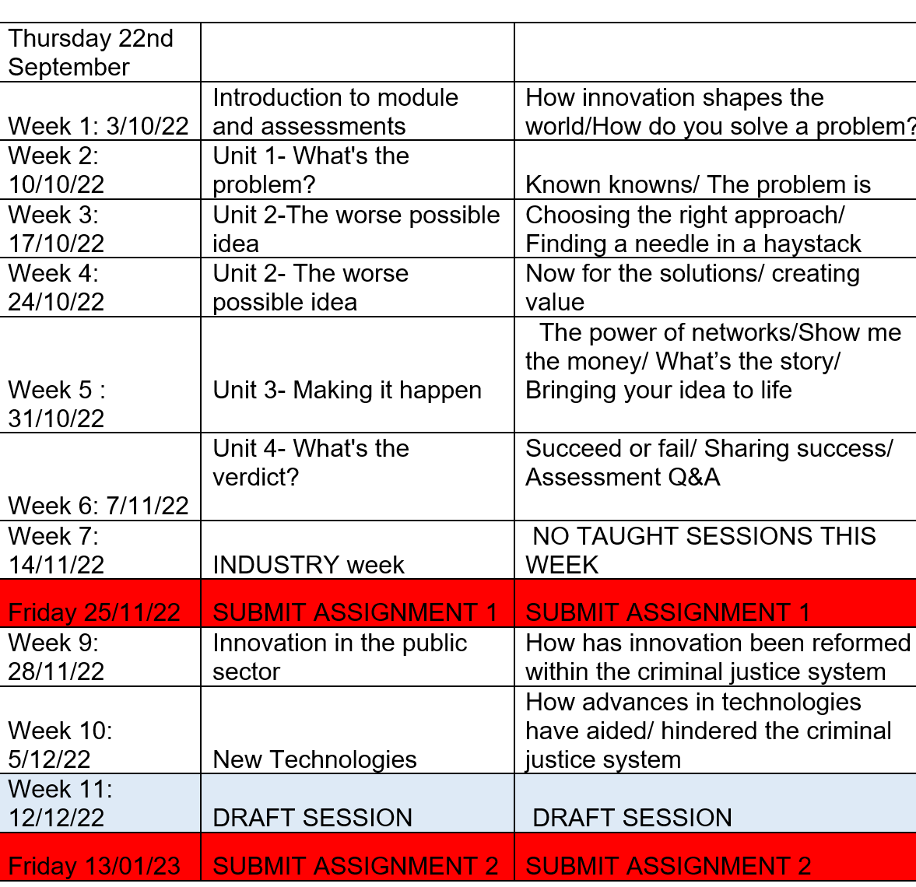
Scheme of work

Slide 3
Aims for today's session...
Discuss assignment 2
How criminal investigations have evolved
Forensic Science

Slide 4
Assignment 2
Essay- 2,000 Words (+/- 10%)
Evaluate the impact of innovation on criminal investigations. Use your discussion to analyse the benefits and drawbacks of these innovations.
Due- 13th January 2023 11:59pm

Slide 5
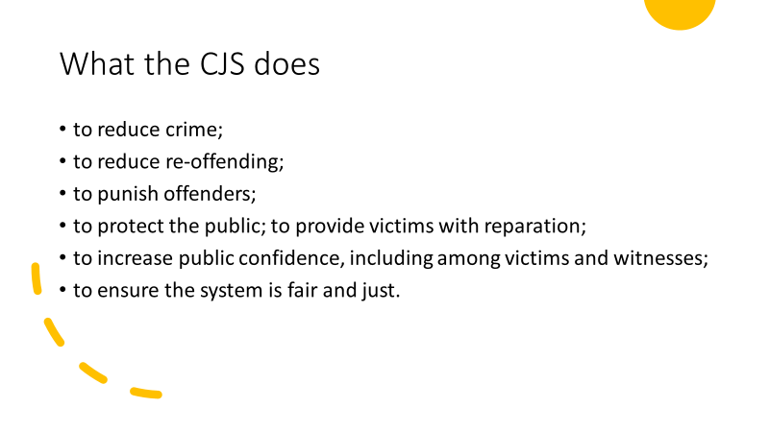

https://youtu.be/NuW57OeTipw

Slide 6

How long do you think an average investigation takes?

Slide 7
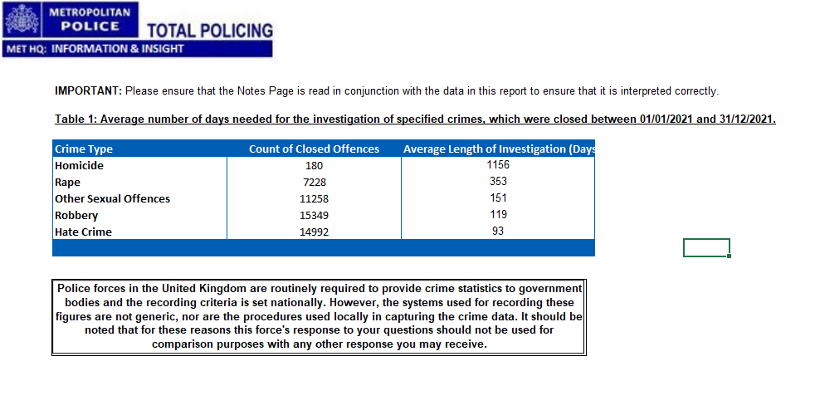
Average length of investigation

Slide 8
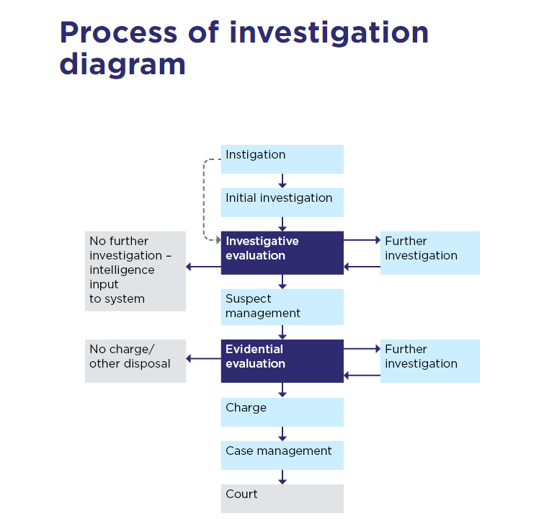
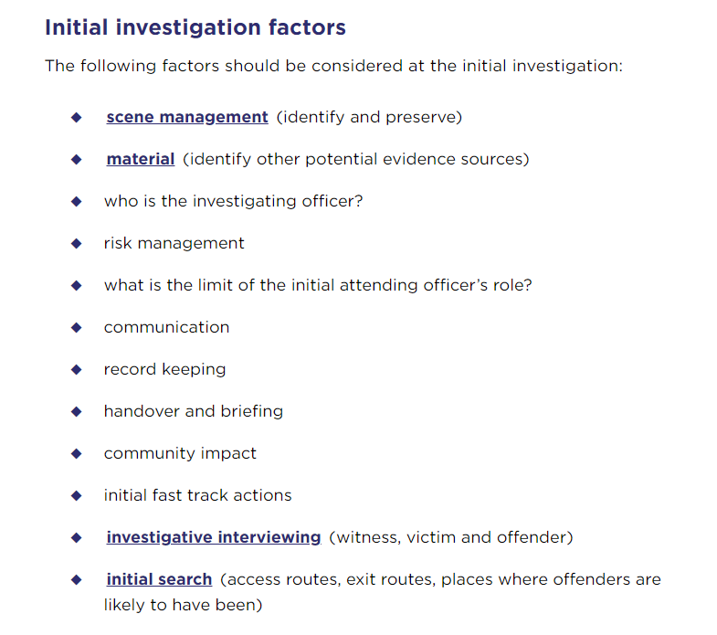
Process of investigation (College of Policing, 2021)

Slide 9
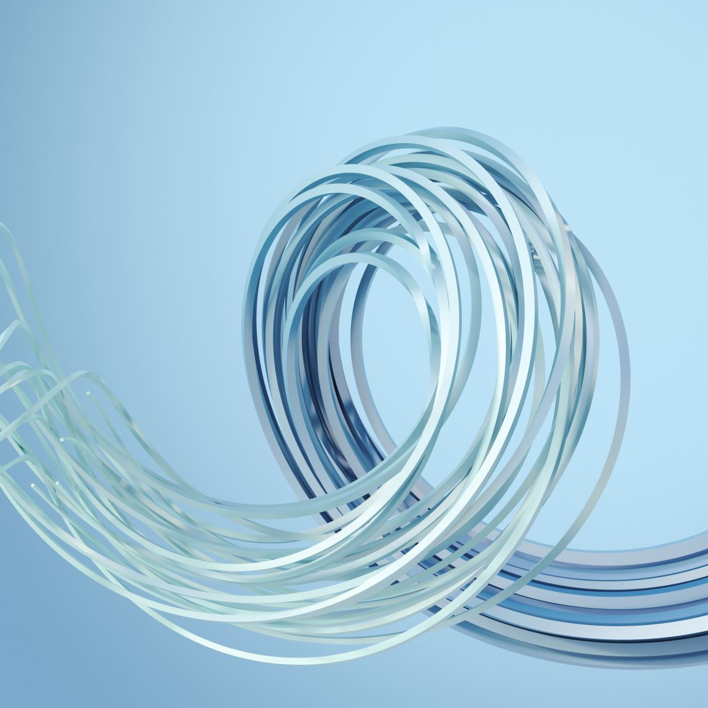
Innovations
Task......
Find 3 different innovations that are used within criminal investigations.
Post them to the forum:- "Innovations used within investigations"

Slide 10
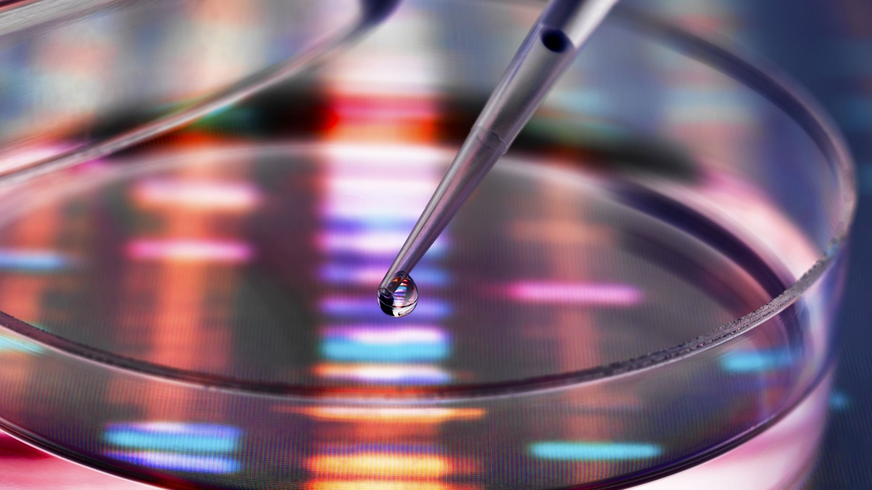
Forensic Science
https://youtu.be/fWH_TLdHYks

Slide 11
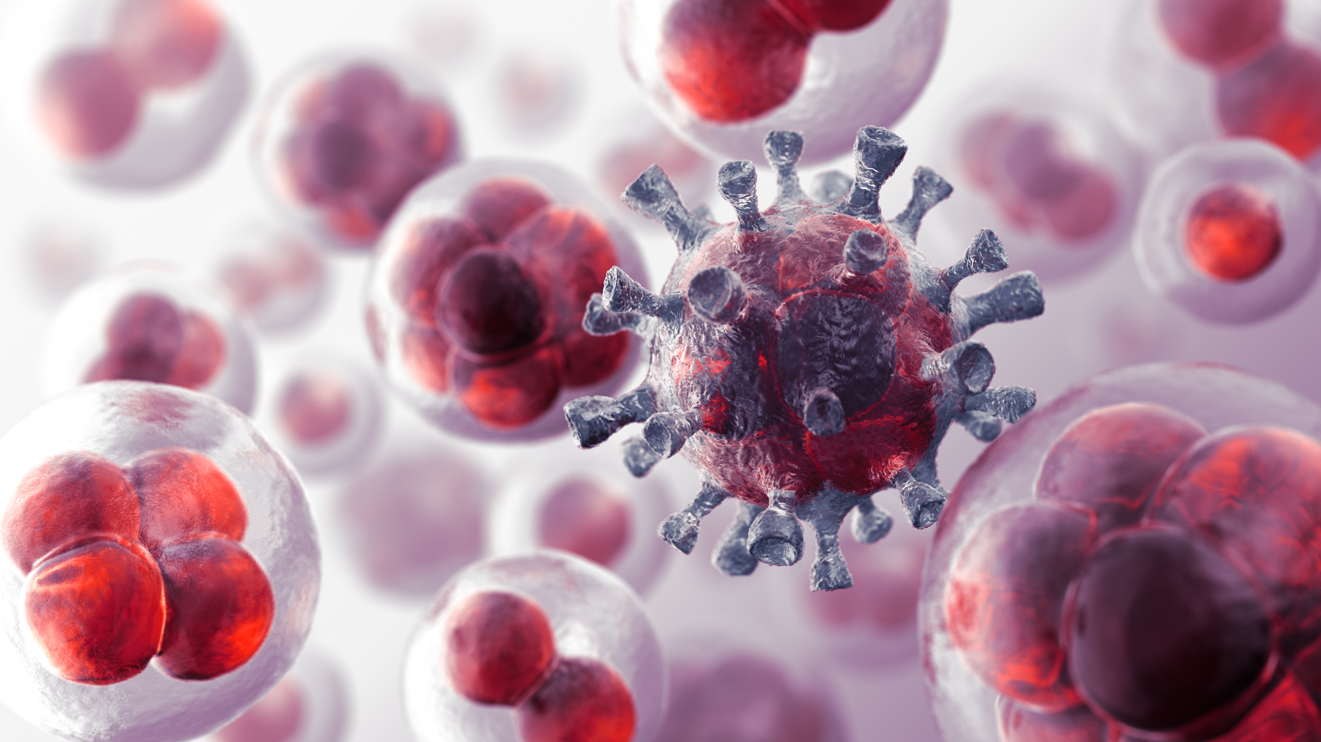
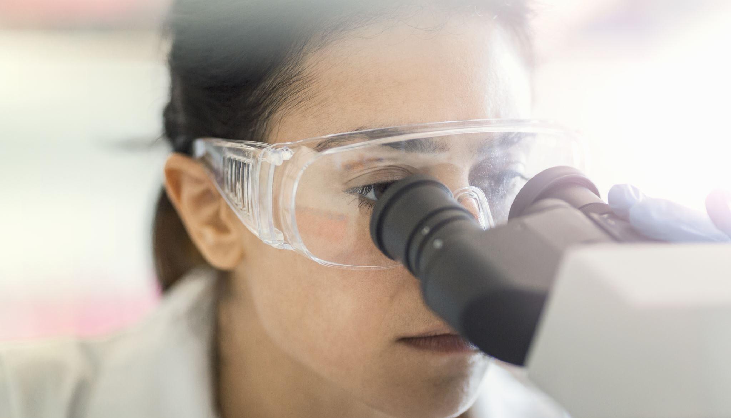
Forensic science
Analysing evidence from crime scenes to include:-
DNA
GSR
FINGERPRINTS/ BOOTPRINTS
BALLISTICS
TOXICOLOGY
BLOOD SPATTER ANALYSIS
BITEMARK ANALYSIS
https://youtu.be/68Y-OamcTJ8

Slide 12
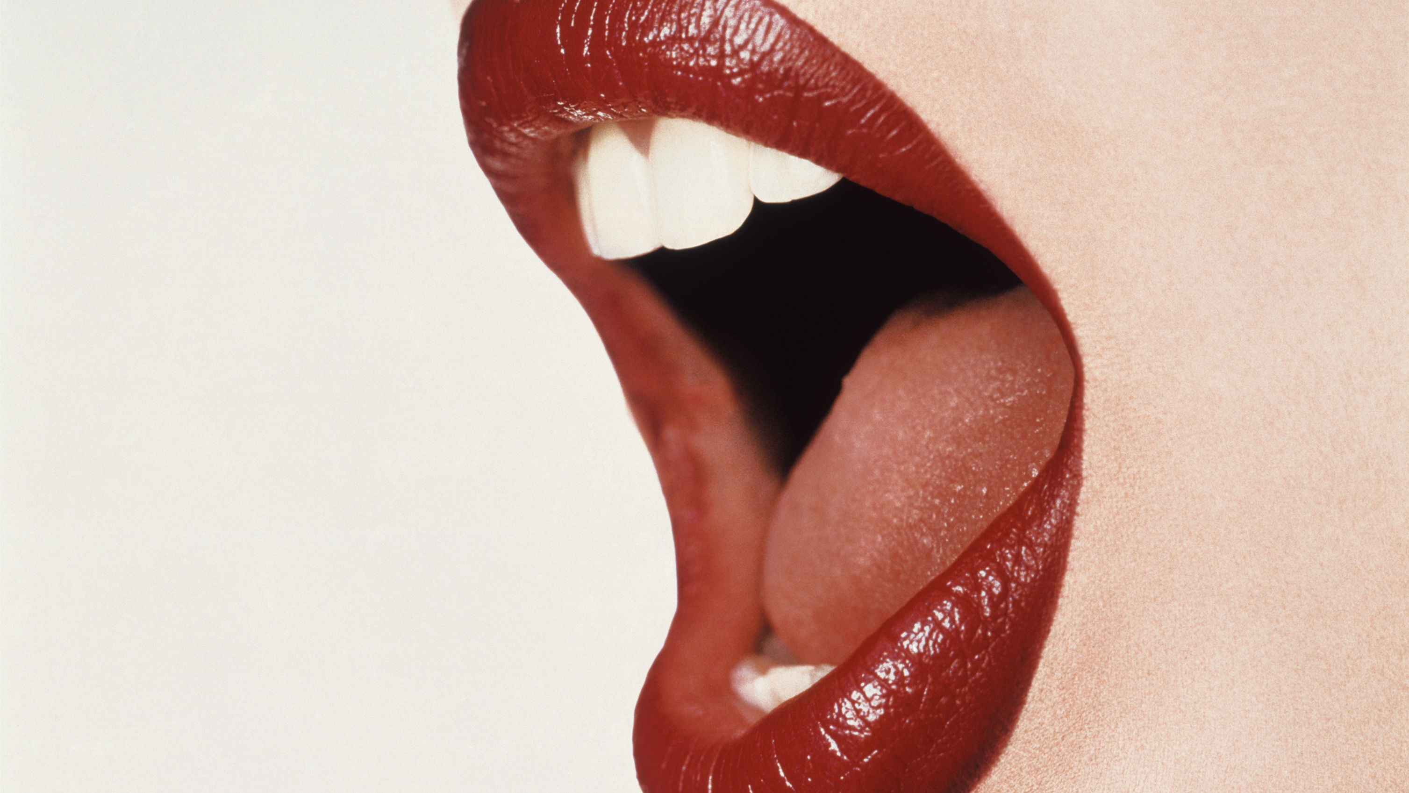
Task....
Research into the pro's and con's of bitemark analysis

Slide 13
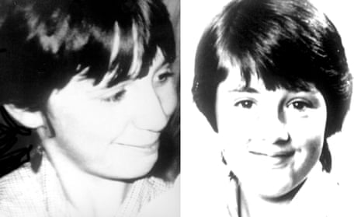
First case in the UK solved using DNA

Slide 14
Dawn Ashworth & Lynda Mann
Dawn was raped and strangled to death in 1986 aged 15 in Leicester
2.5 years prior to this in 1983, Lynda Mann a 15 year old girl was also murdered in the same way
Local boy held on suspicion- 17 year old Richard Buckland, who had learning disabilities
Dr Jefferey's, a genetic scientist worked on the case taking samples of Buckland's semen and blood and tested them against those found on the girls bodies. This proved Buckland innocent.

Slide 15
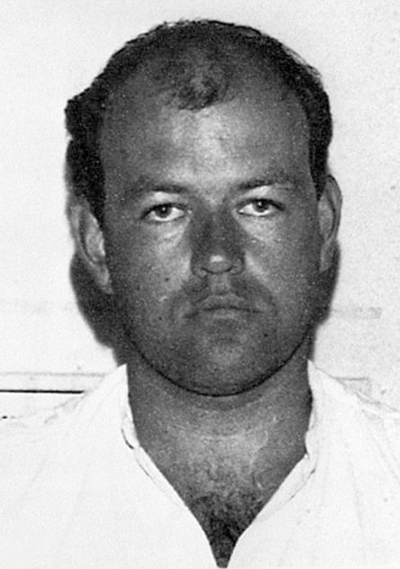
Colin Pitchfork
Local police ran screening centres for men to voluntarily supply blood and semen samples.
According to records, Pitchfork attended the screening.
In 1987, over a year later, a male called Kelly was overheard in the pub telling a friend how he impersonated Pitchfork to provide samples
Pitchfork was arrested and when asked why he killed Dawn- "Opportunity, she was there and I was there"
https://youtu.be/QxCoG5vuinc

Slide 16
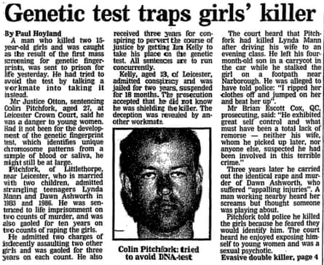

Slide 17
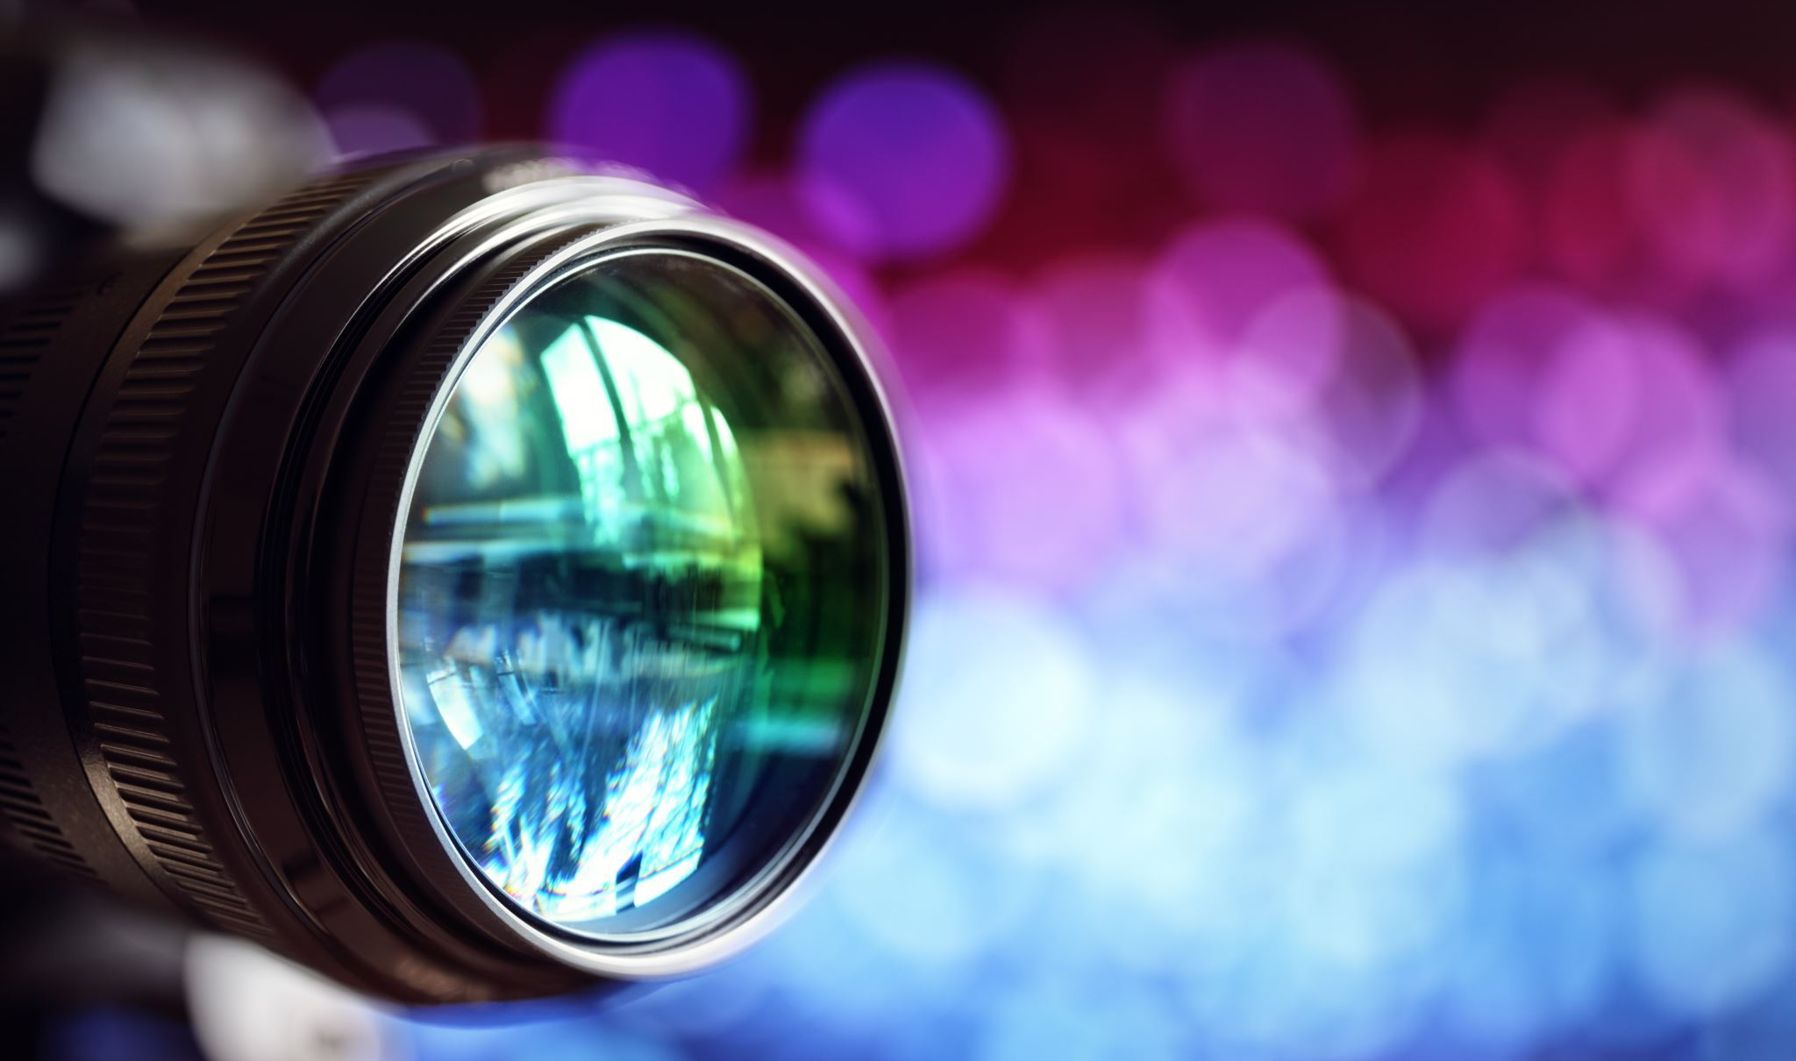
FILM- Forensic science
tps://www.bbc.co.uk/iplayer/episode/m0004w8v/forensics-the-real-csi-series-1-2-mixed-profiles

Slide 18
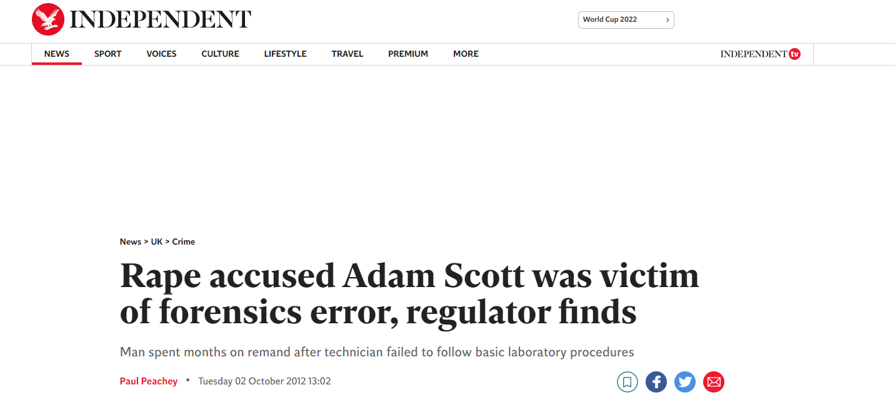
Is DNA 100% accurate?

Slide 19
Problems with forensic science
Unreliable and invalid forensic disciplines- Different labs have different rules
Evidence must be clean- In order to provide decent results, the DNA collected must be a decent sample in order to test 16 different "markers"
DNA can be easily damaged or contaminated
Partial profiles can lead to miscarriages of justice- Adam Scott/ Raymond Easton
Due to budget cuts, limited evidence is now sent to labs

