Slide 1


Strategies for promoting Health
* What strategies help to promote the health of individuals?

Slide 2
What is health promotion?
Health promotion is the process that enables people to improve or have greater control over their health.
The aim of health promotion is to help an individual or group reach a state of complete physical, mental and social well-being. It involves an individual or group being able to:
• identify and realise aspirations
• satisfy needs
• change with the environment.
Health promotion makes it possible for people to increase control over the determinants of health and thereby improve their health.

Slide 3
Figure 3.1 Health promotion encompasses a range of activities
Community-based Work
e.g. community transport
Preventative Health services e.g. breast cancer screening
Environmental health e.g. Reusable bags
Organisational Development e.g. health promoting schools
Health
Promotion
Health education e.g. Sexual health and drug education in schools
Public Policies
e.g. Banning smoking in restaurants, pubs and clubs
Economic regulatory activities e.g. Restrictions on the sale of alcohol

Slide 4
Responsibility for health promotion
Health promotion is not just the responsibility of the health sector. The responsibility is shared among individuals, community groups/schools, health professionals, health service institutions and governments. They must work together to provide a health care system that promotes health.

Slide 5
Individuals
Health is created and experienced by people within the settings of their everyday life; where they learn, work and play.
Health promotion includes and encourages individual responsibility and action.

Slide 6
Community groups/schools
Community health programs may have targets on varying scales. They may be directed at individuals, local communities, or the entire country.
Health information is provided to the general public through the mass media.
Schools have an important role in health promotion with health education and personal development important parts of the school curriculum eg. sun protection in the playground.

Slide 7
Non-government organisations
Non-government and professional organisations play an important role in community education, providing health services, research, workforce development and political advocacy. Non-government organisations (NGOs) include large national organisations, such as the National Heart Foundation

Slide 8
Government
All levels of government—local, national and international—have a key role to play in health promotion.

Slide 9
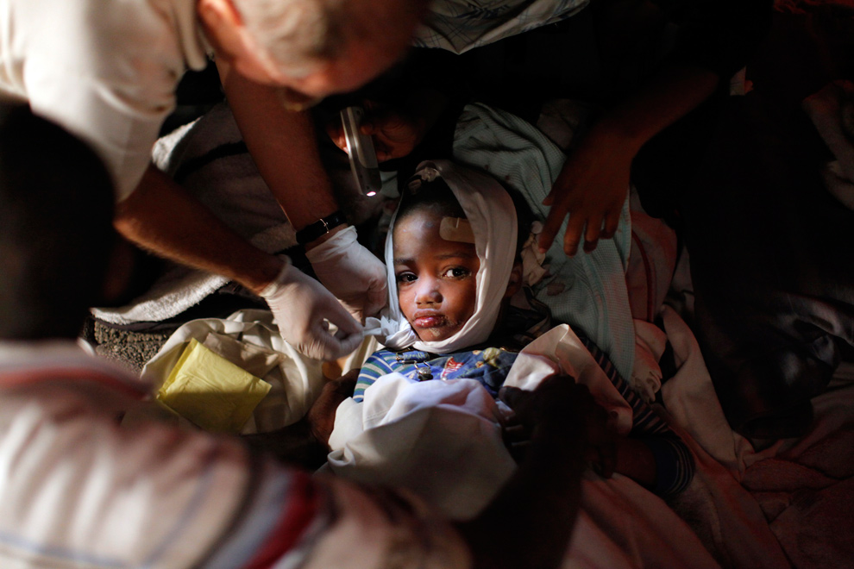
International organisations
To assist and guide countries in achieving the best health for their citizens, a number of international health organisations have been established. The United Nations, World Health
Organisation and United Nations Children’s Fund are three such organisations. All three bodies are involved in promoting global health.

Slide 10
The United Nations (UN) maintains international peace and security; develops friendly relations between countries based on respect for the principle of equal rights and self-determination of peoples; cooperates in solving international economic, social, cultural and humanitarian problems; and promotes respect for human rights and fundamental freedoms.
Within the UN are administrative bodies that play a key role in health promotion, including the World Health Organization (WHO) and the United Nations Children’s Fund (UNICEF).

Slide 11
Health promotion approaches and strategies
Health promotion is aimed at improving the health of an individual or community or changing behaviour that may have a negative influence on health. Health promotion approaches and strategies range from individually focused interventions (such as posters providing positive health messages) through to the Development of a national health promoting policy (such as the National Mental Health Strategy).

Slide 12

Figure 3.4 A framework for health promotion
Health promotion
Focus Strategies Outcomes
Illness
or health
Risk Impact
Behavioural adaptations: changes to behaviour that will improve health
Lifestyle/Behavioural
Preventative medical
Public Health
Individuals
Groups
Populations
Better health and well-being
Quality of life
Environmental adaptations: Changes to the environment that promote health

Slide 13
Lifestyle/behavioural approaches
Lifestyle/behavioural approaches are concerned with individuals or groups whose behavioural or social situations place them at greater risk of developing unhealthy lifestyles.
These approaches target smaller ‘at-risk’ groups within a population to change their behaviour. This is based on the theory that a change in behaviour of a small percentage of the whole population results in significantly more people changing behaviours.

Slide 14
Lifestyle/behavioural approaches are directed at improving the health of groups whose behaviours put their health at risk, such as people who smoke, have poor nutrition, are physically inactive or misuse substances. These approaches use health education, social marketing, put their health at risk, such as people who smoke, have poor nutrition, are physically inactive or misuse substances. These approaches use health education, social marketing,

Slide 15
self-help, self-care
Self-help is the use of
strategies to manage one’s
own health problems
rather than seeking
professional help.
Self-care is caring for
oneself or a friend or
family member rather
than using the care
traditionally provided
by professional health
care providers.

Slide 16
Individual lifestyle approach
The individual lifestyle approach to health promotion is based on the principles that the major causes of morbidity and mortality within countries are diseases resulting from poor lifestyle behaviour choices. This approach tends to blame individuals for their poor health.
It presumes that, with relevant information, people will change their actions and way of thinking to improve their health. However, the individual lifestyle approach to health promotion does not explain why people make unwise health choices in the first place and fails to recognise the factors that influence an individual’s behaviour, such as social, economic and environmental factors.

Slide 17
Smoking has been identified as one of the most significant causes of avoidable death and disease.
Describe some health promotion programs that have been developed to reduce the impact of smoking.

Slide 18
Socio-environmental approach
The socio-environmental approach promotes health by addressing the social determinants of health, such as access to food, housing, income, employment, transport and education and factors such as addiction, social isolation and early life experiences.
Health promotion actions commonly used in the socio-environmental approach include:
• creating environments that support health (for example, a school providing trees and sheltered areas to protect students and staff from the Sun’s rays)

Slide 19
working with communities to strengthen their development (for example, a school developing a nutrition policy to promote healthy eating and selling nutritious food in the canteen)
advocating for public policy (for example, a school becoming a health promoting school).

Slide 20
Harm-minimisation approach
The harm-minimisation approach accepts that, despite our best
efforts, some people will choose to engage in risk-taking
behaviour, such as drug use or unsafe sexual activity. The harm
minimisation approach aims to reduce the adverse health,
social and economic consequences of risk-taking behaviours by
minimising or limiting the harms and hazards for both the
community and the individual without necessarily eliminating
use.

Slide 21
A harm-minimisation approach to drug use, for example, involves a range of strategies. These include demand reduction, supply control, controlled use, safer drug use and abstinence.

Slide 22
preventative medical approaches
Preventative medical approaches are the traditional approaches of the health sector, which regards health as the absence of illness and disease. These approaches are directed at improving physiological risk factors; that is, those relating to the way living things function. Examples are high blood pressure and lack of immunisation. These approaches also
focus on the treatment and prevention of disease.

Slide 23
public health approaches
Public health approaches aim to provide the maximum benefit
for the largest number of people.
They are concerned with preventing disease or injury from
occurring or reoccurring, promoting health, and returning health
to populations and communities following natural or man-made
disasters.

Slide 24
Health promotion strategies
Types of strategies
Three main types of strategies are employed in the
implementation of health promotion.
These are:
• enabling
• creating environments that are supportive of health
• advocating to create the essential conditions for health.

Slide 25


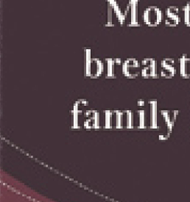

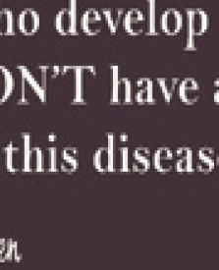
Deciding on a strategy
Critical inquiry
Propose actions that may improve the health of
young people.
Figure 3.11 The Breast Screen Australia Program promotes
positive health behaviour

Slide 26
The Ottawa Charter as an effective health promotion framework
The WHO conducted the first International Conference on Health Promotion at Ottawa in November1986. A document, titled the Ottawa Charter for Health Promotion, was produced as a result of this conference.
The charter provides a framework for the implementation of health promotion in five specific areas:
• develop personal skills
• create supportive environments
• strengthen community action
• build healthy public policy.

