Slide 1

Effective Teamwork
The elements and skills you need for a successful team

Slide 2
Elena Daniela Marcu 2119677
Rose-Marie Gherman 2119161
Ioana Florina Istrate 2119831
Camelia Danila 2119198
Elena Andreea Popa 2115854
Lecturer: Soban Sadiq
BMSW4002 Effective Team Work and Communication

Slide 3

Elena Daniela Marcu
2119677

Slide 4
Teamwork depends on connection and collaboration between participants for effectiveness.
Every individual on the team should devote their great attempts to the learning experience and be adaptable enough to respond to changing circumstances (Benson, 2014).
The objectives of the group can only be accomplished if every member participates, collaborates, and encourages one another.

Slide 5

Benefits of a team working
Collaboration Increases Productivity (Brindley, 2016).
Greater Synergy
It boosts innovation
Notes:
Collaboration Increases Productivity: Teams that collaborate are more efficient and driven to achieve organizational objectives. Fully motivated teams exhibited a 21% improvement in efficiency (Brindley, 2016). Teamwork enables everybody to interact more effectively frequently in live time, hence minimizing downtime and inefficiencies. All of these factors result in greater output quality.
Greater Synergy: Various skill types, expertise, and experiences comprise teams. Whenever this variety combines, it can provide larger results than the aggregate of personal effort. By learning from one another's failures and successes, teamwork can encourage collaboration amongst individuals.
It boosts innovation: In an environment in which staff have an inquisitive mind, regular sharing of their thoughts, analyses, recommendations, and worries can improve ideation. This paves the way for a more robust debate about fresh ideas and varying viewpoints, resulting in ongoing innovation.

Slide 6

Benefits of a team working (Continue)
Motivates Employees (Gallagher, 2022).
Improves Adaptability
Overcomes Obstacles
Notes:
Motivates Employees: Teamwork enables workers to mingle, debate freely, and engage in non-work-related discussions. Collaboration fosters ties, which in turn fosters a sense of identity and boosts general optimism (Gallagher, 2022). If everyone works with excitement, is willing to assist others, and goes further than the line of duties, victory is assured.
Improves Adaptability: Most team members are mindful of one another's duties and obligations and are eager to assist if someone can fully execute a particular task. This enables adaptability inside the group and creates a group that can readily overcome obstacles.
Overcomes Obstacles:
Whenever a team is confronted with a dilemma, they might employ their diverse knowledge to provide potential answers. In addition to assisting each other in overcoming adversity, group members are better prepared to deal with any snags along the route and may also alert one another of foreseen dangers.

Slide 7
Rose-marie gherman
2119161

Slide 8
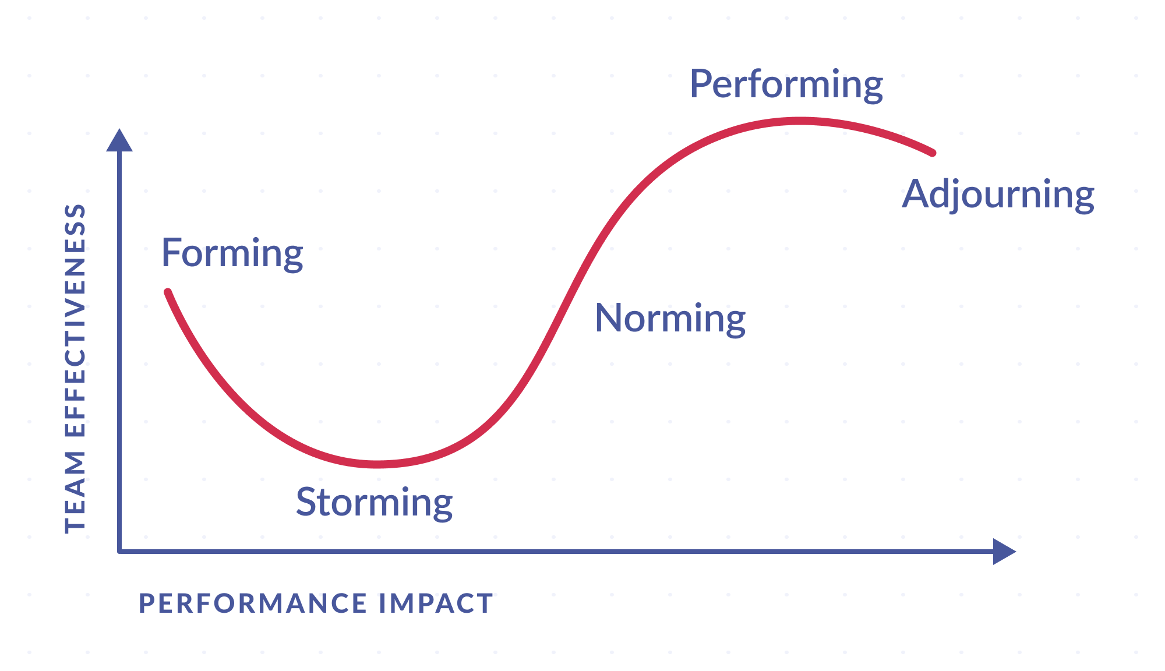
Team Evolutionary Stages
Team advancement is the process of training to collaborate effectively. Studies suggest that groups go over distinct growth processes.
Academic psychologist Bruce Tuckman developed a five-stage planning framework that so many high-performing organizations follow (Gawerc, 2013).
He referred to them as the forming, storming, norming, performing, and disbanding phases.
Figure: Team Evolutionary Stage
Source: (Sabbath, 2022)
Notes:
Team advancement is the process of training to collaborate effectively. Studies suggest that groups go over distinct growth processes. Academic psychologist Bruce Tuckman developed a five-stage planning framework that so many high-performing organizations follow (Gawerc, 2013). He referred to them as the forming, storming, norming, performing, and disbanding phases.

Slide 9
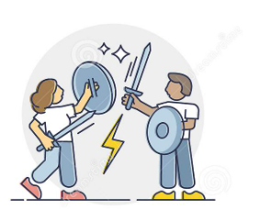
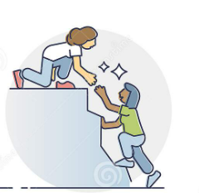
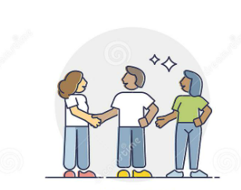
Team Evolutionary Stages
Forming stage
There is a time of introduction and becoming acquainted with one another during the initial stages.
Storming stage
The storming phase is the more challenging and crucial phase to traverse (Huang and Murad, 2021).
Norming stage
When teams pass the performing stage, conflicts are overcome and a level of teamwork develops.
Notes:
Forming stage
This is the first stage of forming a team where everyone gets introduced to each other and initial talking and ice-breaking happen. Throughout this stage, there is a significant amount of uncertainty, and individuals seek direction and control.
Storming stage
The storming phase is the most critical as well as challenging. As distinct identities form, it is an out by rivalry and conflict. The performance in the field can potentially decline due to the expenditure of resources on counterproductive behaviors (Huang and Murad, 2021). Individuals may differ over shared goals, and subgroups and friendship groups may emerge over dominant personalities or regions of consensus. To progress throughout this phase, teammates must show courage, embrace differences between individuals, and resolve opposing opinions.
Norming stage
Conflicts are resolved and a level of collaboration emerges as teams move past the performing stage. The agreement is reached regarding the leadership structure and the duties assigned to each member during the start phase.

Slide 10
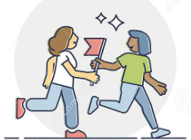
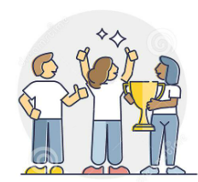
Team Evolutionary Stages
Stage performance: Agreement and collaboration are well-established in the performing stage, and the group is mature, structured, and very well (M. Abo El Nasr, 2015).
Stage of pause: Almost all of the team's objectives have been met as the meeting comes to a close.
Notes:
Stage performance
Stage performance is another stage of forming a team where agreement and collaboration are well-established and the group format is well structured and matured (M. Abo El Nasr, 2015). The team has a clear and solid framework in place, and everyone is dedicated to the player's objective.
Stage of pause
This is the last stage where all the objectives that have been set were achieved. The focus is on assembly-mounted tasks and recording work and outcomes. Single members of the team may well be moved to certain other teams when the pressure decreases, and the team may disintegrate.

Slide 11
Ioana florina istrate
2119831

Slide 12
Roles for Effective Teamwork

Slide 13
Leadership SKILLS
A leader's responsibility is to offer guidance to the group, a vision clearly, inspiration to the squad, team development abilities, and establish ground rules for working together (Raza Zaidi and Siddiqui, 2021).
The overall purpose of a manager is to ensure the effective accomplishment of the group goals, including roles and duties.
Notes:
: Leadership Skills: A leader plays a vital role in managing teamwork. He shows the vision, offers proper guidance, motivates members, and set ground rules for teamwork about what to do and what not to do (Raza Zaidi and Siddiqui, 2021).
However, the manager also has a role in this to see whether the goal, as well as duties and roles, are effectively accomplished or not.
Roles of the Creative Director
A creative director also has certain roles to work with. He must ensure that in teamwork technologies that are advanced and intellectual are being used for gaining victory. He also has a role to see whether individuals are coming up with new innovations or not and if there are any issues or not and also inspire the groups to thrive for improvement.

Slide 14
Roles of the Creative Director
A wellspring of intellectual technologies is vital for every current victory.
Whenever individuals work collaborate, they want someone who can come up with innovative and bring new, original ideas.
It avoids stagnation and maintains the group always striving for improvement.

Slide 15

In several businesses, the moderator does not have official power; instead, the moderator assists the group in reaching an agreement
Regardless of whether a leader is serving as a mediator, the group is being asked or supported to perform these actions
Whenever groups discuss and debate thoughts and strategies, a moderator must be present to properly and exactly record all.
Facilitator
Notes:
Facilitator: A facilitator is a person who helps the teamwork to go in the right way and helps the members in any kind of problem-solving. Though in many cases, a facilitator does not hold any official power he is always there to help the teams reach any kind of agreement. Whenever a team is working with something controversial or debatable a moderator needs to be present there to record all of that conversation and strategies.

Slide 16

Coach
Following practice, the coach in a group offers one-on-one assistance.
Assume a staff member was already educated in something, and the trainer continues to help that person after the education.
If a problem arises during one-on-one instruction, the trainer is the initial person to call. Those principles occasionally conflict
Notes:
A coach is a person who offers one-on-one assistance to the members of the team. A coach is a person who continuously helps a person through the person who has gained some knowledge on specific issues. While providing coaching one-on-one problems as well as conflict may arise and it is quite common at that moment trainer is the person to call to solve the situation initially though conflict arises very occasionally. A coach and team manager may be one individual.

Slide 17
Camelia danila
2119198

Slide 18

CONFLICT MANAGEMENT
The process of resolving conflicts involves minimizing unfavourable outcomes and prioritizing beneficial outcomes.
This essential managerial talent entails negotiation, innovative problem-solving, and the use of various strategies depending on the circumstance.(Schram, 2019)
An organization can reduce interpersonal problems, improve client happiness, and achieve better business results by managing conflict well.
There are 5 conflict management styles, Accommodation, Avoiding, Collaboration, Compromising, and Competing
Notes:
Conflict management is a process of solving the conflict among the team members or two individuals where an unfavorable situation arises and outcomes become negative for all. The person who solves the conflict may be a manager or leader who must possess some qualities such as negotiation skills, problem-solving skills, and so on. There may be different types of problems in an organisation and there is also conflict management styles with 5 parts.

Slide 19
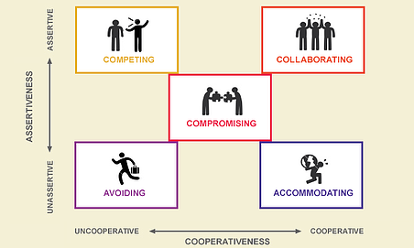
CONFLICT MANAGEMENT
Accommodating
Avoiding
If a person fears himself/herself could be in error or if you he/she does not feel as strongly about the subject as the other person, then accommodation is the best course of action (Frondizi, 2009).
This choice emphasizes maintaining harmony, not exerting more effort than is necessary, and understanding when to pick your battles.
By avoiding it in some way, eliminating the parties who are in conflict, or ignoring it altogether, this approach seeks to lessen conflict (García-Marzá, 2012).
Conflicting team members may be kicked off the project, deadlines may be extended, or even persons may be transferred to different departments.
(Novak, 2022)
Notes:
Avoiding: It is a way to manage the conflict by avoiding the whole situation or ignoring the person who started the conflict. On the other hand, to avoid conflict the person who initiated the conflict can be kicked out of the group temporarily or can be shifted to another department.
Accommodating: If anyone holds a doubt in himself that he may done some mistake or any error can be taken place by him or doesn’t hold strong confidence about a subject or the other person to work with then it is the best possible solution to accommodate.

Slide 20
CONFLICT MANAGEMENT (Continue)
Compromising
By requesting that both parties give up some of their desired outcomes in order to reach an agreement on a solution, this approach aims to find a middle ground.
Competing
This approach forgoes compromise and entails defying the opinions and desires of others.
Collaboration
Though it is frequently the most challenging and time-consuming to achieve, this style has the best long-term outcomes.
Because both parties will have to make some concessions in order to reach an understanding on the main point, this approach is frequently referred to as "lose-lose
When it comes to how they believe a matter should be handled, one party is adamant and will not relent until they get their way.
This may occur when there is no time to look for a different solution, when moral considerations require the adoption of a particular course of action, or when an unpopular choice must be made (Farber, 2014).
The needs and desires of each party are taken into account, and a win-win solution is found so that everyone is happy.
This frequently entails everyone getting on the same page, discussing the issue, and working out a compromise.
Notes:
Compromising: This is one of the best actions to solve a conflict. When a situation becomes so tough and both the conflicting parties want their best then one of the best ways is to compromise and it should come from both sides so that an agreement can be reached easily. Both the parties receive benefits from this.
Competing: This is opposite to compromising where both parties don’t want any mutual agreement and want to gain their own benefit by defeating another party. One party has to win the agreement and the other will lose the battle.
Collaboration: This is another good solution and here both the parties get a win-win solution. Though it consumes much time and is challenging at the same time but brings long-term good output for the organisation.

Slide 21
Andreea Elena popa
2115854

Slide 22

Successful Team Development
Successful team development refers to the process where the team’s goals and objectives are achieved through mutual communication, support, trust, encouragement, and development of the inner strengths of everyone.
Group working success factors are unique aspects that are greatly regarded in order to get the greatest increase in the success rate (Wynne, 2017).
These are characterized by five important critical areas: team leadership, shared vision, attitudes and commitment, mutual trust, and team cooperation.
Figure: Successful Team Development
(Walter, 2022)
Notes:
Team development becomes successful when the team’s goals and objectives are achieved and along with that all team members learn about communication, encouragement, and trust as well as develop the inner strengths of each individual. There are many success factors that can describe whether a team development is successful or not. However, there are five critical areas that have been described in the next slides.

Slide 23
Successful Team Development
Leadership
Each team requires a leader who can keep everyone focused on the objective, reason, and the project's objectives (Verow, 2019).
This person must be dedicated to the current victory and be prepared to be made liable by the player's sponsorship as well as other partners for directing the group via procedures that guarantee its objectives are met.
Visionary Collaboration
A feeling of huge interest and worth holds a common goal united. At the same time, it must concentrate on logistical considerations such as: Daily issues, New instruments, Ideas ,Field advancements Others who function and items that do not really
Figure: Successful Team Development
(Walter, 2022)
Notes:
Leadership
Every team requires a good leader who can set goals for the team and set out strategies that will help them to find out their mission and vision for developing themselves and at the same time find motivation for working inside a team (Verow, 2019).
A leader must be dedicated to getting the best result for a team and for that he will do the best for the team and individually assist the work performance of every member so that a member who is weak in some cases can be given proper direction to meet the objectives set by him.
Visionary Collaboration
A leader also needs to have a vision that will assist him to hold the common goal and make the team united to get the best result and along with that other daily activity such as issues of performance, instrumental improvement, bringing new ideas, focusing on new ideas also be considered time to time.

Slide 24
Successful Team Development
Commitment and Attitudes
Attitudes and devotion make a major impact in the ultimate effectiveness of a team endeavor (Yannibelli and Amandi, 2018).
Mutual Trust
Mutual trust is regarded as the primary essential aspect of effective cooperation.
Collaboration on a Team
An effective group comprises of teammates whom is constantly intrigued and involved in the player's focus and activities. Every group member should freely agree to carrying out implementation plan which are required for the group to accomplish its desired targets.
Notes:
Commitment and Attitudes
Every team member must be committed and show a positive attitude towards the teamwork and only then team development will be successful. The average member of a group actually determines whether or not to thrive (Yannibelli and Amandi, 2018).
Mutual Trust
Mutual trust is must-have a thing for the development of a successful team. Being an element of a player's identity, confidence permits the group to participate in public discussion and judgment, which results in "active engagement" from everyone on the team.
Collaboration on a Team
Collaboration is also a must-needed thing in a team because it helps to implement new plans and procedures among the team and also helps to identify the members who are constantly performing well and giving focus and attention to the activities of the team.

Slide 25
References
Benson, A., 2014. Person-centred Teams: A Practical Guide to Delivering Personalisation through Effective Team-work Sanderson Helen and Lepkowsky Mary Beth Person-centred Teams: A Practical Guide to Delivering Personalisation through Effective Team-work 168pp £19.99 Jessica Kingsley 9781849054553 184905455X. Nursing Management, 21(7), pp.11-11.
Brindley, J., 2016. The benefits of mentorship for the dental team. BDJ Team, 3(5).
Gallagher, A., 2022. Father-Son Team Highlights Benefits of Rural Working and Living. ASA Monitor, 86(6), pp.41-42.
Gawerc, M., 2013. Research Note: Integrative Ties as an Approach to Managing Organizational Conflict. Conflict Resolution Quarterly, 31(2), pp.219-225.
Huang, L. and Murad, Z., 2021. Pulling for the Team: Competition Between Political Partisans. Evolutionary Psychological Science, 7(2), pp.97-105.
McGurk, V., 2015. Person-Centred Teams – A Practical Guide to Delivering Personalisation Through Effective Team-work Sanderson Helen and Lepkowsky Mary Beth Person-Centred Teams – A Practical Guide to Delivering Personalisation Through Effective Team-work 168pp £19.99 Jessica Kingsley Publishers 978 1 8490 5455 3 184905455X. Nursing Standard, 29(29), pp.30-30.
Raza Zaidi, S. and Siddiqui, D., 2021. Self-Sacrifice: The Impact of Leader Self-Sacrifice on Teams’ Effective Work and Leaders’ Work Engagement, and Their Well Being: The Mediatory Role of Team Effective Commitment, and Leader Depletion, Complemented by Leader’s Competence. SSRN Electronic Journal,.
Schram, P., 2019. Managing Insurgency. Journal of Conflict Resolution, 63(10), pp.2319-2353.
Stewart, B. and Powell, S., 2015. Team building and team working. Team Performance Management: An International Journal, 10(1/2), pp.35-38.
Verow, S., 2019. Tiny tots bring great benefits to the Maltings. BDJ Team, 6(3), pp.18-18.
Wynne, L., 2017. Effective team work in the management of periodontal diseases. Dental Nursing, 3(1), pp.30-33.

Slide 26
References
Yannibelli, V. and Amandi, A., 2018. Collaborative Learning Team Formation Considering Team Roles: An Evolutionary Approach based on Adaptive Crossover, Mutation and Simulated Annealing. Research in Computing Science, 147(4), pp.61-74.
Zhao, Y., 2009. Evolutionary Stages of the Earliest Skeletal Fauna and Division and Correlation of the Precambrian-Cambrian Boundary Strata. Acta Geologica Sinica - English Edition, 1(3), pp.233-248.
Rahman, A., 2022. Top 10 Teamwork Skills Required To Succeed In Any Company. [online] Resume Example. Available at: <https://resume-example.com/teamwork-skills/> [Accessed 10 August 2022].
Sabbath, N., 2022. The 5 Stages of Team Development. [online] Teamwork.com. Available at: <https://www.teamwork.com/blog/the-5-stages-of-team-development-what-you-need-to-know/#:~:text=Team%20development%20stages&text=It%20talked%20about%20the%20four,storming%2C%20norming%2C%20and%20performing.> [Accessed 10 August 2022].
Walter, J., 2022. Four Stages of Team Evolution - MEDI Leadership. [online] MEDI Leadership. Available at: <https://medi-leadership.org/four-stages-of-team-evolution> [Accessed 10 August 2022].
Novak, M., 2022. 5 Most Effective Conflict Management Styles (+When To Use Each One). [online] Learn.g2.com. Available at: <https://learn.g2.com/conflict-management-styles> [Accessed 11 August 2022].
García-Marzá, D., 2012. Business Ethics as Applied Ethics: A Discourse Ethics Approach. Ramon Llull Journal of Applied Ethics, 3(3), p.99.
Frondizi, R., 2009. Contemporary Argentine Philosophy. Philosophy and Phenomenological Research, 4(2), p.180.

