Slide 1
Welcome to our presentation
BMSK4002

Slide 2
Contents
--- Presentation Title
--- Presentation Plan
--- Key theories (Tuckman)
--- Explanations
--- Key theories (Belbin)
--- Explanation
--- Belbin theory’s implementation
--- Importance of trust
--- Group dynamics
--- High performing teams
--- References
--- Presentation evaluation sheet

Slide 3
Presentation Plan
Title
Contents
Presentation Plan
Introduction
Key Theories : Tuckman
Explanation
Key Theories : Belbin
Explanation
Key Theories and Models
Elements of high performing teams
Choice of Approach
References
Presentation Evaluation Sheet

Slide 4
Introduction
Good teamwork means the way of working with each person committed and working to complete the same goals.
Every organizations strives for effective teamwork.
They are two fundamental dimension for functional teams : the team’s task and social factors.
This two influence how members of a team work together as a unit.
Teams are created with the expectation to carry out tasks better than an individual can, but this is not all the time a good thing because in a team are different individual, emotional and social needs. If this are ignored means failing to achieve the potential of team performance.

Slide 5
Key Theories
In 1965 psychologist Bruce Tuckman developed his group development model in which explain how healthy teams cohere over time.
In this model, Tuckman identifies five stages through which groups progress :
-- forming
-- storming
-- norming
-- performing
-- adjourning

Slide 6
Explanation
Tuckman’s model explain that relationships establish when team develops maturity and ability.
Tuckman’s model it is helpful in training for groups work and work up to their full potential because it gives understanding of groups development.
Only Runkee et. al. (1971) set out to test this model , and the conclusion was supportive for Tuckman’s model . Also the result may not be reliable.

Slide 7
Key theories : Belbin
Belbin defines a team role as :
‘’ A tendency to behave ,contribute and interrelate with others in a particular way .‘’
Belbin identify 9 team roles:
1. Shaper (SH)
2. Implementer (IMP)
3. Complete-Finisher (CF)
4. Coordinator (CO)
5. Team Worker (TW)
6. Resource Investigator (RI)
7. Plant (PL)
8. Monitor-Evaluator (ME)
9. Specialist (SP)

Slide 8
Explanation
A team is a congregation of individuals not a bunch of people with job titles, every individual has a role which is known by other members.
Belbin and his team discovered nine clusters of behavior called “Belbin Team Roles”.
All are used to identify strengths and weaknesses in the work place.
The strengths of a team can be increased by understanding the individual role in the team according to Belbin. (Belbin, 2017).

Slide 9
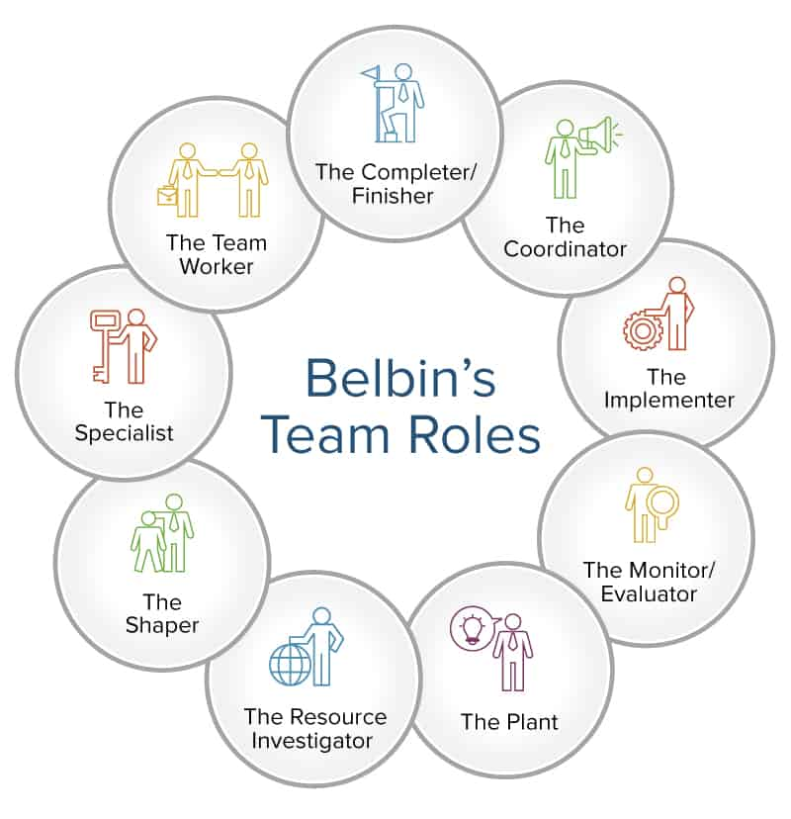
Key Theories, Models

Slide 10
Elements of high performing teams
--- Clear direction
--- Open doors and clear communication
--- Collaboration spirit : “ None of us is as smart as all of us “ ( Ken Blanchard )
--- Playing by the rules
--- Defined roles
--- Encouraging differences in options
--- Mutual accountability
--- Team trust
--- Decision making
--- Efficient use of ideas
--- Having fun

Slide 11
Choice of approach
--- In a team all individuals should try to achieve the high performance.
--- In every situation it should be used key behaviour of teamwork.
--- Depends on the situation should be applied theories and models of effective teamwork.

Slide 12
References
BELBIN, R. M. (2010). Team roles at work. Oxford. Butterworth-Heinemann.
Belbin, R. (2017) Management teams. 13th ed., p. 167. Amsterdam: Elsevier Butterworth-Heinemann.
Tuckman, E. (2016) Emanuel Tuckman, BMJ, 346 (may22 21), pp. f2314-f2314. DOI:10.1136/bmj.f2314
B. W. Tuckman. (1965), ‘developmental sequence in small groups’, psychological bulletin 63.
French, R. and Russ, V. (2018) Group relations, management, and organization. 11th ed., p. 178. Oxford: Oxford University Press.
Bluck, R. (2018) Team management. 14th ed., p. 187. London: Library Association.

Slide 13


