Slide 1
Marketing Mix
“Focus on Product”
LCLM7024
Week 3 – Session 2

Slide 2
Content of the Session
To understand the Marketing Mix model and its purpose.
To explore the product element in detail through the following concepts:
    Key Product/Service Concepts
    Product/Service Choice Criteria
    Product Life Cycle
    Diffusion of Innovation
To gain an overview of the other elements—Price, Place, and Promotion—which will be covered in more detail in the coming weeks.

Slide 3
Marketing Mix
In the early 1960s, prominent American marketing expert Neil Borden (1964) introduced the phrase "marketing mix" to encompass the key activities of companies believed to enhance the appeal of their products and services.
These activities were categorised under the well-known "4Ps" of marketing: product, price, promotion, and place, which later expanded to include three additional Ps: People, Process, Physical Evidence.

Slide 4
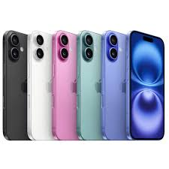

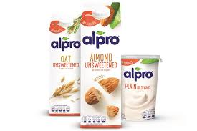

Product
Most market offerings consist of both a physical, tangible product and an intangible service.

Slide 5
Key Product/Service Concepts
Products are best understood as solutions to customers' problems or means of fulfilling their needs.
Philip Kotler, a renowned American marketing expert, expressed this idea effectively in 1997 by stating that customers don’t purchase a drill - they buy the hole it creates.
In essence, people seek the benefits a product provides rather than the product itself.

Slide 6
Product/Service Choice Criteria (1 of 4)
Customers may select one product over another for multiple reasons, such as a cheaper price, or for more complex, lifestyle and beliefs, like how it aligns with their preferences.
To better understand these decision-making factors, it helps to categorise them into two main types: rational and overt; and the emotional and covert. Explained in next slides.

Slide 7
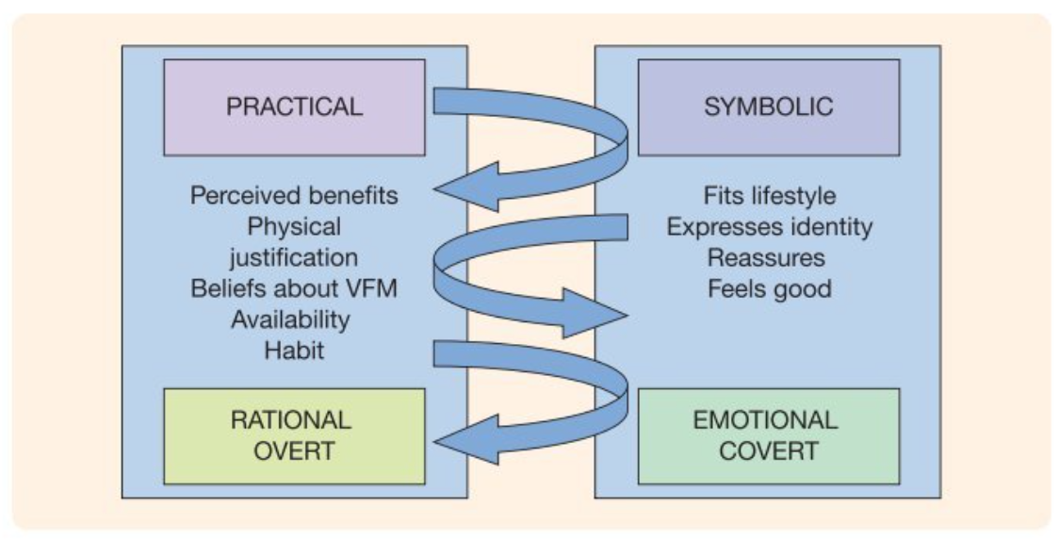
Product/service Choice Criteria (2 of 4)
Figure 1: Product Choice Criteria
(Hooley et al., 2020, p 289)

Slide 8
Practical & Rational Overt (3 of 4)
Focuses on tangible and functional aspects of a purchase. Consumers consider:
  Perceived benefits – What they gain from the product?
  Physical justification – Logical reasons for choosing it.
  Beliefs about value for money (VFM) – Cost vs. benefits analysis.
  Availability – Ease of access to the product.
  Habit – Past behaviours influencing future purchases.

Slide 9
Symbolic & Emotional Covert (4 of 4)
Emphasises psychological and identity-related factors. Consumers consider:
  Lifestyle fit – Aligns with personal values and daily life.
  Identity expression – Helps showcase personality or social status.
  Reassurance – Provides comfort or confidence in the decision.
  Feeling good – Emotional satisfaction from the purchase.

Slide 10
Product/Service Differentiation
A key aspect of successful marketing is product differentiation.
Making sure that the overall market offering stands out from competitors in a way that provides meaningful value to the target customer.

Slide 11
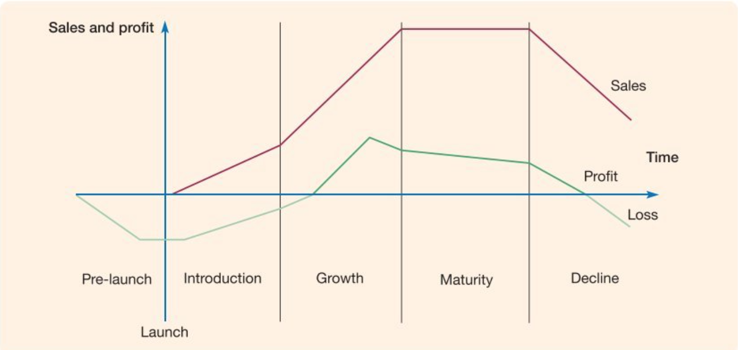
Product Life Cycle (1 of 7)
Figure 3: The Product Life Cycle
(Hooley et al., 2020, p 291)

Slide 12

Pre-Launch (2 of 7)
During the pre-launch phase, before the product reaches the market, the organisation primarily focuses on research and development while also preparing production capacity for the upcoming launch.

Slide 13

Launch (3 of 7)
The launch phase of the product life cycle presents a key opportunity for the organisation to strongly highlight the advantages it offers beyond what existing products provide.
At this stage, the primary goal is to persuade the best prospect customers of its value.

Slide 14
Introduction (4 of 7)
The introduction phase after launch is critical for a new product, as many fail to progress beyond this stage.
While sales start to grow, marketing costs remain high to position the product as a better alternative.
Competitors closely monitor its success, looking for opportunities to replicate or enhance it.

Slide 15

Growth (5 of 7)
The growth phase of the product life cycle is often the most dynamic and preferred by brand and marketing managers.
As the product gains market acceptance, sales and profitability increases, and risks decrease.
However, competition intensifies significantly, leading to the emergence of substitutes and alternative products.

Slide 16
Maturity (6 of 7)
The maturity phase begins when market growth slows, and most potential customers have adopted the product.
Competition becomes intense as companies that entered during the growth phase focus on gaining market share rather than expanding the market.
Price wars are frequent, and profit margins shrink.

Slide 17
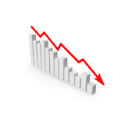
Decline (7 of 7)
During the decline phase, and ultimately the product’s phaseout, profits shrink further as newer-generation products dominate the market.

Slide 18

Diffusion of Innovation (1 of 3)
The introduction of new products into the product life cycle (PLC) requires strategic management.

Slide 19
Diffusion of Innovation (2 of 3)
The rate of innovation proposed by Rogers' (1962) depends on five key factors:
Perceived Benefits: How much better the innovation is compared to existing solutions.
Compatibility: How well it aligns with current values and norms.
Ease of Use: The simplicity of adopting and using it.
Trialability – The ability to test it with minimal risk.
Visibility & Communication – How easily its benefits can be understood and shared.

Slide 20
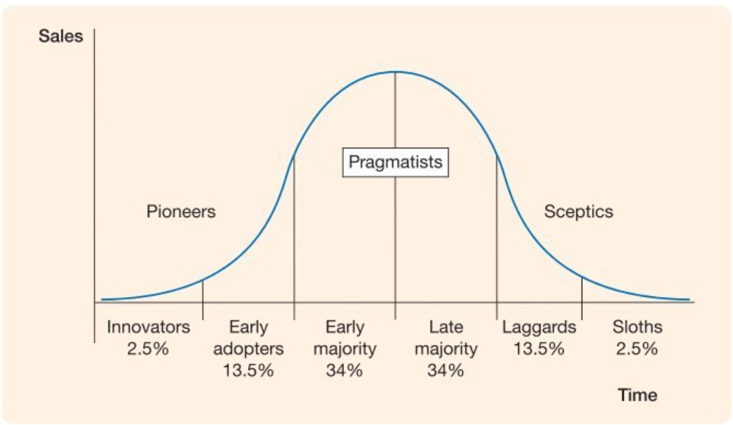
Diffusion of Innovation (3 of 3)
Figure 3: The Diffusion of Innovation
(Hooley et al., 2020, p 289)

Slide 21
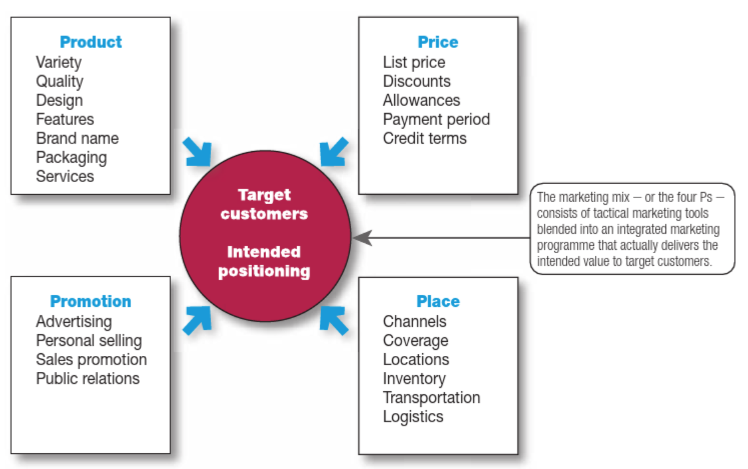
Marketing Mix –
Price, Place, Promotion

Slide 22
Group Work
In groups of 3-4, find an example of a company that launched a new consumer product within the past five years.
Develop an analysis of how the company applied the Four Ps (Product, Price, Place, and Promotion) in launching the product.
Be sure to focus on the product and explain its journey through the Product Life Cycle (PLC).

Slide 23
References
Hooley, G. J., Nicoulaud, B., Rudd, J. M., & Lee, N. (2020) Marketing strategy and competitive positioning. Seventh edition. Harlow, England ; Pearson.
Kotler, P., Armstrong, G., Harris, L. and Piercy, N. (2020) Principles of marketing. 8th European edn. Harlow: Pearson.

